Slide 1
Two Sample Hypothesis Testing, ANOVA and Regression Analysis

Slide 2
2-Sample Hypothesis Testing
Two catalysts are being analyzed to determine how they affect the mean yield of a chemical process.
Specifically, catalyst 1 is currently in use, but catalyst 2 is acceptable. Since catalyst 2 is cheaper, it should be adopted, providing it does not change the process yield.
A test is run in the pilot plant and results in the data shown in Table 10,1. Is there any difference between the mean yields? Use α = 0.05, and assume equal variances.

Slide 3
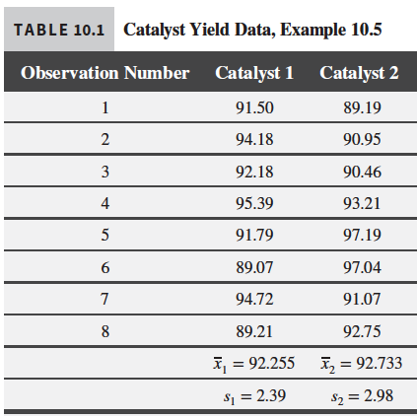
2-Sample Hypothesis Testing | Yield from a Catalyst
Two catalysts are being analyzed to determine how they affect the mean yield of a chemical process.
Specifically, catalyst 1 is currently in use, but catalyst 2 is acceptable. Since catalyst 2 is cheaper, it should be adopted, providing it does not change the process yield.
A test is run in the pilot plant and results in the data shown in Table 10,1. Is there any difference between the mean yields? Use α = 0.05, and assume equal variances.

Slide 4
ANOVA One-Way Analysis of Variance
A One-Way Analysis of Variance is a way to test the equality of three or more means at one time by using variances.
Assumptions
The populations from which the samples were obtained must be normally or approximately normally distributed.
The samples must be independent.
The variances of the sample populations must be equal.
Hypotheses
The null hypothesis will be that all population means are equal, the alternative hypothesis is that at least one mean is different.

Slide 5
ANOVA
Which of these plots provide sufficient evidence to indicate a difference between the corresponding population means?

Slide 6
ANOVA A completely randomized design - Example
The compressive strength of concrete is being studied, and four different mixing techniques are being investigated. Find Data Compressive Strength on D2L.
(a) Test the hypothesis that mixing techniques affect the strength of the concrete. Use α = 0.05.

Slide 7
ANOVA Two-Factor Factorial Experiments
Factorial experiments are volume-increasing designs conducted to investigate the effect of two or more independent variables (factors) on the mean value of the response y.

Slide 8
ANOVA Two-Factor Factorial Experiments

Slide 9
ANOVA Two-Factor Factorial Experiments
Impact of cutting tool material on cutting force. The use of coated cutting tools to machine various materials is considered state-of-the art technology. The impact of cutting tool coating and material on cutting force was investigated in an article published in the International Journal of Engineering and Applied Sciences (Vol. 7, 2011). Five different steel cutting tool materials were compared: (1) uncoated CBN-High, (2) CBN-High coated with TiN alloy, (3) CBN-Low coated with TiN alloy, (4) CBN-Low coated with TiAIN alloy, and (5) mixed ceramic.

Slide 10
ANOVA Two-Factor Factorial Experiments
Each cutting tool was run at three different speeds—100, 140, and 200 meters per minute—and two observations on cutting feed force (Newtons) were obtained for each run. The data set is available on D2L. The objective of the experiment is to assess the impact of cutting tool type and cutting speed on feed force.

Slide 11
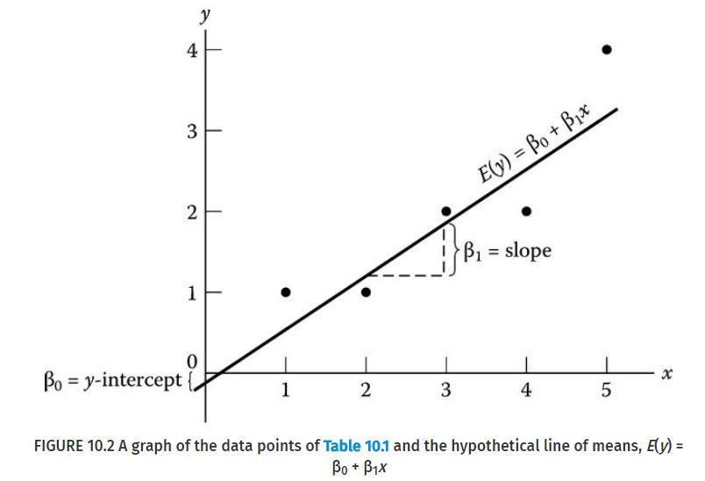
Simple Linear Regression Model

Slide 12
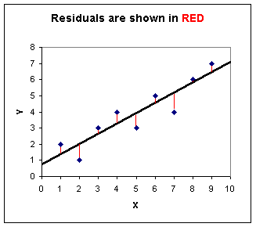
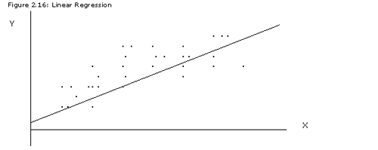
Simple Linear Regression Model
Residual Error
$∈_{i} = yi − \hat{y}i$is called the residual. The residual describes the error in the fit of the model to the ith observation y_{i}

Slide 13
Coefficient of Determination R²
Coefficient of determination R²
The coefficient of determination R² is a measure of how well the linear model fits the data
$0 ≤R^{2}≤1.$
The closer R² is to one, the better the model fits the data.

Slide 14
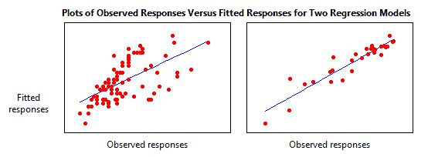
Coefficient of Determination R²
R² = .38
R² = .87

Slide 15
Simple Linear Regression Model
Estimating repair and replacement costs of water pipes. Pipes used in a water distribution network are susceptible to breakage due to a variety of factors. When pipes break, engineers must decide whether to repair or replace the broken pipe. A team of civil engineers used regression analysis to estimate y = the ratio of repair to replacement cost of commercial pipe in the IHS Journal of Hydraulic Engineering (September 2012). The independent variable in the regression analysis was x = the diameter (in millimeters) of the pipe. Data for a sample of 13 different pipe sizes are provided in the file WATERPIPE. Fit a simple linear regression model.

Slide 16
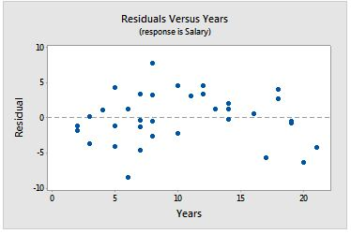
Simple Linear Regression Model
Residual Error

Slide 17
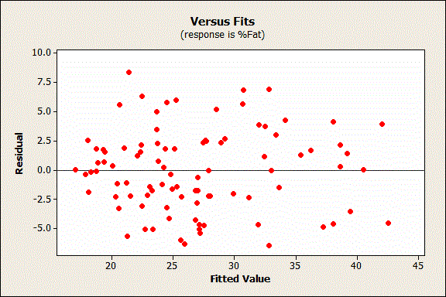
Simple Linear Regression Model
Residual Error

Slide 18
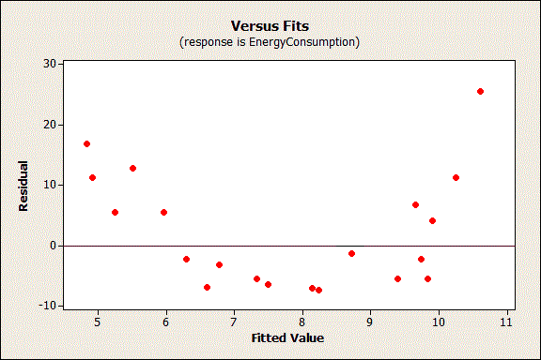
Simple Linear Regression Model
Residual Error

Slide 19
Adequacy of the Regression Model

Slide 20
Adequacy of the Regression Model

Slide 21
Multiple Linear Regression Model
A multiple regression model
$Y =β0 +β1x1 +β2x2 +∈$
The dependent variable or response Y may be related to k independent or regressor variables. The model
$Y =β0 +β1x1 +β2x2 +…………… +βkxk +∈$

Slide 22
Multiple Linear Regression Model

Slide 23
Multiple Linear Regression Model
Let’s fit a multiple linear model

Slide 24
Multiple Linear Regression Model
In industry cooling applications (e.g., cooling of nuclear reactors), a process called subcooled flow boiling is often employed. Subcooled flow boiling is susceptible to small bubbles which occur near the heated surface. The characteristics of these bubbles were investigated in Heat Transfer Engineering (Vol. 34, 2013). A series of experiments was conducted to measure two important bubble behaviors—bubble diameter (millimeters) and bubble density (liters per meters squared). The mass flux (kilograms per meters squared per second) and heat flux (megawatts per meters squared) were varied for each experiment. The data obtained at a set pressure are listed in the file BUBBLE2.

Slide 25
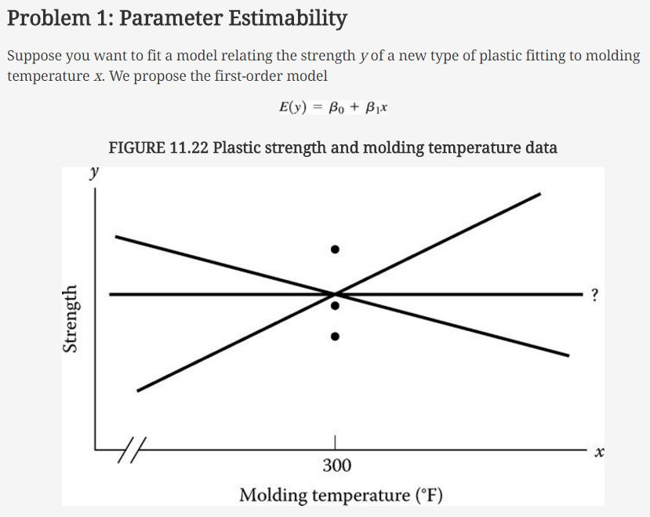
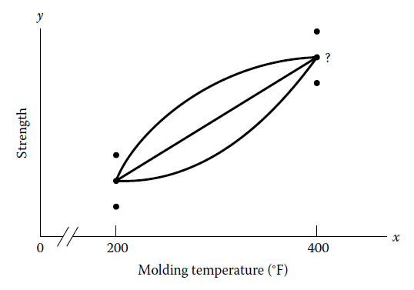
Linear Regression Model
Some Pitfalls: Estimability, Multicollinearity, and Extrapolation

Slide 26
Linear Regression Model
Problem 2: Parameter Interpretation
Beware of a cause-and-effect relationship between E(y) and xi.

Slide 27
Linear Regression Model
Problem 3: Multicollinearity
In regression, multicollinearity refers to predictors that are correlated with other predictors.
Severe multicollinearity is problematic because it can increase the variance of the regression coefficients, making them unstable and difficult to interpret.
To measure multicollinearity:
Use variance inflation factor (VIF), which measures how much the variance of an estimated regression coefficient increases if your predictors are correlated. If the VIF = 1, there is no multicollinearity but if the VIF is > 1, predictors may be moderately correlated. When the VIF is 5 - 10, the regression coefficients are poorly estimated.
Possible solutions to severe multicollinearity:
Remove highly correlated predictors from the model.

Slide 28
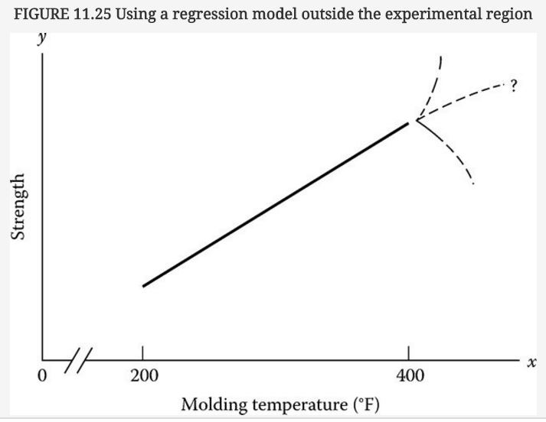
Linear Regression Model
Problem 4: Prediction Outside the Experimental Region

Slide 29
Linear Regression Model
Use Prior Studies to Determine which Variables to Include in the Regression Model
Keep the Model Simple
Correlation is Not Causation . . . in Regression Analysis
Present Confidence and Prediction Intervals in Addition to Statistical Significance

