Slide 1
Introduction to Surveying
Surveying: The art and science of locating points at, above, or below the earth’s surface.
Graphical Representations: Diagrams, maps, profiles, and cross sections.
Measurements Provide:
Locations
Volume
Slope
Directions
Area

Slide 2
Important Units and Conversions
Gunters Chain: 66.0 ft = 100 links (1 link = 7.92 inches).
Link: 7.92” or 0.66 ft.
Mile: 5280 ft = 80 Gunters Chains.
Rod, Pole, Perch: 16.5 ft.
Acre: 43560.174 square feet
Square Mile: 639.997 or 640 acres
International System (SI) Basics
Basic Unit: Meter (used for some control work and projects in the US).
Conversions:
1 inch = 2.54 cm
1 meter = 100 cm
1 kilometer = 1000 meters

Slide 3
Additional Conversions and Measurements
Yard: 3.00 ft
Meter: 3.2808 ft
1 cm: 10 mm
1 international ft: 0.999998 US Survey ft
1 hectare: 2.47104 acres
1 Labor: 177.14 acres
1 League: 4428.40 acres
1 section: 1 square mile = 640 acres
Conversions:
Chains to feet: x 66.0 ft
Rods to feet: x 16.5 ft
Varas to feet: / 0.36 ft
Horizontal and Vertical Planes
Horizontal Plane:
Perpendicular to the direction of gravity.
Tangent to the geoid or parallel to such a plane.
In land surveying, perpendicular to the plumb line.
Assumes all plumb lines and horizontal planes are parallel.
Vertical Plane:
Passes through a point on Earth, containing the zenith and nadir.
Contains a plumb line.
Right angles to a horizontal plane.

Slide 4
Systems of Measure
English System:
Basic unit: Foot.
Conversions: 1’ = 12”, 1yd = 3’, 1 chain = 66’, 1 acre = 43560.174 sq ft.
International System (SI):
Basic unit: Meter.
Conversions: 1 inch = 2.54 cm, 1 meter = 100 cm, 1 kilometer = 1000 meters.

Slide 5
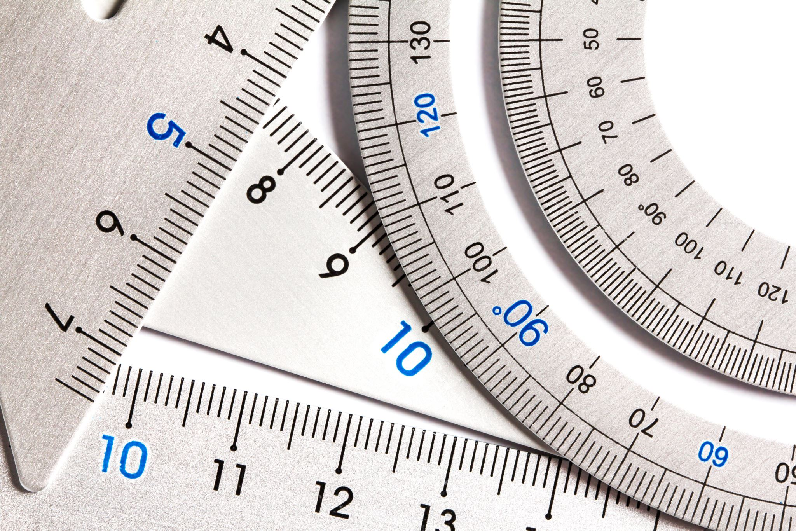
Measuring Distance
Horizontal Distance (HD): Straight line distance on a horizontal plane.
Methods: Pacing, Measuring wheels, Tapes, EDM.
Vertical Distance (VD): Difference in height or elevation between two positions.
Methods: Altimeter, Transit, Plumb line and tape, Differential and trigonometric leveling.
Other Methods: GPS, Aerial Surveys, Laser Scanning.

Slide 6
Maps and Refraction
Planimetric Map:
Presents horizontal positions only.
Topographic Map:
Presents both horizontal and vertical positions.
Refraction:
Bending of light rays when passing between media with different refractive indices.
Angle of Refraction: Angle between the refracted ray and the normal to the surface.
Curvature and Refraction Formula:
C+R=(0.0206)(F2)
(C) = correction for curvature
(R) = correction for refraction
(Z) = sighting distance in thousands of feet

Slide 7
Understanding Slope
Slope: Deviation from the horizontal plane (Rise/Run).
Expressions of Slope:
Constant change between vertical and horizontal distances.
Percent of Slope: (Change in elevation / Horizontal ground distance) x 100.
Degree of Slope: Angular measure equal to the central angle of a circle’s circumference.

Slide 8
Zenith and Angles
Zenith:
Point on the celestial sphere vertically above a given point on Earth.
Zenith Angle:
Angle less than 180° between the celestial meridian plane and the vertical plane containing the observed object.
Reckoned from the direction of the elevated pole.
Vertical Angle:
Angle in a vertical plane.
Can be a zenith distance or an angle of elevation/depression.

