Slide 1
Gantt Chart Schedule

Slide 2
Module Learning Objectives
History of Gantt Chart Schedule
How to create a Gantt Chart
Types of Gantt Charts
How to Create a Gantt Chart using Microsoft Excel

Slide 3
Gantt (Bar) Chart Schedule
History
The development of the bar chart dates back to World War I, when Henry L. Gantt used the bar chart method of scheduling to plan and control military operations. In honor of Gantt’s early development of bar chart scheduling, you will often hear the term Gantt chart when referring to a bar chart. For practical purposes, the terms Gantt chart, Gantt schedule, or bar chart schedule are one and the same.

Slide 4
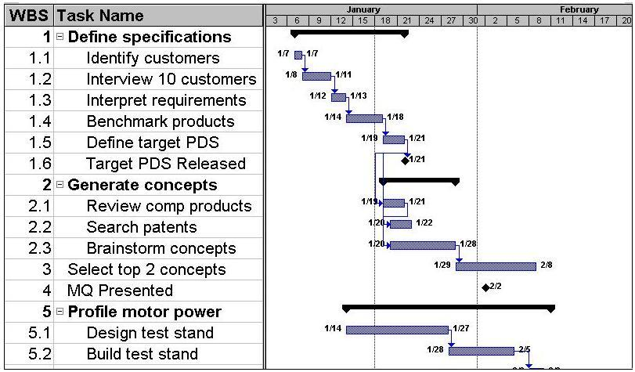
Gantt (Bar) Chart Schedule
Definition
A bar chart is ‘‘a graphic representation of project activities, shown in a time-scaled bar line’’

Slide 5
Gantt (Bar) Chart Schedule

Slide 6
Gantt (Bar) Chart Schedule
Creating Bar Charts
The creation of a hand-drawn bar chart schedule is a relatively simple process
Step 1: Using a piece of graph paper, write the calendar date across the top of the page. Some managers like to list the work day as well.
The time scale is typically based on units of days, but for a summary bar chart or long-range planning (when less detail is necessary) it is common to use units of weeks, months, quarters, or even years

Slide 7
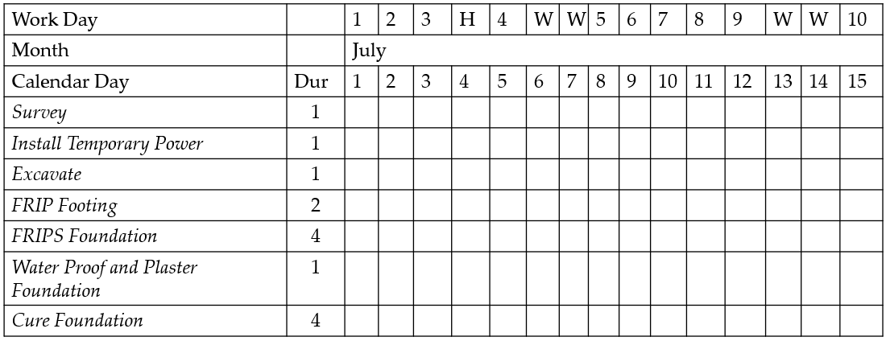
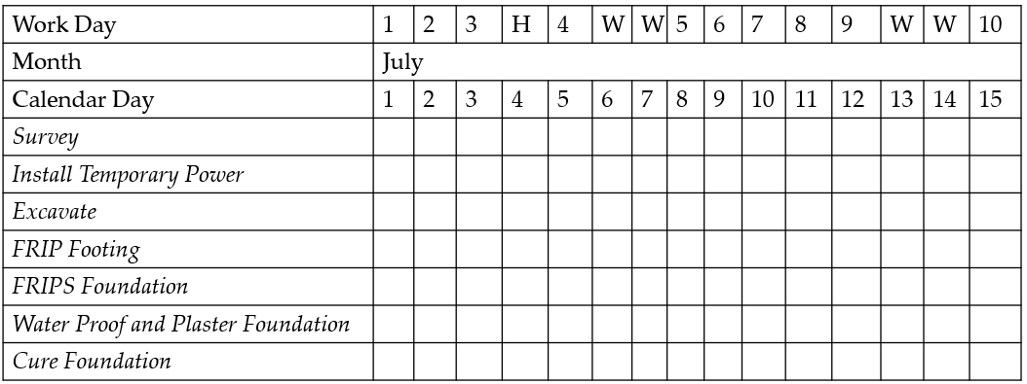
Gantt (Bar) Chart Schedule
Creating Bar Charts
Step 2: list the activities required to complete the project on the left side of the paper. As the activities are listed, put them in chronological order.
Step 3: Determine the durations of activities. The duration should be based on productivity records, available resources, and experience. We will learn how to determine duration of activities in more detail later in this course

Slide 8
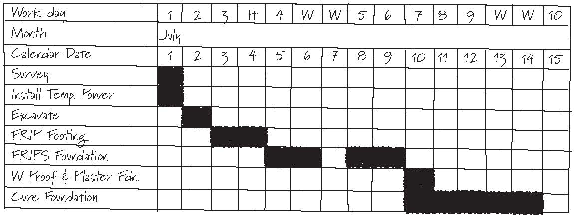
Gantt (Bar) Chart Schedule
Creating Bar Charts
Step 4: show or plot a bar on the dates when that activity is expected to take place. Commonly bars are shaded. For example, This beginning bar chart shows Survey as the first activity, which is scheduled to take place on the first work day, July 1. Continue listing the activities in chronological order with their corresponding bars as shown in the Figure.
Read page 28-29 from handout “Bar Chart Schedules”

Slide 9
Gantt (Bar) Chart Schedule
Creating Bar Charts
Example
Your project manager asks you to buy a piece of equipment for a project. Develop a Gantt chart for this activity. Start day Sep 12th
Calendar Day |  | 09/12 | 09/13 | 09/14 | 09/15 | 09/16 | 09/17 | 09/18 | 09/19 | 09/20 | 09/21
Activity Description Dur |  | 1 | 2 | 3 | 4 | 5 | W | W | 6 | 7 | 8
Determine equipment requirements | 1
Determine budget | 1
Research Brands and Models and Select | 3
Check On-line and local outlets | 2
Select Retailer and Purchase | 1

Slide 10
Gantt (Bar) Chart Schedule
Creating Bar Charts
Class Exercise
You are the head of engineering of a company. Recently a quality control engineer is retired and you need to hire a new quality control engineer to replace the position. Develop a Gantt chart for this hiring project with at least 8 tasks/activities. Project start second Monday of June.

Slide 11
Gantt (Bar) Chart Schedule
Creating Bar Charts
0

Slide 12
Gantt (Bar) Chart Schedule
Advantages of Bar Charts
Simple and ease of prepare and understand
Bar charts are time-scaled. Just by looking at the chart one can get an idea on the duration of each activity.
Bar charts particularly appeal to persons who do not have a technical background.

Slide 13
Gantt (Bar) Chart Schedule
What are the disadvantages of Bar Charts
The main disadvantage of bar charts is lack of logical representation (relationships): Why did this activity start on that date? Bar charts do not reveal the answer. It could be a logical relationship, a resource constraint, or a subjective decision by the project manager/scheduler/owner
Not easily modified
Bar charts may not be practical for complex projects with large numbers of activities
0

Slide 14
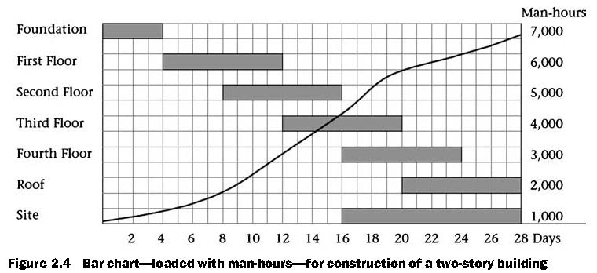
Gantt (Bar) Chart Schedule
Various Types of Bar Charts
Bar charts have become a vehicle for representing many pieces of a project’s information. Many variations of bar charts have evolved
Bar chart loaded with construction labor hours

Slide 15
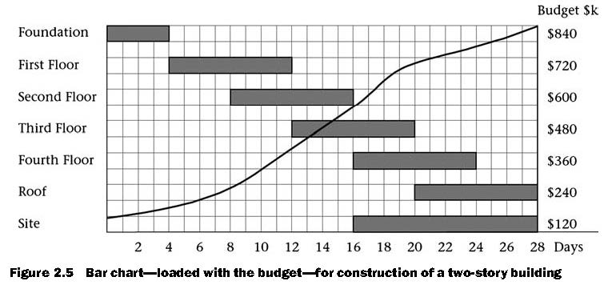
Gantt (Bar) Chart Schedule
Various Types of Bar Charts
Bar charts have become a vehicle for representing many pieces of a project’s information. Many variations of bar charts have evolved
Bar chart loaded with construction budget

Slide 16
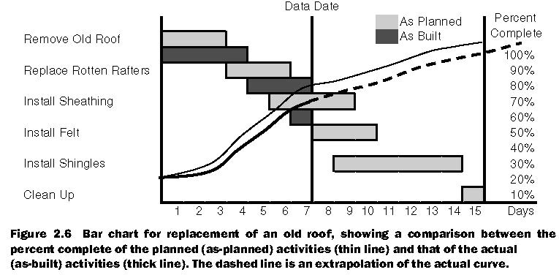
Gantt (Bar) Chart Schedule
Various Types of Bar Charts
Bar charts have become a vehicle for representing many pieces of a project’s information. Many variations of bar charts have evolved
Bar chart shows comparison between as planned vs as built

Slide 17
How to Create a Gantt Chart using Microsoft Excel
Click on the link below to learn how to create an automated Gantt (bar) chart in Microsoft Excel
https://www.youtube.com/watch?v=6MOw3qDG4iI

