Slide 1
Engineering ethics

Slide 2
Learning outcomes
Principles and Codes of Engineering ethics
Applications of ethics in engineering decision-making

Slide 3
WHAT ARE ENGINEERING ETHICS?
Engineering ethics are principles and guidelines engineers follow to ensure their decision-making is aligned with their obligations to the public, their clients, and the industry.

Slide 4
NSPE Code of Ethics for Engineers
Fundamental Canons
Engineers, in the fulfillment of their professional duties, shall:
Hold paramount the safety, health, and welfare of the public.
Perform services only in areas of their competence.
Issue public statements only in an objective and truthful manner.
Act for each employer or client as faithful agents or trustees.
Avoid deceptive acts.
Conduct themselves honorably, responsibly, ethically, and lawfully so as to enhance the honor, reputation, and usefulness of the profession.

Slide 5
What Guides an Engineer’s Decisions
Mathematics, Engineering, Science
Conventions
Standards
Codes
Ethics

Slide 6
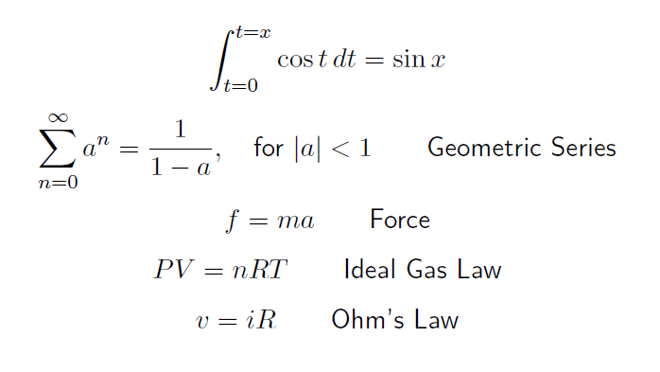
Mathematics, Engineering, Science

Slide 7
Conventions
Convention a way in which something is usually done
The decision may appear to be arbitrary
It may not be known why it is done that way

Slide 8
Conventions
QWERTY Layout
Clocks turn clockwise
To drive a screw or tighten a bolt, it is (usually) turned clockwise
What is today’s date?
9/7/2023 (in the US)
7/9/2023 (in most of the rest of the world)
Measurement Units
mi, ft, in; lb, oz; °F
km, m, cm; kg, g; °C
Hz;
rad s⁻¹; rad
In some countries you drive on the right hand side of the road and in other countries you drive on the left hand side of the road
x and y axes; number lines; writing direction
Dvorak keyboard layout

Slide 9
Standards
Standards are
an agreed way of doing things
developed by subject matter experts representing scientists, engineers, manufacturers, consumers, trade groups, professional societies, government regulators, etc.
designed for voluntary use (designed so it is to your advantage to use them)
tools to drive innovation and productivity

Slide 10
Standards – Examples
IEEE (Institute of Electrical and Electronics Engineers) 802.11g – A set of protocols for implementing Wi-Fi computer communications
SAE (Society of Automotive Engineers) 5W-30 – a numerical code system for grading motor oils according to their viscosity characteristics
ISO (International Organization for Standardization) 8601 – an international standard for exchange of date and time data, eg. 2022-09-01

Slide 11
Standards – Examples

Slide 12
Codes (Building Codes)
Building codes:
are a set of rules that specify the standards for constructed objects
protect public health, safety and welfare
become law when approved by a governing body
Example
ASCE 7-22: Minimum Design Loads and Associated Criteria for Buildings and Other Structures

Slide 13
Codes (Building Codes)
Building codes:
International Building Code (IBC)
International Residential Code (IRC)
International Energy Conservation Code (IECC)

Slide 14
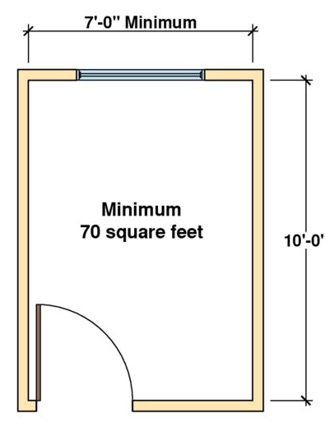
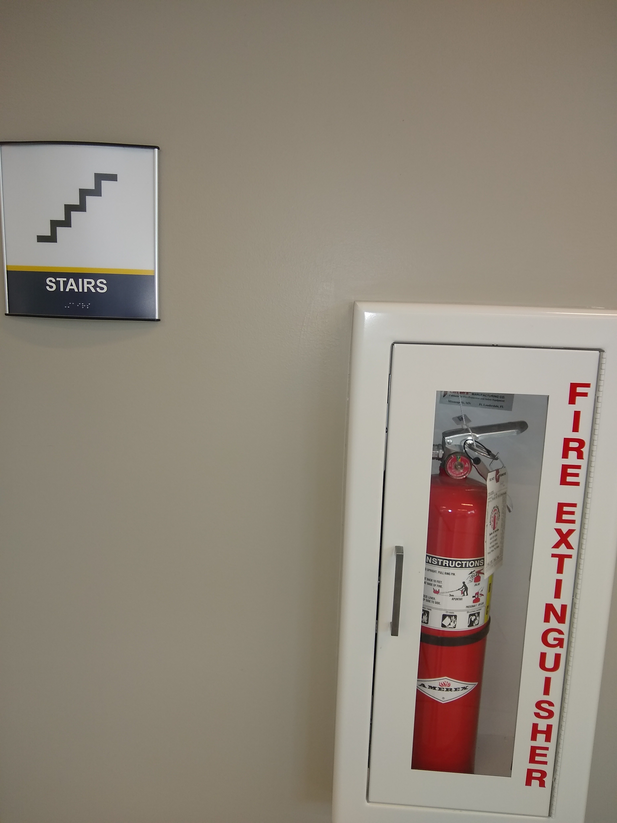
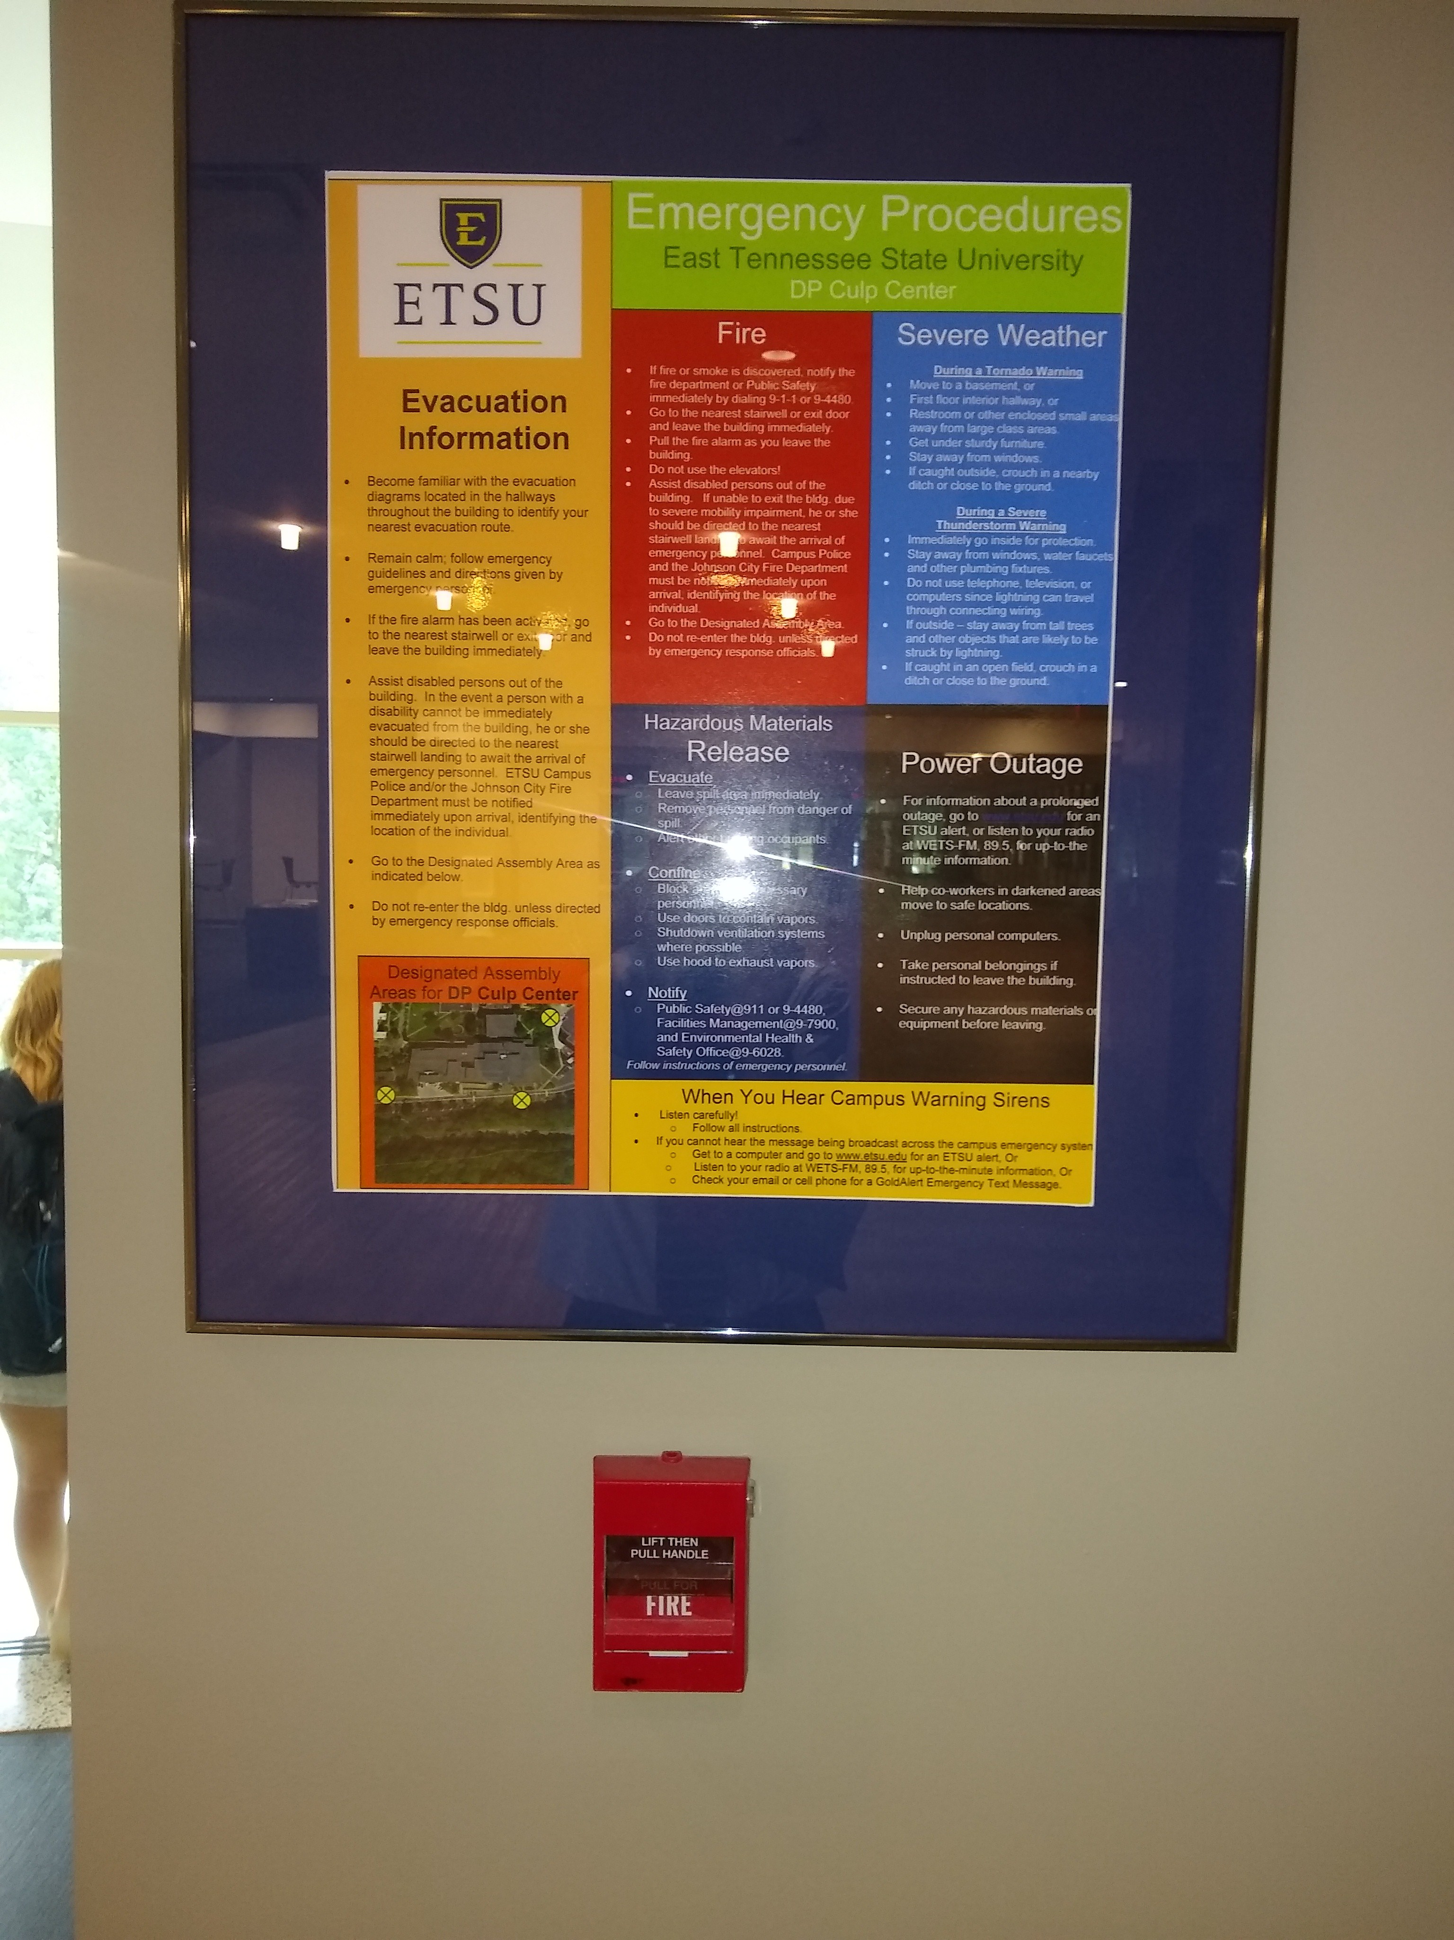
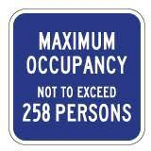
Codes (Building Codes)

Slide 15
National Society of Professional Engineers (NSPE) – Code of Ethics for Engineers https://www.nspe.org/resources/ethics/code-ethics
“Engineering is an important and learned profession. As members of this profession, engineers are expected to exhibit the highest standards of honesty and integrity. Engineering has a direct and vital impact on the quality of life for all people. Accordingly, the services provided by engineers require honesty, impartiality, fairness, and equity, and must be dedicated to the protection of the public health, safety and welfare. Engineers must perform under a standard of professional behavior that requires adherence to the highest principles of ethical conduct.”

Slide 16
Code of Ethics for Engineers
Codes of Ethics
they form a contract between professionals and the public
Codes of Ethics have been adopted by state licensing boards, professional engineering societies and other agencies and even private industries

Slide 17
Model Rules
Goals
To safeguard the health, safety, and welfare of the public and to maintain integrity and high standards of skill and practice in the engineering and surveying professions
the rules of professional conduct provided here shall be binding upon every engineer and on all firms authorized to offer or perform engineering or surveying services in their respective jurisdiction.

Slide 18
Obligation to the Society
First and Foremost responsibility is to safeguard the health, safety, and welfare of the public
Engineer shall approve and seal only those plans, surveys and other documents that conform to accepted engineering and surveying standards and that safeguard the health, safety, and welfare of public
Engineer shall notify their employer or client and such other authority as may be appropriate" when their professional judgment is overruled when the health, safety or welfare of the public is endangered.

Slide 19
Obligation to the Society
Engineer shall to the best of their knowledge, include all relevant and pertinent information in an objective and truthful manner within all professional documents, statements and testimony.
Engineer shall express a professional opinion publicly only when it is founded upon an adequate knowledge of the facts, and a competent evaluation of the subject matter.
Engineer shall issue no statements, criticisms or arguments on engineering and surveying matters that are inspired or paid for by interested parties, unless they explicitly IDENTIFY the interested parties on whose behalf they are speaking and reveal any interest they have.

Slide 20
Obligation to the Society
Engineer shall not partner, practice or offer to practice with person or firm that they know is engaged in fraudulent or dishonest business or professional practices.
Engineer who have knowledge or reason to believe that any person or firm has violated any rules or laws applying to the practice of engineering shall report to the board, may report it to appropriate legal authorities, and shall cooperate with the board and the authorities as requested.
Engineer shall not knowingly provide false or incomplete information regarding an applicant in obtaining licensure.
Engineer shall comply with the licensing laws and rules governing their professional practice in each of the jurisdictions in which they practice.

Slide 21
Obligation to Employer and Clients
Engineer shall undertake assignments only when qualified by education or experience in the specific technical fields of engineering or surveying involved.
Engineer shall not affix their signatures or seals to any plans or documents dealing with subject matter in which they lack competence, nor to any such plan or document not prepared under their responsible charge.
Engineer may accept assignments and assume responsibility for coordination of an entire project, if each technical segment is signed and sealed by the licensee responsible for preparation of that technical segment.

Slide 22
Obligation to Employer and Clients
Engineer shall not reveal facts, data, or information obtained in a professional capacity without the prior consent of the client, employer or public body on which they serve except as authorized or required by law or rules.
Engineer shall not solicit or accept gratuities, directly or indirectly, from contractors, their agents, or other parties in connection with work for employers or clients.
Engineer shall disclose to their employers or clients all known or potential conflicts of interest or other circumstances which could influence or appear to influence their judgment or the quality of their professional service or engagement.

Slide 23
Obligation to Employer and Clients
Engineer shall not solicit or accept compensation, financial or otherwise, from more than one party for services pertaining to the same project, unless the circumstances are fully disclosed and agreed to in writing by all interested parties.
Engineer shall not solicit or accept a professional contract from a governmental body on which a principal or officer of their organization serves as a member. Conversely, licensees serving as members, advisors, or employees of a government body or department, who are the principals or employees of a private concern, shall not participate in decisions with respect to professional services offered or provided by said concern to the governmental body which they serve.
Engineer shall not use confidential information received in the course of their assignments as a means of making personal profit without the consent of the party from whom the information was obtained

Slide 24
Environmental Consideration
"Creating a sustainable world that provides a safe, secure, healthy life for all peoples is a priority of the US engineering community. Engineers must deliver solutions that are technically viable, [economically] feasible, and environmentally and socially sustainable.“
Sustainable approaches during planning, design, and construction or manufacture will carry forward throughout a project’s or product’s operation and maintenance to end-of-life. Sustainable principles include consideration of
Safety
Public health
Quality of life
Resource allocation
Non-renewable resources

Slide 25
Environmental Consideration
“Sustainable” development meets the needs of the present without compromising the ability of future generations to meet their own needs” (Brundtland Commission 1987)
What Is the Triple Bottom Line?

Slide 26
Life cycle assessment (LCA)
ISO 14040, 14044: Guidance Documents for LCA
Definition: “compilation and evaluation of the inputs, outputs and the potential environmental impacts of a product system throughout its life cycle”
Description: A technique for assessing the environmental impact of a product, process or activity from its `cradle’ to ‘grave’
LCA is one of the most effective and credible ways to:
Evaluate environment impact of product/process
Detailed investigation of possible causes
Compare environmental attributes of multiple products/processes
Suggest potential improvements in design

Slide 27
Ethics and Engineering Decisions
We generally believe that lying, misleading, cheating or causing physical harm go against our fundamental morals.
Professional code of ethics have been created for many professions to define commonly accepted standards of honesty and integrity expected of members of the profession.
Avoid deceptive acts
Don’t make false statements of omit important facts
Don’t accept payments from suppliers for recommending their products

Slide 28
Here are examples of companies that were found guilty of false advertising
Activia yogurt - Dannon stated that its yogurt had nutritional benefits other yogurts didn't. They had to pay $45 million in a class action settlement.
Splenda - Ads say it is made from sugar; but, that is not the case. It is made of highly-processed chemical compounds.
New Balance - One of their sneakers has been sold with claims to help consumers burn calories. No studies confirmed this and the shoe turned out to be an injury hazard.
Taco Bell seasoned beef - It was not really seasoned, but had oat filler. This tricked consumers into thinking it had a higher grade of beef.
Hyundai and KIA - These companies overstated the horsepower of their vehicles, as much as 9.6 percent.

Slide 29
Business Conduct Guidelines (BCG)
Your future employer may require you to annually certify that you will comply to the company’s BCG
Your employment may be conditioned on your annual certification of the BCG
Violations of the BCG may lead to termination of employment
For engineers the BCG are mainly about honesty
For procurement and sales the BCG also cover kickbacks and bribery
Be careful when dealing with government agencies – the BCG bar may be higher
Although bribery and kickbacks may be tolerated or even expected in some foreign countries, it is illegal for a US based company to offer bribes or kickbacks in a foreign country

Slide 30
Ethics in technical writing
To maintain and preserve trust in the engineering profession, it is our duty and ethical responsibility to provide truthful and accurate information to the people we serve.
Typical Ethics Issues in Technical Writing
Research that Does Not Support the Project Idea: misrepresenting facts in a technical document or including conflicting data that does not support the project’s goal.
Remedy: your report should be fact based. Use reliable data, statistics and needs to justify the objectives of the project. The scope of the project should comply with prevailing codes, standards, conventions, and laws

Slide 31
Ethics in technical writing
Typical Ethics Issues in Technical Writing
Suppressing Relevant Information: suppressing important contextual information
Remedy: incorporate and synthesize information from a variety of reliable sources. Do not pick and choose only the sources to make a point.

Slide 32
Ethics in technical writing
Typical Ethics Issues in Technical Writing
Not Verifying Sources Properly: incorporating others’ ideas into your documents and making it sounds like yours idea. Use of statistics that can mislead rather than accurately inform
Remedy: give credit to the work and ideas of others who made substantial contributions. it is important to verify the original source because you need to make sure that information is, in fact, correct, and that it is not being taken out of context from the original source.

Slide 33
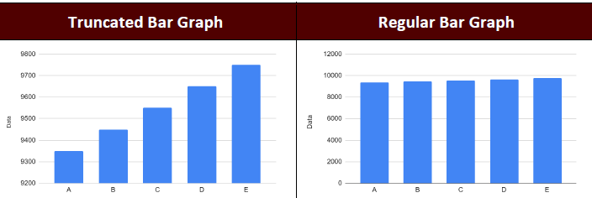
Ethics in technical writing
Typical Ethics Issues in Technical Writing
Misuse of Visuals : take a look at the bar graphs in the Figure below. What do you notice about their presentation?
The left bar graph shows dramatic increase only a narrow range of numbers (9100 to 9800). The right bar graph shows the complete picture by presenting numbers from 0-1200 on the vertical axis, and we see that the numbers have in fact been relatively stable.
Remedy: in visuals illustrate key facts, statistics, or information that depicts a complete picture

Slide 34
Ethics in technical writing
Typical Ethics Issues in Technical Writing
Limited Source Information in Research: including only limited number of sources, unreliable reference sources, personal opinion or bias sources.
Remedy: peer reviewed journal articles, conference proceedings, books and reports from reputed organizations typically considered reliable sources. Use CRAP test (currency, reliability, authority and purpose) to decide if a web resource is a credible. For ETUS use the following link for reference materials
https://libraries.etsu.edu/home

Slide 35
Ethics in technical writing
Typical Ethics Issues in Technical Writing
Presentation of Information: burying crucial bit of information somewhere in a long document seriously de-emphasizes the information. On the other hand, putting a minor point in a prominent spot (say the first item in a bulleted list in a report’s executive summary) tells reader that information is crucial.
Remedy: Using a large section of your report to prove an already established principle implies that you are saying something new about the principle—which is not true. Be honest, fair and strive for high quality. demonstrate empathy, respect, and constructive criticism when engaging with others and their technical communication skills

Slide 36
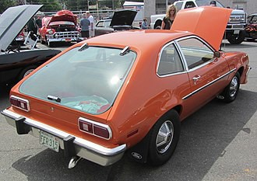
Ethics –Case study
The Ford Pinto was a subcompact produced by Ford from 1971–1980
The fuel tank was vulnerable to leaking and fire subject to certain rear-end collision scenarios
A Ford cost-benefit analysis estimated that the $11 fix per car over12.5 million vehicles would cost $137 million
The fix would save 180 burn deaths and 180 burn injuries
Valuing human life at $200,000, the fix would benefit society by about $50 million
Was Ford’s analysis ethical?

Slide 37
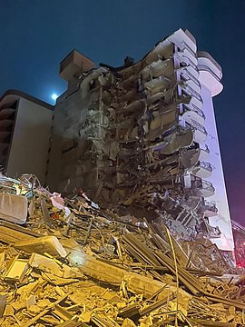
Ethics –Case study
On June 24, 2021, Champlain Towers South, a 12-floor condominium in Surfside, Florida, partially collapsed killing 98 people.
The design of the structure failed to meet the codes and standards applicable at the time of original construction
Champlain Towers South Surfside, Florida

Slide 38
Ethics –Case study
During the 2010s Volkswagen promoted in the US its line of “clean” diesel vehicles
Volkswagen achieved the clean scores by rigging their vehicles with software to activate the emissions controls only during emissions testing
Volkswagen spent of $18 billion in recalls and fines for their action
Volkswagen’s actions were illegal and executives were charged with crimes
Volkswagen engineers were aware of the illegal activity and participated in it

Slide 39
Ethics –More Case studies
National Society of professional engineers’ Ethics Resources page includes many interesting case studies. Please visit the following link
https://www.nspe.org/resources/ethics/ethics-resources/board-ethical-review-cases

Slide 40
Conclusions
Many factors enter into engineering decisions
Ethical issues beyond the math/engineering/science, conventions, standards and codes will also shape decisions
In your engineering career you will be faced with ethical issues

Slide 41
Questions?

