Slide 1
Engineering Communication oral Presentation

Slide 2
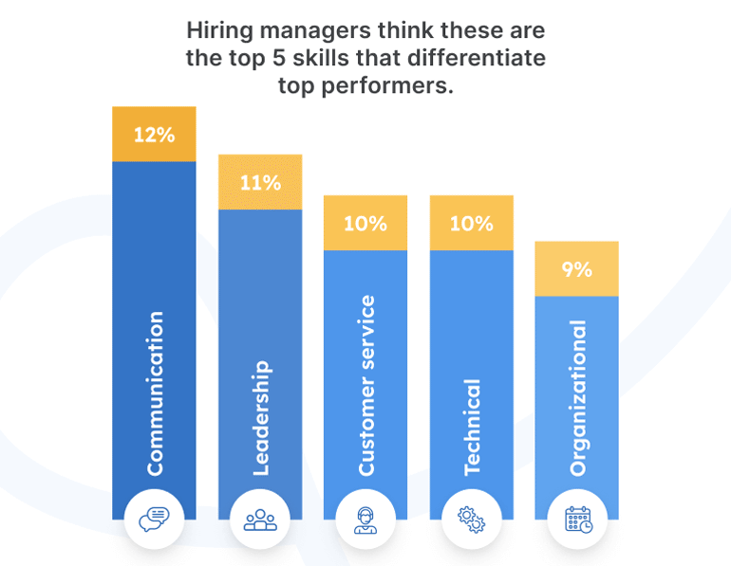
Importance of Engineering communication

Slide 3
Engineering oral communication situations
Presenting a new idea to your boss
Presenting the idea to donors
Presenting new technical method in a conference
Presenting the project to the community

Slide 4
Basic Presentation Skills
A daunting task

Slide 5
Basic Presentation Skills
Preplanning
WHO IS MY AUDIENCE?
WHAT IS MY PURPOSE?
WHERE IS ALL THE EQUIPMENT I NEED?
WHEN AM I ON THE PROGRAM AGENDA?
HOW LONG SHOULD I TALK?

Slide 6
Basic Presentation Skills
Preparing the Verbal Elements
4-S formula for structuring the presentations.
SHORT: Use short sentences, avoid too many details, and do not talk too long.
SIMPLE: Avoid wordy, lengthy phrases.
STRONG: Use active voice and action verbs, not passive voice and “to be” verbs.
SINCERE: Convey empathy, understanding, and respect for the audience.

Slide 7
Basic Presentation Skills
Preparing Visual Aids
Keep each slide simple, with one concept per slide.
Present data in simple graphs rather than in lists or tables.
Pictures, diagrams, and video simulations all may enhance your presentation. Be sure that all are large enough to be seen by the audience
Use bullet points with important phrases to convey ideas. Avoid complete sentences
Large-size text is best. A font size of preferably no less than 24 points should be used

Slide 8
Basic Presentation Skills
Preparing Visual Aids
Use high-contrast colors
Use a light background and dark print to keep the room brighter
Keep background styles simple and minimize animation

Slide 9
Making the Presentation
When delivering a presentation, DO:
Relax!
Speak slowly and clearly, making good eye contact.
When your hands are not busy, drop them to your sides.
Rehearse your presentation out loud multiple times. If possible, have a friend critique.
Arrive early enough to make sure that all technology is present and working, and resolve any problems you may discover.

Slide 10
Making the Presentation
When delivering a presentation, DO NOT:
Lean on your surroundings, turn your back to the audience, or cover your mouth while speaking.
Read your presentation from a prepared text.
Tell inappropriate jokes.
Stammer, overuse the pronoun “I,” or repeatedly say “um” or “uh.”
Chew gum, rattle coins in pockets, crack your knuckles, etc.
Shuffle your feet or slouch; move repetitively, for example, pace back and forth or sway.

Slide 11
Sample Presentations
Critique the Presentations

Slide 12
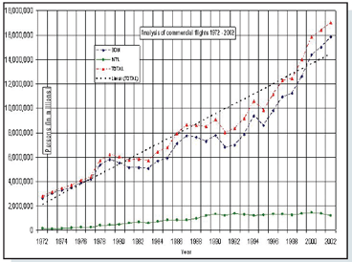
Sample Presentations

Slide 13
Sample Presentations

Slide 14
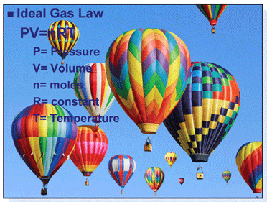
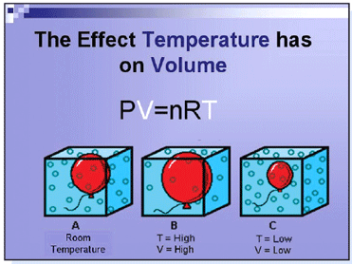
Sample Presentations
Sample Presentations

Slide 15
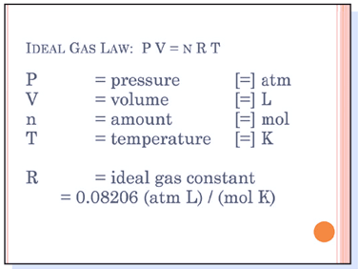
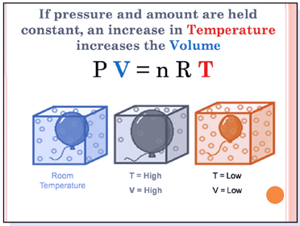
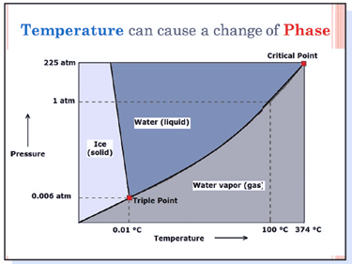
Sample Presentations
Sample Presentations

Slide 16
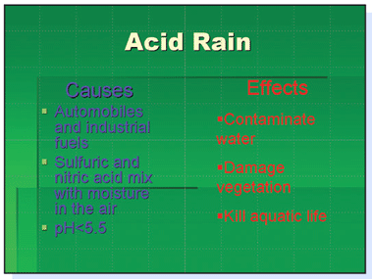
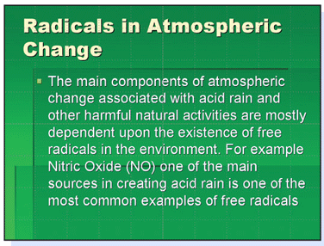
Sample Presentations

Slide 17
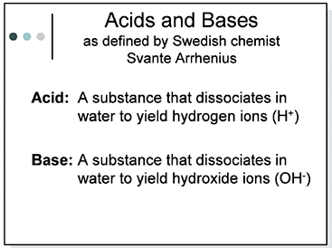
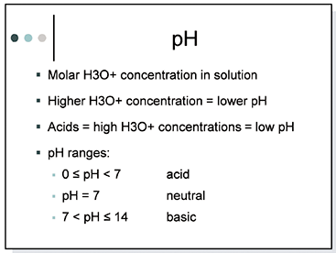
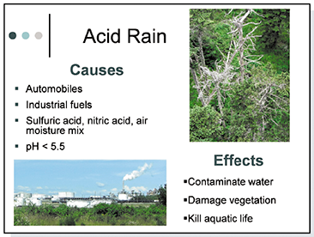
Sample Presentations

