Slide 1
Engineering Capstone: East Tennessee State University Workshop Safety Rules Location: Wilson-Wallis Hall Room 103
Elissa Ledoux
M. Moin Uddin
Nicholas Matta
Matthew Sheppard

Slide 2
General Safety Procedures
Always wear personal protective equipment (PPE), including safety glasses, ear protection, and appropriate clothing.
Gloves are required for operating certain machines.
Keep the workshop clean and organized.
Ensure all machine guards are in place before use.
If you are uncertain about a safety concern, please ask.

Slide 3
Machine-Specific Safety Guidelines:
Ensure all protocols and procedures are adhered to when using equipment within the lab.
Always wear ANSI-approved safety glasses/goggles or eyeglasses when in the lab.
They must be worn regardless of whether you are actively performing work, other students/faculty around you may be using equipment.
NEVER leave a machine while it’s on or in operation.

Slide 4
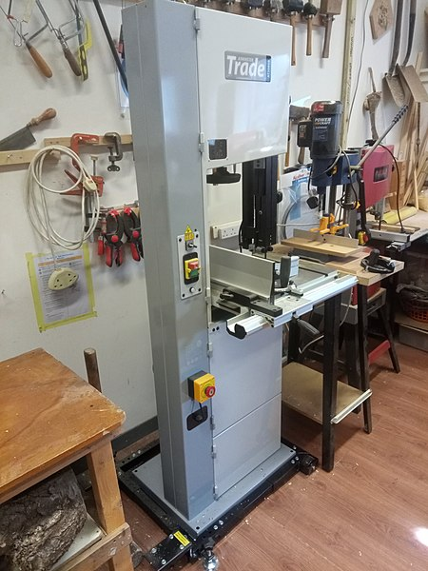
Bandsaw
Use push sticks for small pieces.
Keep hands away from the blade.
Ensure the bandsaw fully stops before reaching in or walking away.
Notes:
Image provided by: https://commons.wikimedia.org/wiki/File:Jed_shed_band_saw.jpg

Slide 5
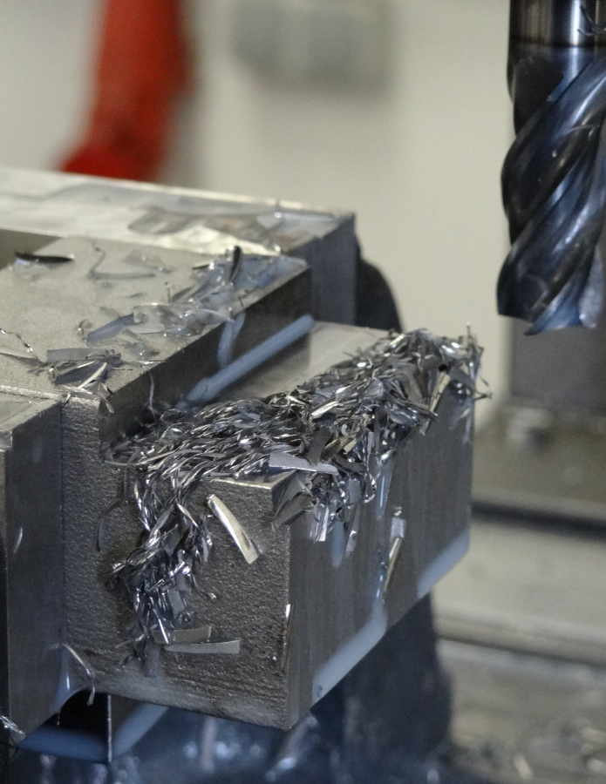
Milling Machine
Secure workpieces properly.
Avoid loose clothing or jewelry.
Know your workpiece material and type of milling bit.
Adjust cutting speed before operation.
Notes:
Image provided by: https://pxhere.com/en/photo/1354424?utm_content=shareClip&utm_medium=referral&utm_source=pxhere

Slide 6
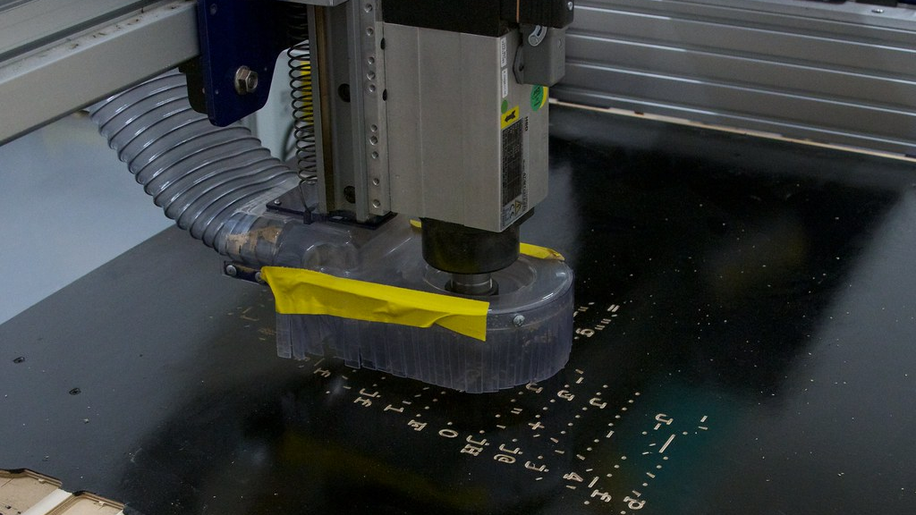
CNC Machine
Follow program instructions carefully.
Ensure cutting material is properly secured to the table.
Stay clear of moving parts during operation.
Hearing protection may be required for milling certain materials.
Notes:
Image Provided by: https://www.flickr.com/photos/oskay/6634528725

Slide 7
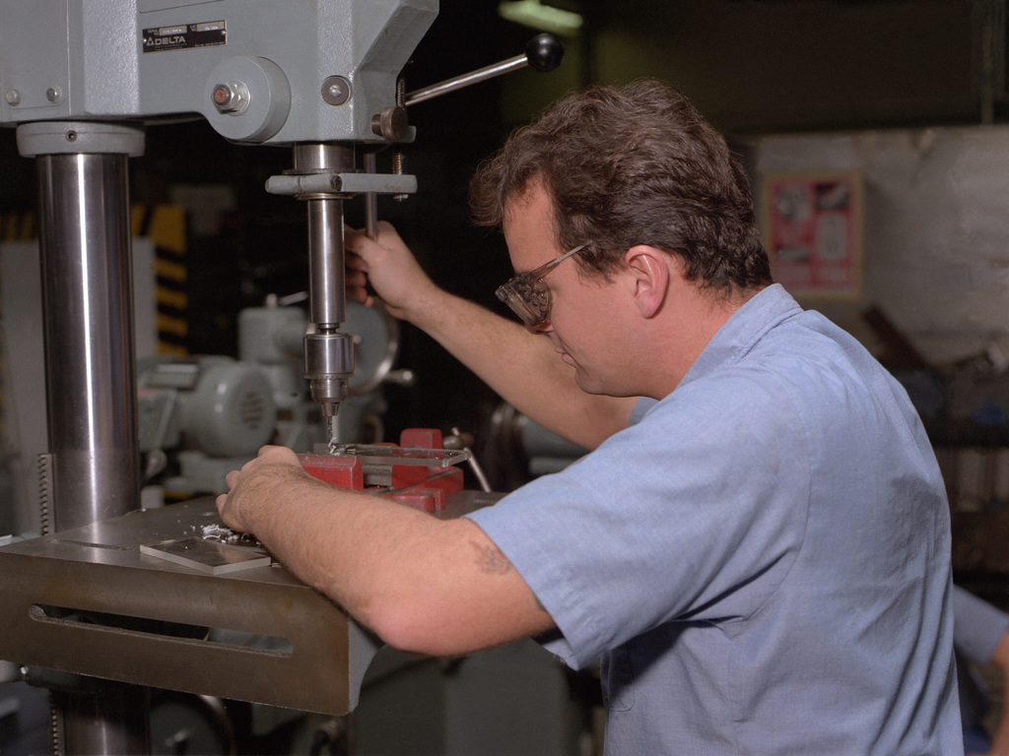
Drill Press
Clamp workpieces securely.
Use the correct drill bit and speed.
Ensure the Drill Press chuck stops rotating before changing the bits.
Notes:
Image provided by: https://nara.getarchive.net/de/media/aviation-structural-mechanic-3rd-class-garrett-uses-a-drill-press-to-repair-74673a

Slide 8
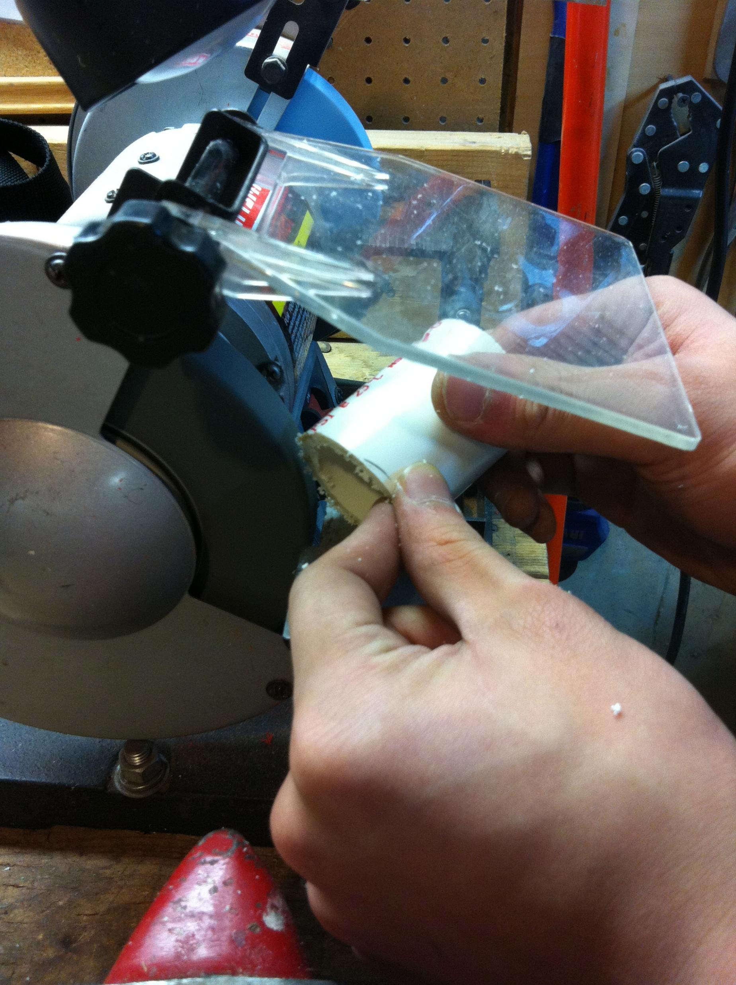
Bench Grinder
Wear eye protection and a face shield.
Keep the work area clear.
Caution: the workpiece may become hot, handle it with care.
Notes:
Image Provided by: https://commons.wikimedia.org/wiki/File:Bench_Grinder_used_for_PVc.jpg

Slide 9
Lathe
Avoid loose clothing or long hair.
Use proper tool rests and guards.
Ensure the chuck/collet has stopped rotating before reaching in.
Always remove the chuck/collet tightening key before starting the lathe.
Notes:
Image provided by: https://www.flickr.com/photos/anders-vindegg/25769994344

Slide 10
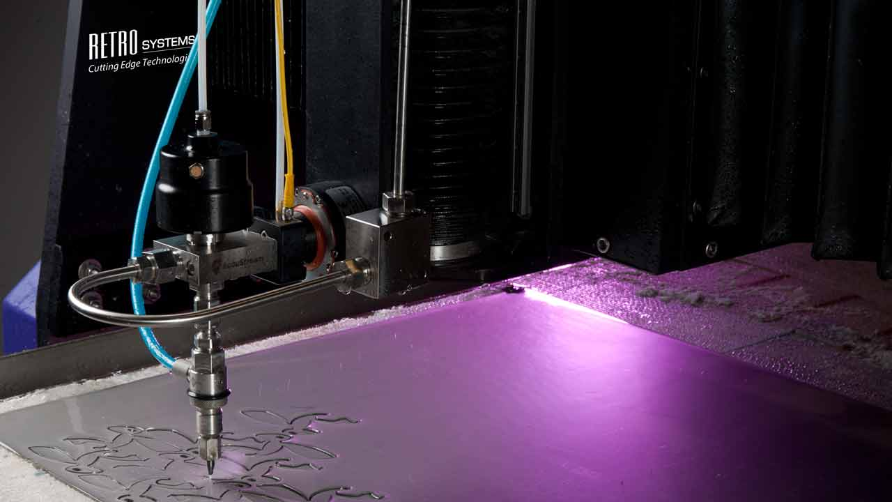
Water Jet
Follow safe startup and shutdown procedures.
Keep hands away from the cutting stream.
Students are not allowed to operate the water jet, contact an ETSU faculty member to assist.
Notes:
Image Provided by: https://commons.wikimedia.org/wiki/File:Retro_Systems_Waterjet.jpg

Slide 11
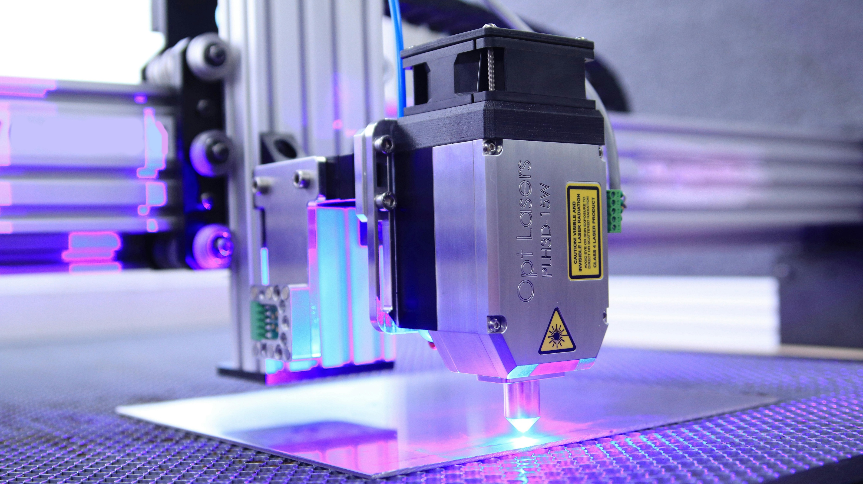
Laser Cutter
Use proper ventilation (turn on the fan and open the air valve).
The laser cutter will prompt if there is inadequate ventilation and will not start the operation until there is.
Calibrate the platform height of the workpiece to the laser.
Avoid looking directly at the laser beam.
Notes:
Image provided by: https://www.pexels.com/photo/close-up-shot-of-a-cnc-laser-7254457/

