Slide 1
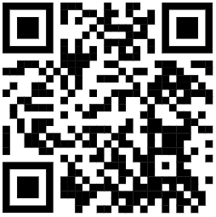
Team or sponsor logo here
TEAM NAME AND PROJECT TITLE
Team: List Team Member Names
Course: ET/ENGR XXXX Faculty Advisor: Sponsor:
MTSU
logo
here
OBJECTIVE
PRODUCT FEATURES
TEST RESULTS
Describe problem statement and project goal in 1-2 sentences
Highlight important features using bullets or callouts
Put them in column format if better use of space
Include graphs, a table, and/or bullets quantifying your project’s performance
Insert nice photo, CAD assembly, or exploded view of prototype
Show relevant
photo here
DESIGN CRITERIA
Include arrows and labels indicating important features or components
CONCLUSION
List important
Design criteria
Using bullets
With parallel
Grammar structure
Highlight success
in 1-2 sentences.
May add acknowledgements,
references, or anything
else applicable after that
May include additional images of user interface, controls,
electrical or pneumatic diagrams,
previous prototypes, or anything else relevant
Project Website →
(or video/social media/etc.)

