Slide 1
Critical Path Method (CPM) Scheduling – Part III

Slide 2
Module Learning Objectives
Types of Floats
Calculate Floats
Determine Critical Activities and Critical Path

Slide 3
The CPM Schedule
In our last module we have learned that a CPM schedule involves five steps. They are:
Determine the work activities: Any project, no matter how large or small, must be divided into smaller entities, called activities, or tasks
Determine activities’ resources: labor (human), materials, and equipment
Determine activities’ durations: time estimates for each operation
Determine logical relationships: Determine FS, SS, FF, & SF and draw logic diagram
Perform the CPM calculations: ES, EF, LS, LF, TF, FF

Slide 4
Floats
In project management, float or slack is the amount of time that a task in a project network can be delayed without causing a delay to:
subsequent tasks or
project completion date
Float is a very valuable concept since it represents the scheduling flexibility or "maneuvering room" available to complete particular tasks. For activities with float, the actual starting time might be chosen to balance work loads over time, to correspond with material deliveries, or to improve the project's cash flow.
There are several types of float. They are
Total Float (TF)
Free Float (FF)
Independent Float (IF)
Shared Float (SF)

Slide 5
Total Float (TF)
Total Float is the time an activity may be delayed without impacting the overall project completion time
Total float is the difference in the early start and the late start days or the difference in the early finish and late finish days
Total Float of an activity = TF = (LS – ES) of that activity or (LF – EF) of that activity
6 | 5 | 11
B
10 | 4 | 15
TF = 10 – 6 = 4
TF = 15 – 11 = 4
ES | Dur | EF
Activity
LS | TF | LF

Slide 6
Example
Calculate total float for the CPM schedule
6 | 5 | 11
B
10 |  | 15
11 | 4 | 15
E
15 |  | 19
0 | 6 | 6
A
0 |  | 6
7 | 3 | 10
C
16 |  | 19
19 | 10 | 29
F
19 |  | 29
29 | 8 | 37
H
29 |  | 37
6 | 1 | 7
D
6 |  | 7
7 | 12 | 19
G
7 |  | 19

Slide 7
Example
Here is the solution
6 | 5 | 11
B
10 | 4 | 15
11 | 4 | 15
E
15 | 4 | 19
0 | 6 | 6
A
0 | 0 | 6
7 | 3 | 10
C
16 | 9 | 19
19 | 10 | 29
F
19 | 0 | 29
29 | 8 | 37
H
29 | 0 | 37
6 | 1 | 7
D
6 | 0 | 7
7 | 12 | 19
G
7 | 0 | 19

Slide 8
Free Float (FF)
Free Float is the time by which an activity can be delayed without delaying the early start of its successor activity
Free float of an activity is determined by subtracting its earliest finish time from the earliest of the early start times of the activities that directly follow
Free Float of an activity = FF = ES of the next activity – EF of that activity
FF = 11 – 11 = 0
6 | 5 | 11
B
10 | 4 | 15
 | 0
11 | 4 | 15
E
15 | 4 | 19
ES | Dur | EF
Activity
LS | TF | LF
SF | FF | IF

Slide 9
Free Float (FF)
If the activity has more than one successor then
FF_{i} = min(ES_{i+1}) - EF_{i}
where min (ES_{i+1}) means the least (i.e., earliest) of the early start dates of succeeding activities
FF of B = min (8,12) – 8 = 8 – 8 = 0
Free Float of an activity = FF = ES of the next activity – EF of that activity
8 | 7 | 15
E
10 | 4 | 17
2 | 6 | 8
B
4 | 4 | 10
 | 0
ES | Dur | EF
Activity
LS | TF | LF
SF | FF | IF
12 | 5 | 17
F
12 | 4 | 17

Slide 10
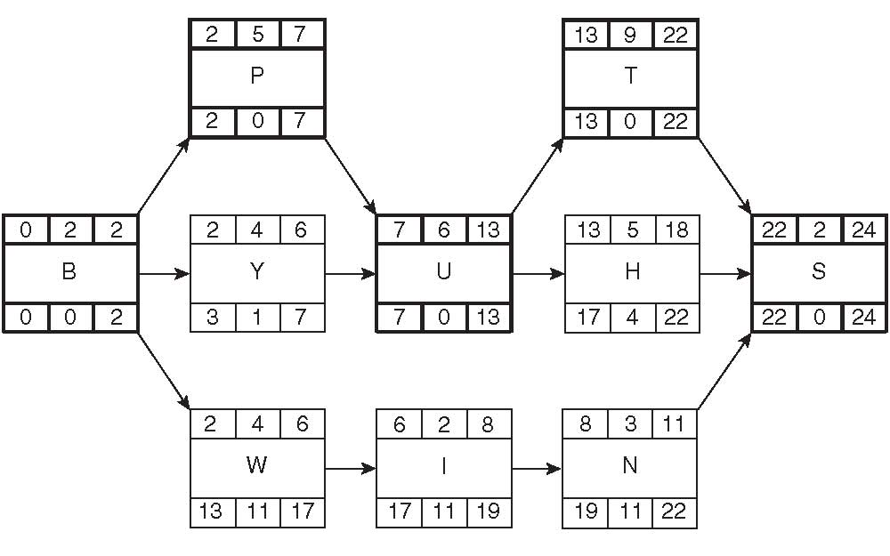
Example
Calculate the Free Float for the CPM schedule

Slide 11
Example
Here is the solution
Note: Coincidentically in this example TF = FF, but this may not be the case in many situations. However, always TF>= FF
 | 0
 | 0
 | 0
 | 1
 | 0
 | 4
 | 0
 | 0
 | 0
 | 11

Slide 12
Independent Float (IF)
Independent float is float that belongs to one activity and that activity alone. It is not shared with any other activities, earlier or later. Independent float is float a management team could give away because it has no effect on other activities.
Read pages 82-83 from the handout “Calculating Floats”

Slide 13
Example
Calculate the Independent Float for the CPM schedule
 | 0
 | 0
 | 0
 | 1
 | 0
 | 4
 | 0
 | 0
 | 0
 | 11

Slide 14
Example
Here is the solution
 | 0 | 0
 | 0 | 0
 | 0 | 0
 | 1 | 1
 | 0 | 0
 | 4 | 4
 | 0 | 0
 | 0 | 0
 | 0 | 0
 | 11 | 0

Slide 15
Shared Float (SF)
Shared float is the time belongs to the path or string of activities, which can be distributed among the activities.
Read pages 78-80 from the handout “Calculating Floats”

Slide 16
Example
Calculate the Independent Float for the CPM schedule
 | 0 | 0
 | 0 | 0
0 | 0 | 0
 | 1 | 1
 | 0 | 0
 | 4 | 4
 | 0 | 0
 | 0 | 0
 | 0 | 0
 | 11 | 0

Slide 17
Example
Here is the solution
0 | 0 | 0
0 | 0 | 0
0 | 0 | 0
0 | 1 | 1
0 | 0 | 0
0 | 4 | 4
0 | 0 | 0
11 | 0 | 0
11 | 0 | 0
11 | 11 | 0

Slide 18
Floats
Most texts and project management software discuss and calculate total float and free floats, but not shared and independent floats. The ability to analyze these types of float prevents the manager from making the mistake of giving away float that may end up damaging the project. It is essential to realize that most of the time float is shared, and it is not independent

Slide 19
CPM – Practice Examples
Practice Example 4.1, 4.2, and 4.3 from the handout “Critical Path Method” – this time with the calculation of total float and free float

Slide 20
CPM
Now that we have learned to calculate total and free float, next step is to identify critical activities and the critical path
The critical path refers to the way the diagram shows those activities that must be completed, and complete in a specific order, so that the project can be completed successfully and on time.
The critical path will be the longest path through the diagram, and will show how long a project is expected to take if the scope does not change and everything goes according to plan.
It is “critical” because all activities on it must be completed in the designated time, otherwise the whole project will be delayed.

Slide 21
CPM
How are critical activities identified?
Identify activities with total float of zero. Activities that have zero float must start on time to prevent the schedule from slipping.
Now link those activities (TF = 0) from start to finish. This is your critical path. Always highlight (color/bold) critical activities and critical path for easy identification.

Slide 22
Example
Identify critical activities and the critical path
6 | 5 | 11
B
10 | 4 | 15
11 | 4 | 15
E
15 | 4 | 19
0 | 6 | 6
A
0 | 0 | 6
7 | 3 | 10
C
16 | 9 | 19
19 | 10 | 29
F
19 | 0 | 29
29 | 8 | 37
H
29 | 0 | 37
6 | 1 | 7
D
6 | 0 | 7
7 | 12 | 19
G
7 | 0 | 19

Slide 23
Example
Critical Path
ES | Dur | EF
Activity
LS | TF | LF
Critical Activity
Here is the solution
6 | 5 | 11
B
10 | 4 | 15
11 | 4 | 15
E
15 | 4 | 19
0 | 6 | 6
A
0 | 0 | 6
7 | 3 | 10
C
16 | 9 | 19
19 | 10 | 29
F
19 | 0 | 29
29 | 8 | 37
H
29 | 0 | 37
6 | 1 | 7
D
6 | 0 | 7
7 | 12 | 19
G
7 | 0 | 19
ES | Dur | EF
Activity
LS | TF | LF

Slide 24
CPM
Critical Path Analysis is an effective and powerful method of assessing:
What tasks must be carried out on time.
Where parallel activity can be performed.
The shortest time in which you can complete a project.
Resources needed to execute a project.
The sequence of activities, scheduling and timings involved.
Task priorities.
The most efficient way of shortening time on urgent projects.
An effective Critical Path Analysis can make the difference between success and failure on complex projects. It can be very useful for assessing the importance of problems faced during the implementation of the plan.

