Slide 1
CPM Calculations – Part II

Slide 2
Module Learning Objectives
Determine activity duration
Describe and develop CPM logic diagram
Calculate forward pass for CPM
Calculate backward pass for CPM

Slide 3
The CPM Schedule
In our last module we have learned that a CPM schedule involves five steps. They are:
Determine the work activities: Any project, no matter how large or small, must be divided into smaller entities, called activities, or tasks
Determine activities’ resources: labor (human), materials, and equipment
Determine activities’ durations: time estimates for each operation
Determine logical relationships: Determine FS, SS, FF, & SF and draw logic diagram
Perform the CPM calculations: ES, EF, LS, LF, TF, FF

Slide 4
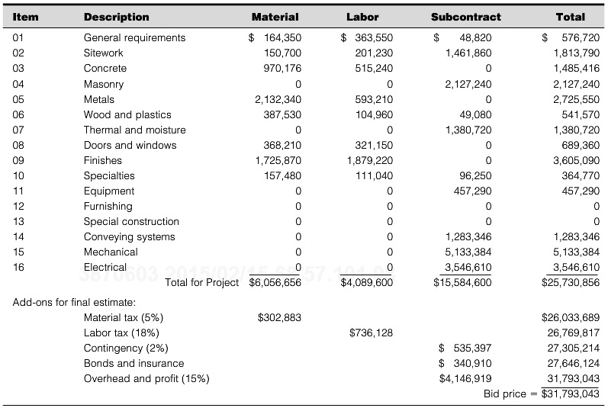
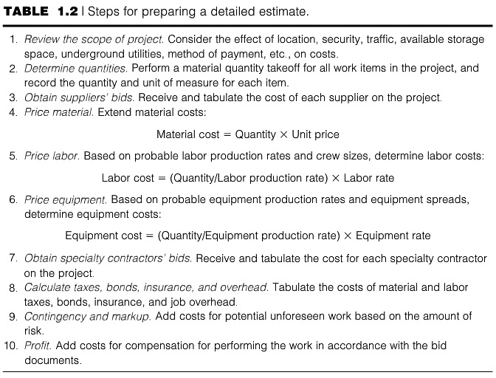
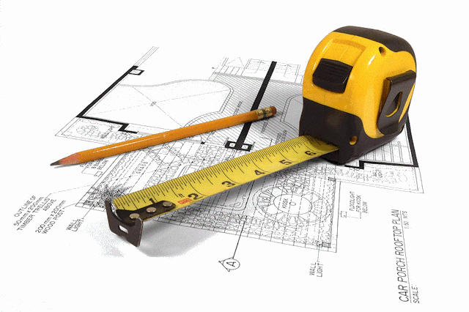
COST ESTIMATING
An estimate is—at best—a close approximation of the actual cost
A project cost estimate is unique to that project
Even when compared to other, similar projects
Soundness of the completed estimate depends on:
Accuracy of the quantity take-off and
Judicious selection of unit costs and production rates

Slide 5
Estimating Durations
The method used to establish duration of an activity depends on the size of the activity and the amount of accuracy required
Most opt to analyze the operation in detail
Schedulers with significant relevant experience may be able to make a good guess
A scheduler can consider performances on past projects, and thus make the duration estimates
Without actually performing any detailed analysis
Durations are generally recorded in terms of whole days
See example on Page 50 of the handout “Determining Activity Durations”

Slide 6
Methods of Duration Estimates
Expert Judgment
Parametric Estimating
Three-Point Estimating
Bottom-up Estimating
Group Decision-Making Techniques
Analogous Estimating

Slide 7
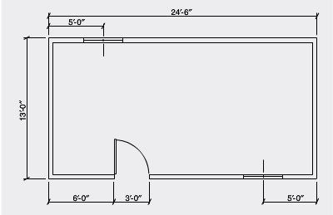
Estimating Durations
Example
Determine the number of sheathing panels required to cover the 8′-0″ high walls of a building measuring 24′-6″ × 13′-0″. A door opening measuring 3′-0″ × 6′-8″ and two window openings measuring 2′-6″ × 3′-0″ each are placed in the walls. Each sheathing panel covers 25 sft. Consider a waste factor of 7%. If a crew can install 5 sheathing panel per hour, how long will it take to install the sheathing panels?

Slide 8
Practice Example
Suppose, your project needs four .NET developers, two User Experience professionals, and one Project Manager. The rates for each of these team members are:
.NET Developers: $80/hour
User Experience Professionals: $90/hour
Project Manager: $100/hour
The .NET developers divide the project into 40 units. If the productivity of the four .NET developers is 0.4 unit/hr, how long will it take them to finish the project? If The project requires the User Experience professionals for 50 hours, and the Project Manager for 100 hours, how much the project will cost?

Slide 9
For Course Project
Identify resources – materials, labor, equipment and tools that you would need to complete the project
Identify/calculate labor productivity and equipment productivity. For construction project RS Means is one of the standard documents that provides estimates of labor and equipment productivity. For other type of projects, there should be some industry guidelines to estimate labor and equipment productivity. Identify those guidelines and include those in the reference of your report
https://www.rsmeansonline.com/

Slide 10
For Your Project
Activity Name | Quantity | Resources and Productivity | Duration Calculation
Footer 18”x9”, reinforced | 100 CY | C-14C, 35 CY/day | Duration = 100CY/(35 CY/day) = 2.85 days ≈ 3 days

Slide 11
Activity Relationships
Relationship is the determination of the sequence, or linking of activities.
Activities may be independent.
Activities may be dependent.
Logic involves the determination of the constraints on activities.
For example, you cannot place the concrete until the formwork and reinforcement are erected. You cannot hang the drywall until framing is done.

Slide 12
Links
Dependencies between activities are indicated by dependency or sequence lines going from one activity to another.
B
A
C

Slide 13
Activity Relationships
Finish to Start (FS)
Task B cannot begin until the task A is complete
For example, "Pour concrete" task cannot begin until the "Dig foundation" task is complete
A
B

Slide 14
Activity Relationships
Start to Start (SS)
Task B cannot start until task A starts
Example - Excavation for the foundation cannot start until clearing and grubbing begins
A
B

Slide 15
Activity Relationships
Finish to Finish (FF)
Task B cannot finish until task A finishes
Example - "Inspect electrical" can't finish until "Add wiring" finishes
A
B

Slide 16
Activity Relationships
Start to Finish (SF)
Task B cannot be completed until the task A begins
For example, the roof trusses for your construction project are built offsite. Two of the tasks in your project are "Truss delivery" and "Assemble roof." The "Assemble roof" task cannot be completed until the "Truss delivery" task begins.
A
B

Slide 17
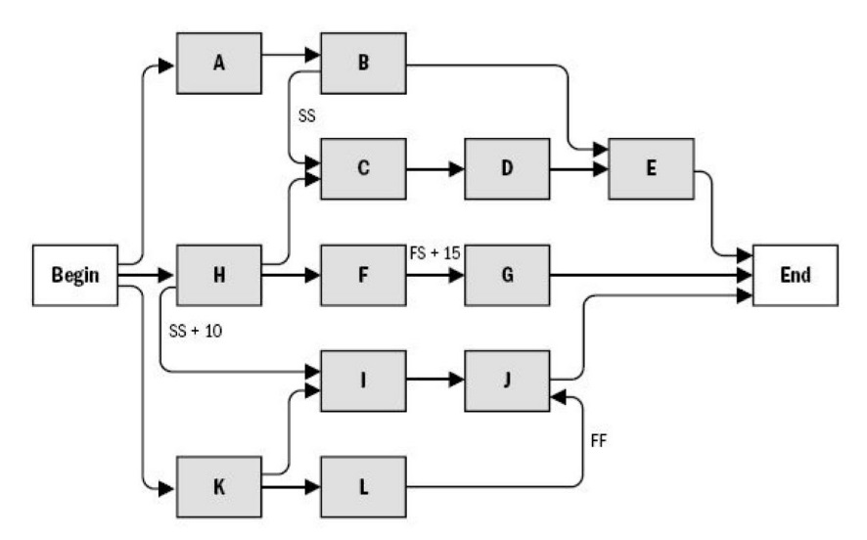
CPM Logic Diagram
A graphical representation of the project.
Shows all activities and their dependencies.
Each activity in the network must be preceded either by the start of the project or by the completion of a previous activity.

Slide 18
CPM Logic Diagram
Each path through the network must be continuous, with no gaps, discontinuities, or dangling activities.
The diagram should start with a single opening or starting activity and conclude with a single closing or finishing activity.

Slide 19
CPM Logic Diagram
Make sure the Logic is correct
Two critical questions to ask yourself of each activity. Go through the complete logic diagram asking these two questions to each and every activity. These questions will put your mind in another gear and help to make sure the logic is correct.
Does this activity really have to be done before each of the following activities can start?
What other activities need to be done before this activity can start?
It is critical that the logic is accurate as to the predecessors and successors of each activity in the project. If the logic diagram is not accurate the results will be a bogus schedule that will be frustrating to everyone involved.

Slide 20
CPM – Calculating Start and Finish Dates
Once the network logic diagram has been created and the durations have been added to the activities, the calculations can be done to determine the start and finish dates
While, in practice, most calculations are now performed by scheduling software programs, it is still important for the scheduler to have a thorough understanding of the specific nature of the computations that are performed in determining the schedule information

Slide 21
CPM – Calculating Start and Finish Dates
Early Start: the earliest time an activity can possibly start, allowing time for the completion of predecessor activities.
Early Finish: earliest time by which an activity can be finished and is determined by adding the activity’s duration to its early start time.
Late Start: the latest time an activity can start if the project completion date is to be met and is determined by subtracting the activity’s duration from its late finish time
Late Finish: the latest an activity can finish and allow the project to be completed by a specified date.
Activity times are usually expressed in terms of expired working days.
Therefore, the start of the project is customarily taken to be at zero time.

Slide 22
CPM – Calculating Start and Finish Dates
The Story
Early Start
Early Finish
Early Start
Early Finish
8 am
10 am
8 am
11 am
Buy Food
Gather Hunting Gear
10 am
12 pm
9 am
12 pm
Late Start
Late Finish
Late Start
Late Finish
Early Start
Early Finish
8 am
12 pm
Fix Car
8 am
12 pm
Late Start
Late Finish

Slide 23
CPM – Calculating Start and Finish Dates
Early Start: the earliest time an activity can possibly start, allowing time for the completion of predecessor activities.
Early Finish: earliest time by which an activity can be finished and is determined by adding the activity’s duration to its early start time.
Late Start: the latest time an activity can start if the project completion date is to be met and is determined by subtracting the activity’s duration from its late finish time
Late Finish: the latest an activity can finish and allow the project to be completed by a specified date.
Activity times are usually expressed in terms of expired working days.
Therefore, the start of the project is customarily taken to be at zero time.

Slide 24
CPM – Calculating Start and Finish Dates
Each activity is depicted in the following manner
Early Start | Activity Duration | Early Finish
Activity Description
Late Start | Total Float | Late Finish

Slide 25
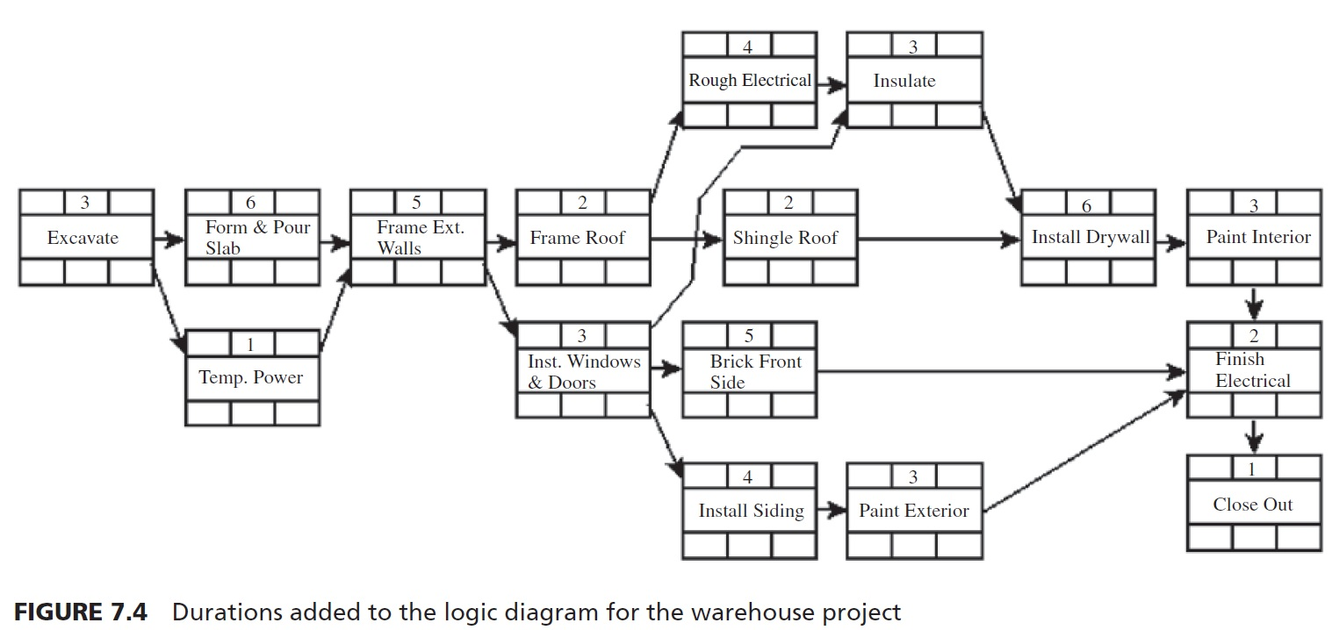
CPM – Calculating Start and Finish Dates
Example: Warehouse Logic Diagram (From handout “Calculating Start and Finish Dates”)

Slide 26
CPM – Calculating Start and Finish Dates
Activity ID | Activity | Duration (Day) | IPA
10 | Excavate | 3 | -
20 | Form & Pour Slab | 6 | 10
30 | Temp Power | 1 | 10
40 | Frame Ext Walls | 5 | 20,30
50 | Frame Roof | 2 | 40
60 | Install Windows & Doors | 3 | 40
70 | Rough Electrical | 4 | 50
80 | Shingle Roof | 2 | 50
90 | Brick Front Side | 5 | 60
100 | Install Siding | 4 | 60
110 | Insulate | 3 | 60,70
120 | Paint Exterior | 3 | 100
130 | Install Drywall | 6 | 80,110
140 | Paint Interior | 3 | 130
150 | Finish Electrical | 2 | 90,120,140
160 | Close Out | 1 | 150
Example: Warehouse

Slide 27
CPM – Calculating Start and Finish Dates
The Forward Pass:
With the network logic diagram completed and the activity durations included for the warehouse project, the next step is to calculate the early start and early finish dates. This process is typically referred to as the forward pass. The calculations start at the beginning of the project and move to the end of the project, or from left to right
Pick activity or activates that start the project. In the example, activity “Excavate” initiate the project. To begin the calculations, put a zero (which represents the morning of the first day) in the early start (ES) area of the activity box. Add the duration to the ES and that results in the early finish (EF) day for the first activity
ES
Dur
EF
EF = ES + Duration
= 0 + 3 = 3
0 | 3 | 3
Excavate

Slide 28
CPM – Calculating Start and Finish Dates
The Forward Pass:
The second activity can start as soon as the first activity has finished; therefore, the next step is to transfer, or copy, the EF of the predecessor activity to the ES of the successor activity.
3 + 6 = 9
3 | 6 | 9
Form & Pour Slab
0 | 3 | 3
Excavate
3 | 1 | 4
Temp. Power

Slide 29
CPM – Calculating Start and Finish Dates
The Forward Pass:
If there are two or more activities (arrows) as predecessors to a single activity, choose the one with the largest EF day to insert into the successor activity. This is done because both activities need to be finished before the successor activity can start.
Notice in the Figure the ES for Frame Ext. Walls is the largest EF of the predecessor activities, the 9, not the 4. Then, add the duration to get the EF day: 9 + 5 = 14. Hence, the EF for Frame Ext. Walls is the end of day 14.
3 | 6 | 9
Form & Pour Slab
9 + 5 = 14
9 | 5 | 14
Frame Ext. Wall
3 | 1 | 4
Temp. Power
Largest of ( EF of Form & Pour Slab and EF of Temp. Power) = largest (9, 4) = 9

Slide 30
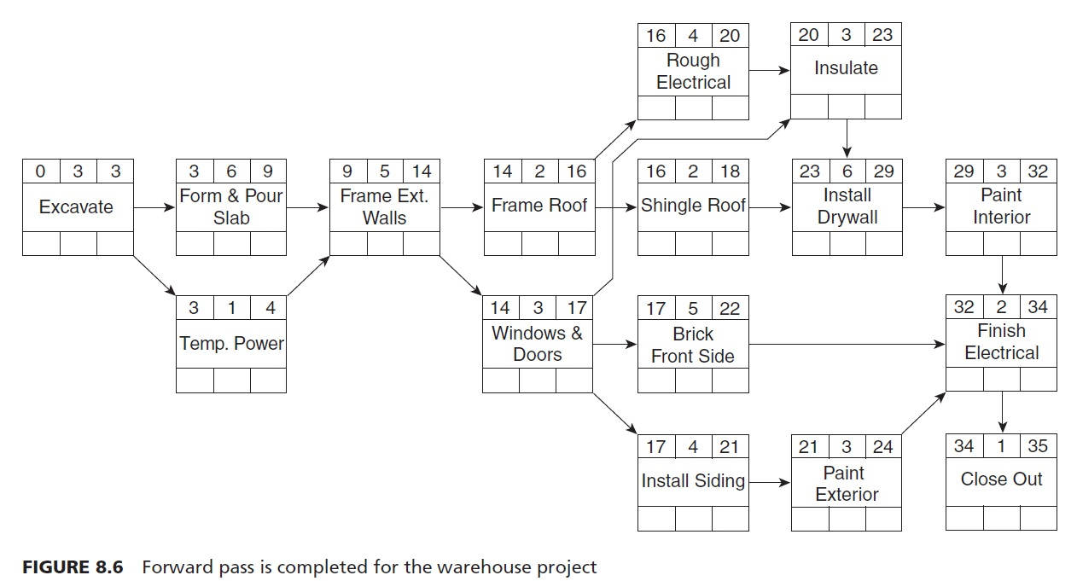
CPM – Calculating Start and Finish Dates
The Forward Pass:
Continue in a like manner, always choosing the larger of the predecessors for the ES day, adding the duration to get the EF day and continuing this through the rest of the network as shown in Figure. As can be seen from the network in Figure, the project is scheduled to finish on the end of day 35

Slide 31
CPM – Calculating Start and Finish Dates
The Backward Pass:
With the forward pass completed, the early start and finish days have been established. To establish the late start and finish days, the same concept is followed, except that everything is done backward. Therefore, it is called the backward pass. The calculations begin at the end of the project and move to the beginning of the project, or from right to left. If two arrows back into an activity, the lowest number is chosen

Slide 32
CPM – Calculating Start and Finish Dates
The Backward Pass:
To begin the backward pass calculations, go to the last activity and copy the EF day (top right cell) into the LF (bottom right) cell of the activity box as shown in Figure. This is the standard or default method of starting the backward pass because it is typical to want the late finish day to be the same day as the early finish day. Then, subtract the duration from the LF day and that gives the LS day for that last activity as shown in Figure.
34 | 1 | 35
Close Out
34 |  | 35
LS = LF – Duration
= 35 – 1 = 34

Slide 33
CPM – Calculating Start and Finish Dates
The Backward Pass:
Next, move to the predecessor of the last activity and copy the LS day of the successor to the LF of the predecessor as shown in Figure.
Close Out has an LS day of 34, so this becomes the LF day for Finish Electrical. Then, subtract the Finish Electrical duration of 2 days (34 – 2 = 32) and this calculates the LS for Finish Electrical to be day 32
32 | 2 | 34
Finish Electrical
32 |  | 34
34 | 1 | 35
Close Out
34 |  | 35
LS = LF – Duration
= 34 – 2 = 32

Slide 34
CPM – Calculating Start and Finish Dates
The Backward Pass:
During the backward pass, when there are two successor activities (noted by arrows) backing into a single activity, choose the one with the earliest LS day to become the LF day to insert into the predecessor activity as shown in Figure.
For example, both Frame Roof (LS of 14) and Windows & Doors (LS of 17) are backing into Frame Ext. Walls. So, the number to enter into the LF of Frame Ext. Walls (lower right) is 14, the earliest or smallest. Remember to focus on the bottom numbers in the activity box. Then subtract the duration of 5 days to get the LS day for Frame Ext. Walls. (14 – 5 = 9).
14 | 2 | 16
Frame Roof
14 |  | 16
9 | 5 | 14
Frame Ext. Walls
9 |  | 14
14 | 3 | 17
Windows and Doors
17 |  | 20
Smallest of ( LS of Frame Roof and LS of Windows and Doors) = smallest (14, 17) = 14

Slide 35
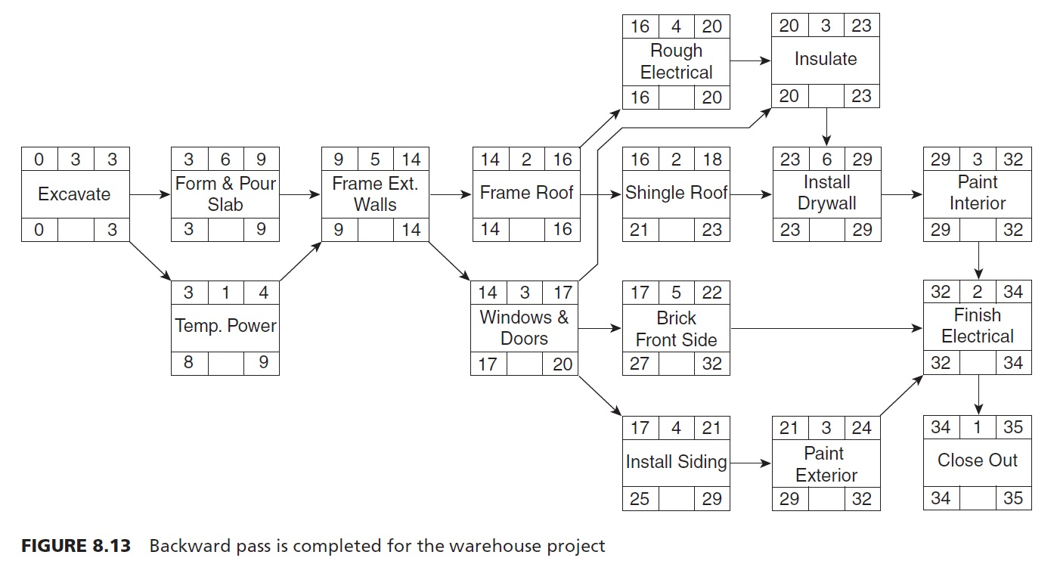
CPM – Calculating Start and Finish Dates
The Backward Pass:
Continue in this manner, always choosing the smaller number backing into the activity, then subtracting the duration, to get the LS day
When the backward pass is complete, the ES and the LS of the first activity should both be zero

Slide 36
CPM – Example 2
Draw the logic diagram and then check it in the next slide
Activity | Duration | IPA
A | 6 | -
B | 5 | A
C | 3 | A, D
D | 1 | A
E | 4 | B
F | 10 | C, E, G
G | 12 | D
H | 8 | E, F, G
I | 5 | G

Slide 37
CPM – Example 2
This is the logic diagram. Do the forward pass then check it in the next slide
 | 4
E
 | 5
B
 | 6
A
 | 3
C
 | 10
F
 | 8
H
PF
 | 1
D
 | 12
G
 | 5
I

Slide 38
CPM – Example 2
This is the logic diagram. Do the forward pass then check it in the next slide
11 | 4 | 15
E
6 | 5 | 11
B
0 | 6 | 6
A
7 | 3 | 10
C
19 | 10 | 29
F
29 | 8 | 37
H
37
PF
6 | 1 | 7
D
7 | 12 | 19
G
19 | 5 | 24
I

Slide 39
CPM – Example 2
This is the logic diagram. Do the forward pass then check it in the next slide
11 | 4 | 15
E
15 |  | 19
6 | 5 | 11
B
10 |  | 15
0 | 6 | 6
A
0 |  | 6
7 | 3 | 10
C
16 |  | 19
19 | 10 | 29
F
19 |  | 29
29 | 8 | 37
H
29 |  | 37
37
PF
6 | 1 | 7
D
6 |  | 7
7 | 12 | 19
G
7 |  | 19
37
19 | 5 | 24
I
32 |  | 37

