Slide 1
Critical Path Method (CPM) Scheduling – Part I
History, Basics, and Work Breakdown Structure

Slide 2
Module Learning Objectives
Define Critical Path Method, History and Background
Basics of Critical Path Method
Main Steps of Critical Path Method
Work Breakdown Structure (WBS)
Resource allocation

Slide 3
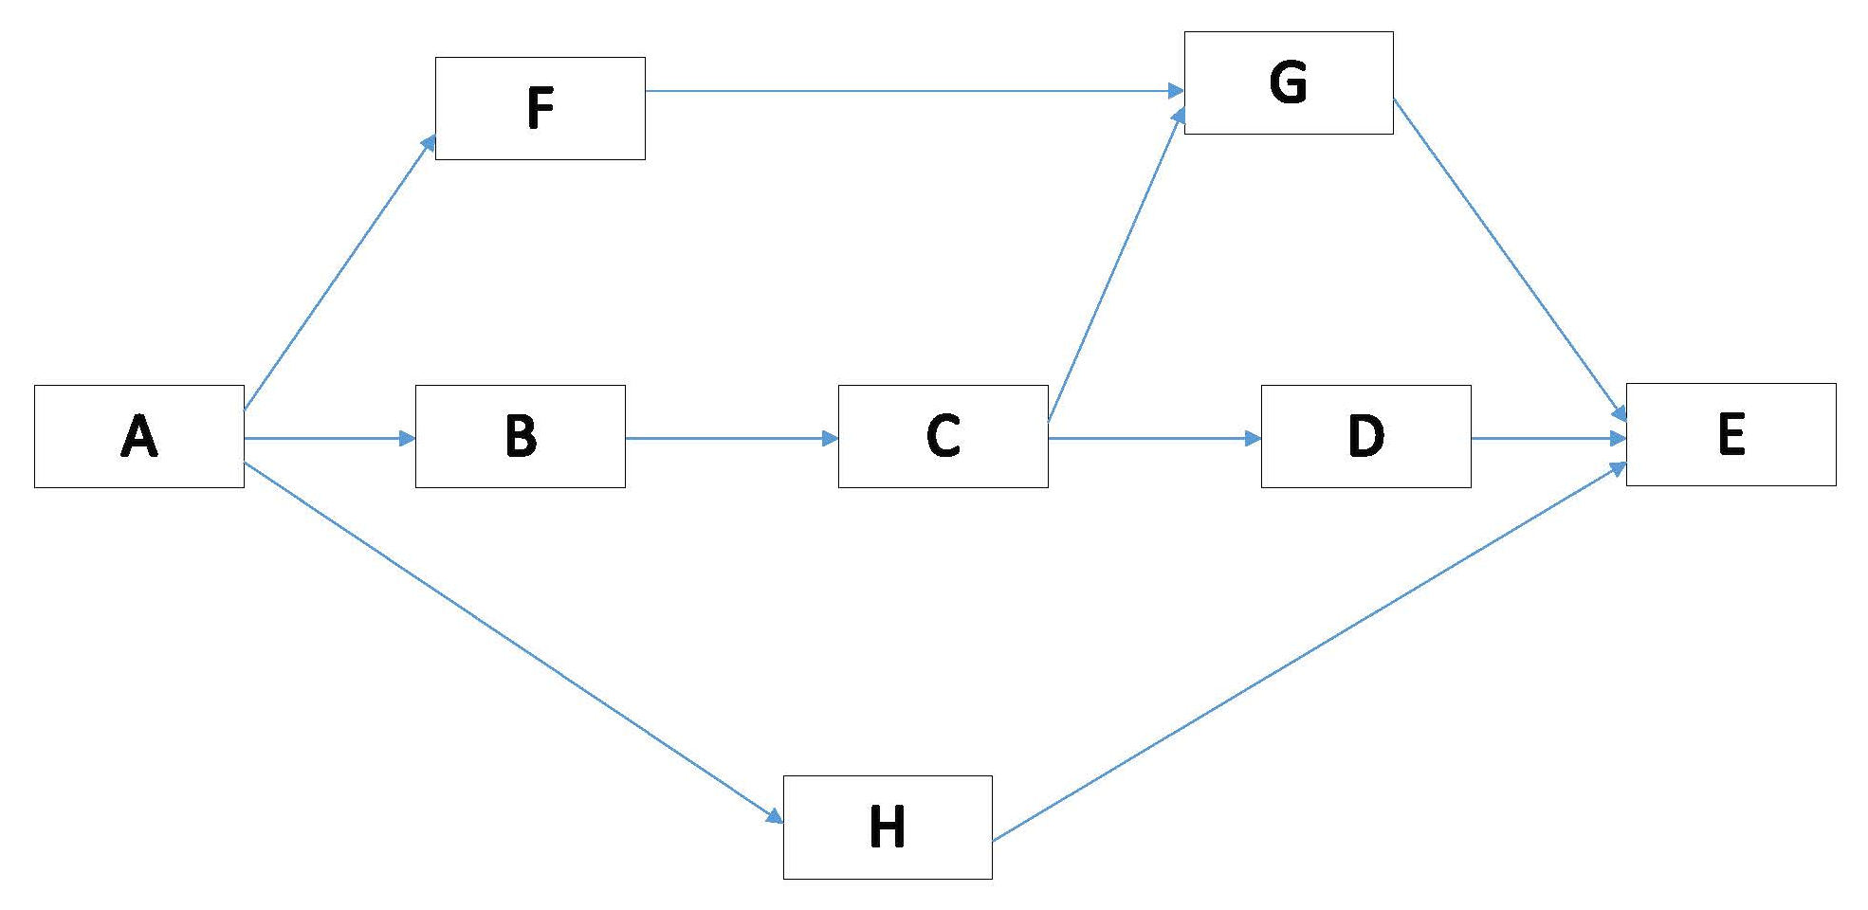
Why do We Need to Learn CPM?
In the last module we have learned how to develop network diagrams : AOA and AON
Provide activities relationships only
But we schedule to know project duration, identify “critical” activities (meaning that they have to be done on time or else the whole project will take longer), and how resources should be allocated to meet project goals
Popular method to accomplish those objectives is load up AON diagram with activity duration → Critical Path Method (CPM) – widely used project management tool

Slide 4
History of CPM?
In 1956 - Dupont chemical company and computer firm Remington Rand - Critical Path Method
In 1958, the U.S. Navy’s Special Projects Office, together with aerospace company Lockheed Missile Systems and consultancy firm Booz Allen & Hamilton, developed Program Evaluation Review Technique, called PERT, for the Polaris missile program
NASA used the critical path method to help determining a efficient schedule for the tasks that led to the moon landing
Critical path method is one of the frequently used techniques in project planning

Slide 5
What is Critical Path Method (CPM)?
The Critical Path Method or Critical Path Analysis, is a graphical, logical and mathematically based algorithm for scheduling a set of project activities
Commonly used with all forms of projects, including construction, software development, research projects, product development, engineering, and plant maintenance, among others
Any project with interdependent activities can apply this method of scheduling

Slide 6
Basics of CPM
The essential technique for using CPM is to construct a model of the project that includes the following:
A list of all activities required to complete the project (also known as Work Breakdown Structure)
Resources needed to work on the activities
The time (duration) that each activity will take to finish
The dependencies between the activities

Slide 7
Basics of CPM
CPM calculates
Determines “critical” activities (on the longest path)
The earliest and latest that each activity can start and finish without making the project longer
The “Critical Path” longest path of planned activities from start to the end of the project
Prioritize activities for the effective management and to shorten the planned critical path of a project by:
Pruning critical path activities
“Fast tracking" (performing more activities in parallel)
“Crashing the critical path" (shortening the durations of critical path activities by adding resources)

Slide 8
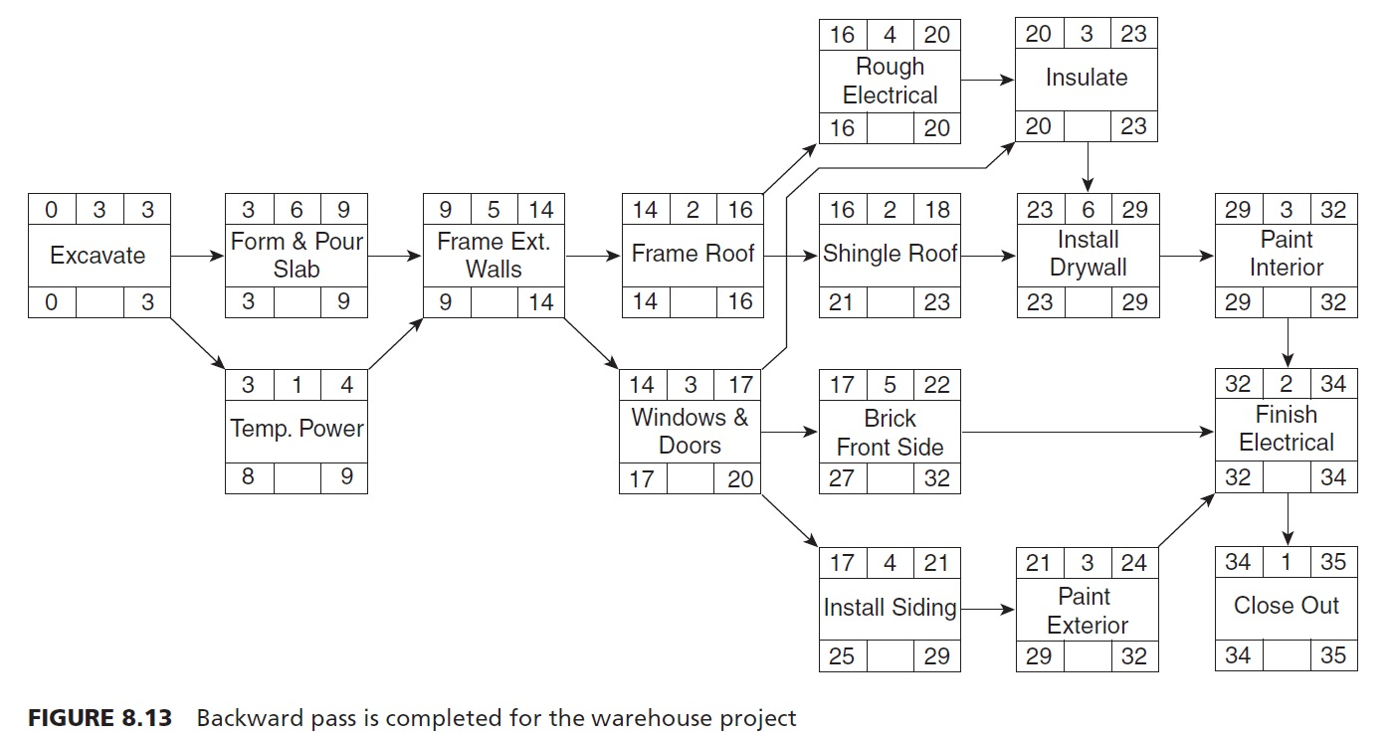
Basics of CPM
CPM provides the following benefits:
Shows the Logic
Identifies the Critical Activities
Allows Management to set Priorities
Shows the Effects of a Change Order or Delay
Easy to Follow Visually – See the Big Picture
Useful for Court Cases – Keeps You Out of Court
Communicates the Process to Every Team Member
Read handout “Introduction to CPM Scheduling”

Slide 9
Basics of CPM
CPM has following disadvantages:
Can Become Complex - It is the Most Sophisticated Scheduling System
Requires Training to Become an Effective User
Due to Not Fully Understanding CPM and Its Complexity, It is Often Abandoned
Read handout “Introduction to CPM Scheduling”

Slide 10
How to Create a CPM Schedule?
In general, the preparation of a CPM schedule includes the following five steps:
Determine the work activities: Any project, no matter how large or small, must be divided into smaller entities, called activities, or tasks
Determine activities’ resources: labor (human), materials, and equipment
Determine activities’ durations: time estimates for each operation
Determine logical relationships: SS, SF, FS, FF, lag and lead
Draw the logic network, and perform the CPM calculations
Calculate earliest possible start date, earliest possible finish date , latest start & finish
Calculate “free float” and “total float”

Slide 11
Work Breakdown Structure (WBS)
Most projects for which formal schedules are prepared tend to be defined with dozens or even hundreds or thousands of activities
When the tasks become numerous, the schedule development becomes more haphazard, and omissions are sure to occur
If one or a series of activities are left out, the adverse impact on the schedule could be quite significant. A more logical tactic is the divide-and-conquer approach
This can be virtually assured if the preparation of the schedule is done in a systematic manner. One such approach is to use a work breakdown structure (WBS) to describe the entire scope of work

Slide 12
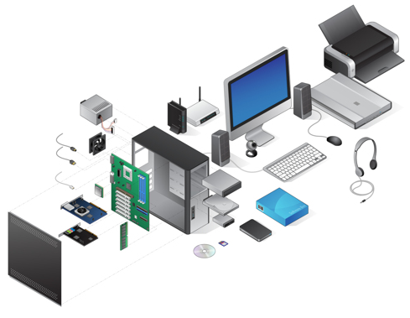
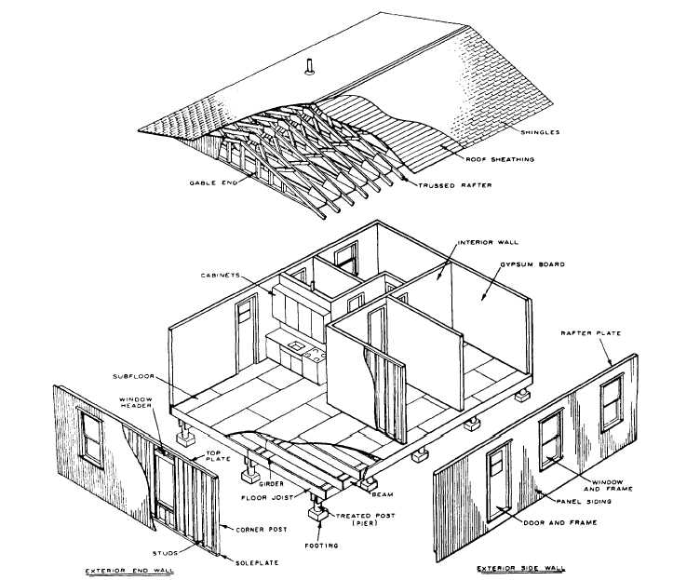
Work Breakdown Structure (WBS)

Slide 13
Work Breakdown Structure (WBS)
WBS is a systematic way of describing the components of a project schedule.
For example, in a typical building the WBS would contain such systems as the site work; structure; mechanical, electrical, and plumbing (MEP); interior finishes; and roofing system.
Developing the WBS begins with the definition of the major systems or components of a project. Then each system is defined in greater and greater detail until there exists a discrete or measurable piece of work and a single responsibility.

Slide 14
Work Breakdown Structure (WBS)
How to Create a Work Breakdown Structure
Creating a work breakdown structure (WBS) helps you be both comprehensive and specific when managing a project
The highest level in the WBS may consist of a single element, the project. At the next level there may be five or ten elements or items. Naturally, the further one goes down the WBS, the greater the amount of detail.
Regardless of the means used to define the elements, the schedule activities are to be defined for the lowest level in the hierarchy or at the greatest level of detail that is required to adequately manage and control the construction process

Slide 15
Work Breakdown Structure (WBS)
Example 1:
Develop a WBS for construction of a house
Step 1: Define the project’s end product. This is usually no more than a title: “House at Avenue Drive” for example. It forms the root of the Work Breakdown Structure document
Step 2: Define the main deliverables. These are the main components of the project’s end product, for example, for a house, External construction, Internal construction, and so on. These become sections or ‘main branches’ under the root, defined in the previous step
Level 1
Level 1
Level 2

Slide 16
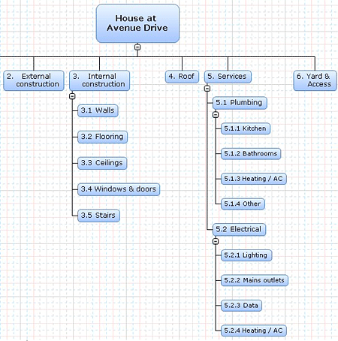
Work Breakdown Structure (WBS)
Example 1 (continue):
Step 3: Break down the main deliverables into their sub-components using as many sub-branches as needed until you have manageable ‘units of work’ which do not need to be subdivided further. These units of work should be of a size that the project manager can easily handle. For example, something that a worker or a team of workers can accomplish in a week might represent a unit of work. Too much subdivision is counter productive as the project manager will then have to get too involved in the project details.
Remember activities in the lowest level are the activities that are used in project scheduling
Level 1
Level 2
Level 3
Level 4

Slide 17
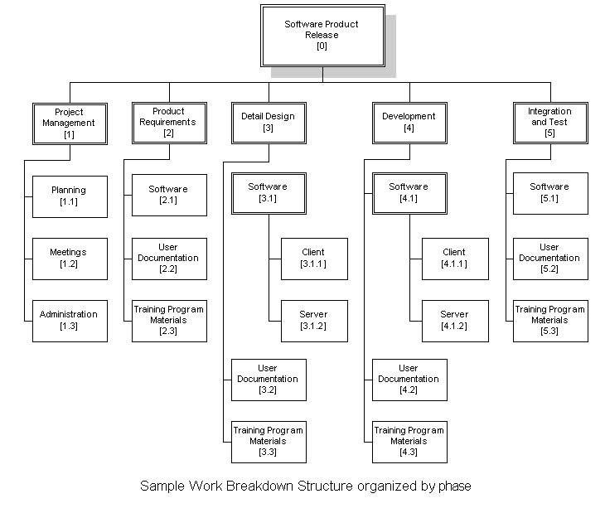
Work Breakdown Structure (WBS)
Example 2:
WBS for a software
Product release

Slide 18
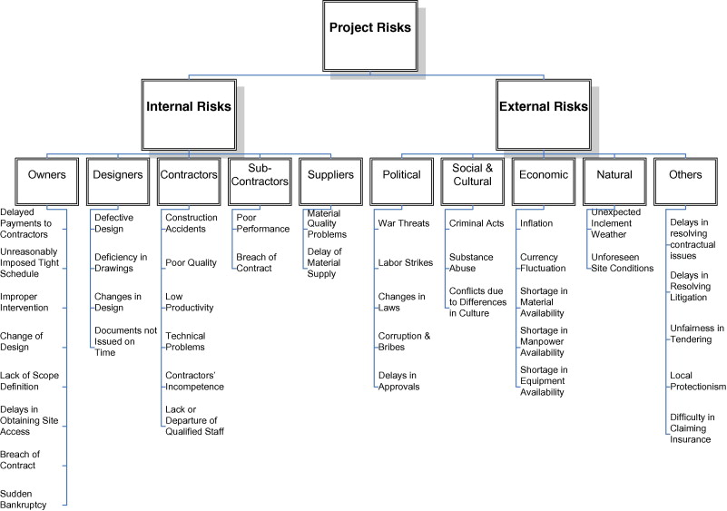
Work Breakdown Structure (WBS)
Example 4:
Project Risks WBS

Slide 19
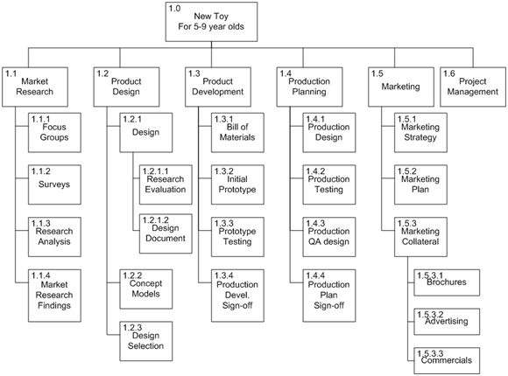
Work Breakdown Structure (WBS)
Example 3:
New Product Development WBS

Slide 20
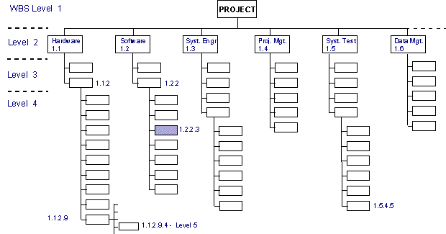
Work Breakdown Structure (WBS)
WBS Numbering
1.3.3
1.3.4.5

Slide 21
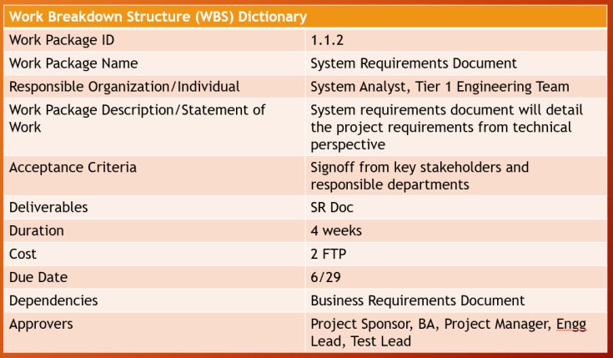
Work Breakdown Structure (WBS)
WBS Dictionary
The WBS dictionary is a document that provides detailed deliverable, activity, and scheduling information about each component in the WBS. The WBS dictionary is a document that supports the WBS. Information in the WBS dictionary may include, but is not limited to:
Code of account identifier,
Description of work,
Assumptions and constraints,
Responsible organization,
Resources required,
Cost estimates,
Quality requirements,
Acceptance criteria,
Technical references, and
Agreement information.

Slide 22
Work Breakdown Structure (WBS)

Slide 23
Resource Allocation
This step identifies the type, quantity, and characteristics of resources required to complete the activity which allows more accurate cost and duration estimates

Slide 24
Resource Allocation
The Three Categories of Resources
1. Human Resource/Labor
Salaried vs hourly/temp workers
2. Equipment
Work equipment vs installed equipment
3. Materials
Construction materials vs installed materials

Slide 25
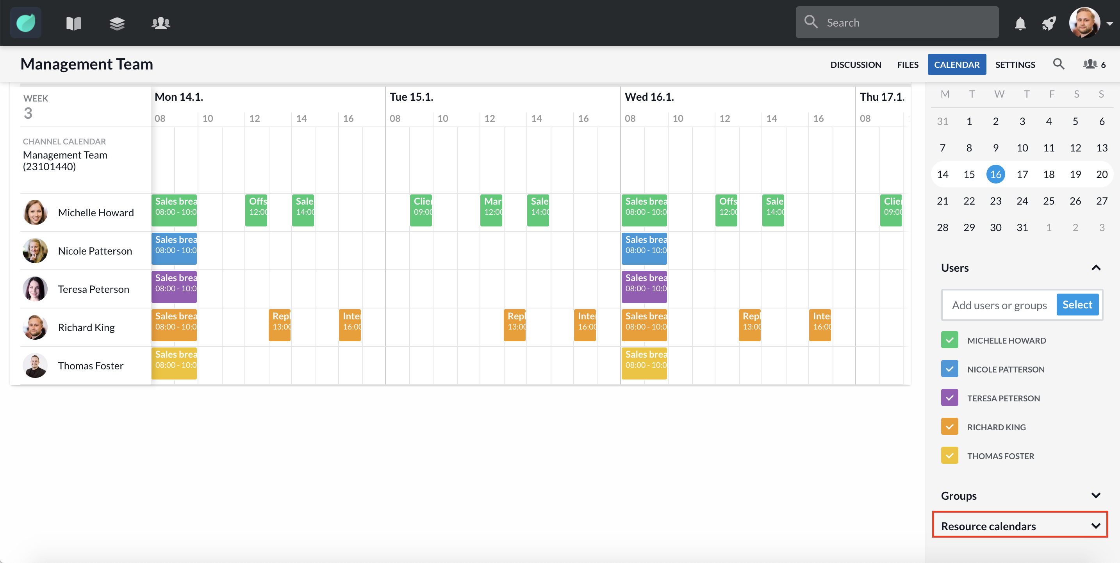
Resource Allocation
Resource Calendar
A resource calendar is a calendar that identifies the working days and shifts on which each specific resource is available
Resource’s productivity
Published productivity information from commercial databases
Risks
Internal and external

Slide 26
WBS and Resource Allocation
Let’s develop a WBS for your project and activity resource needs
Level | WBS Code | Activity Name | Activity Description | Resources
 |  |  |  | Labor | Equipment | Materials

