Slide 1
Creating Data Summary and Data Visualization

Slide 2
Learning Objectives
Compute and interpret the mean, variance, standard deviation, median, and range
Construct and interpret visual data displays, including stem-and-leaf display, histogram, and the box plot

Slide 3
Exploratory Data Analysis

Slide 4
Basic Methods of Collecting Data
Three basic methods of collecting data:
A retrospective study using historical data
Data collected in the past for similar/other purposes.
Example: Historical data collected by NHTSA
https://explore.dot.gov/views/DV_FARS_PV/Home?%3Aembed=y&%3Aiid=1&%3AisGuestRedirectFromVizportal=y
An observational study
Data, presently collected, by a passive observer.
Example: Survey
A designed experiment
Data collected in response to process input changes.
Example: Engineering lab experiments

Slide 5
What is Data Cleaning?
Data cleaning is the process of fixing or removing incorrect, corrupted, incorrectly formatted, duplicate, or incomplete data within a dataset.

Slide 6
What is Data Cleaning?
Data cleaning is the process of fixing or removing incorrect, corrupted, incorrectly formatted, duplicate, or incomplete data within a dataset.
How to clean data?
Step 1: Remove duplicate or irrelevant observations
Step 2: Fix structural errors
Step 3: Filter unwanted outliers
Step 4: Handle missing data
Step 5: Validate and QA

Slide 7
Numerical Summaries of Data
Data summaries and displays are essential to good statistical thinking
It is useful to describe data features numerically
We describe the collection in terms of shape, outliers, center, and spread (SOCS).
The center is measured by the mean.
The spread is measured by the variance.

Slide 8
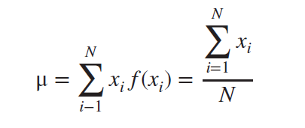
Sample Mean
The location or central tendency in the data can be characterized by the arithmetic average or the sample mean.
For a finite population with $N$ equally likely values, the probability mass function is $f(x_{i})=1/N$and the mean is

Slide 9
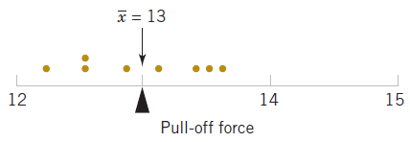
Example 6.1 | Sample Mean
Consider 8 observations $(xi)$ of pull-off force from engine connectors as shown in the table.
Figure 6.1 The sample mean is the balance point.

Slide 10
Sample Variance and Standard Deviation
The variability or scatter in the data may be described by the sample variance or the sample standard deviation.
The units of measurement for the sample variance are the square of the original units of the variable, while the standard deviation measures variability in the original units.

Slide 11
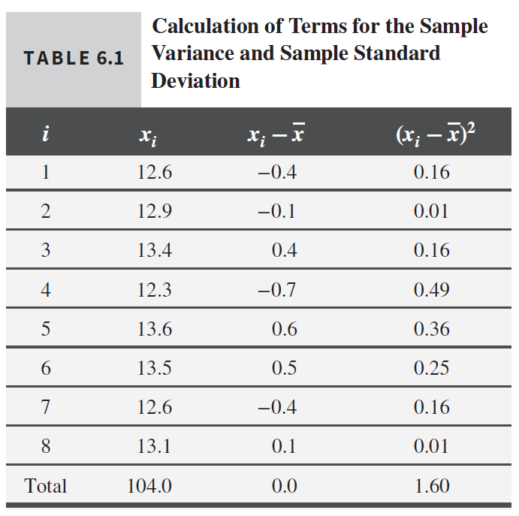
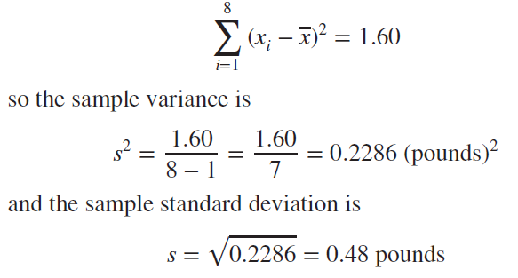
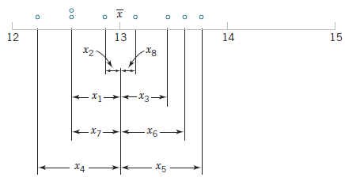
Example 6.2 | Sample Variance
The table displays the quantities needed for calculating the sample variance and sample standard deviation.
The numerator of $s^{2}$ is

Slide 12
Shortcut Computation of $s^{2}$
The prior calculation is definitional and tedious. A shortcut is derived here and involves just 2 sums.

Slide 13
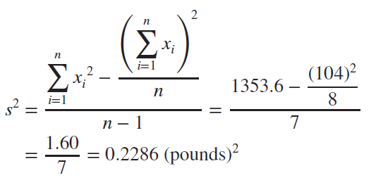
Example 6.3 | Shortcut Computation of $s^{2}$
For Example 6.2, we calculate the sample variance and standard deviation using the shortcut method.

Slide 14
The meaning of $n−1$ in the denominator
The population variance is calculated with $N$, the population size. Why isn’t the sample variance calculated with $n$, the sample size?
The true variance is based on data deviations from the true mean, $μ$.
The sample calculation is based on the data deviations from $\overline{x}$, not $μ$.
$\overline{x}$ is an estimator of $μ$; close but not the same.
So, the $n−1$divisor is used to compensate for the error in the mean estimation.

Slide 15
Standard Error of Mean
By calculating standard error, you can estimate how representative your sample is of your population and make valid conclusions.
A high standard error shows that sample means are widely spread around the population mean—your sample may not closely represent your population. A low standard error shows that sample means are closely distributed around the population mean—your sample is representative of your population.

Slide 16
Sample Range
In addition to the sample variance and sample standard deviation, the sample range is a useful measure of variability.
For Example 6.3 (pull-off force data), the sample range is $r=13.6−12.3=1.3$.

Slide 17
Coefficient of Variance
The coefficient of variation (CoefVar) is a measure of spread that describes the variation in the data relative to the mean.
$$CV= \frac{σ}{μ}$$
For Example 6.3 (pull-off force data), the coefficient of variation CV$=0.48/13.0=0.0369$.

Slide 18
Practice Example
A quality control engineer needs to ensure that the caps on shampoo bottles are fastened correctly. If the caps are fastened too loosely, they may fall off during shipping. If they are fastened too tightly, they may be too difficult to remove. The target torque value for fastening the caps is 18. The engineer collects a random sample of 68 bottles and tests the amount of torque that is needed to remove the caps.
As part of the initial investigation, the engineer analyzes the descriptive statistics of the torque measurements to assess the distribution of the data from each machine.

Slide 19
Practice Example
Using Microsoft Excel
You will need Analysis ToolPak. If you don’t have it, go to File > Options > Add-ins > select Analysis ToolPak > Go > OK. It should be available under Data Menu
Open the sample data, CapTorque.xlsx.
Choose Data > Data Analysis > Descriptive Statistics.
In Input Range, select all data including the col heading.
Grouped by Columns, Check Labels in First Row.
In Output Range, select an empty cell next to the data.
Check Summary statistics box.
Click OK.

Slide 20
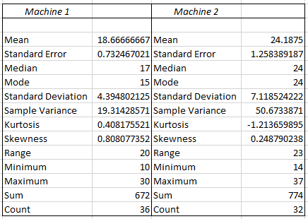
Practice Example
Interpret the results
The mean torque value for Machine 1 is closer to the target of 18 than the mean torque value for Machine 2. The mean torque required to remove caps from Machine 1 is 18.667, and the mean torque required to remove caps from Machine 2 is 24.19. The distribution of data from Machine 1 also is less variable. The standard deviation is 4.395 for Machine 1 and is 7.12 for Machine 2.

Slide 21
Graphical Presentation of Data
Dot Plot
Stem-and-Leaf Diagram
Histogram
Pareto Chart
Box Plot
Time Sequence Plot
Scatter Diagram
Probability Plot

Slide 22
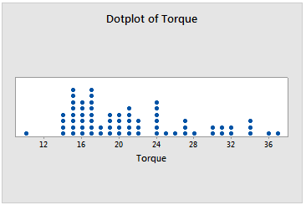
Dot Plot
When to use: Use Dotplot to assess and compare sample data distributions.
A dotplot divides sample values into small intervals and represents each value or small group of values with a dot along a number line.

Slide 23
Practice Example
Using Microsoft Excel
Open the sample data, CapTorque.xlsx.
In Col B, select the cell next to 14.
Enter this equation =COUNTIF($A$2:$A2,A2) and drag it down to row 37.
Select all the data > Insert > Recommended chats > Scatter.
Delete y axis and extend the length of the graph.

Slide 24
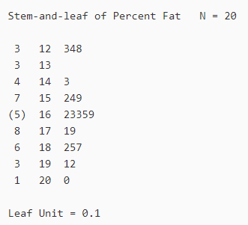
Stem-and-Leaf Diagrams
When to Use: Stem-and-Leaf Plot to examine the shape and spread of sample data. A stem-and-leaf plot is similar to a histogram that is turned on its side. However, instead of displaying bars, a stem-and-leaf plot displays digits from the actual data values to denote the frequency of each bin (row).

Slide 25
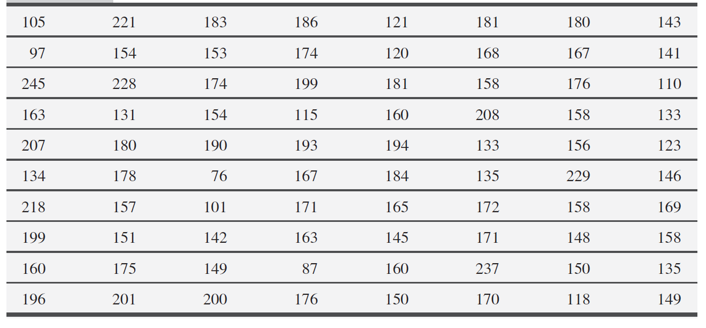
Practice Example
Compressive Strength of an Alloy
Consider the data in the table below. We select stem values the numbers 7, 8, 9, …, 24.

Slide 26
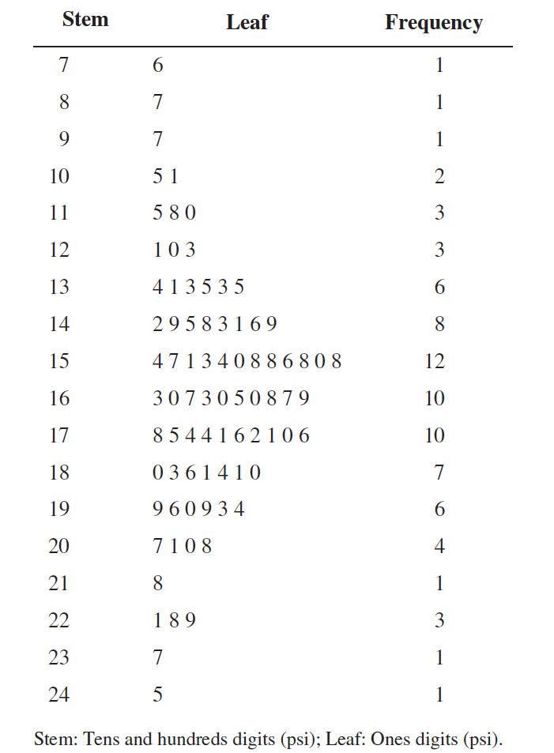
Practice Example
The resulting stem-and-leaf diagram is shown.
Inspection of the diagram reveals that most of the comprehensive strengths lie between 110 and 200 psi and that a central value is somewhere between 150 and 160 psi.
The strengths are distributed approximately symmetrically about the central value

Slide 27
Frequency Distributions and Histograms
A frequency distribution is a more compact summary of data than a stem – and – leaf diagram
To construct, we must divide the range of the data into intervals, which are usually called class intervals, cells, or bins
Choosing number of bins approximately equal to the square root of the number of observations often works well in practice

Slide 28
Practice Example
Frequency Distribution for the Compressive Strength of an Alloy

Slide 29
Histograms
A histogram is a visual display of the frequency distribution
Provides a visual impression of the shape and distribution of the measurements and information about the central tendency and scatter or dispersion in the data
A histogram looks similar to a bar chart but it is for quantitative data.
Follow these steps to create a Histogram
Group the data into class intervals (also known as bin). Label the bin boundaries on a horizontal axis
Then create a tally to show the frequency (or relative frequency) of the data into each interval. The relative frequency is the frequency in a particular class divided by the total number of observations.
Above each bin, draw a rectangle where height is equal to the frequency (or relative frequency) corresponding to that bin.

Slide 30
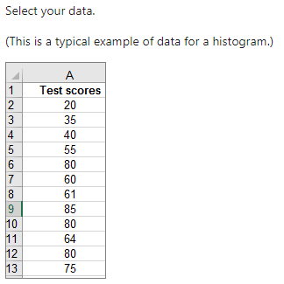
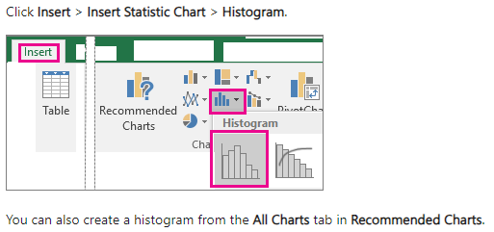
Histograms
Creating a Histogram in Excel
Step 1
Step 2

Slide 31
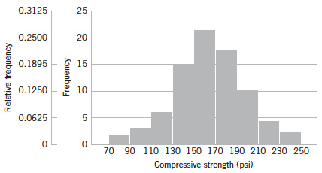
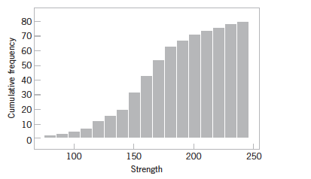
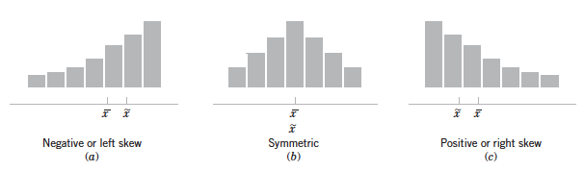
Histograms
Histogram of compressive strength for 80 copper-zinc alloy
A cumulative distribution plot of compressive strength for 80 copper-zinc alloy
Histograms for symmetric and skewed distribution

Slide 32
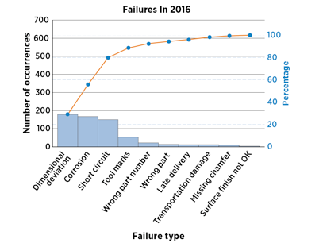
Pareto Chart
A Pareto chart is a bar graph which visually depicts which situations are more significant.
The lengths of the bars represent frequency or cost (time or money), and are arranged with longest bars on the left and the shortest to the right.

Slide 33
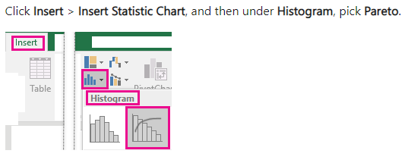
Pareto Chart
Creating Pareto Chart in Excel
Step 1: Select your data. Typically, you select a column containing text (categories) and one of numbers. A Pareto chart then groups the same categories and sums the corresponding numbers.
Step 2: Click Insert > Charts, and then under Histogram, pick Pareto.

Slide 34
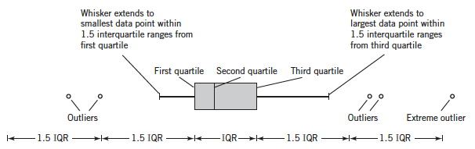
Box Plots
The box plot is a graphical display that simultaneously describes several important features of a data set, such as center, spread, departure from symmetry, and identification of unusual observations or outliers
Sometimes called box – and – whisker plots
Displays three quartiles
A line, or whisker, extends from each end of the box

Slide 35
Box Plots
Why use a box plot?
Box plots can help you visualize the distribution of values, identify outliers and compare different categorical values.
These diagrams are practical in various statistical applications

Slide 36
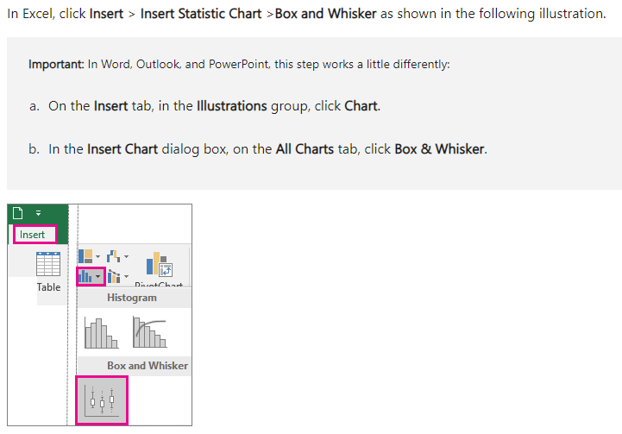
Box Plots
Creating Box-Plot using Excel
Select your data—either a single data series, or multiple data series.

Slide 37
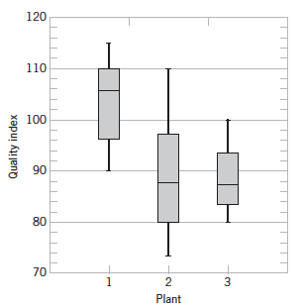
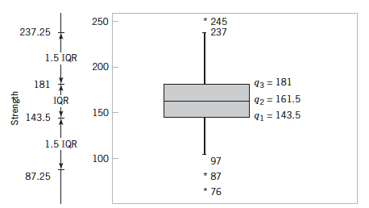
Box Plots
Box plot for compressive strength data
Comparative box plots of a quality index at three plants. Quality index of plant is better than other two plants

Slide 38
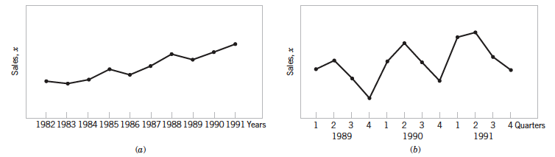
Time Sequence Plots
A time series or time sequence is a data set in which the observations are recorded in the order in which they occur
A time series plot is a graph in which the vertical axis denotes the observed value of variable and the horizontal axis denotes the time

Slide 39
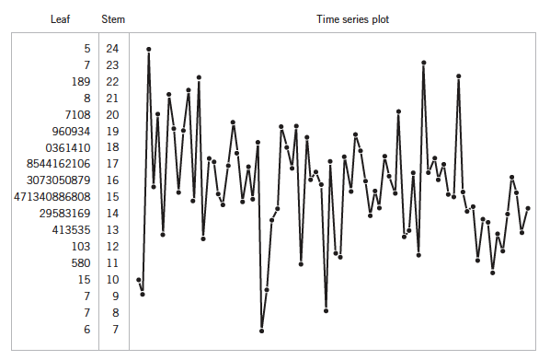
Time Sequence Plots
Combination of stem – and – leaf plot with a time series plot is a digidot plot

Slide 40
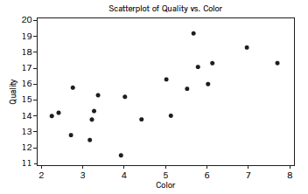
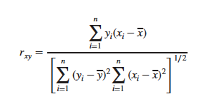
Scatter Diagrams
Multivariate: each observation consists of measurements of several variables
The scatter diagram is a useful way to graphically display the potential relationship between two variables
When two or more variables exist, the matrix of scatter diagrams may be useful in looking at all of the pairwise relationships between the variables in the sample
The sample correlation coefficient is a quantitative measure of the strength of the linear relationship between two random variables x and y

Slide 41
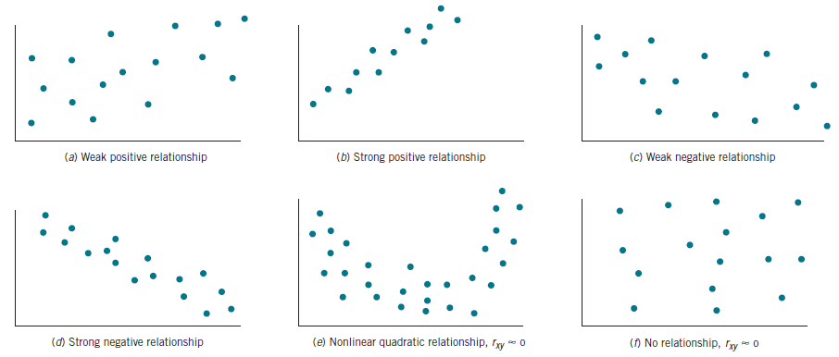
Scatter Diagrams and relationships

Slide 42
Creating Scatter plot in excel
Watch the following video
https://www.khanacademy.org/math/ap-statistics/bivariate-data-ap/scatterplots-correlation/v/constructing-scatter-plot

Slide 43
Practice Example | Wine Quality
An example of multivariate data taken from an article on the quality of different young red wines in the Journal of the Science of Food and Agriculture (1974, Vol. 25(11), pp. 1369–1379) by T.C. Somers and M.E. Evans. The authors reported quality along with several other descriptive variables. We show only quality, pH, total SO₂ (in ppm), color density, and wine color for a sample of their wines.

Slide 44
Probability Plots
A probability plot is a graphical method for determining whether sample data conform to a hypothesized distribution based on a subjective visual examination of the data
To construct a probability plot:
Rank the data observations in the sample from smallest to largest: x₍₁₎, x₍₂₎,…, x_{(n)}.
The observed value x_{(j)} is plotted against the observed cumulative frequency (j – 0.5)/n.
The paired numbers are plotted on the probability paper of the proposed distribution.
If the plotted points depict a straight line, then the hypothesized distribution adequately describes the data.

Slide 45
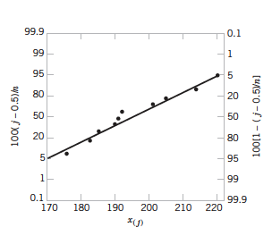
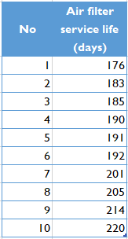
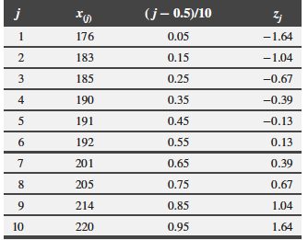
Practice Example | Air Filter
The effective service life ( in days) of air filter used in an airplane engine are given in the table below.
We hypothesize that air filter service life is adequately modeled by a normal distribution.
To test this hypothesis, first arrange the observations in ascending order and calculate their cumulative frequencies and plot them.
Fig: Normal Probability plot for battery life.

Slide 46
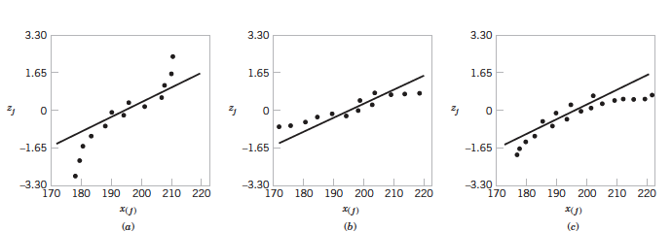
Normal Probability Plot
Following normal probability plots indicate non-normal distribution. In each case data are not closely aligned with the straight line and also exhibit patterns (s curved in (a))
Ideal normal probability plot where data are closely align with the straight line without any pattern.
Indicates light tailed distribution
Indicates heavy-tailed distribution
Indicates positive (or right) skew distribution

Slide 47
Useful links for Data Visualization
https://www.khanacademy.org/math/statistics-probability/displaying-describing-data/quantitative-data-graphs/e/creating-frequency-tables

