Slide 1
Engineering Capstone: Construction Estimating Overview
The following slides will provide a brief overview of the material and equations covered during the Construction Estimating course.
Elissa Ledoux
M. Moin Uddin
Nicholas Matta
Matthew Sheppard

Slide 2
Four Stages of the Estimating Process:
Planning the bid
Pre-bid day activities
Bid-day activities
Post-bid activities

Slide 3
Steps for Preparing Detailed Estimates:
Planning the bid:
Define scope of work.
Schedule the bid.
Assign tasks.
Pre-bid activities:
Order bond.
Request subcontractor quotes.
Perform quantity takeoff (material, labor, equipment prices).
Calculate project overhead.
Prepare bid document.
Bid day activities:
Select subcontractors.
Combine pricing.
Add markups.
Review bid for errors.
Submit bid.
Post bid activities:
Review bid.
Project buyout.
Close-out audit.

Slide 4
Taking Phone Quotes:
Collect project details, subcontractor contact information, bid items, and specifics like addends, inclusions, exclusions, sales tax, and freight.

Slide 5
Fundamentals of Quantity Takeoff
Quantity Takeoff
The process of preparing a complete list of all building components needed for a project, also known as a quantity survey.
Examples include footings, masonry walls, windows, and jobsite overheads like supervision and temporary facilities.

Slide 6
Categories of Materials for Quantity Takeoff
Counted Items: Nonrepetitive and repetitive items.
Linear Items: Measured by length (e.g., footing forms, rebar for continuous footings).
Sheet and Roll Goods: Measured by area (e.g., wall forms, face brick).
Volumetric Goods: Measured by volume (e.g., concrete, excavation).
Quantity-from-Quantity Goods: Estimated based on the quantity of another item (e.g., paint, roofing nails).

Slide 7
Commonly Used Units
Linear feet, square feet, board feet, square yards, cubic yards, acres, each, months, lump sum.
Conversion Factors
1 yard = 3 feet
1 square yard = 9 square feet
1 cubic yard = 27 cubic feet
1 foot = 12 inches

Slide 8
Methods for Calculating Quantities
Repetitive Counted Items: Use mathematical equations for items at both ends, one end, or neither end.
(D) = distance over which the item occurs
(S) = spacing between the items
Ensure both spacing and distance are measured in the same unit
Repetitive Item at Both Ends
Number of Items $=\frac{D}{S}$ + 1
Repetitive Item at One End
Number of items $=\frac{D}{S}$
Repetitive Item at Neither End
Number of Items $=\frac{D}{S}$ - 1

Slide 9
Linear Components
Calculate based on length, considering butt joints and lap joints.
Measured by length
Common units: linear feet (feet), each
Examples: footing forms, rebar for continuous footings, steel handrails, fencing, etc.
Number of Pieces: Number of Pieces = $\frac{L}{Le}$
(L) = Length of linear component
(L_{e}) = Effective length = distance between the start of the pieces
Butt Joint: no overlapping
L_{e} – length of a piece (L_{p})
Number of pieces = $\frac{L}{Lp}$
Lap Joint: overlapping
L_{e} = length of piece (L_{p}) – Lap
Number of pieces = $\frac{L}{(Lp−Lap)}$

Slide 10
Sheet and Roll Goods
Use area method or row and column method, considering butt joints, lapped joints, and spaced joints.
𝑁𝑢𝑚𝑏𝑒𝑟 𝑜𝑓 𝑝𝑖𝑒𝑐𝑒𝑠 = $\frac{A}{Ae}$
L = Area to be covered
Ae = Area covered by one piece including spacing or lap
Butt Joint:
No overlapping, no spacing
A_{e} = Length x Width
Lapped Joint:
Overlapping
A_{e} = (Length – Lap_{Length}) x (Width – Lap_{width})
Spaced Joints:
Spacing between the pieces
A_{e} = (Length + Space_{Length}) x (Width + Space_{Width})

Slide 11
Row and Column Method
Number (N) = Number of rows (N_{rows}) x (N_{columns})
Butt Joint:
N_{rows} = $\frac{Height}{{Height}_{piece}}$
N_{columns} = $\frac{Length}{{Length}_{piece}}$
Lapped Joint:
N_{rows} = $\frac{Height}{{Height}_{piece }− Lap}$
N_{columns} = $\frac{Length}{{Length}_{piece} − Lap}$
Spaced Joints:
N_{rows} = $\frac{Height}{{Height}_{piece} + Space}$
N_{columns} = $\frac{Length}{{Length}_{piece} + Space}$

Slide 12
Volumetric Goods
Calculate volume for different shapes like cylinders, columns, prisms, cones, and pyramids.
Rectangular column: Height x Width x Length
V_{Cylinder} = πR2H
V_{Column} = LWH
V_{Prism} = BHL/2
V_{Cone} = πR2H/3
V_{Pyramid} = LWH/3

Slide 13
Quantity-from-Quantity Goods
Use coverage-based or average quantity-based methods.
Quantity = Quantity of material needed
Coverage Based:
Quantity = $\frac{{Quantity}_{base}}{Coverage}$
Quantity_{base}= Quantity of the item that the estimate is based upon
Coverage = coverage of the material needed
Average Quantity Based:
Quantity = Quantity_{base} x Average Quantity required
Quantity_{base}= Quantity of the item that the estimate is based upon
Average Quantity required = Average quantity needed to cover one unit of base material

Slide 14
Waste Management
Avoidable Waste: Due to improper use, lost or damaged materials, and discrepancies between actual and design dimensions.
Unavoidable Waste: Resulting from the inability to use scrap materials.
Formula for calculating waste:
Quantity_{with waste} = Quantity _{without waste}(1 + $\frac{Waste percentage}{100})$
Waste percentage can be obtained from the historical data or experience

Slide 15
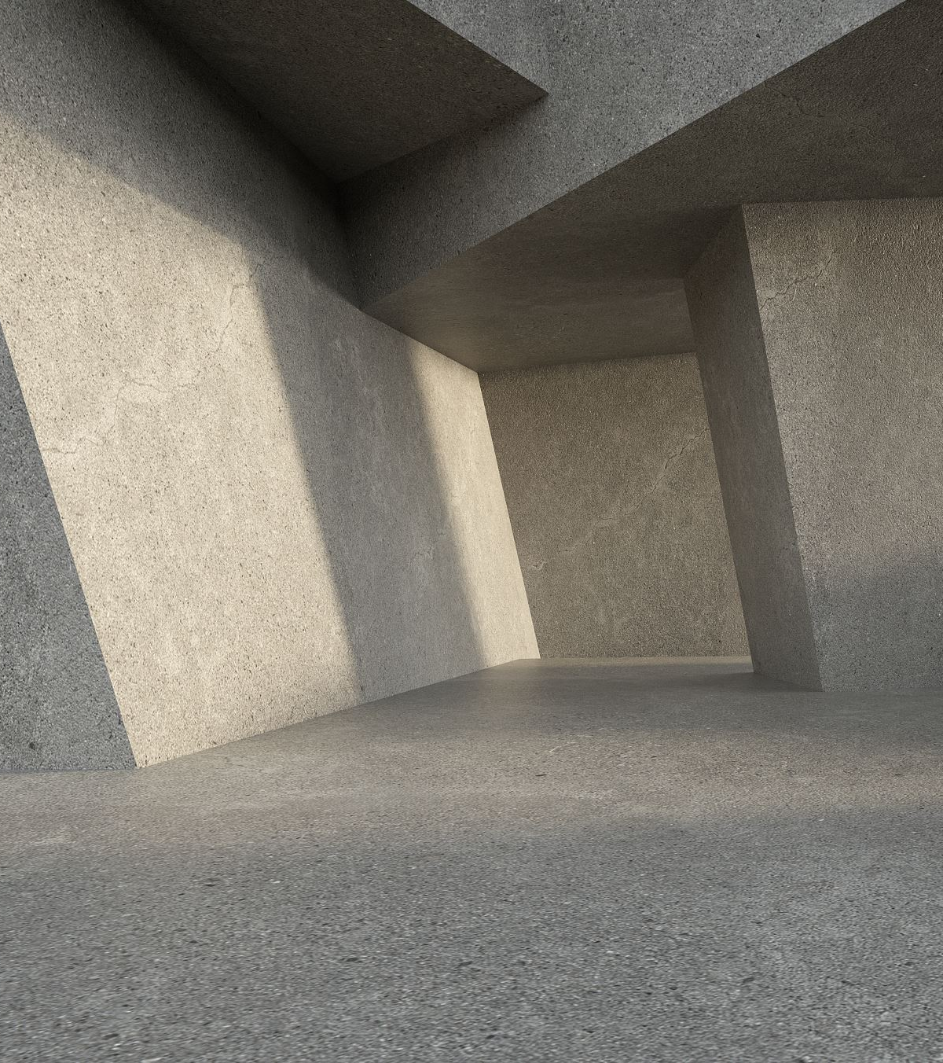
Concrete
Components of Concrete Works
Forms: Measured in square feet, linear feet, or sets. Include all sides.
Reinforcing: Includes rebar, rebar chairs, welded wire fabric (WWF), and wire ties.
Concrete: Consider admixtures, weather, and waste (typically 5-10%).

Slide 16
Specific Concrete Elements
Spot (Column) Footings:
Concrete is a volumetric good (Volume = Height × Width × Length).
Forms are linear or sheet goods depending on height.
Rebar and dowels are counted items.
Columns:
Rectangular: Concrete is volumetric, forms are linear/sheet goods, rebar and ties are counted.
Round: Concrete volume calculated using:
π (Diameter/2)² × Height.
Continuous Footings:
Concrete is volumetric.
Forms are linear or sheet goods.
Rebar includes cross bars, dowels (counted items), and continuous bars (linear goods).

Slide 17
Specific Concrete Elements Cont.
Foundation Walls:
Concrete is volumetric.
Forms are sheet goods.
Rebar includes vertical (counted) and horizontal (linear) rebar.
Beams:
Estimated similarly to walls but include forms on the bottom and specialty rebar like stirrups.
Slab on Grade:
Estimated similarly to walls but include forms on the bottom and calculate the area to be finished.
Raised Slabs:
Concrete is volumetric (Volume = Width × Length × Average Thickness).
Average Thickness (T_{ave})
T_{ave} = T + (W₁ + W₂)D/(2S)
Stairs:
Concrete is volumetric (Volume = Cross Section × Width).

Slide 18
Masonry
Blocks and Structural Brick
Block and Structural Brick: Considered sheet goods.
Vertical Rebar and Rebar Around Openings: Counted items.
Horizontal Rebar: Linear good.
Mortar and Grout: Quantity-from-quantity goods, based on past experience.
Anchor Bolts and Embeds: Counted items.

Slide 19
Brick Veneer
Brick: Considered a sheet good.
Brick Ties: Counted items, needed at the top and corners of walls.
Number of Rows = Height / Spacing
Number of Columns = Length / Spacing + 1
Ties = Number_{Rows} × Number_{Columns}
Mortar: Volumetric good, based on past experience.

Slide 20
Metals
Steel Shapes:
Understanding different steel shapes used in construction.
Weight of Beams and Columns:
Calculating weight using the formula:
Weight = Length × Weight Per Length
Approximate weight is 490 lb/cubic foot.
Connections:
Various types of beam and column connections:
Beam to beam – measure to the center of the beam
Beam to column flange – measure to the column flange
Beam over top of the column – measure across the column
Joists:
Joists are counted items.
Designation and specifications for joists. 24K3 (depth/joist type/section#)
Joist Girders:
Joist girders are also counted items.
Designation and specifications for joist girders. 24G5N8K (depth/girder/# of spaces/Load on each panel point)
Metal Deck:
Metal deck is considered a sheet good.
Trusses and Handrails:
Listing components including welding and bolts.

Slide 21
Woods, Plastics, and Composites
Floor Systems:
Sills: Linear component, must be durable or pressure-treated wood.
Posts, Girders, Joists: Counted items.
Rim Joists, Blocking: Linear components.
Floor Sheathing, Wood Decking: Sheet goods.
Openings: Require doubled trimmers and framing anchors for larger openings.

Slide 22
Walls
Top and Bottom Plates: Linear goods.
Studs: Counted items, with extra studs needed at corners, intersections, and openings.
Headers: Counted items, may require plywood spacers.
Hold Downs, Blocking: Counted and linear components respectively.
Wall Sheathing: Sheet good.

Slide 23
Roof Systems
Rafters, Trusses: Counted item
Common rafter:
Length = (Run² + Rise²)^{0.5} + Width (Rise/Run)
Length = Run (1 + Slope²)^{0.5} + Width(Slope)
Roof Sheathing: Sheet good.
Hip rafter:
Length = Run_{Common}(2 + Slope_{Common}²)^{0.5} + Width(Slope_{Hip})
Fascia: Linear good.
Width_{Fascia}= Width_{Rafter}(1 + Slope²)^{0.5} + Thickness_{Fascia}(Slope)
Soffit: Sheet good.

Slide 24
Finish Carpentry and Cabinets
Trim, Shelving, Cabinets: Counted items.
Paneling: Sheet good

Slide 25
Thermal and Moisture Protection
Shingle Roofs:
Drip Edge: Installed around the perimeter of the roof, considered a linear component.
Field Shingles: Calculations involve the slope of the roof and average width of trapezoid.
Starter
Area_{starter shingles} = Exposure (ft) * Length (ft)
Standard
Area_{standard shingles for field}= Area_{plan}(ft²) * $\sqrt{1+s^{2}}$
s = slope of roof
Cap
𝐴𝑟𝑒𝑎_{𝑐𝑎𝑝 𝑠ℎ𝑖𝑛𝑔𝑙𝑒𝑠 𝑓𝑜𝑟 𝑟𝑖𝑑𝑔𝑒} = 𝐿𝑒𝑛𝑔𝑡ℎ_{𝑟𝑖𝑑𝑔𝑒} ∗ 1𝑓𝑡
𝐴𝑟𝑒𝑎_{𝑐𝑎𝑝 𝑠ℎ𝑖𝑛𝑔𝑙𝑒𝑠 𝑓𝑜𝑟 ℎ𝑖𝑝} = 𝐿𝑒𝑛𝑔𝑡ℎ_{𝐻𝑖𝑝 𝑖𝑛 𝑝𝑙𝑎𝑛} ∗ $\sqrt{1+ s_{h^{2}}}$∗ 1𝑓𝑡
s_{h} = slope of hip

Slide 26
Thermal and Moisture Protection Cont.
Building Paper and Vapor Barriers:
Calculations include the slope of the roof and additional areas for hip/valley in hip roofs.
Length_{sloped} = Length_{plan} * $\sqrt{1+ s^{2}}$
S = slope of roof
Average width of trapezoid
= (W₁+W₂)/2 + W_{felt} + Lap_{End}
Length_{Ridge felt} = Length_{Ridge} + 2*Lap_{End}

Slide 27
Thermal and Moisture Protection Cont.
Vinyl or Aluminum Siding:
Components: Starter strip, outside corner molding, J molding (around openings and at soffit), and siding.
Starter Strip, Corner Molding, and J Molding: Linear components.
Siding: Considered a sheet good. Trapezoidal or triangular portions are approximated by calculating the average length.
Vinyl or Aluminum Siding:
𝐿𝑒𝑛𝑔𝑡ℎ = $\frac{\text{Lengt}\text{h}\text{top}\text{+}\text{Lengt}\text{h}\text{bottom}}{2}$ + $\frac{Exposure}{Slope}$

Slide 28
Earthwork
Characteristics of Soils
Wet Unit Weight (Wet Density): Density of water and solids.
Dry Unit Weight (Dry Density): Density of the solids.
Water Content: Ratio of the weight of water to the weight of solids.
Swell and Shrinkage
Swell Percentage: Soils increase in volume when excavated.
Swell % = (D_{B}/D_{L} – 1)100
D_{B} = Bank dry density (unit weight)
D_{L} = Loose-dry density (unit weight)
Shirkage Percentage: Soils decrease in volume as they are compacted.
Shrinkage % = (1 - D_{B}/D_{C})100
D_{B} = Bank dry density (unit weight)
D_{C} = Compact dry density (unit weight)

Slide 29
Geometric Methods
Average-width-length-depth Method
Volume = (W_{ave})(L_{ave})(D_{ave})
W_{ave}= average width
L_{ave}= average depth
D_{ave}= average depth at bottom of excavation (does not include side slopes)

Slide 30
Average End Method
Volume = L(A₁ + A ₂)/2
L = perpendicular distance between the cross-sections
A₁ = Area of cross-section 1
A₂ = Area of cross-section 2
Volume = L(0.5A₁ + A₂ + A₃ + … + A_{n-1} + 0.5A_{n})
L = Perpendicular distance between the cross sections (must be the same for all cross sections)
A₁ = Area of cross-section 1
A₂ = Area of cross-section 2
A₃ = Area of cross-section 3
A_{n-1} = Area of cross-section n-1
A_{n} = Area of cross-section n

Slide 31
Modified-Average-end Method
Volume = L[A₁ + A ₂ + $\sqrt{A_{1}xA_{2}}$]/3
L = Perpendicular distance between the cross-sections
A₁ = Area of cross section 1
A₂ = Area of cross section 2

Slide 32
Cross Sectional Method
Cross Sectional Method:
Step 1: Divide the site into grids
Equally spaced
Aligned with key features
Step 2: Calculate the cut or fill at each grid intersection
Cut/Fill = Grade_{Proposed} – Grade_{Existing}
Positive = Fill
Negative = Cut

Slide 33
Cross-Sectional Method cont.
Step 3: If existing grade is not known at a grid intersection, it can be calculated by interpolating
Grade_{P} = (Grade₂ – Grade₁ )(Dist_{P-1} )/(Dist₂₋₁ ) + Grade₁
Grade_{P} = Grade at intersection
Grade₁ = Grade of first contour line
Grade₂ = Grade of second contour line
Dist_{P-1} = Distance between the intersection and first contour line
Dist₂₋₁ = Distance between the second and first contour line

Slide 34
Cross Sectional Method cont.
Step 4: Separate the cuts and fills with a zero line
Dist_{C-0} = (Dist_{C-F} )(Cut)/(Cut + Fill)
Dist_{C-0} = Distance from the intersection with a cut to the zero Line
Dist_{C-F} = Distance from the intersection with a cut to the intersection with a fill
Cut = Cut at the intersection with a cut (use a positive sign)
Fill = Fill at the intersection with a fill (use a positive sign)
Step 5: Calculate the volume of the cuts and fills
Cuts and fills calculated separately
Volume_{Cut} = (Cut_{Average})(Area_{Cut})
Cut_{Average} = ∑Cut/Number of cuts
Volume_{Fill} = (Fill_{Average})(Area_{Fill})
Fill_{Average} = ∑Fill/Number of fills
Area = rectangular or triangular areas
Total Volume of cuts and fills

Slide 35
Backfill Volume
V_{Backfill} = V_{Excavation} – V_{Footing} – V_{Column}
V_{Column} = Volume of the column below ground level excluding the footing depth

