Slide 1
Engineering Capstone: PowerPoint Slide Transitions
How to add Dynamic Flow to your Presentation
Elissa Ledoux
M. Moin Uddin
Nicholas Matta
Matthew Sheppard

Slide 2
What Are Slide Transitions?
A slide transition is a visual effect as you move from one slide to the next in a presentation.
They enhance the visual effects of a presentation.
You can alter the speed, add sounds, and customize the transition effects.

Slide 3
Accessing the Transitions Tab
To access transitions, locate ‘Transitions’ on the PowerPoint ribbon.
Use the drop-down arrow to view all the transitions.

Slide 4
Choosing the Right Transition
What are the different transitions
Match transitions to the content and tone of the slide

Slide 5
Applying a Transition
Select the slide you want to add a transition to.
Select the Transitions tab and choose a transition. Select a transition to see a preview.
Select Effect Options to choose the direction and nature of the transition.
Select Preview to see what the transition looks like.
When you select a transition, you will get a preview of its effect.
Experiment with the various transitions to see which one best compliments your presentation.

Slide 6
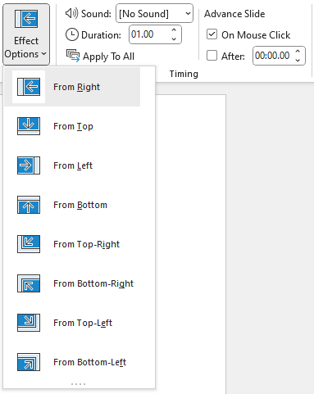
Transition Direction
Some transitions allow you to adjust the direction.
The effect options will be available to change directions on select transitions.

Slide 7
Transition Timing
Adjust the transition speed to speed up or slow down the effect.
The duration of a transition affects the flow of the presentation.
Adjust the timing for different transitions that best suit your needs
You can apply it to all slides; remember that overusing transitions may be distracting.

Slide 8
Transition Sound Effects
Use sound effects sparingly, they may be distracting to the overall presentation.
Think about which sounds are appropriate and be cautious about overusing them.

Slide 9
Avoiding Transition Overload
Moderation is key
Too many transitions can be distracting to the audience

Slide 10
Experiment
Try new things – you can always undo transitions (by selecting the None transition or selecting undo from the ribbon).
The more you practice, the more proficient you become (saving time while editing)

Slide 11
Videos on PowerPoint Transitions
Add/change/remove transitions: https://support.microsoft.com/en-us/office/add-change-or-remove-transitions-between-slides-3f8244bf-f893-4efd-a7eb-3a4845c9c971
Animate Text or objects: https://support.microsoft.com/en-us/office/animate-text-or-objects-305a1c94-83b1-4778-8df5-fcf7a9b7b7c6
Morph Transition: https://support.microsoft.com/en-us/office/use-the-morph-transition-in-powerpoint-8dd1c7b2-b935-44f5-a74c-741d8d9244ea
Source: support.Microsoft.com

