Slide 1
UA.I Regulations
E. OOP
Notes:
Note: This is a long and complex addition to Part 107. There will be a few questions on Category 1, 2, 3, and 4 sUAS on the UAG. Most questions will deal with labeling, kinetic energy impacts. A majority of the content deal with regulatory issues such as Declaration of Compliance and Means of Compliance. It will be up to the educator the depth of coverage of the content.

Slide 2
Topics

Slide 3
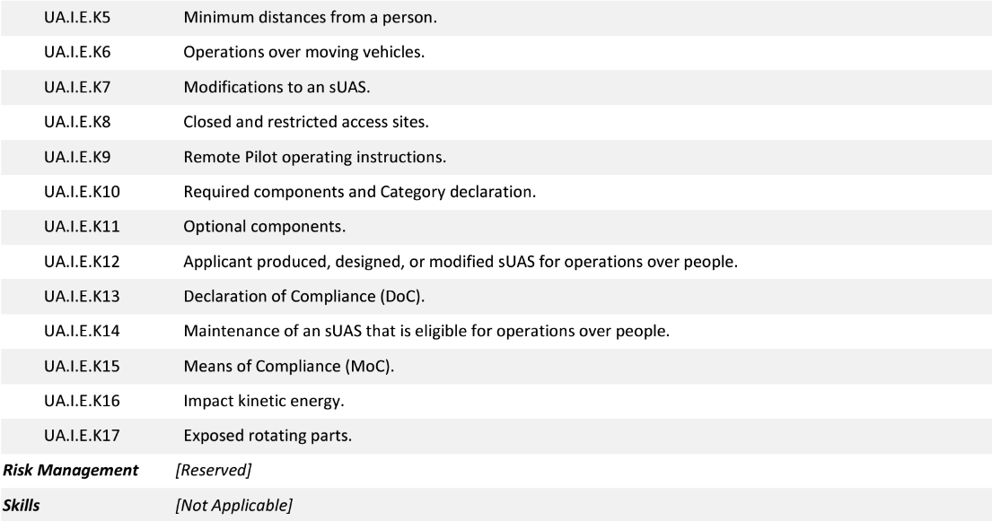
Topics

Slide 4
14 CFR §107—Small Unmanned Aircraft Systems
https://www.ecfr.gov/current/title-14/chapter-I/subchapter-F/part-107

Slide 5
Subpart E—Operations Over People
AC 107-2A.8.13 Remote Pilot Responsibilities When Conducting Operations Over People.
The remote pilot has additional responsibilities when conducting small unmanned aircraft operations over people. In addition to the other operational requirements in part 107, the pilot is responsible for determining he or she is operating a small unmanned aircraft in the appropriate category for the type of operation he or she will conduct. The remote pilot is also responsible for verifying the small unmanned aircraft is properly labeled and listed on an FAA-accepted DOC. The remote pilot should perform all of the recommended preflight actions for all flights described in previous chapters and appendices of this AC.
UA.I.E.K1

Slide 6
Subpart E—Operations Over People
AC 107-2A.8.14 Operations Over People at Night.
The categories and their respective restrictions for operations over people do not change due to conditions of night. The test methods, analyses, or manner of inspection an applicant uses for determining that a small unmanned aircraft meets the performance-based safety requirements are time-of-day neutral. The risk mitigation measures apply equally to day and night operations when operating over people, with specific requirements for both the manufacturer of the small unmanned aircraft and the remote pilot.
8.14.1 If the small unmanned aircraft used in an operation at night is eligible to operate in any category for operations over people listed in part 107 subpart D, then the remote pilot may operate the small unmanned aircraft over human beings at night pursuant to the requirements of §§ 107.29 and 107.39. In declaring any small unmanned aircraft as eligible for operations in Category 2 or 3, manufacturers who produce small unmanned aircraft eligible to operate over people at night will most likely need to consider the mass of an anti-collision light in declaring the small unmanned aircraft fulfills the safety requirements set forth in either §§ 107.120(a) or 107.130(a).
UA.I.E.K2

Slide 7
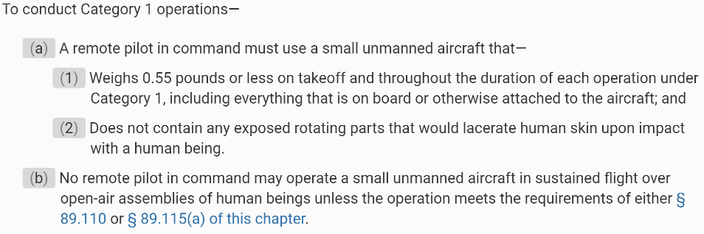
Subpart E—Operations Over People
§ 107.110 Category 1 operations.
UA.I.E.K3a

Slide 8
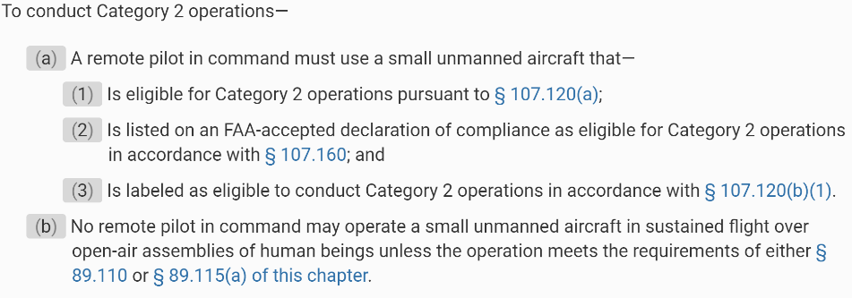
Subpart E—Operations Over People
§ 107.115 Category 2 operations.
UA.I.E.K3b

Slide 9
Subpart E—Operations Over People
§ 107.120 Category 2 operations: Eligibility of small unmanned aircraft and other applicant requirements.
UA.I.E.K3b

Slide 10
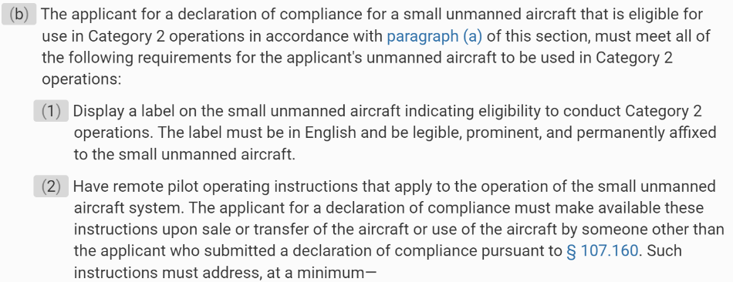
Subpart E—Operations Over People
§ 107.120 Category 2 operations: Eligibility of small unmanned aircraft and other applicant requirements.
UA.I.E.K3b

Slide 11
Subpart E—Operations Over People
§ 107.125 Category 3 operations: Operating requirements.
UA.I.E.K3c

Slide 12
Subpart E—Operations Over People
§ 107.125 Category 3 operations: Operating requirements.
UA.I.E.K3d

Slide 13
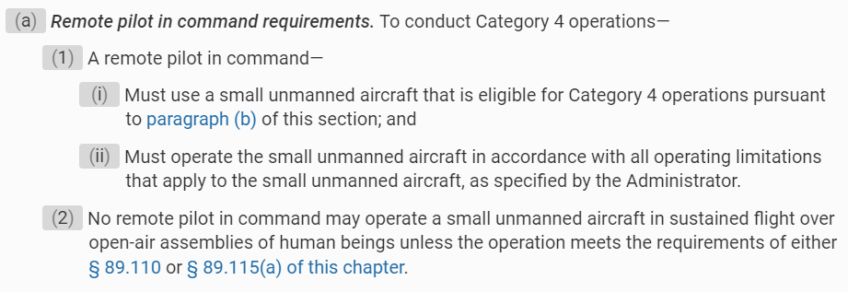
Subpart E—Operations Over People
§ 107.130 Category 3 operations: Eligibility of small unmanned aircraft and other applicant requirements.
UA.I.E.K3c

Slide 14
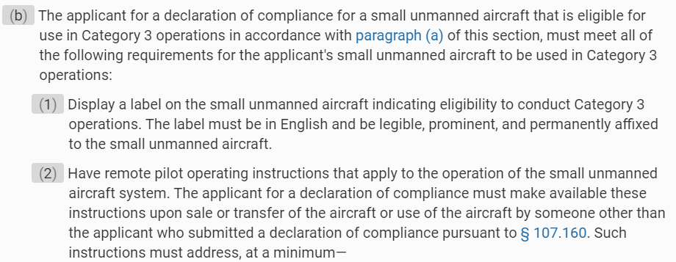
Subpart E—Operations Over People
§ 107.140 Category 4 operations.
UA.I.E.K3d

Slide 15
Subpart E—Operations Over People
AC 107-2A.8.3 Operations Over People.
Selecting an operational location where there are no people and none are expected to be present for the duration of the operation. If the remote pilot selects a location where people are present, the remote pilot should have a plan of action to ensure human beings remain clear of the operating area. The remote pilot may be able to direct people to remain indoors or remain under safe cover until the small unmanned aircraft flight operation has ended. Safe cover is a structure or stationary vehicle that protects a person from harm if the small unmanned aircraft impacts that structure or vehicle.
UA.I.E.K4

Slide 16
Subpart E—Operations Over People
AC 107-2A 8.3.1 Minimum Distances from a Person.
Part 107 does not impose a specific stand-off distance requirement from people when operating a small unmanned aircraft. The remote pilot may elect to observe a minimum stand-off distance to ensure the safety of the operation. When determining an appropriate stand-off distance, the remote pilot should consider the following factors:
• The small unmanned aircraft’s performance, to include course, speed, trajectory, and maneuverability.
• Environmental conditions such as wind, including gusts, precipitation, and visibility.
• Operational area conditions such as the location and movement of people, vessels, or vehicles, as well as terrain features, including structures or any other item that could affect the operational area where the small unmanned aircraft is being maneuvered.
• Probable failures and the ability to perform emergency maneuvers, including emergency landings.
• The remote pilot’s familiarity with and ability to maneuver the small unmanned aircraft.
UA.I.E.K5

Slide 17
Subpart E—Operations Over People
AC 107-2A 8.3.2 Operations Over Open-Air Assembly of People.
Remote pilots are prohibited from operating a small unmanned aircraft as a Category 1, 2, or 4 operation in sustained flight over open-air assemblies, unless the operation meets the requirements of § 89.110 or § 89.115(a). This prohibition is subject to waiver.
8.3.2.1 “Sustained flight” over an open-air assembly of persons in a Category 1, 2, or 4 operation does not include a brief, one-time transiting over a portion of the assembled gathering where the transit is merely incidental to a point-to-point operation unrelated to the assembly.
8.3.2.2 Category 3 operations are not allowed over an open-air assembly of persons.
UA.I.E.K5

Slide 18
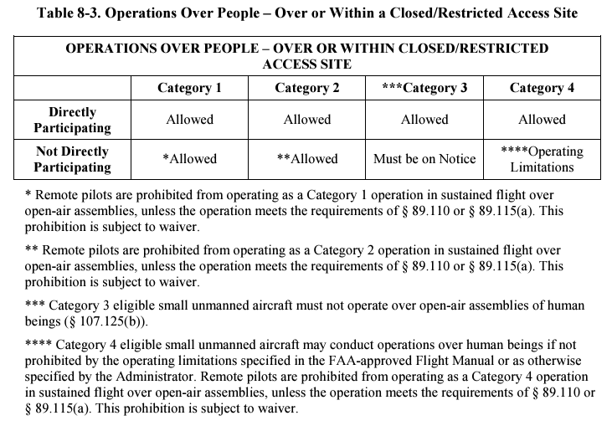
Subpart E—Operations Over People
UA.I.E.K5

Slide 19
Subpart E—Operations Over People
AC 107-2A 8.3.3 Operations Over Moving Vehicles.
Part 107 allows small unmanned aircraft operations over people inside moving vehicles with a small unmanned aircraft that meets the eligibility requirements for a Category 1, 2, 3, or 4 operation subject to one of the following conditions:
8.3.3.1 For Categories 1, 2, and 3 small unmanned aircraft, the operation must be conducted within or over a closed- or restricted-access site. Any person located inside a moving vehicle within the closed- or restricted-access site must be on notice that a small unmanned aircraft may fly over them; or
8.3.3.2 AC 107-2A If the operation is not conducted within or over a closed- or restricted-access site, the small unmanned aircraft must not maintain sustained flight over any moving vehicle.
UA.I.E.K6

Slide 20
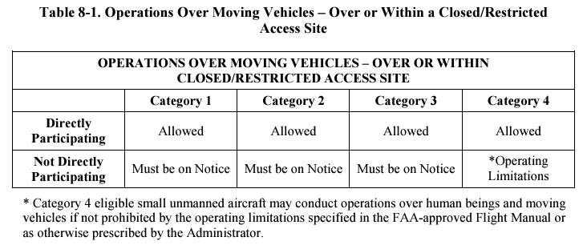
Subpart E—Operations Over People
UA.I.E.K6

Slide 21
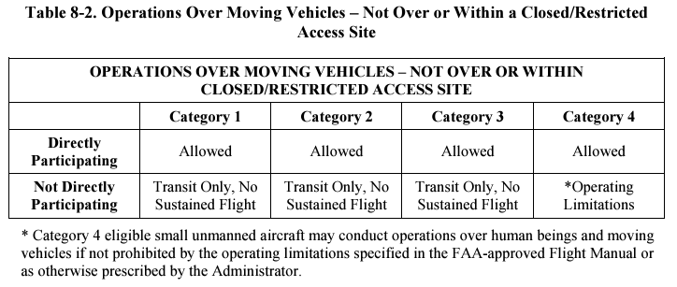
Subpart E—Operations Over People
UA.I.E.K6

Slide 22
Subpart E—Operations Over People
AC 107-2A 8.6.5 Modifications
The remote pilot operating instructions may contain details concerning allowable modifications of the small unmanned aircraft. Modifications not allowed by the remote pilot operating instructions may render the small unmanned aircraft ineligible for operations over people. Such modifications would require submission of a new DOC. Additionally, the small unmanned aircraft may need to be relabeled to reflect the category of operations it is eligible to conduct. In the case of the sale or transfer of the small unmanned aircraft, or use of the aircraft by someone other than the applicant, the applicant must provide remote pilot operating instructions that reflect the aircraft’s eligible category and acceptable modifications. Therefore, the FAA encourages manufacturers of small unmanned aircraft to keep track of modifications that would require an update to the remote pilot operating instructions.
UA.I.E.K7

Slide 23
Subpart E—Operations Over People
AC 107-2A 8.6.6 Closed or Restricted Sites
Category 3 operations may take place over or within closed- or restricted-access sites where everyone located within the site must be on notice that a small unmanned aircraft may fly over them, as long as the operational area is not considered an open-air assembly. People who are not directly participating in the operation of the small unmanned aircraft but who are performing functions at the closed- or restricted-access site must be on notice of potential small unmanned aircraft operations, and should be advised of precautions or other recommended actions to take, if necessary. Remote pilots are responsible for ensuring no inadvertent or unauthorized access to the site occur. Adequate assurance could include physical barriers such as barricading and fencing or monitoring personnel to ensure inadvertent or unauthorized access to the site does not occur. Geographical boundaries, such as rivers, canals, cliffs, and heavily wooded areas may serve as effective barriers to restrict access.
UA.I.E.K8

Slide 24
Subpart E—Operations Over People
AC 107-2A 8.12 Closed or Restricted Sites
The FAA requires applicants to provide remote pilot operating instructions for a small unmanned aircraft eligible to conduct Category 2 or Category 3 operations upon sale or transfer of the small unmanned aircraft, or use of the small unmanned aircraft by someone other than the applicant. In addition, the applicant should keep the instructions up-to-date to account for any changes it makes to a small unmanned aircraft.
UA.I.E.K9

Slide 25
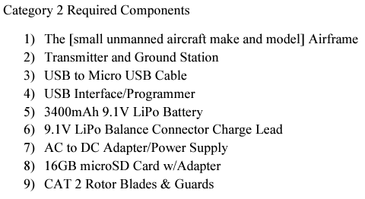
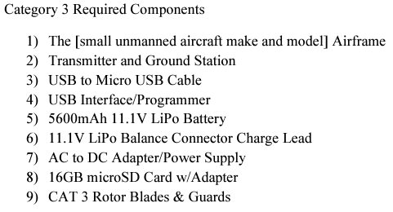
Subpart E—Operations Over People
UA.I.E.K10

Slide 26
Subpart E—Operations Over People
AC 107-2A 8.12.2.2 Optional Components
The [small unmanned aircraft make and model] is already equipped with a high-definition camera. If you intend to conduct operations over people in accordance with Category 2 or Category 3, you may replace the camera only with a pre-approved camera listed in the remote pilot operating instructions, which may be found on the [manufacturer’s] website. Additionally, for operations over people in accordance with Category 2 or Category 3, you may not affix any other payload to the [small unmanned aircraft make and model] unless it is listed in the remote pilot operating instructions, which may be found on the [manufacturer’s] website. Any permissible payload you affix to the small unmanned aircraft must be securely attached throughout the duration of all operations that occur in accordance with Category 2 or Category 3. Failure to adhere to these requirements will result in the ineligibility of the [small unmanned aircraft make and model] to operate over people in accordance with Category 2 or Category 3.
UA.I.E.K11

Slide 27
Subpart E—Operations Over People
AC 107-2A 8.9 Declaration of Compliance
For a small unmanned aircraft to be eligible to conduct Category 2 or 3 operations over people, the person who designs, produces, or modifies the small unmanned aircraft must declare compliance with the appropriate performance-based safety requirements through use of an FAA-accepted MOC. The FAA will receive such DOCs via an electronic form available on the FAA’s website https://uasdoc.faa.gov. Submission of a DOC involves the applicant declaring the following information:
UA.I.E.K12

Slide 28
Subpart E—Operations Over People
AC 107-2A 8.9 Declaration of Compliance
The applicant has demonstrated that the small unmanned aircraft meets the performance-based safety requirements for the category or categories of operation through an FAA-accepted MOC;
The applicant maintains a process to notify owners of small unmanned aircraft and the FAA of any unsafe conditions that render those small unmanned aircraft noncompliant with part 107 subpart D;
The applicant verifies that the small unmanned aircraft does not contain any safety defects; and
The applicant will allow the FAA access to its facilities and technical documents, records, or reports required or witness any test necessary to determine compliance with the DOC.
UA.I.E.K12

Slide 29
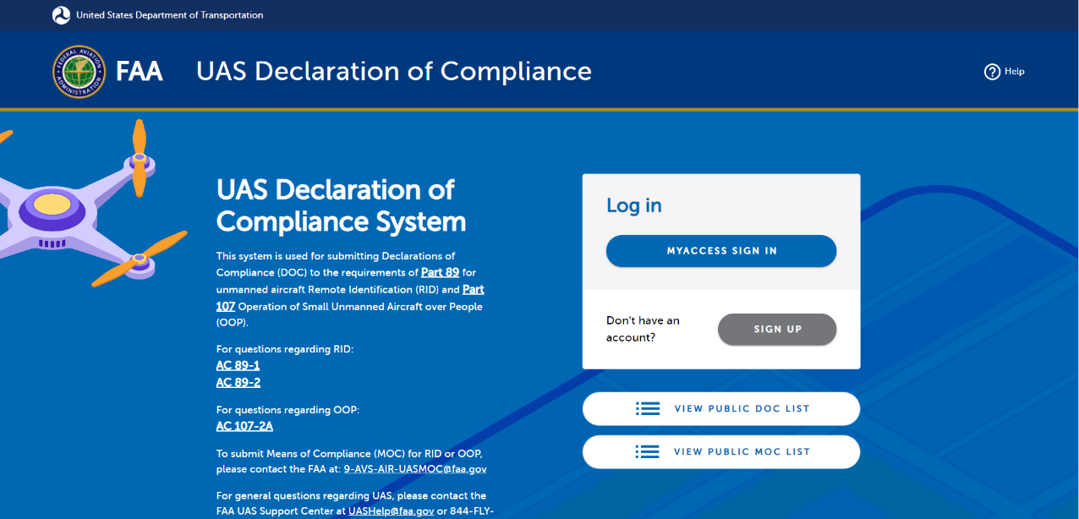
https://uasdoc.faa.gov/login

Slide 30
Subpart E—Operations Over People
AC 107-2A 8.3.7.4 Applicability of Maintenance and Record Retention Requirements
When a remote pilot operates a small unmanned aircraft in accordance with part 107, having an FAA-issued airworthiness certificate under part 21, the requirements of parts 43 and 91 do not apply. However, a small unmanned aircraft issued an airworthiness certificate may be eligible to operate under part 91, under certain circumstances. Part 107 contains necessary updates to the regulatory text to reflect the applicability of operating rules. Category 4 does not prescribe as many maintenance and record retention requirements as are required by parts 43 and 91, respectively. Therefore, it may be difficult for an owner or operator to switch between operating rules. A small unmanned aircraft operated and maintained in accordance with part 107 may find it difficult to show compliance with the requirements of part 43 and 91. To address this concern, an owner or operator can elect to comply with the relevant parts 43 and 91 requirements, even while operating in accordance with part 107. Under these circumstances, electing to comply with the relevant parts 43 and 91 requirements may help facilitate moving back and forth between operational parts, if desired, because the requirements of parts 43 and 91 are more stringent than those of § 107.140 with regard to maintenance and airworthiness.
UA.I.E.K14

Slide 31
Subpart E—Operations Over People
AC 107-2A 8.5 Means of Compliance—General Information
An MOC is a method to show that a small unmanned aircraft does not exceed the applicable injury severity limit upon impact with a human being, does not contain any exposed rotating parts that would lacerate human skin, and does not contain any safety defects. An MOC must be accepted by the FAA before an applicant can rely on it to declare compliance with the safety requirements for operations over people. Anyone may submit an MOC to the FAA for acceptance if it fulfills Category 2 or Category 3 safety requirements. An individual or a voluntary consensus standards body (e.g., ASTM International or SAE) could develop an acceptable MOC. The MOC must demonstrate through test, analysis, or inspection that the small unmanned aircraft is eligible for operations over people in Category 2, Category 3, or both. The MOC may include consensus standards. Once the FAA accepts
UA.I.E.K15

Slide 32
Subpart E—Operations Over People
AC 107-2A 8.6.1 Impact of Kinetic Energy
An applicant may use the FAA-provided MOC to satisfy the impact kinetic energy requirements by confirming the impact of the small unmanned aircraft does not exceed the applicable injury severity limits during a typical failure mode at the aircraft’s maximum performance capabilities. To test a small unmanned aircraft using this MOC, an applicant would first determine the maximum forward airspeed that the small unmanned aircraft is capable of attaining at full power in level flight. This would be done using a reliable and accurate airspeed measurement method under typical environmental conditions. For example, an applicant could measure the maximum speed using a Global Positioning System (GPS) groundspeed indicator, a radar gun, or tape measure and stop watch. Note that small unmanned aircraft operated under part 107 may not exceed the speed limitations in part 107 unless authorized under a Certificate of Waiver (CoW) or an exemption (§ 107.51(a)).
UA.I.E.K16

Slide 33
Subpart E—Operations Over People
AC 107-2A 8.6.2 Exposed Rotating Parts
One means, but not the only means, of complying with the requirement would be to manufacture the small unmanned aircraft so that it does not contain any exposed rotating parts. For example, if the propellers that provide lift and thrust for the small unmanned aircraft are internal to the unmanned aircraft, such as in a ducted fan configuration, and would not make contact with a person as a result of a typical impact, then the parts would not be exposed. Therefore, the small unmanned aircraft would satisfy this requirement. Testing and analysis may be required to determine that the rotating parts could not become exposed as a result of a typical impact with a person. If the forces on the small unmanned aircraft during an impact with a person are likely to cause structural failures that cause the rotating parts to become exposed, then that design would not satisfy this requirement.
UA.I.E.K17

