Slide 1
UA.V Operations
E. Physiology

Slide 2
Remote Pilot – Airman Certification Standards
Task | E. Physiology
References | AC 107-2; FAA-H-8083-2; FAA-H-8083-25
Objective | To determine that the applicant is knowledgeable in the physiological factors affecting remote pilot performance.
Knowledge | The applicant demonstrates understanding of:
UA.V.E.K1 | Physiological considerations and their effects on safety, such as dehydration and heatstroke.
UA.V.E.K2 | Drug and alcohol use.
UA.V.E.K3 | Prescription and over-the-counter medication.
UA.V.E.K4 | Hyperventilation.
UA.V.E.K5 | Stress and fatigue.
UA.V.E.K6 | Factors affecting vision.
UA.V.E.K7 | Fitness for flight.
Risk Management | [Reserved]
Skills | [Not applicable]

Slide 3
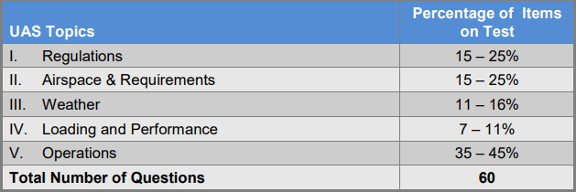
Certification Knowledge Test Description

Slide 4
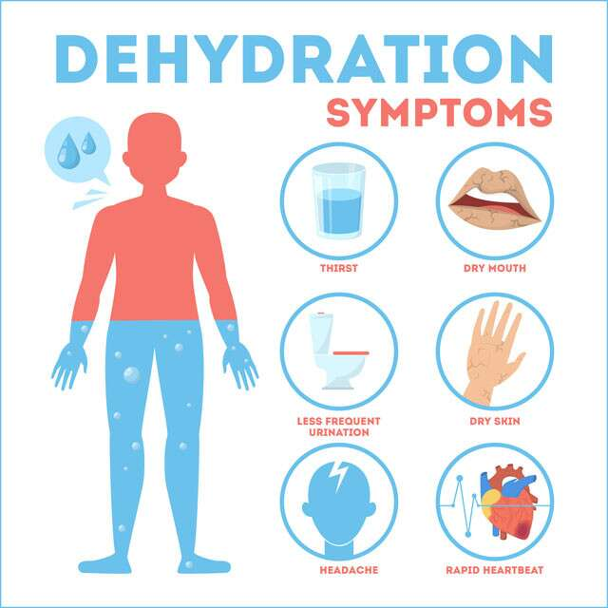
Physiological considerations and their effects on safety,
such as dehydration and heatstroke.
UA.V.E.K1

Slide 5
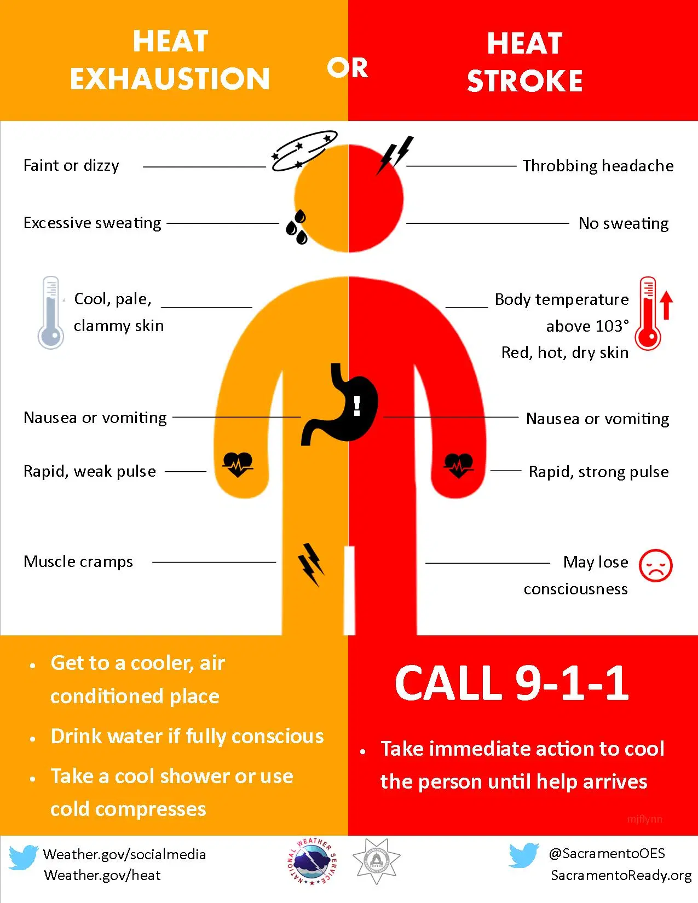
Physiological considerations and their effects on safety,
such as dehydration and heatstroke.
UA.V.E.K1

Slide 6
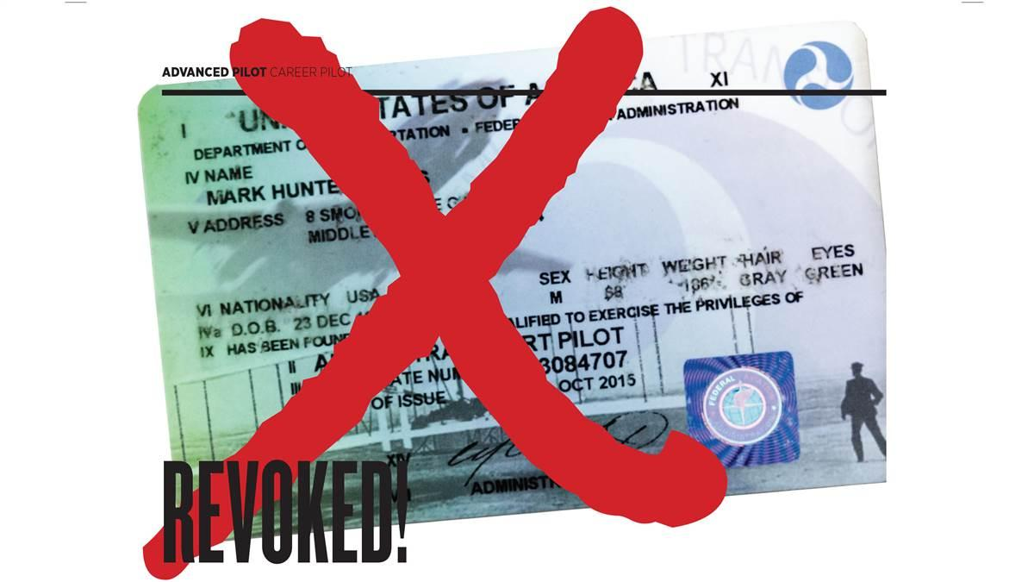
Drug and alcohol use
UA.V.E.K2

Slide 7
Drug and alcohol use
Intoxication is determined by the amount of alcohol in the bloodstream. This is usually measured as a percentage by weight in the blood. 14 CFR part 91 requires that blood alcohol level be less than .04 percent and that 8 hours pass between drinking alcohol and piloting an aircraft. A pilot with a blood alcohol level of .04 percent or greater after 8 hours cannot fly until the blood alcohol falls below that amount. Even though blood alcohol may be well below .04 percent, a pilot cannot fly sooner than 8 hours after drinking alcohol. Although the regulations are quite specific, it is a good idea to be more conservative than the regulations.
UA.V.E.K2

Slide 8
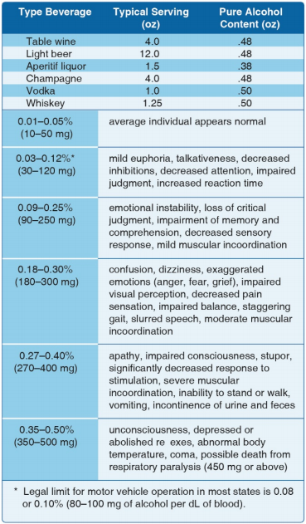
Drug and alcohol use
UA.V.E.K2

Slide 9
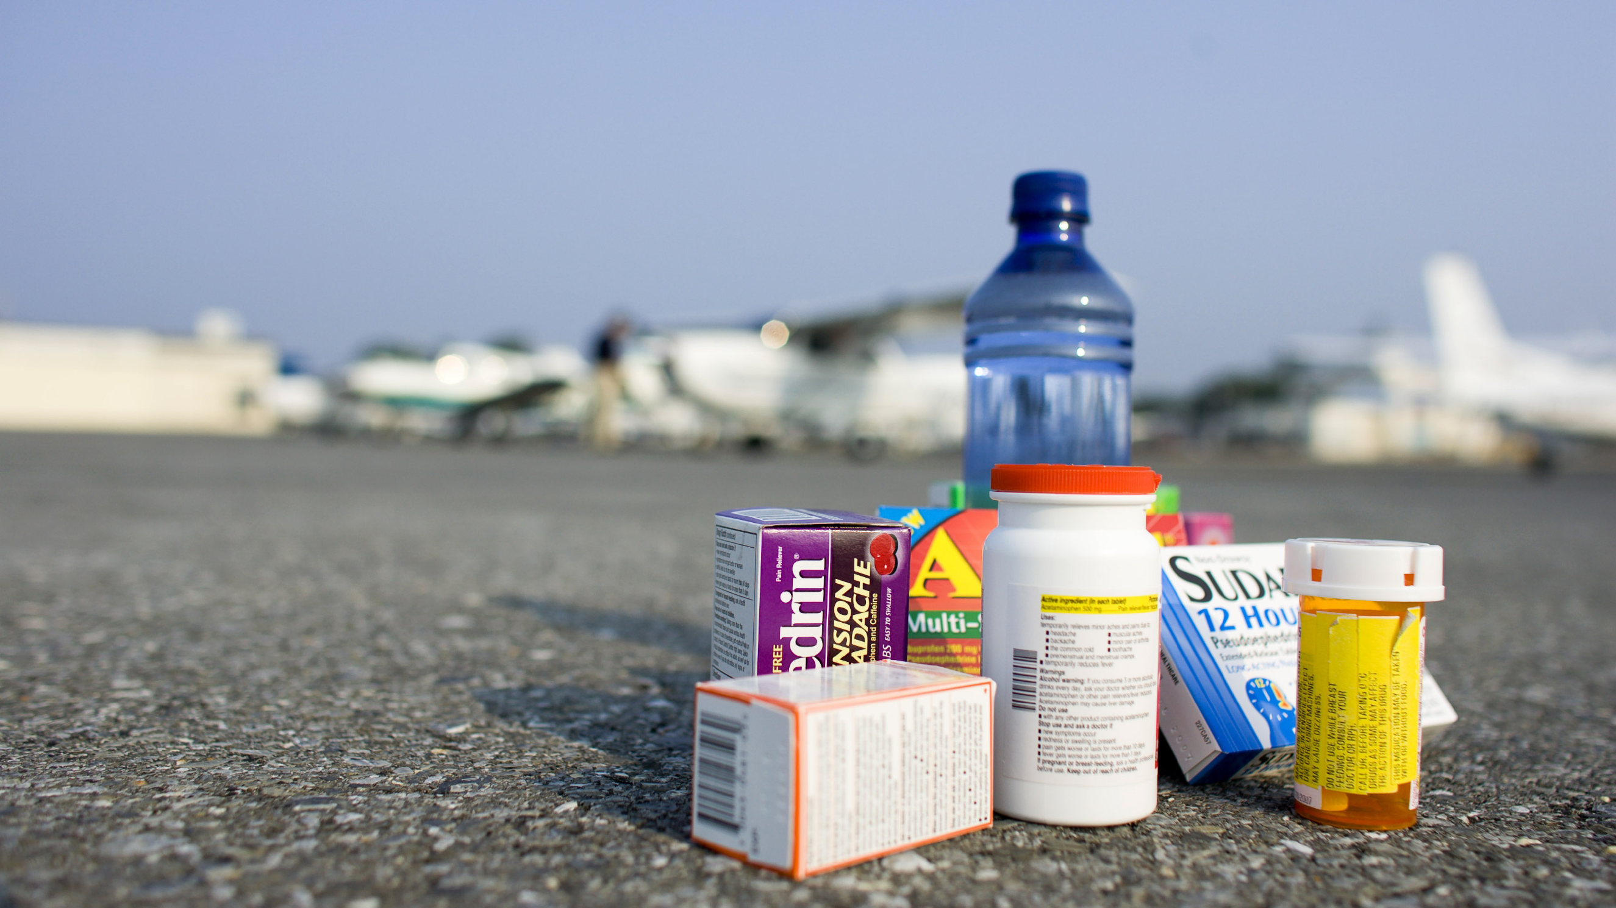
Prescription and over-the-counter medication
UA.V.E.K3

Slide 10
Prescription and over-the-counter medication
Guide for Aviation Medical Examiners
Pharmaceuticals (Therapeutic Medications) Do Not Issue - Do Not Fly
https://www.faa.gov/about/office_org/headquarters_offices/avs/offices/aam/ame/guide/pharm/dni_dnf/
What Over-the-Counter (OTC) medications can I take and still be safe to fly?
https://www.faa.gov/licenses_certificates/medical_certification/media/OTCMedicationsforPilots.pdf
UA.V.E.K3

Slide 11
Hyperventilation
UA.V.E.K4

Slide 12
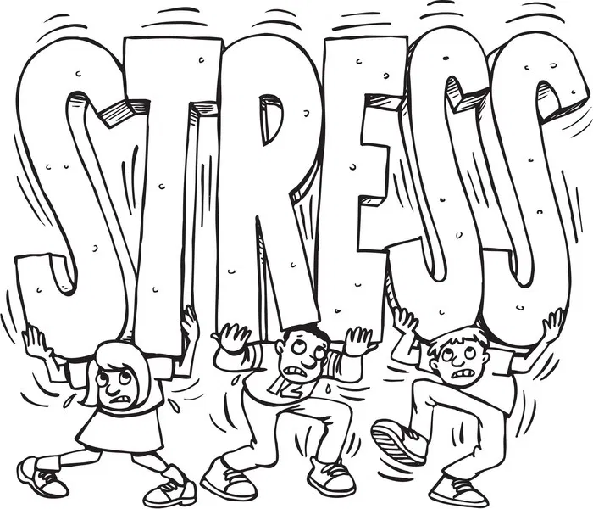
Stress and fatigue
UA.V.E.K5

Slide 13
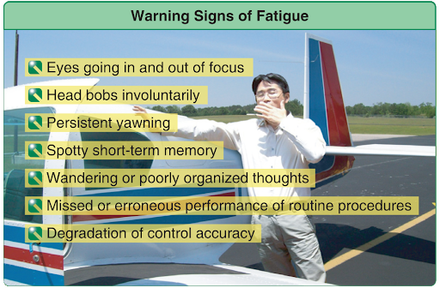
Stress and fatigue
UA.V.E.K5

Slide 14
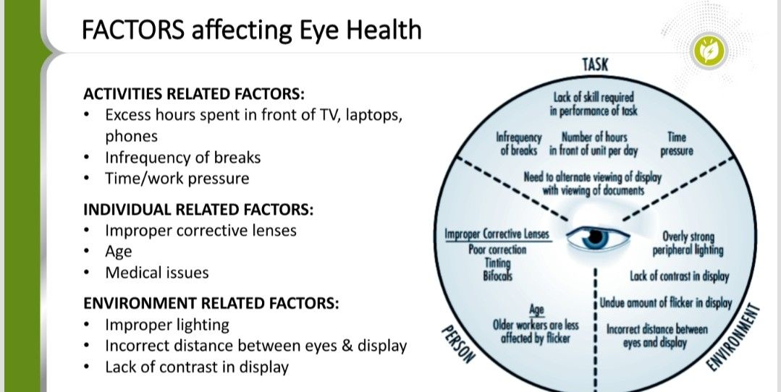
Factors affecting vision
UA.V.E.K6

Slide 15
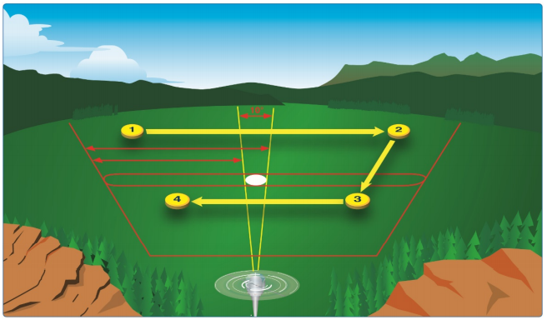
Factors affecting vision
UA.V.E.K6

Slide 16
Fitness for flight
UA.V.E.K7

