Slide 1
UA.V Operations
D. Aeronautical Decision Making

Slide 2
Remote Pilot – Airman Certification Standards
Task | D. Aeronautical Decision-Making (*)
References | AC 107-2; FAA-H-8083-2; FAA-H-8083-25
Objective | To determine that the applicant is knowledgeable in aeronautical decision-making.
Knowledge | The applicant demonstrates understanding of:
UA.V.D.K1 | Aeronautical Decision-Making (ADM):
UA.V.D.K1a | a. Effective team communication
UA.V.D.K1a | b. Task management
UA.V.D.K2 | Crew Resource Management (CRM).
UA.V.D.K3 | Situational awareness.
UA.V.D.K4 | Hazardous attitudes.
UA.V.D.K5 | Hazard identification and risk assessment.
Risk Management | [Reserved]
Skills | [Not applicable]

Slide 3
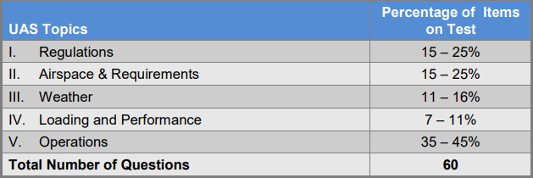
Certification Knowledge Test Description

Slide 4
Aeronautical Decision-Making (ADM)
Aeronautical decision-making (ADM) is decision-making in a unique environment—aviation. It is a systematic approach to the mental process used by pilots to consistently determine the best course of action in response to a given set of circumstances. It is what a pilot intends to do based on the latest information he or she has.
The importance of learning and understanding effective ADM skills cannot be overemphasized. While progress is continually being made in the advancement of pilot training methods, aircraft equipment and systems, and services for pilots, accidents still occur. Despite all the changes in technology to improve flight safety, one factor remains the same: the human factor which leads to errors. It is estimated that approximately 80 percent of all aviation accidents are related to human factors and the vast majority of these accidents occur during landing (24.1 percent) and takeoff (23.4 percent).
ADM is a systematic approach to risk assessment and stress management. To understand ADM is to also understand how personal attitudes can influence decision-making and how those attitudes can be modified to enhance safety in the operation of a small UA. It is important to understand the factors that cause humans to make decisions and how the decision-making process not only works, but can be improved.
Remote Pilot – Small Unmanned Aircraft Systems Study Guide: Chapter 10
UA.V.D.K1a

Slide 5
Effective team communication
UA.V.D.K1a

Slide 6
Task management
Task Loading = Number of Tasks
Time
UA.V.D.K1b

Slide 7
Crew Resource Management (CRM).
While CRM focuses on pilots operating in crew environments, many of the concepts apply to singlepilot operations. Many CRM principles have been successfully applied to single-pilot aircraft and led to the development of Single-Pilot Resource Management (SRM). SRM is defined as the art and science of managing all the resources available to a single pilot (prior to and during flight) to ensure the successful outcome of the flight. SRM includes the concepts of ADM, risk management (RM), task management (TM), automation management (AM), controlled flight into terrain (CFIT) awareness, and situational awareness (SA). SRM training helps the pilot maintain situational awareness by managing the automation and associated aircraft control and navigation tasks. This enables the pilot to accurately assess and manage risk and make accurate and timely decisions.
SRM is all about helping pilots learn how to gather information, analyze it, and make decisions.
UA.V.D.K2

Slide 8
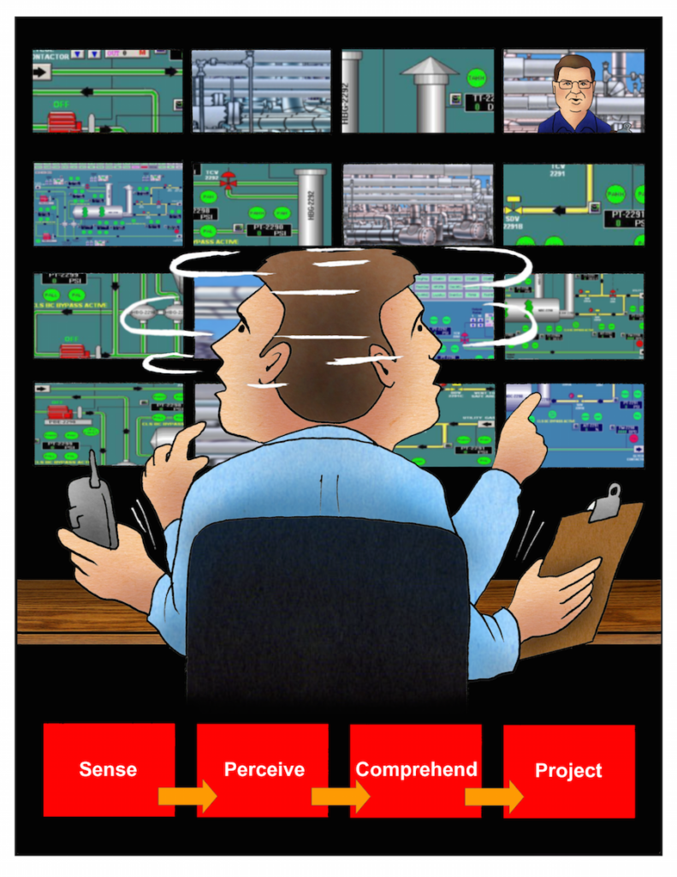
Situational awareness.
Situational awareness is the accurate perception and understanding of all the factors and conditions within the five fundamental risk elements (flight, pilot, aircraft, environment, and type of operation that comprise any given aviation situation) that affect safety before, during, and after the flight.
Maintaining situational awareness requires an understanding of the relative significance of all flight related factors and their future impact on the flight. When a pilot understands what is going on and has an overview of the total operation, he or she is not fixated on one perceived significant factor. Not only is it important for a pilot to know the aircraft’s geographical location, it is also important he or she understand what is happening
UA.V.D.K3

Slide 9
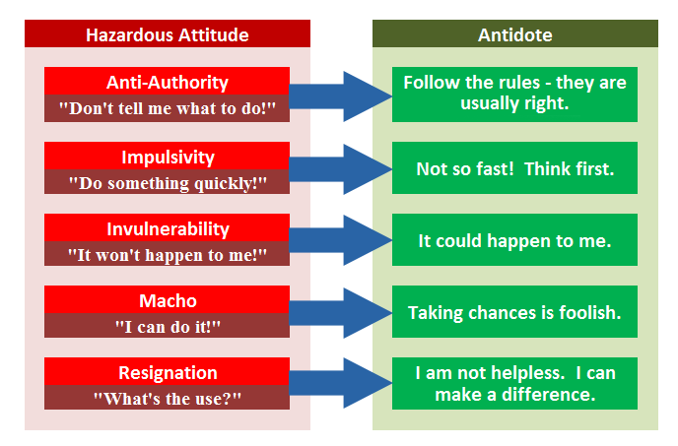
Hazardous attitudes.
UA.V.D.K4

Slide 10
Hazard identification and risk assessment.
Two defining elements of ADM are hazard and risk. Hazard is a real or perceived condition, event, or circumstance that a pilot encounters. When faced with a hazard, the pilot makes an assessment of that hazard based upon various factors. The pilot assigns a value to the potential impact of the hazard, which qualifies the pilot’s assessment of the hazard—risk.
Therefore, risk is an assessment of the single or cumulative hazard facing a pilot; however, different pilots see hazards differently.
During each flight, the single pilot makes many decisions under hazardous conditions. To fly safely, the pilot needs to assess the degree of risk and determine the best course of action to mitigate the risk.
UA.V.D.K5

Slide 11
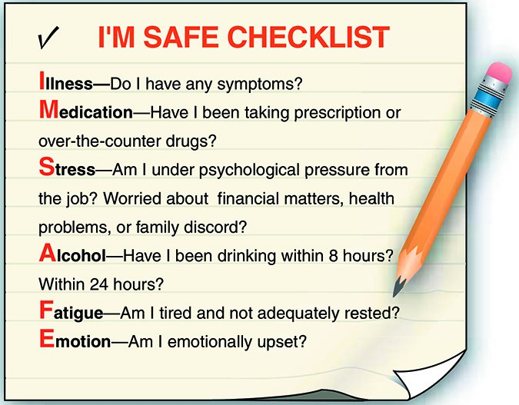
Hazard identification and risk assessment.
UA.V.D.K5

Slide 12
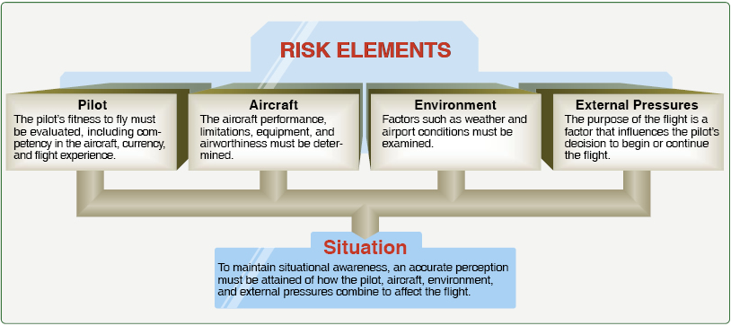
Hazard identification and risk assessment.
UA.V.D.K5

