Slide 1
UA.V Operations
C. Emergency Procedures

Slide 2
Remote Pilot – Airman Certification Standards
Task | C. Emergency Procedures (*)
References | AC 107-2; FAA-H-8083-25; SAFO 15010, SAFO 10017, SAFO 09013
Objective | To determine that the applicant is knowledgeable in sUAS emergency procedures.
Knowledge | The applicant demonstrates understanding of:
UA.V.C.K1 | Emergency planning and communication.
UA.V.C.K2 | Characteristics and potential hazards of lithium batteries:
UA.V.C.K2a | a. Safe transportation, such as proper inspection and handling
UA.V.C.K2b | b. Safe charging
UA.V.C.K2c | c. Safe usage
UA.V.C.K2d | d. Risks of fires involving lithium batteries
UA.V.C.K3 | Loss of aircraft control link and fly-aways.
UA.V.C.K4 | Loss of Global Positioning System (GPS) signal during flight and potential consequences
UA.V.C.K5 | Frequency spectrums and associated limitations.
Risk Management | [Reserved]
Skills | [Not applicable]

Slide 3
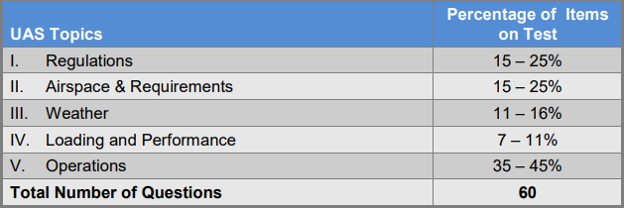
Certification Knowledge Test Description

Slide 4
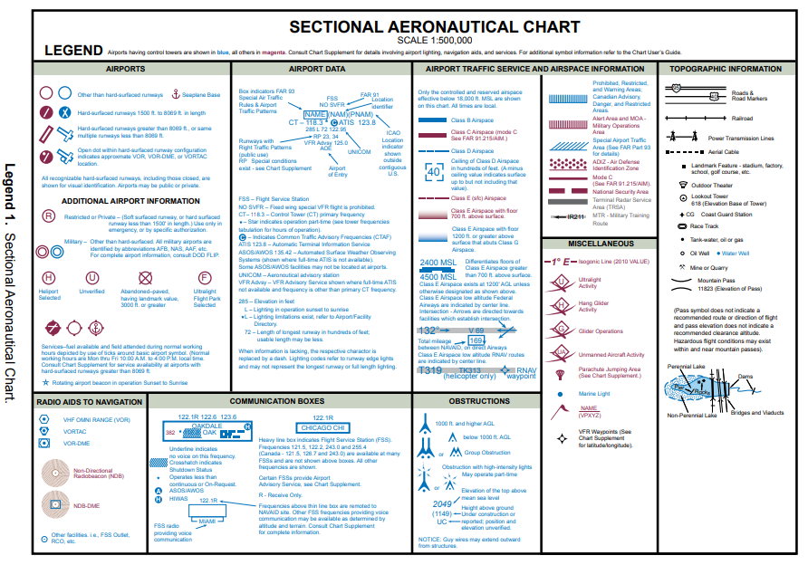
Emergency planning and communication.
Types of airports, such as towered,
uncontrolled towered, heliport, and seaplane bases.
UA.V.C.K1

Slide 5
Emergency planning and communication.
Types of airports, such as towered,
uncontrolled towered, heliport, and seaplane bases.
UA.V.C.K1

Slide 6
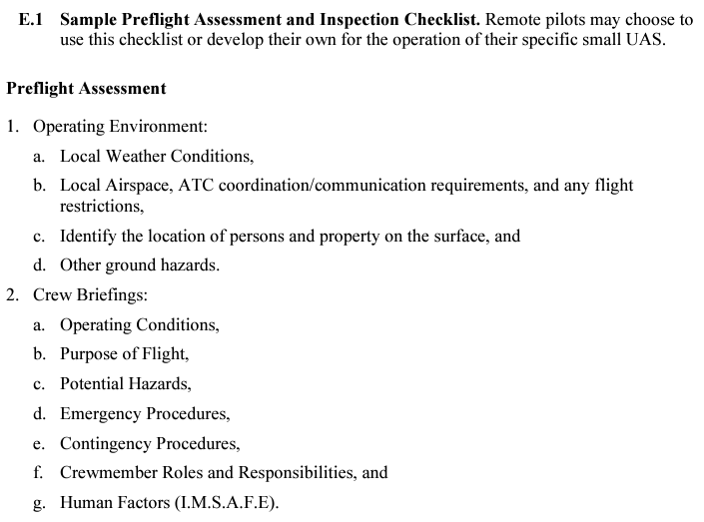
Emergency planning and communication.
Types of airports, such as towered,
uncontrolled towered, heliport, and seaplane bases.
UA.V.C.K1

Slide 7
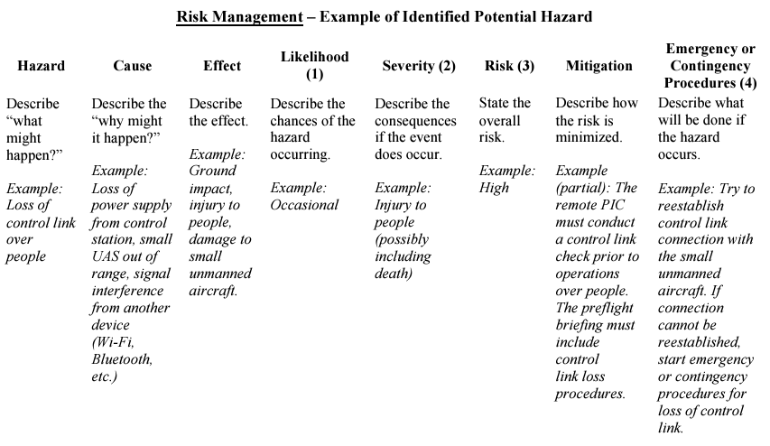
Emergency planning and communication.
Types of airports, such as towered,
uncontrolled towered, heliport, and seaplane bases.
UA.V.C.K1

Slide 8
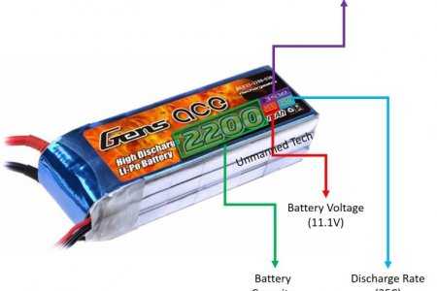
Characteristics and potential hazards of lithium batteries:
Types of airports, such as towered,
uncontrolled towered, heliport, and seaplane bases.
UA.V.C.K2

Slide 9
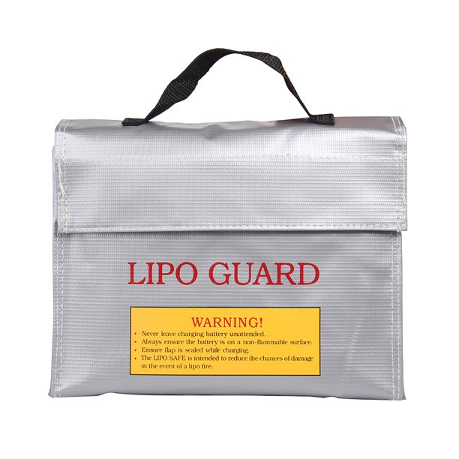
Characteristics and potential hazards of lithium batteries:
Safe transportation, such as proper inspection and handling
Types of airports, such as towered,
uncontrolled towered, heliport, and seaplane bases.
UA.V.C.K2a

Slide 10
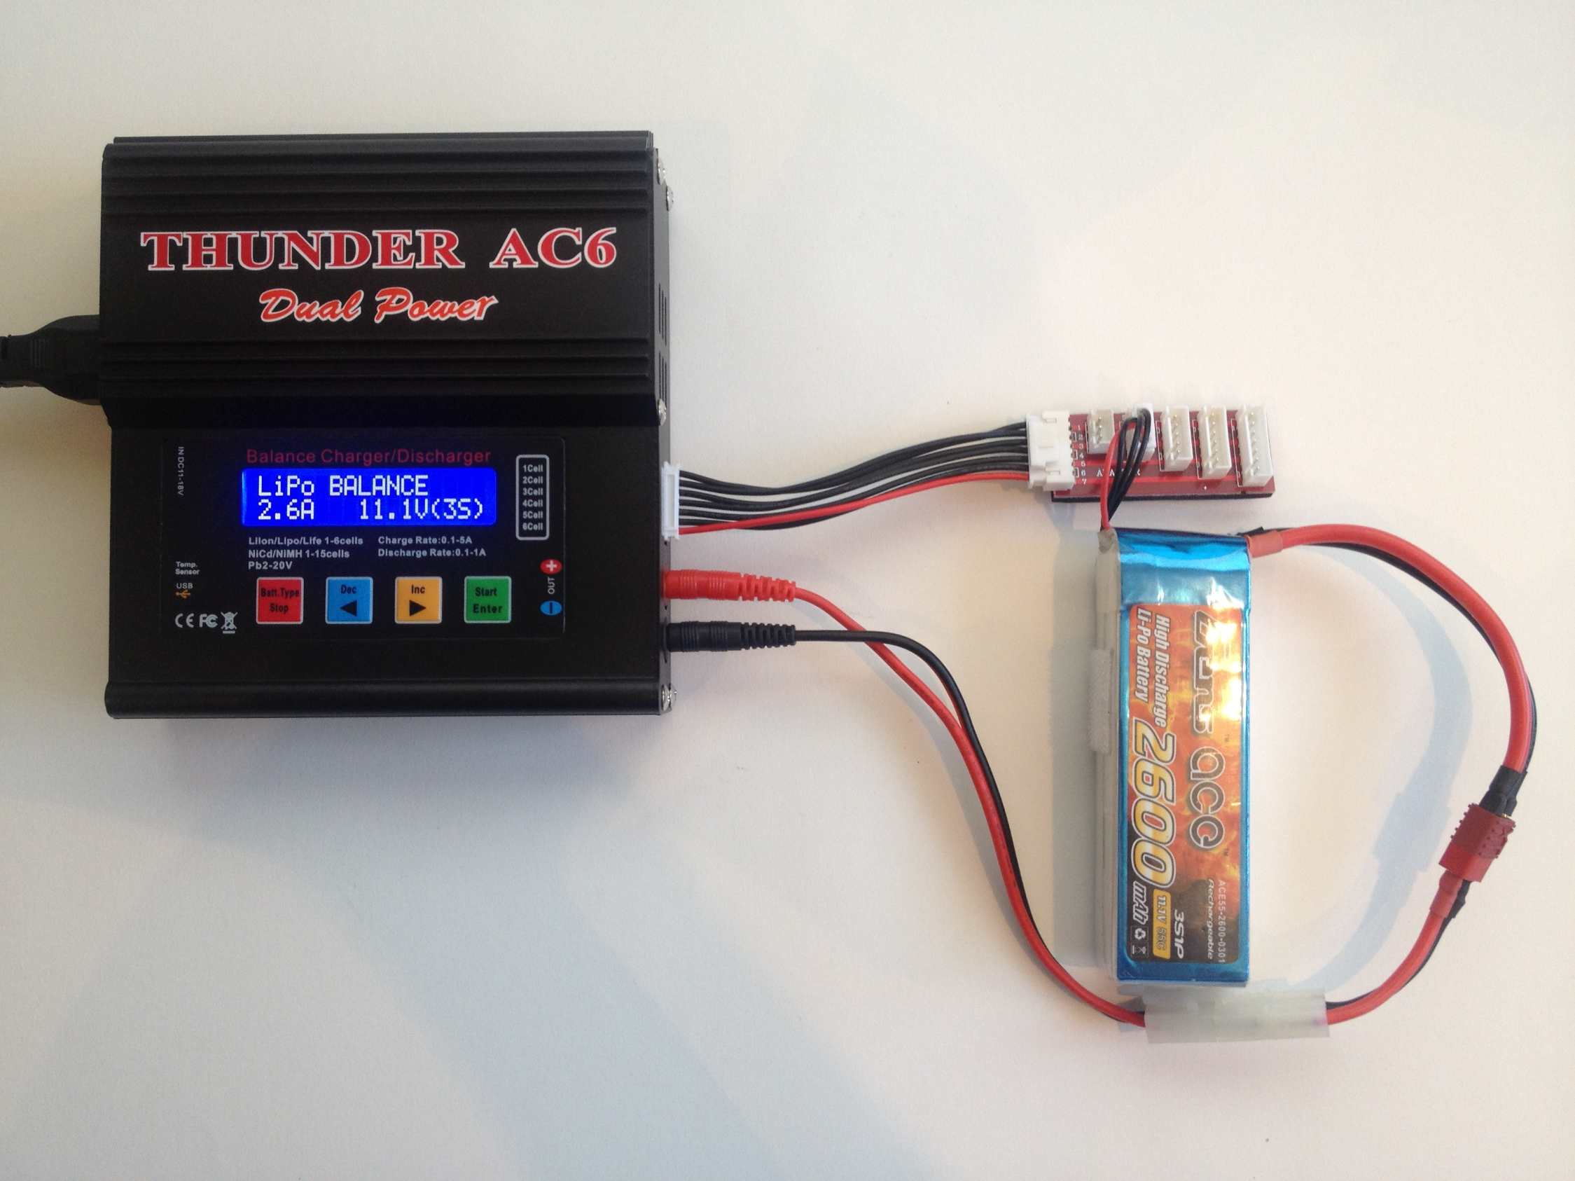
Characteristics and potential hazards of lithium batteries:
Safe charging
Types of airports, such as towered,
uncontrolled towered, heliport, and seaplane bases.
UA.V.C.K2b

Slide 11
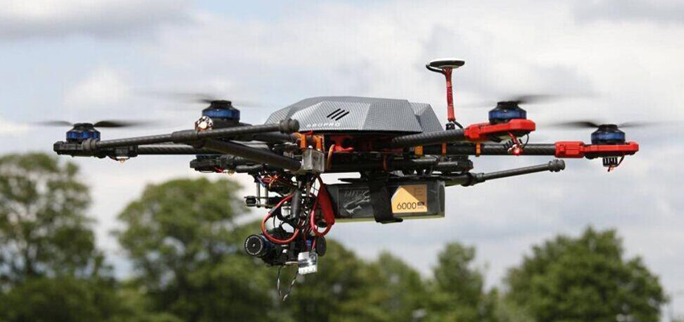
Characteristics and potential hazards of lithium batteries:
Safe usage
Types of airports, such as towered,
uncontrolled towered, heliport, and seaplane bases.
UA.V.C.K2c

Slide 12
Characteristics and potential hazards of lithium batteries:
Risks of fires involving lithium batteries
Types of airports, such as towered,
uncontrolled towered, heliport, and seaplane bases.
UA.V.C.K2c
Notes:
LiPO Spontaneously catches on fire at EZDrone (1:38) https://www.youtube.com/watch?v=fF9fhlr9S5s

Slide 13
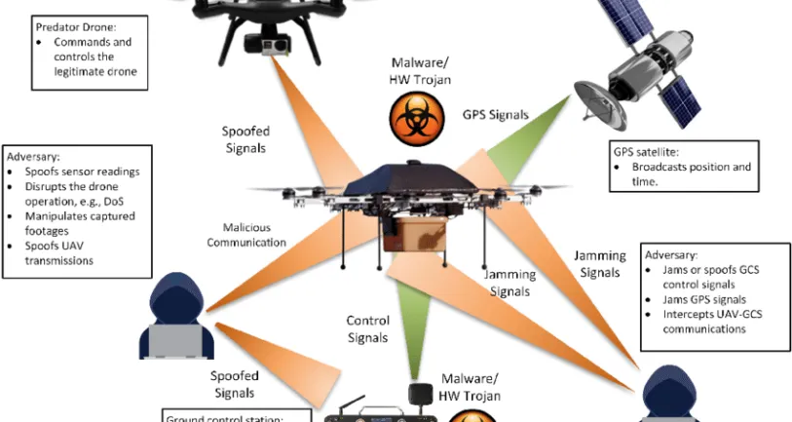
Characteristics and potential hazards of lithium batteries:
Loss of aircraft control link and fly-aways.
Types of airports, such as towered,
uncontrolled towered, heliport, and seaplane bases.
UA.V.C.K3

Slide 14
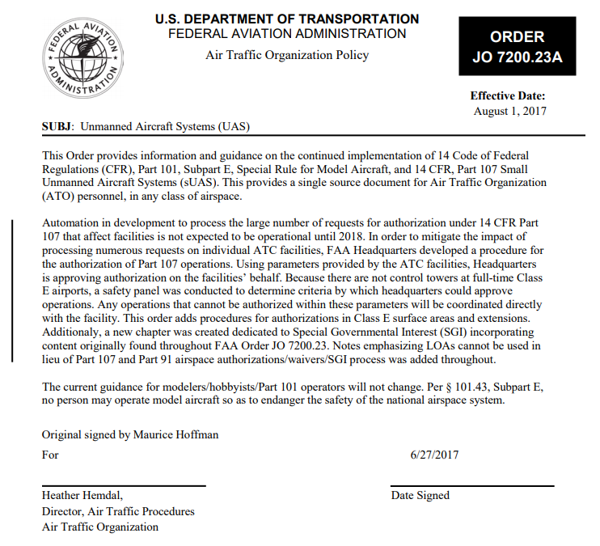
Characteristics and potential hazards of lithium batteries:
Loss of aircraft control link and fly-aways.
Types of airports, such as towered,
uncontrolled towered, heliport, and seaplane bases.
UA.V.C.K3

Slide 15
Characteristics and potential hazards of lithium batteries:
Loss of Global Positioning System (GPS) signal during flight
and potential consequences
Types of airports, such as towered,
uncontrolled towered, heliport, and seaplane bases.
UA.V.C.K4

Slide 16
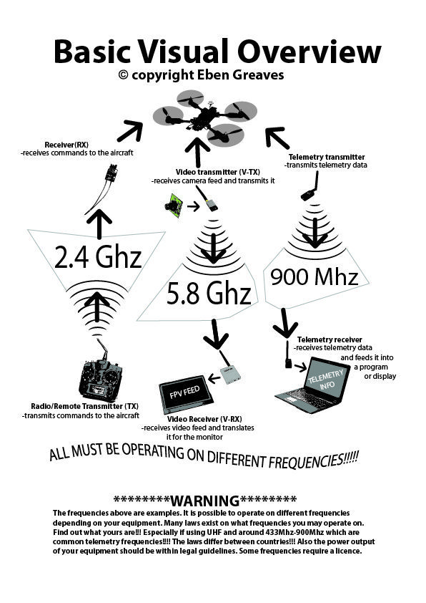
Characteristics and potential hazards of lithium batteries:
Frequency spectrums and associated limitations.
Types of airports, such as towered,
uncontrolled towered, heliport, and seaplane bases.
UA.V.C.K5

