Slide 1
UA.V Operations
B. Airport Operations

Slide 2
Remote Pilot – Airman Certification Standards
Task | B. Airport Operations (*)
References | AC 107-2, AC 150/5200-32; FAA-H-8083-25; AIM
Objective | To determine that the applicant is knowledgeable in airport operations.
Knowledge | The applicant demonstrates understanding of:
UA.V.B.K1 | Types of airports, such as towered, uncontrolled towered, heliport, and seaplane bases.
UA.V.B.K2 | ATC towers, such as ensuring the remote pilot can monitor and interpret ATC communications to improve situational awareness
UA.V.B.K3 | Runway markings and signage.
UA.V.B.K4 | Traffic patterns used by manned aircraft pilots.
UA.V.B.K5 | Security Identification Display Areas (SIDA).
UA.V.B.K6 | Sources for airport data:
UA.V.B.K6a | a. Aeronautical charts
UA.V.B.K6b | b. Chart Supplements
UA.V.B.K7 | Avoiding bird and wildlife hazards and reporting collisions between aircraft and wildlife.
Risk Management | [Reserved]
Skills | [Not applicable]

Slide 3
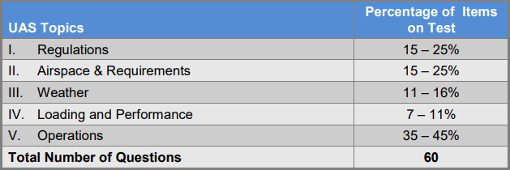
Certification Knowledge Test Description

Slide 4
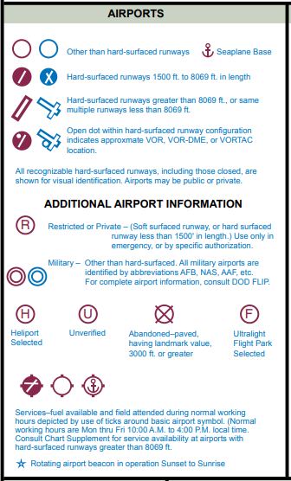
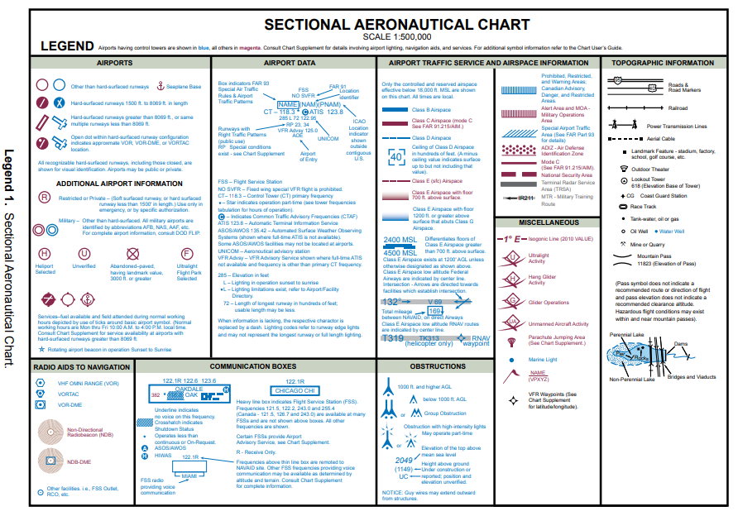
Types of airports, such as towered,
uncontrolled towered, heliport, and seaplane bases.
UA.V.B.K1
Airman Knowledge Testing Supplement for Sport Pilot, Recreational Pilot, Remote Pilot, and Private Pilot

Slide 5
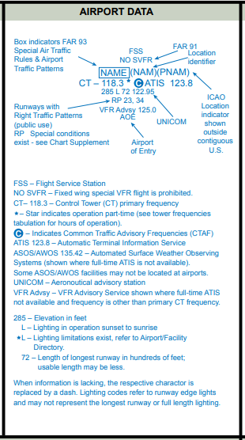
Types of airports, such as towered,
uncontrolled towered, heliport, and seaplane bases.
UA.V.B.K1
Airman Knowledge Testing Supplement for Sport Pilot, Recreational Pilot, Remote Pilot, and Private Pilot

Slide 6
Types of airports, such as towered,
uncontrolled towered, heliport, and seaplane bases.
UA.V.A.K1

Slide 7
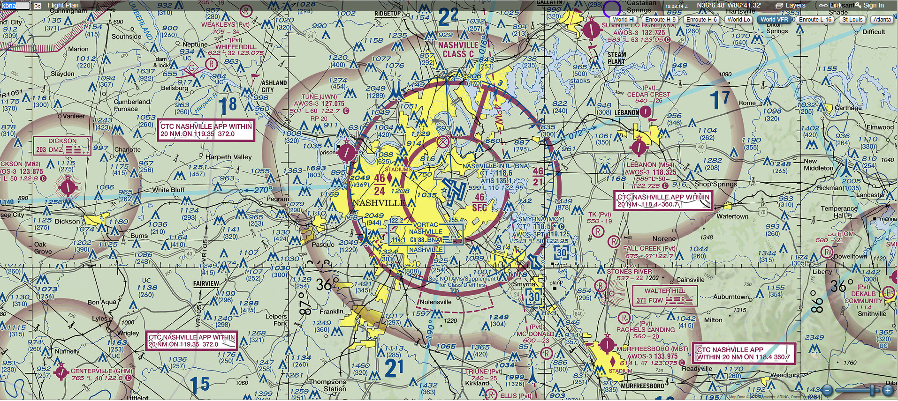
ATC towers, such as ensuring the remote pilot can monitor and interpret ATC communications to improve situational awareness
UA.V.A.K2

Slide 8
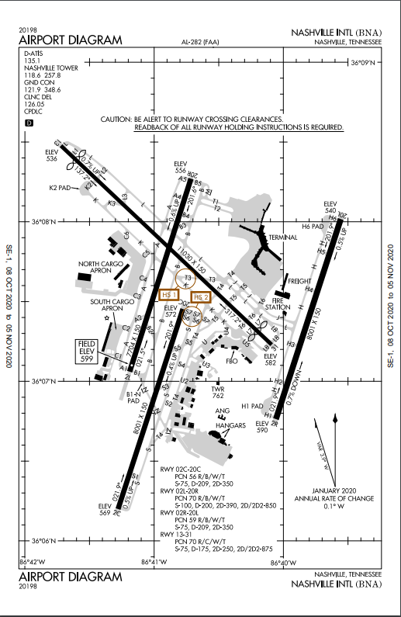
UA.V.A.K2

Slide 9
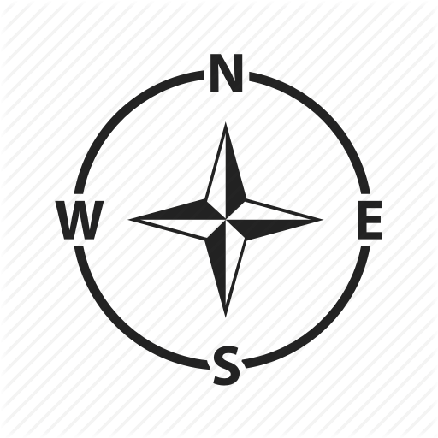
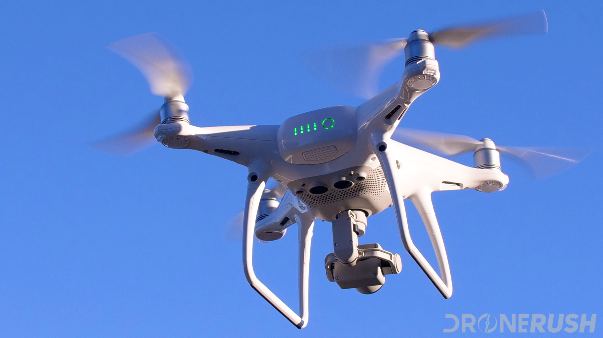
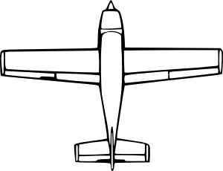
ATC: “Piper 1234 fly heading 360.
Unmanned aircraft traffic at 9 o’clock and 3 miles”
Which direction would you look for traffic?
UA.V.B.K2

Slide 10
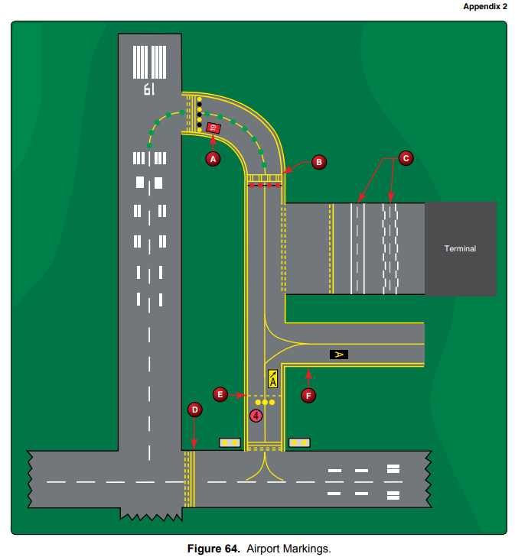
Runway markings and signage.
UA.V.A.K3

Slide 11
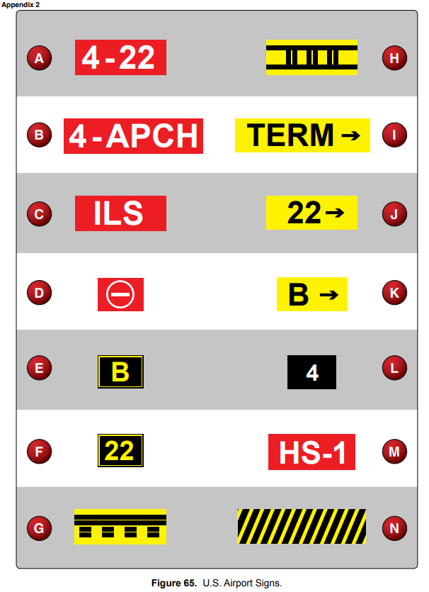
Runway markings and signage.
UA.V.A.K3

Slide 12
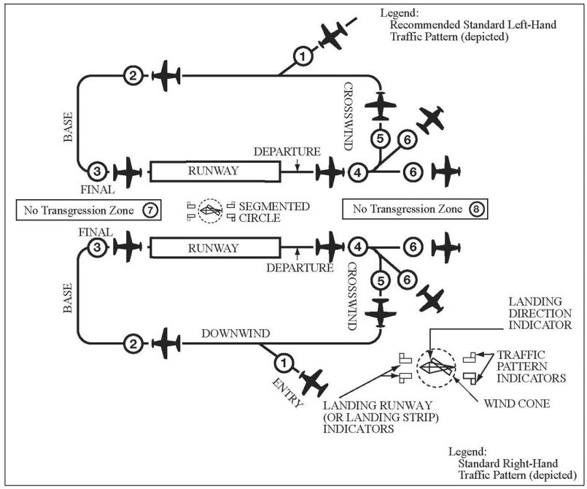
Traffic patterns used by manned aircraft pilots.
UA.V.A.K4

Slide 13
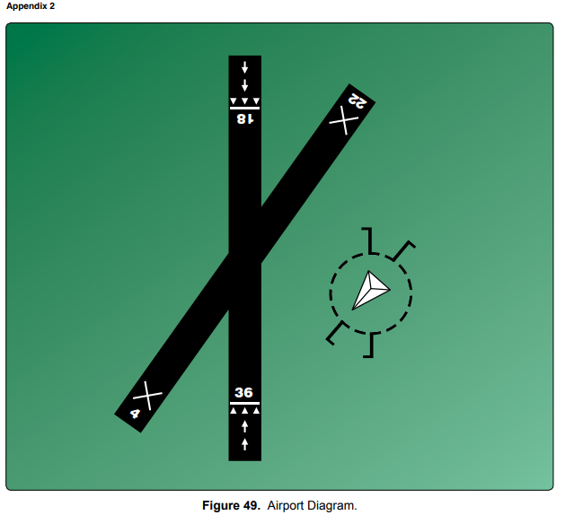
Traffic patterns used by manned aircraft pilots.
UA.V.A.K4

Slide 14
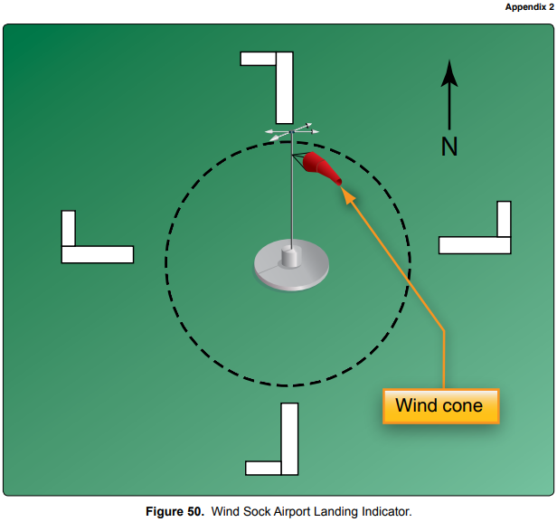
Traffic patterns used by manned aircraft pilots.
UA.V.A.K4

Slide 15
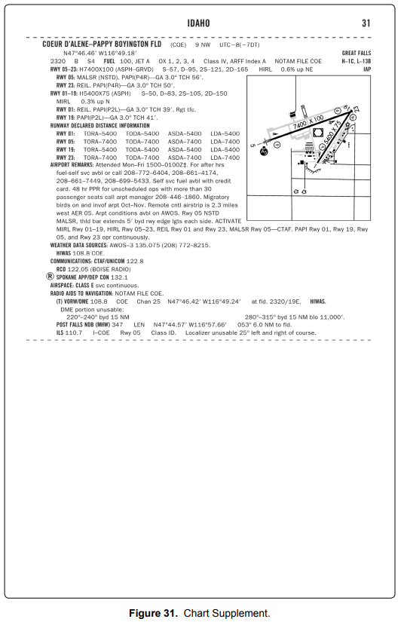
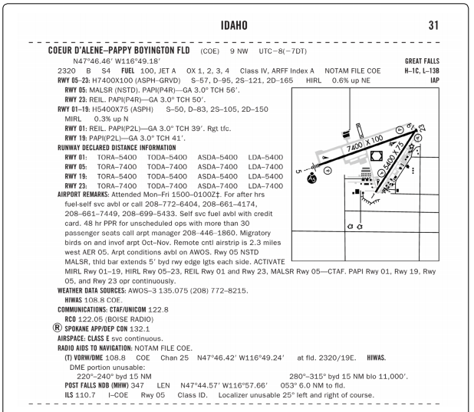
Traffic patterns used by manned aircraft pilots.
UA.V.A.K4

Slide 16
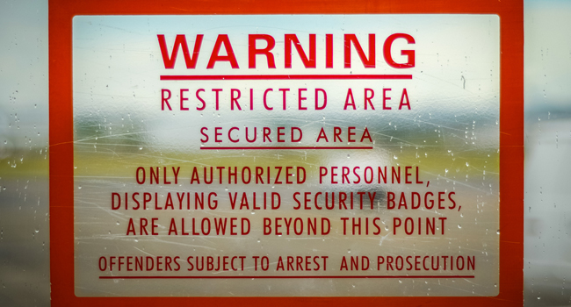
Security Identification Display Areas (SIDA).
UA.V.A.K5

Slide 17
Sources for airport data: Aeronautical Charts
UA.V.B.K6a
Airman Knowledge Testing Supplement for Sport Pilot, Recreational Pilot, Remote Pilot, and Private Pilot

Slide 18
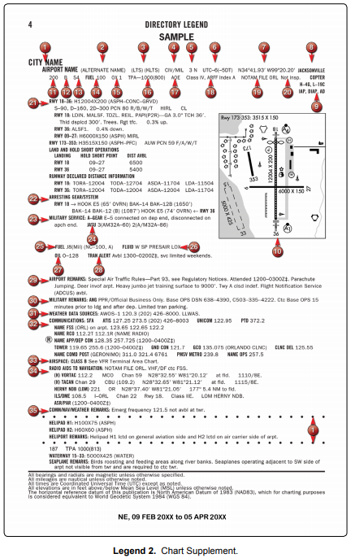
Sources for airport data: Chart Supplements
UA.V.A.K6b

Slide 19
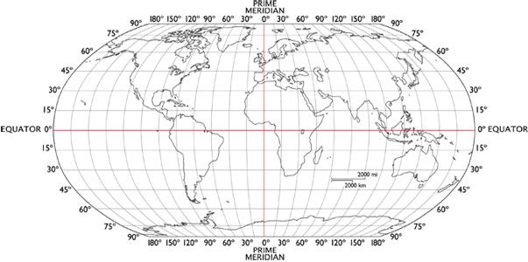
Sources for airport data: Chart Supplements
UA.V.A.K6b
Notes:
Sectional Charts - Latitude and Longitude https://www.youtube.com/watch?v=de1JxnfzZNA&t=0s&index=123&list=PLxBmQqtkMWMjFN0QRpejocw5rJjG016CH

Slide 20
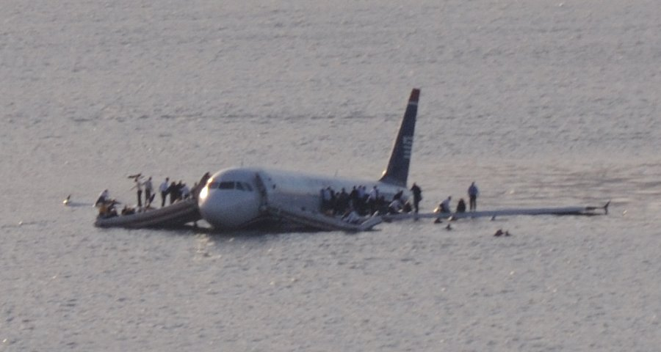
Avoiding bird and wildlife hazards and reporting
collisions between aircraft and wildlife.
UA.V.A.K7

