Slide 1
UA.V Operations
A. Radio Comm Procedures

Slide 2
Remote Pilot – Airman Certification Standards
Task | A. Radio Communications Procedures
References | AC 107-2; FAA-H-8083-25; AIM
Objective | To determine that the applicant is knowledgeable in radio communication procedures.
Knowledge | The applicant demonstrates understanding of:
UA.V.A.K1 | Airport operations with and without an operating control tower.
UA.V.A.K2 | The description and use of a Common Traffic Advisory Frequency (CTAF) to monitor manned aircraft communications
UA.V.A.K3 | Recommended traffic advisory procedures used by manned aircraft pilots, such as self announcing of position and intentions.
UA.V.A.K4 | Aeronautical advisory communications station (UNICOM) and associated communication procedures used by manned aircraft pilots.
UA.V.A.K5 | Automatic Terminal Information Service (ATIS).
UA.V.A.K6 | Aircraft call signs and registration numbers.
UA.V.A.K7 | The phonetic alphabet.
UA.V.A.K8 | Phraseology: altitudes, directions, speed, and time
Risk Management | [Reserved]
Skills | [Not applicable]

Slide 3
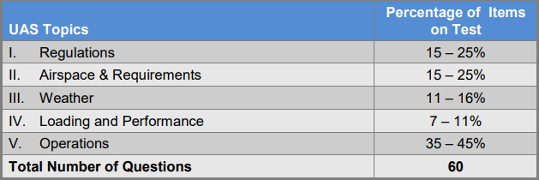
Certification Knowledge Test Description

Slide 4
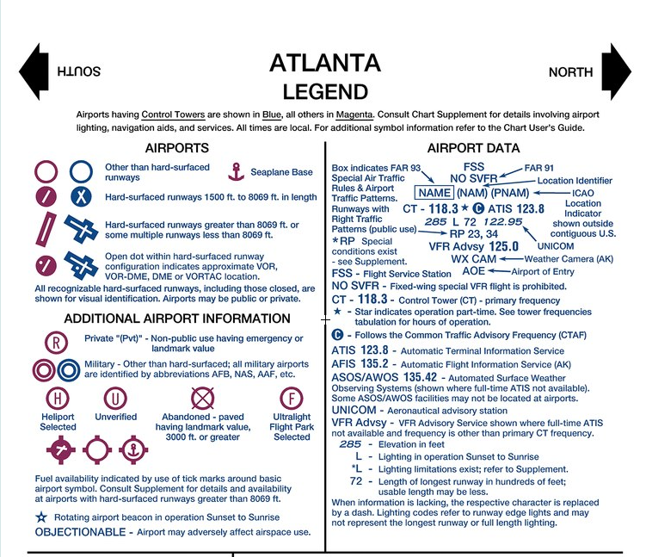
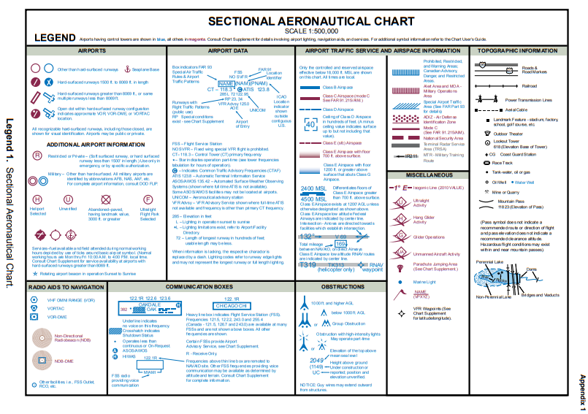
Airport operations with and without an operating
control tower.
UA.V.A.K1

Slide 5
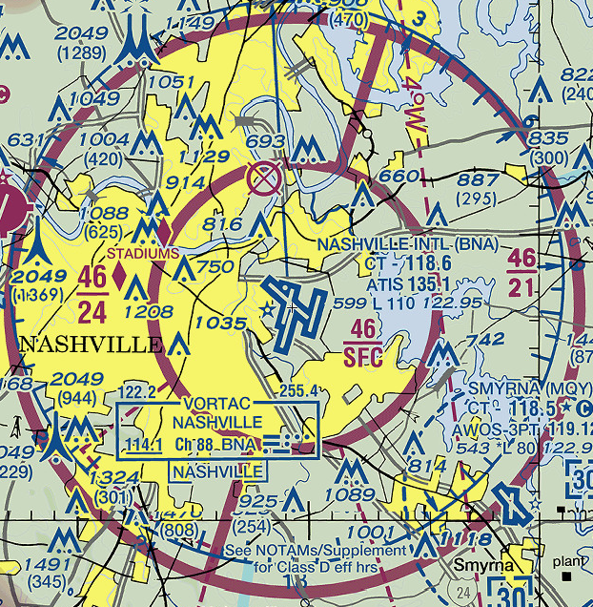
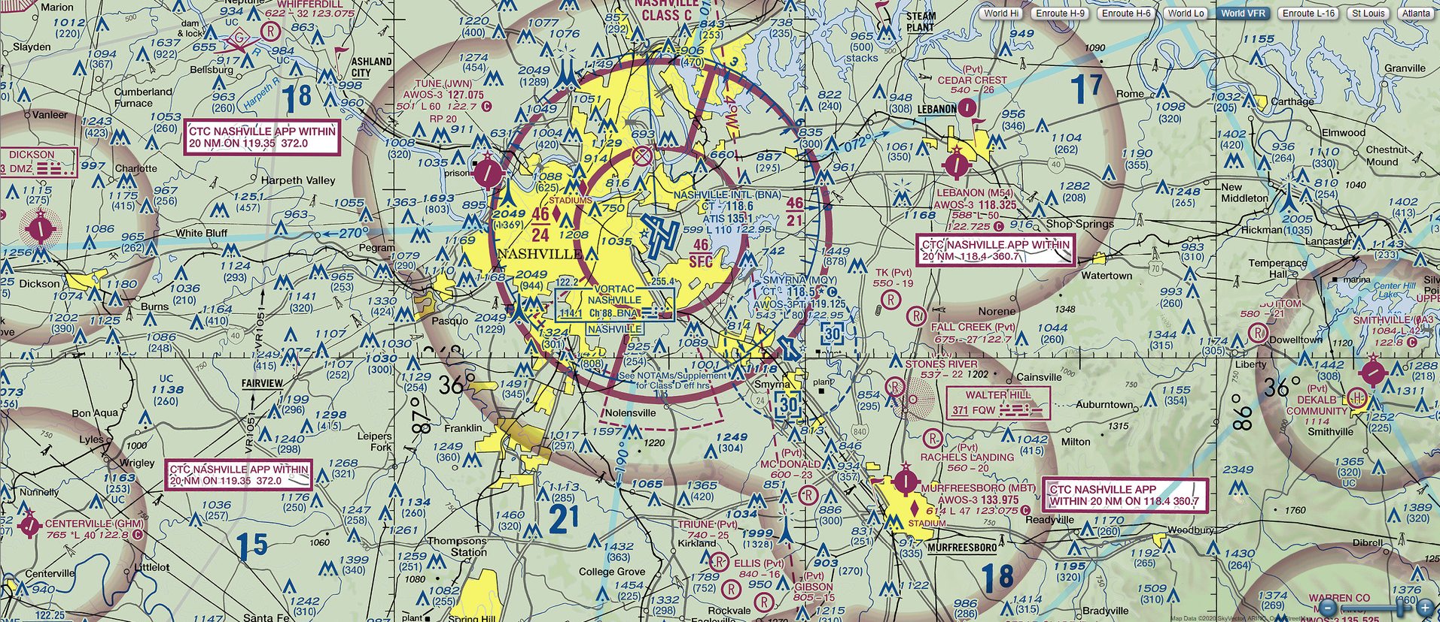
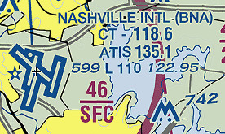
Airport operations with and without an operating
control tower.
UA.V.A.K1
Notes:
Feel free to change example to a local airport.

Slide 6
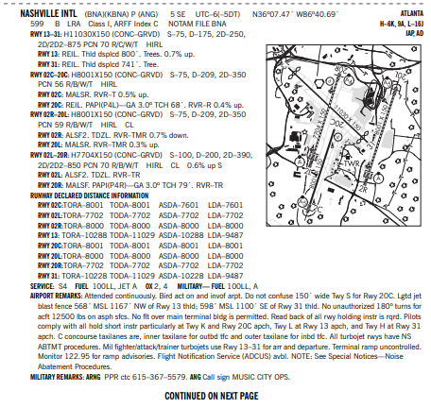
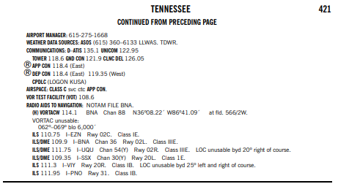
UA.V.A.K1

Slide 7
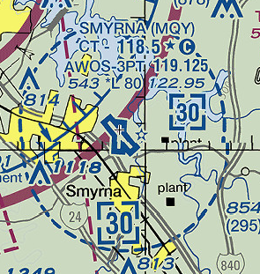
Airport operations with and without an operating
control tower.
UA.V.A.K1

Slide 8
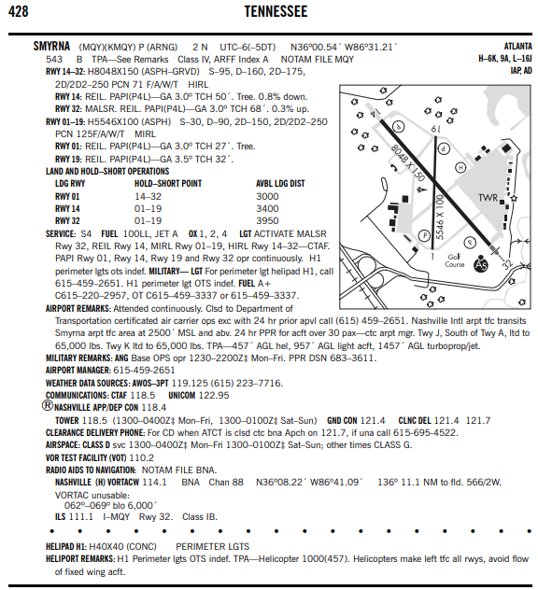
UA.V.A.K1

Slide 9
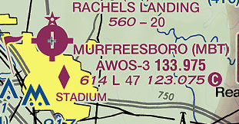
Airport operations with and without an operating
control tower.
UA.V.A.K1

Slide 10
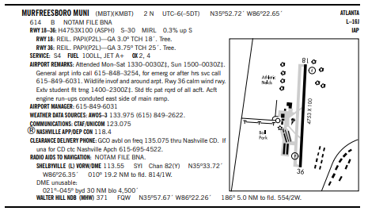
UA.V.A.K1

Slide 11
Automatic Terminal Information Service (ATIS).
UA.V.A.K5

Slide 12
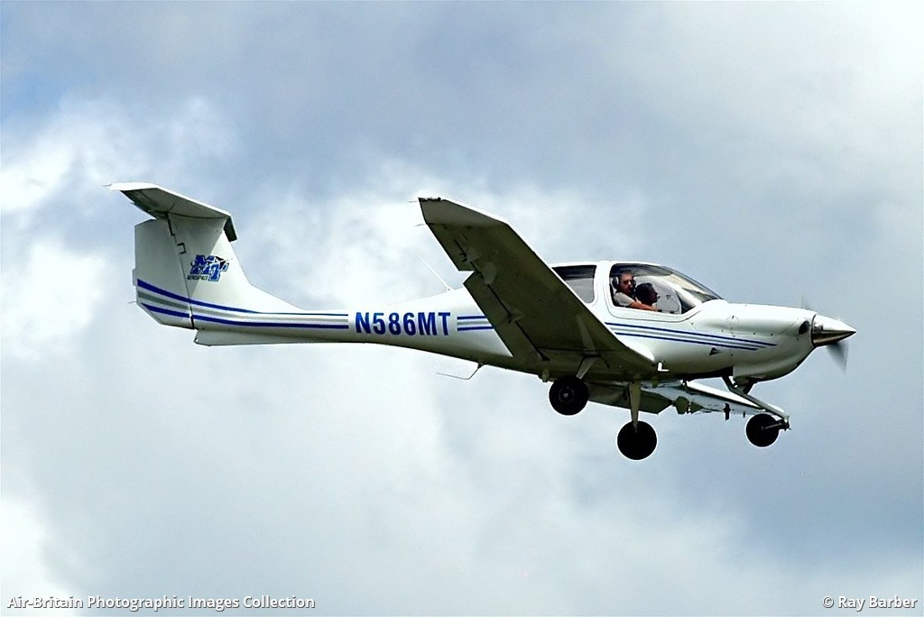
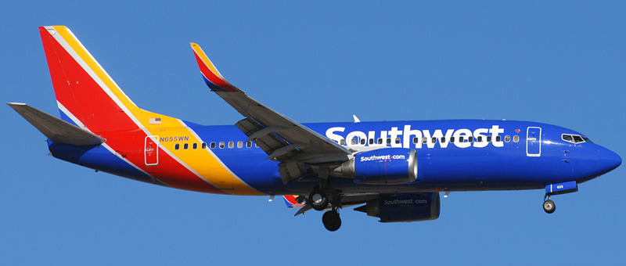
Aircraft call signs and registration numbers.
UA.V.A.K6

Slide 13
The phonetic alphabet.
UA.V.A.K7

Slide 14
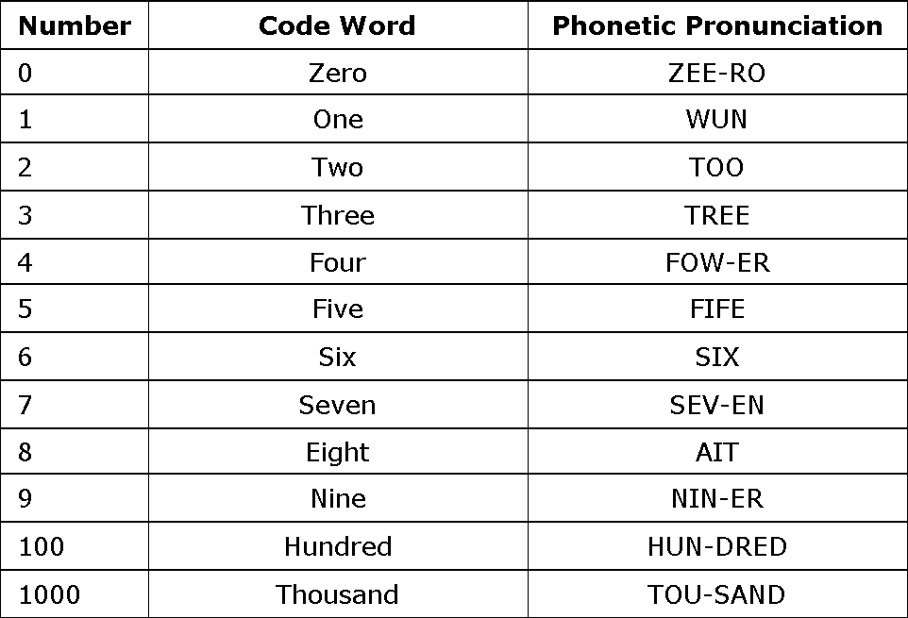
Phraseology: altitudes, directions, speed, and time
UA.V.A.K8

Slide 15
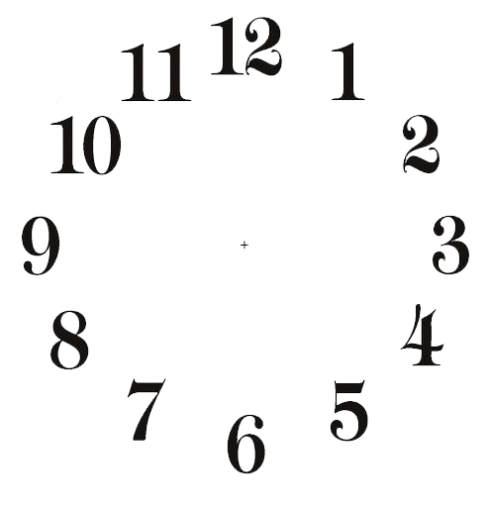
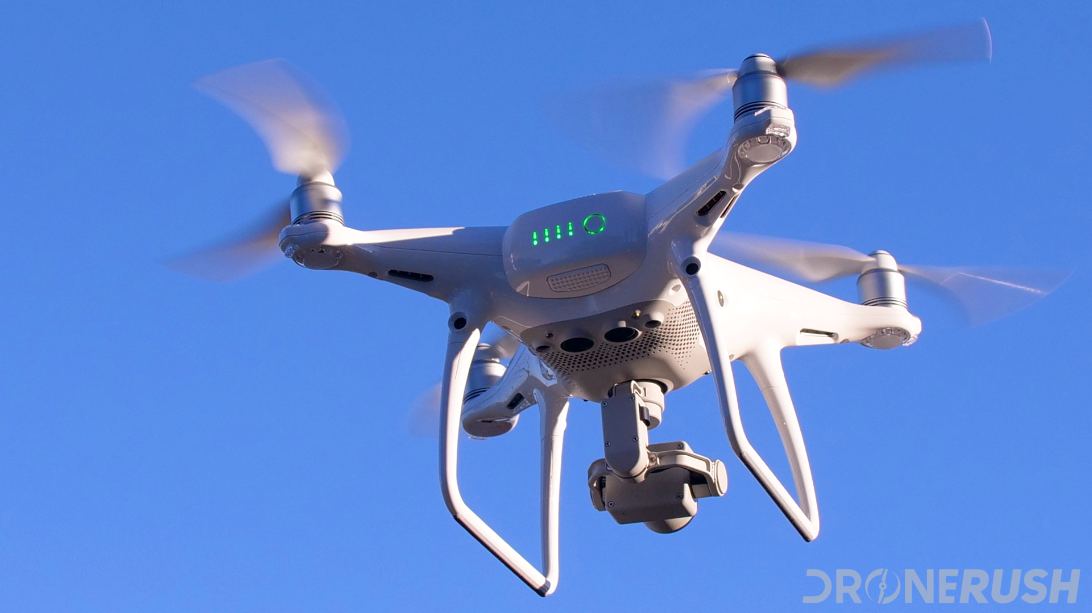
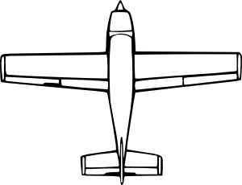
Phraseology: altitudes, directions, speed, and time
ATC: “Piper 1234 fly heading 360.
Unmanned aircraft traffic at 9 o’clock and 3 miles”
Which direction would you look for traffic?
UA.V.A.K8

