Slide 1
UA.IV Loading & Performance
A. Loading & Performance

Slide 2
Remote Pilot – Airman Certification Standards
Task | Task A. Loading and Performance
References | AC 107-2; FAA-H-8083-25; FAA-G-8082-22
Objective | To determine that the applicant is knowledgeable in the loading and performance of an sUAS.
Knowledge | The applicant demonstrates understanding of:
UA.IV.A.K1 | General loading and performance, including:
UA.IV.A.K1a | The description and use of a Common Traffic Advisory Frequency (CTAF) to monitor manned aircraft communications
UA.IV.A.K1b | Recommended traffic advisory procedures used by manned aircraft pilots, such as self announcing of position and intentions.
UA.V.IA.K2 | Aeronautical advisory communications station (UNICOM) and associated communication procedures used by manned aircraft pilots.
Risk Management | [Reserved]
Skills | [Not applicable]

Slide 3
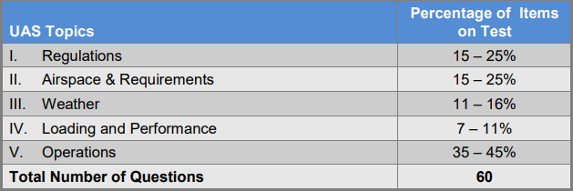
Certification Knowledge Test Description

Slide 4
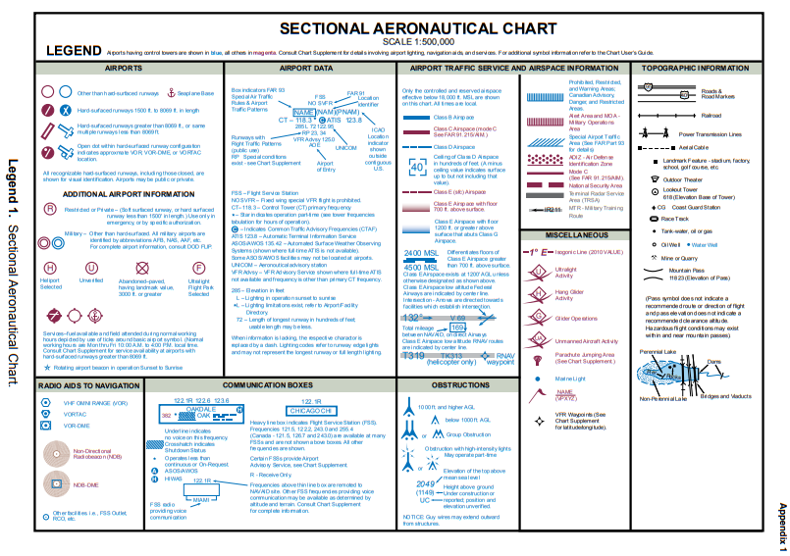
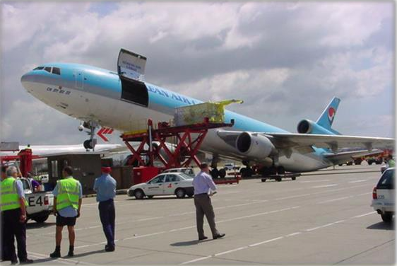
Airport operations with and without an operating
control tower.
AC-107-2A B.2 Small Unmanned Aircraft Loading and Its Effects on Performance.
B.2.1 Weight and Balance (W&B). Before any flight, the remote PIC should verify the aircraft is correctly loaded by determining the W&B condition of the aircraft. An aircraft’s W&B restrictions established by the manufacturer, or the builder should be closely followed. Compliance with the manufacturer’s W&B limits is critical to flight safety. The remote PIC must consider the consequences of an overweight aircraft, as it may result in an unsafe condition.
UA.V.A.K1
UA.IV.A.K1a

Slide 5
Airport operations with and without an operating
control tower.
AC 107-2A B.2 Small Unmanned Aircraft Loading and Its Effects on Performance.
B.2.1.1 Although a maximum gross takeoff weight may be specified, the aircraft may not always safely take off with this load under all conditions. Conditions that affect takeoff and climb performance, such as high elevations, high air temperatures, and high humidity (high density altitudes) may require a reduction in weight before flight is attempted. Other factors to consider prior to takeoff are runway/launch area length, surface, slope, surface wind, and the presence of obstacles. These factors may require a reduction in weight prior to flight.
B.2.1.2 Weight changes during flight also have a direct effect on aircraft performance. Fuel burn is the most common weight change that takes place during flight. As fuel is used, the aircraft becomes lighter and performance is improved, but this could have a negative effect on balance. In UAS operations, weight change during flight may occur when expendable items are used on board (e.g., a jettisonable load).
UA.V.A.K1
UA.IV.A.K1a

Slide 6
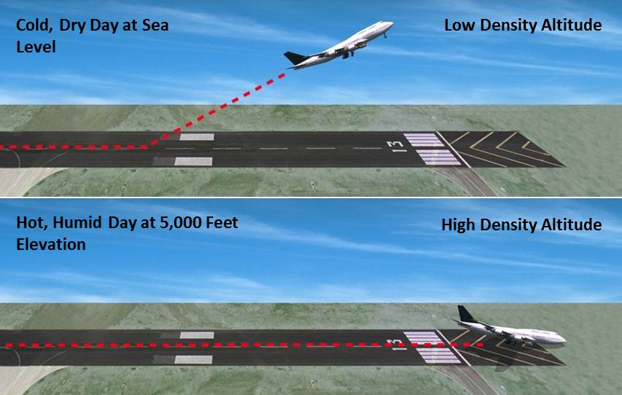
Airport operations with and without an operating
control tower.
UA.V.A.K1
UA.IV.A.K1a

Slide 7
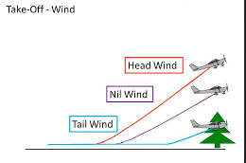
Airport operations with and without an operating
control tower.
UA.V.A.K1
UA.IV.A.K1a

Slide 8
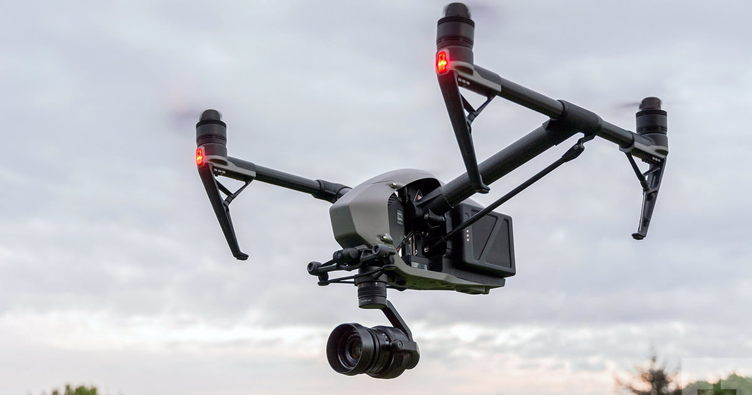
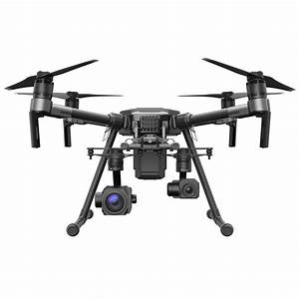
Airport operations with and without an operating
control tower.
UA.V.A.K1
UA.IV.A.K1a
Notes:
Highlight that some sUAS will automatically adjust the CG based on the payload installed.

Slide 9
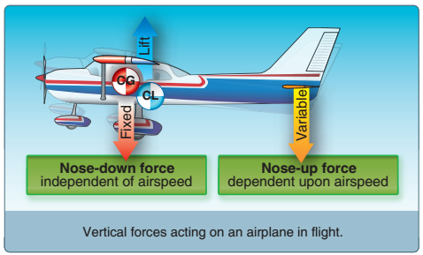
Airport operations with and without an operating
control tower.
Center of Gravity:
The Center of Gravity is the specific point where the aircraft's mass or weight is said to center; that is, a point around which, if the aircraft could be suspended or balanced, the aircraft would remain in place at any attitude
It is computed during initial design and construction and is further affected by the installation of onboard equipment, aircraft loading, and other factors
C.G. is of major importance in an aircraft, for its position (within a designed range) has a great bearing upon longitudinal stability
UA.V.A.K1
UA.IV.A.K1a

Slide 10
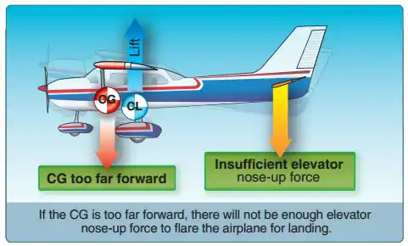
Airport operations with and without an operating
control tower.
Forward Center of Gravity:
Stable feeling
Nose Heavy
Longer takeoff distance (more airflow required to provide more force to lift heavy nose)
High stall speeds (more airflow deflection of the elevator required to maintain altitude at slower airspeeds resulting in high Angles of Attack (AoA)
UA.V.A.K1
UA.IV.A.K1a

Slide 11
Airport operations with and without an operating
control tower.
Rearward/Aft Center of Gravity:
As the C.G. moves rearward (towards the tail), the aircraft becomes more and more dynamically unstable
The tail will feel heavy to compensate, which requires additional nose down-force
Should the aircraft stall or spin, it will be much more difficult, if not impossible, to recover
Higher true airspeed
More tail down-force
Performance impacts are due to lift/drag changes
UA.V.A.K1
UA.IV.A.K1a

Slide 12
Airport operations with and without an operating
control tower.
AC 107-2A B.2 Small Unmanned Aircraft Loading and Its Effects on Performance.
B.2.2 Balance, Stability, and Center of Gravity (CG).
Adverse balance conditions (i.e., weight distribution) may affect flight characteristics in much the same manner as those mentioned for an excess weight condition. Limits for the location of the CG may be established by the manufacturer. The CG is not a fixed point marked on the aircraft; its location depends on the distribution of aircraft weight. As variable load items are shifted or expended, there may be a resultant shift in CG location. The remote PIC should determine how the CG will shift and the resultant effects on the aircraft. If the CG is not within the allowable limits after loading or does not remain within the allowable limits for safe flight, it will be necessary to relocate or shed some weight before flight is attempted.
UA.V.A.K1
UA.IV.A.K1b

Slide 13
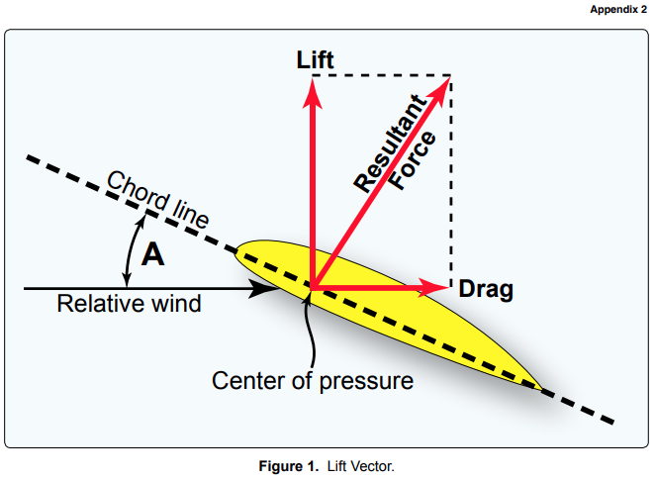
Airport operations with and without an operating
control tower.
UA.V.A.K1
UA.IV.A.K2

Slide 14
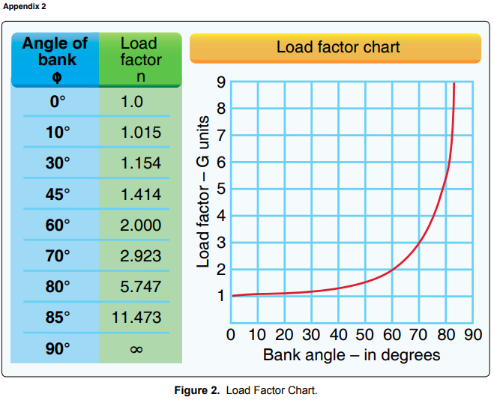
Airport operations with and without an operating
control tower.
UA.V.A.K1
UA.IV.A.K2

Slide 15
Airport operations with and without an operating
control tower.
UA.V.A.K1
UA.IV.A.K2
Notes:
How does stall speed change in a turn? 1:39 https://www.youtube.com/watch?v=3l6gxlQbbjU&t=1s

