Slide 1
UA.III Weather
B. Effects of Weather
on Performance

Slide 2
Remote Pilot – Airman Certification Standards
Task | B. Effects of Weather on Performance
References | AC 00-6; AC 107-2; AIM; FAA-H-8083-25
Objective | To determine that the applicant is knowledgeable of the effects of weather on performance.
Knowledge | The applicant demonstrates understanding of:
UA.III.B.K1 | Weather factors and their effects on performance:
UA.III.B.K1a | a. Density altitude
UA.III.B.K1b | b. Wind and currents
UA.III.B.K1c | c. Atmospheric stability, pressure, and temperature
UA.III.B.K1d | d. Air masses and fronts
UA.III.B.K1e | e. Thunderstorms and microbursts
UA.III.B.K1f | f. Tornadoes
UA.III.B.K1g | g. Icing
UA.III.B.K1h | h. Hail
UA.III.B.K1i | i. Fog
UA.III.B.K1j | j. Ceiling and visibility
UA.III.B.K1k | k. Lightning

Slide 3
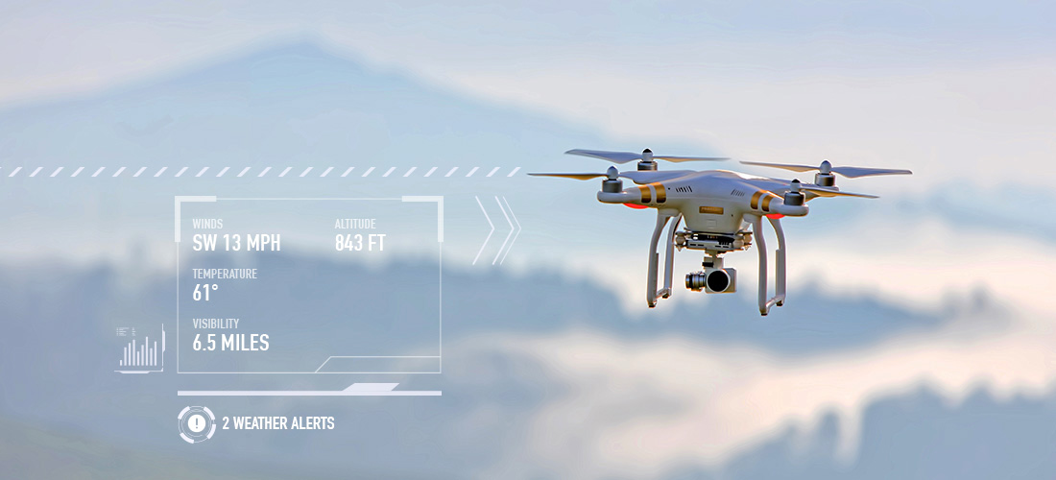
Weather factors and their effects on performance:
UA.III.B.K1

Slide 4
Density altitude
The more appropriate term for correlating aerodynamic performance in the nonstandard atmosphere is density altitude—the altitude in the standard atmosphere corresponding to a particular value of air density.
Density altitude is pressure altitude corrected for nonstandard temperature. As the density of the air increases (lower density altitude), aircraft performance increases. Conversely, as air density decreases (higher density altitude), aircraft performance decreases. A decrease in air density means a high density altitude; an increase in air density means a lower density altitude. Density altitude is used in calculating aircraft performance. Under standard atmospheric condition, air at each level in the atmosphere has a specific density; under standard conditions, pressure altitude and density altitude identify the same level. Density altitude, then, is the vertical distance above sea level in the standard atmosphere at which a given density is to be found.
Pilot Handbook of Aeronautical Knowledge, pg 11-3
UA.III.B.K1a

Slide 5
Pressure altitude
Pressure altitude is the height above the standard datum plane (SDP). The aircraft altimeter is essentially a sensitive barometer calibrated to indicate altitude in the standard atmosphere. If the altimeter is set for 29.92 "Hg SDP, the altitude indicated is the pressure altitude—the altitude in the standard atmosphere corresponding to the sensed pressure.
The SDP is a theoretical level at which the pressure of the atmosphere is 29.92 "Hg and the weight of air is 14.7 psi. As atmospheric pressure changes, the SDP may be below, at, or above sea level. Pressure altitude is important as a basis for determining aircraft performance, as well as for assigning flight levels to aircraft operating at above 18,000 feet.
Pilot Handbook of Aeronautical Knowledge, pg 11-3
UA.III.B.K1a

Slide 6
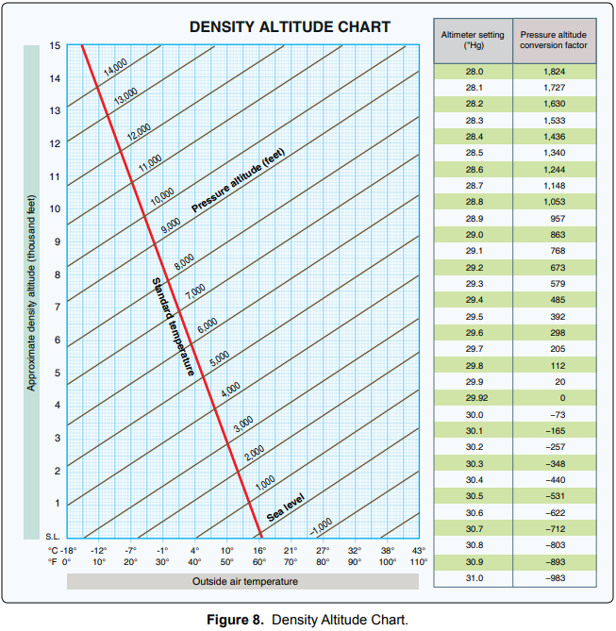
Pressure altitude
KMBT 614' MSL
Current Altimeter 29.92" Hg
Pressure Altitude?
614' MSL + 0 = 614' MSL
Airman Knowledge Testing Supplement for Sport Pilot, Recreational Pilot, Remote Pilot, and Private Pilot
UA.III.B.K1a
Notes:
Feel free to change airport to an airport near you.

Slide 7
Pressure altitude
KMBT 614' MSL
Current Altimeter 29.92" Hg
Pressure Altitude?
614' MSL + 0 = 614' MSL
Current Altimeter 30.25" Hg
Pressure Altitude?
614' MSL + —302.5 = 311.5' MSL
30.2 | -257
30.25 | -302.5
30.3 | -348
Airman Knowledge Testing Supplement for Sport Pilot, Recreational Pilot, Remote Pilot, and Private Pilot
UA.III.B.K1a

Slide 8
Pressure altitude
KMBT 614' MSL
Current Altimeter 29.92" Hg
Pressure Altitude?
614' MSL + 0 = 614' MSL
Current Altimeter 30.25" Hg
Pressure Altitude?
614' MSL + —302.5 = 311.5' MSL
Current Altimeter 28.80" Hg
Pressure Altitude?
614' MSL + 1630 = 2244' MSL
Airman Knowledge Testing Supplement for Sport Pilot, Recreational Pilot, Remote Pilot, and Private Pilot
UA.III.B.K1a

Slide 9
Density altitude chart
KMBT 614' MSL
Current Altimeter 29.92" Hg
Pressure Altitude
614' MSL
Temperature 15°C/59°F
Density Altitude ?
614' MSL
Airman Knowledge Testing Supplement for Sport Pilot, Recreational Pilot, Remote Pilot, and Private Pilot
UA.III.B.K1a

Slide 10
Density altitude chart
KMBT 614' MSL
Current Altimeter 28.80" Hg
Pressure Altitude
2244' MSL
Temperature 32°C/90°F
Density Altitude ?
≈4650' MSL
Airman Knowledge Testing Supplement for Sport Pilot, Recreational Pilot, Remote Pilot, and Private Pilot
UA.III.B.K1a

Slide 11
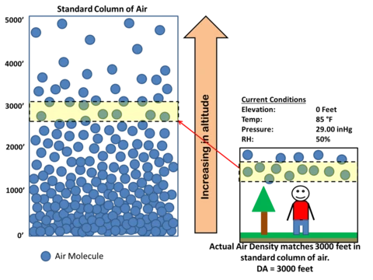
Density altitude
UA.III.B.K1a

Slide 12
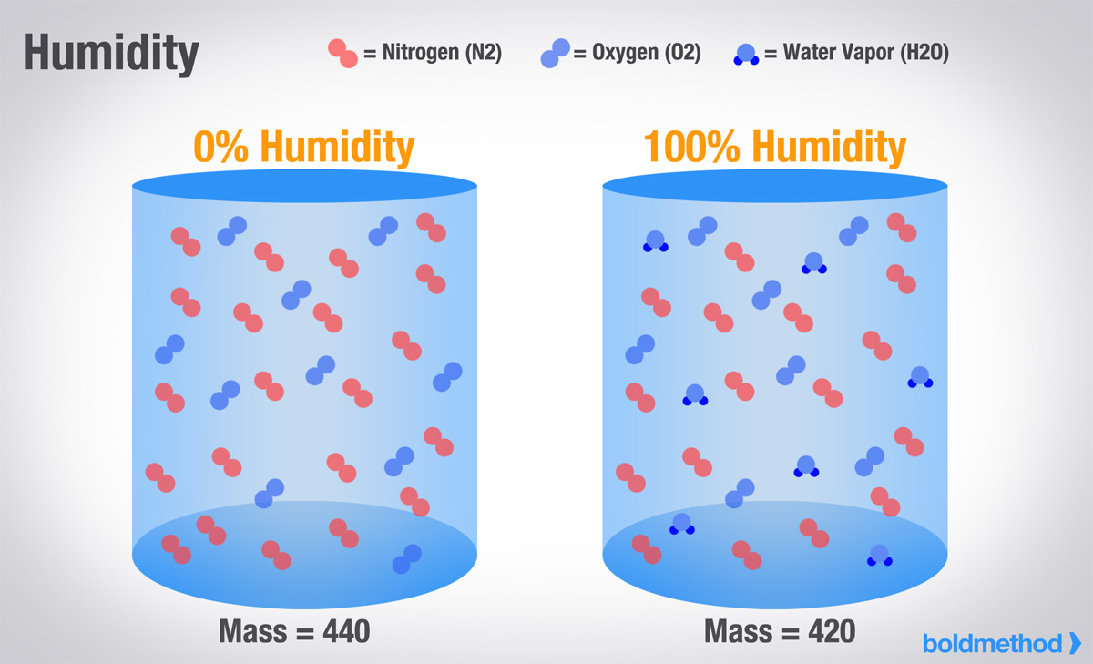
Density altitude
UA.III.B.K1a

Slide 13
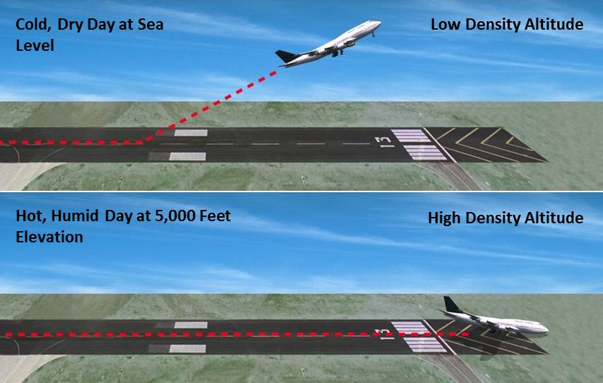
Density altitude
UA.III.B.K1a

Slide 14
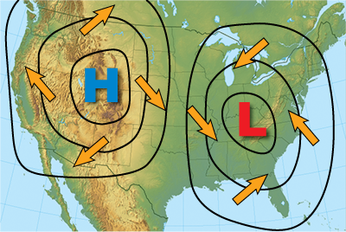
Wind and currents
UA.III.B.K1b

Slide 15
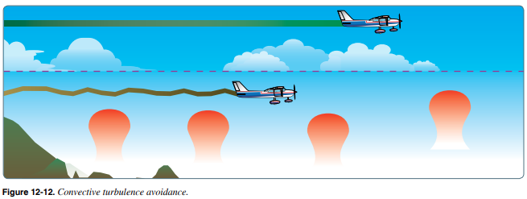
Wind and currents
UA.III.B.K1b

Slide 16
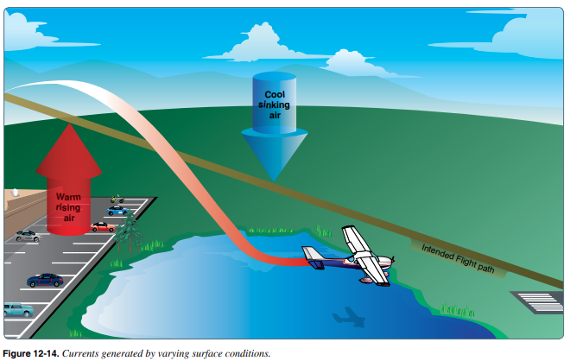
Wind and currents
UA.III.B.K1b

Slide 17
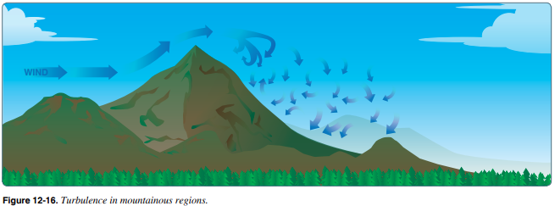
Wind and currents
UA.III.B.K1b

Slide 18
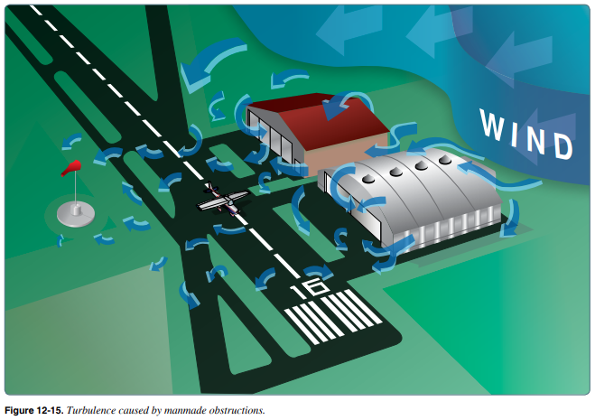
Wind and currents
UA.III.B.K1b

Slide 19
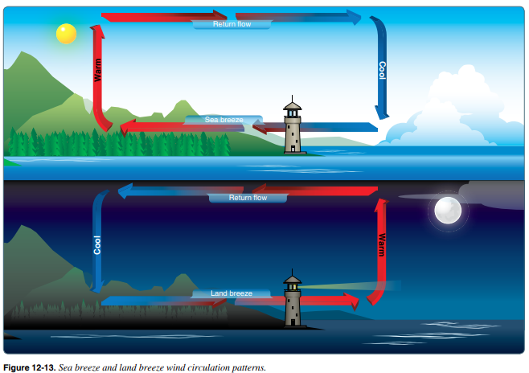
Wind and currents
UA.III.B.K1b

Slide 20
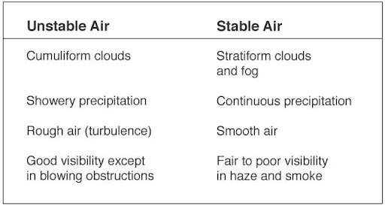
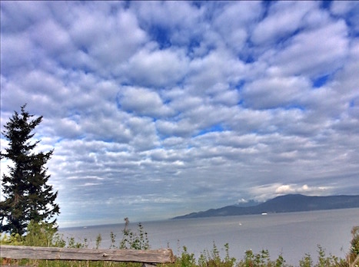
Atmospheric stability, pressure, and temperature
UA.III.B.K1c

Slide 21
Atmospheric stability, pressure, and temperature
STD Day 5°C = 41°F
Std Day 15°C = 59°F
UA.III.B.K1c

Slide 22
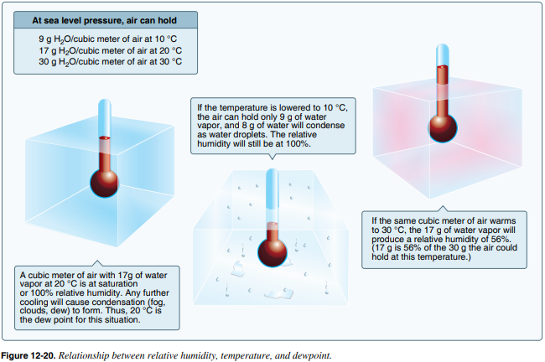
Atmospheric stability, pressure, and temperature
UA.III.B.K1c

Slide 23
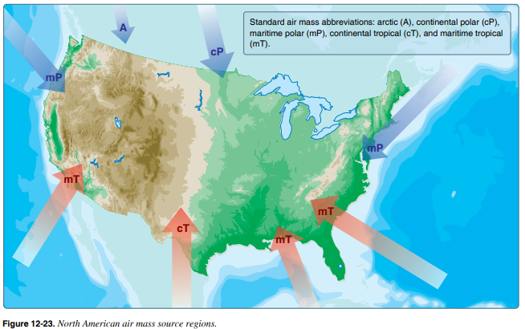
Air masses and fronts
UA.III.B.K1d

Slide 24
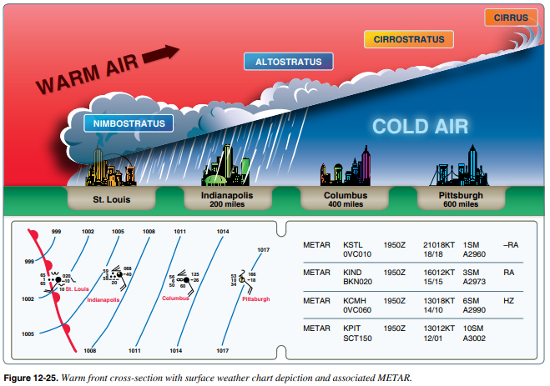
Air masses and fronts
UA.III.B.K1d

Slide 25
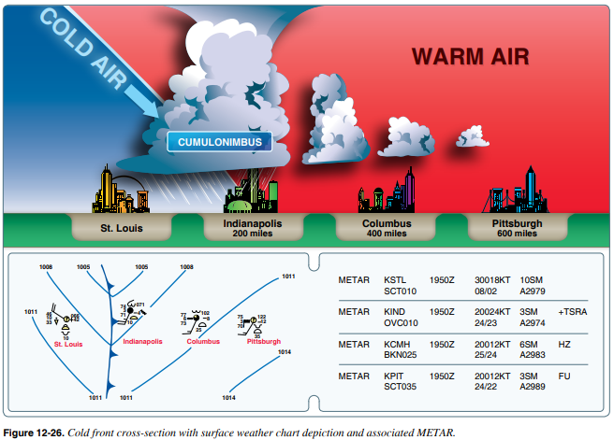
Air masses and fronts
UA.III.B.K1d

Slide 26
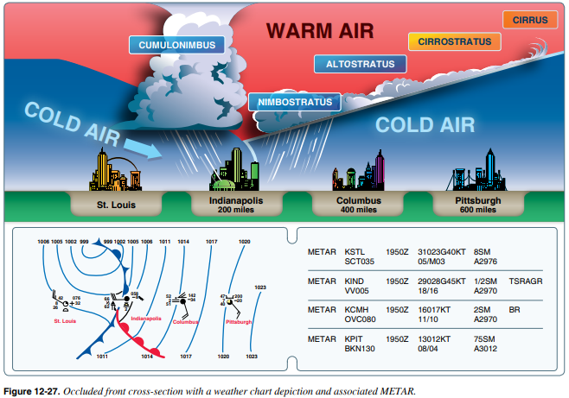
Air masses and fronts
UA.III.B.K1d

Slide 27
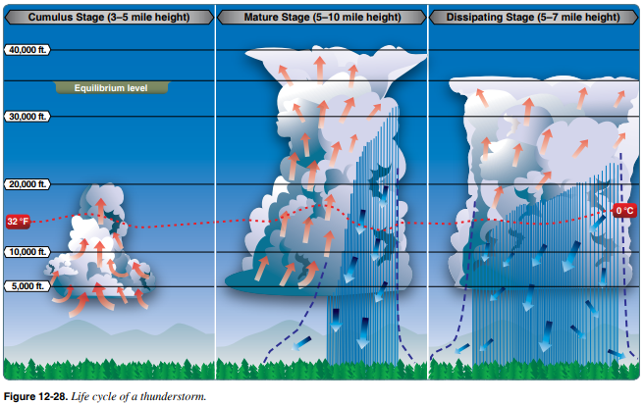
Thunderstorms and microbursts
UA.III.B.K1e

Slide 28
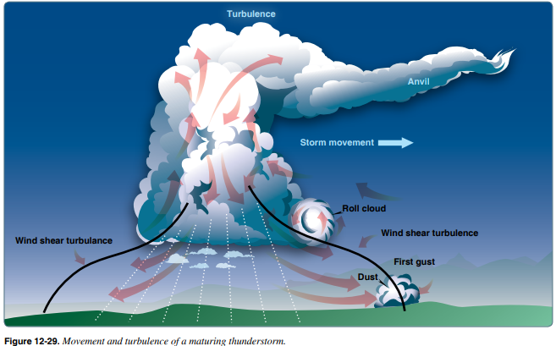
Thunderstorms and microbursts
UA.III.B.K1e

Slide 29
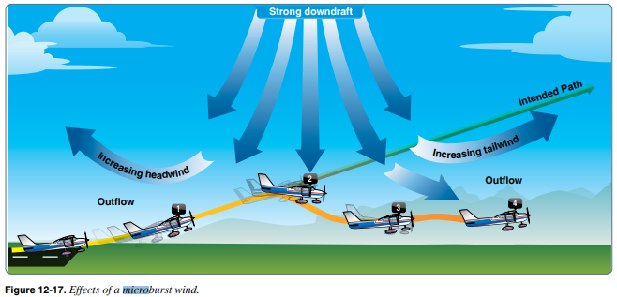
Thunderstorms and microbursts
UA.III.B.K1e

Slide 30
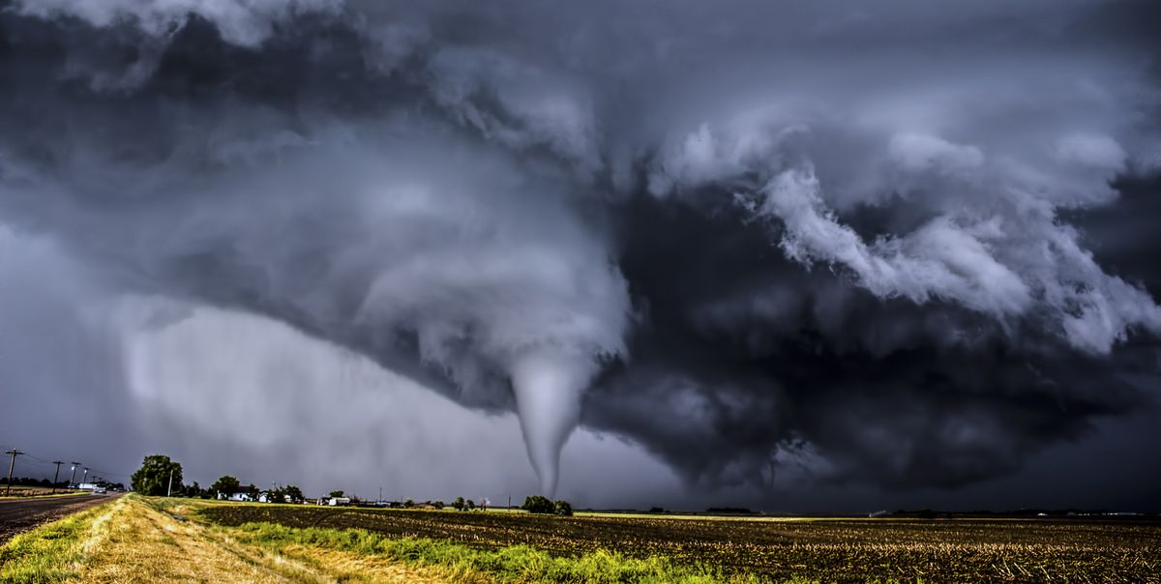
Tornadoes
UA.III.B.K1f

Slide 31
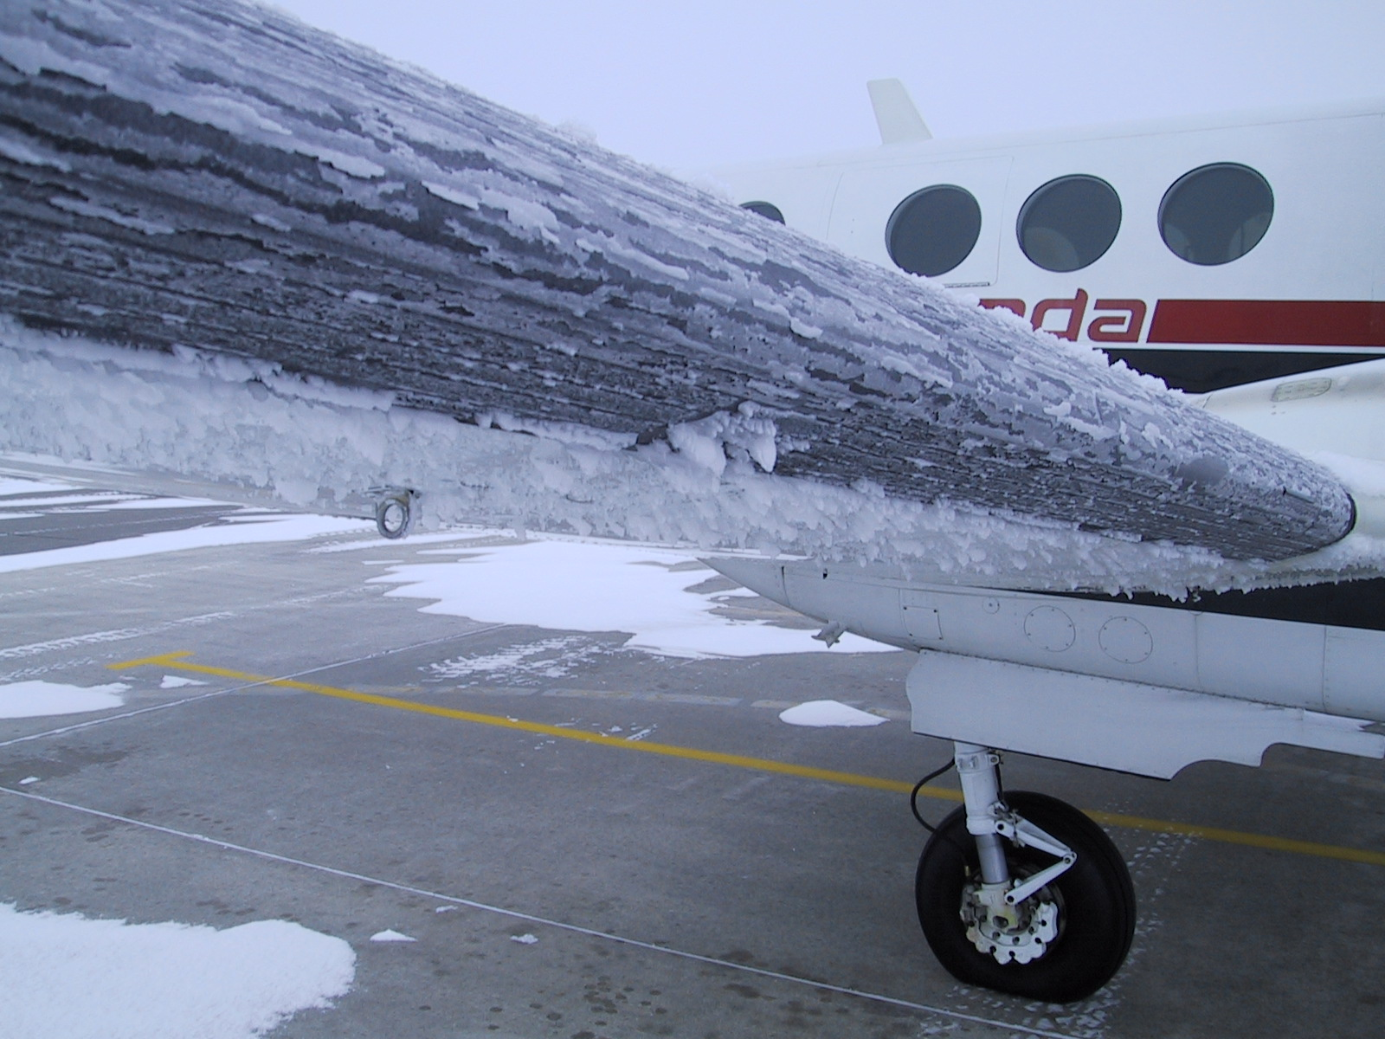
Icing
Two conditions are necessary for structural icing in flight:
1. The aircraft must be flying through visible water such as rain or cloud droplets
2. The temperature at the point where the moisture strikes the aircraft must be 0° C or colder.
Aerodynamic cooling can lower temperature of an airfoil to 0° C even though the ambient temperature is a few degrees warmer.
UA.III.B.K1g

Slide 32
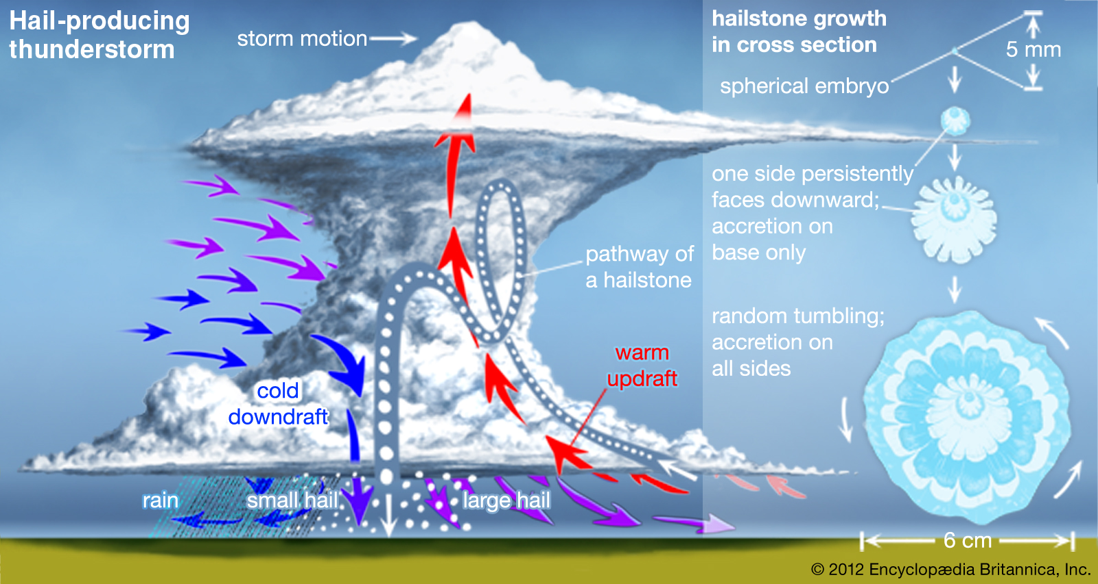
Hail
UA.III.B.K1h

Slide 33
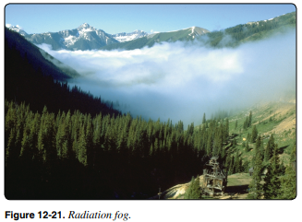
Fog
Radiation Fog
Clear nights
No wind
Ground cools rapidly
UA.III.B.K1i

Slide 34
Fog
Advection Fog
Wind up to 15 knots
Warm moist air
Cold Surface
Mostly coastal areas
UA.III.B.K1i

Slide 35
Fog
Upslope Fog
Moist stable air
Forced up slope
Requires wind
UA.III.B.K1i

Slide 36
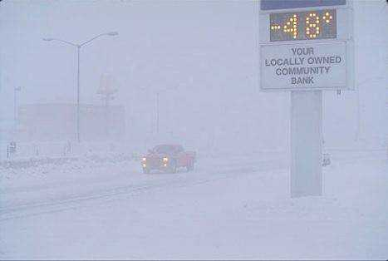
Fog
Ice Fog
Cold weather
Water forms ice crystals
Requires cold temperature
UA.III.B.K1i

Slide 37
Ceiling and visibility
Ceiling
For aviation purposes, a ceiling is the lowest layer of clouds reported as being broken or overcast, or the vertical visibility into an obscuration like fog or haze. Clouds are reported as broken when five-eighths to seven-eighths of the sky is covered with clouds. Overcast means the entire sky is covered with clouds. Current ceiling information is reported by the aviation routine weather report (METAR) and automated weather stations of various types.
Visibility
Closely related to cloud cover and reported ceilings is visibility information. Visibility refers to the greatest horizontal distance at which prominent objects can be viewed with the naked eye. Current visibility is also reported in METAR and other aviation weather reports, as well as by automated weather systems. Visibility information, as predicted by meteorologists, is available for a pilot during a preflight weather briefing.
UA.III.B.K1j

Slide 38
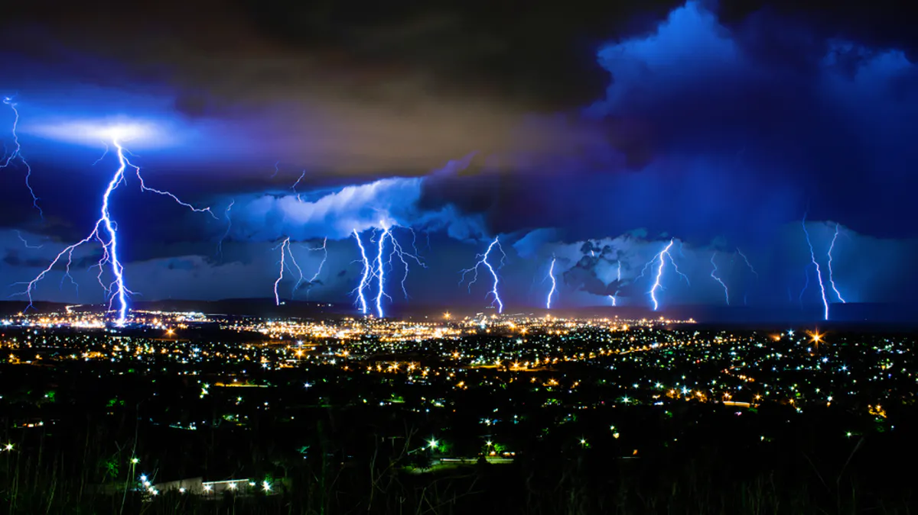
Lightning
UA.III.B.K1k

