Slide 1
UA.III Weather
A. Sources of Weather

Slide 2
Remote Pilot – Airman Certification Standards
Task | A. Sources of Weather
References | AC 107-2; FAA-H-8083-25; AIM
Objective | To determine that the applicant is knowledgeable in sources of weather information.
Knowledge | The applicant demonstrates understanding of:
UA.III.A.K1 | Internet weather briefing and sources of weather available for flight planning purposes.
UA.III.A.K2 | Aviation routine weather reports (METAR).
UA.III.A.K3 | Terminal aerodrome forecasts (TAF).
UA.III.A.K4 | Weather charts.
UA.III.A.K5 | Automated surface observing systems (ASOS) and automated weather observing systems (AWOS).
Risk Management | [Reserved]
Skills | [Not applicable]

Slide 3
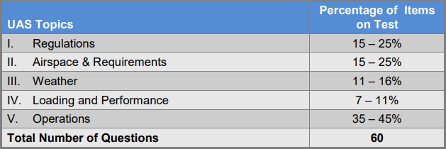
Certification Knowledge Test Description

Slide 4
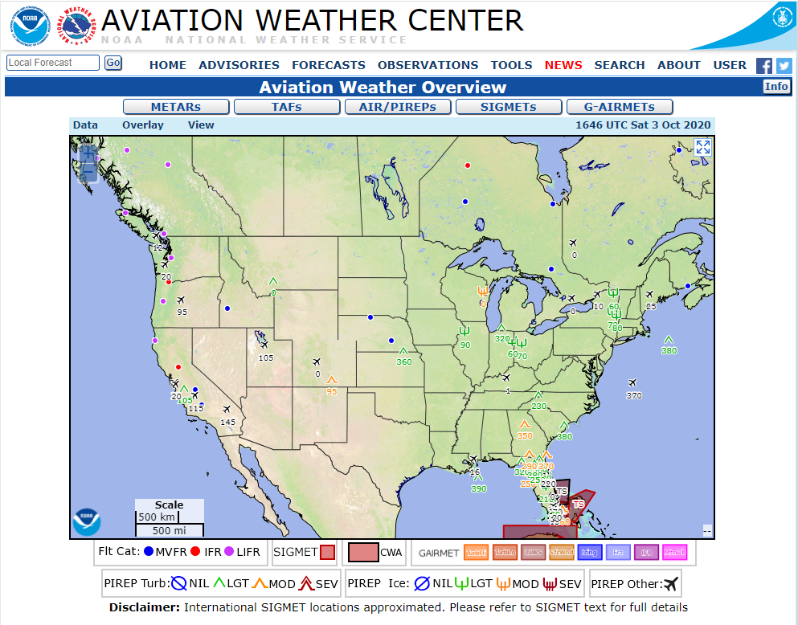
Internet weather briefing and sources of weather
available for flight planning purposes
UA.III.A.K1
https://www.aviationweather.gov/
Notes:
Highlight the use of https://www.aviationweather.gov/ to determine current and forecasted weather.

Slide 5
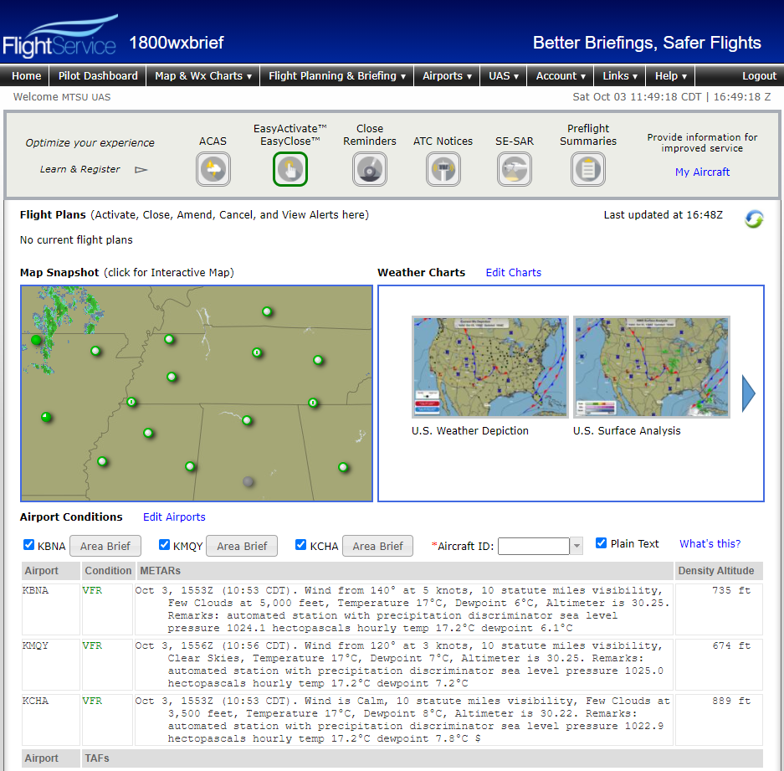
Internet weather briefing and sources of weather
available for flight planning purposes
UA.III.A.K1
1800wxbrief.com
Notes:
Have learners create an account for future use. Highlight the use of 1800wxbrief.com to determine current and forecasted weather. Show learners the decode feature to show METARs and TAFs in plain language. Also show the NOTAM feature.

Slide 6
Internet weather briefing and sources of weather
available for flight planning purposes
Types of Briefing
Standard Briefing - Operation < 6 hours
Abbreviated Update – Update Standard Briefing
Outlook Briefing - Operation > 6 hours
1 800 wx-brief (1 800 992-7433)
UA.III.A.K1
Notes:
Describe the benefits of talking to a FSS Briefer and the 3 different types of briefings.

Slide 7
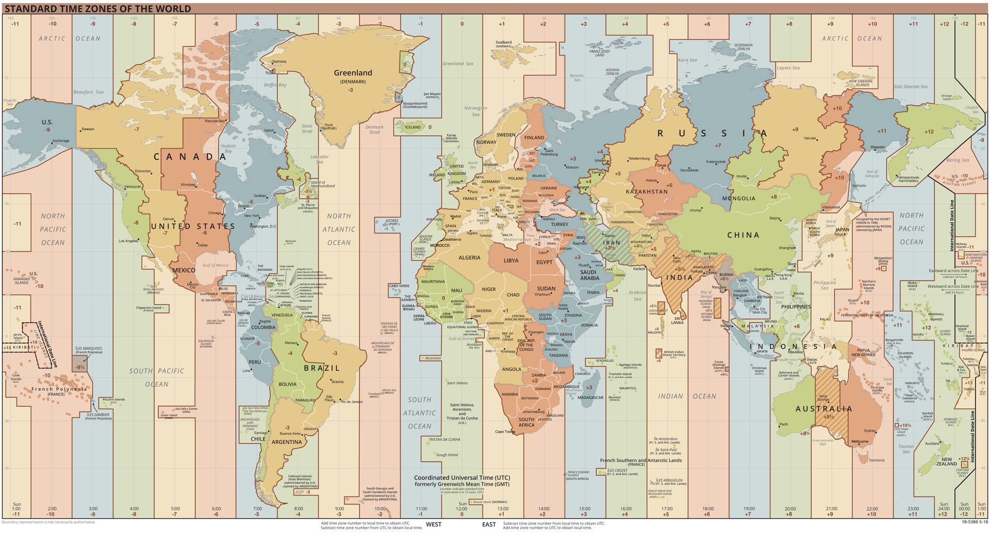
Aviation routine weather reports (METAR)
Greenwich Mean Time (GMT)
Universal Coordinate Time (UTC)
Zulu Time (Z)
UA.III.A.K2
Notes:
Discuss time zones and highlight how aviation time is based on UTC. Explain how to determine local time from UTC.

Slide 8
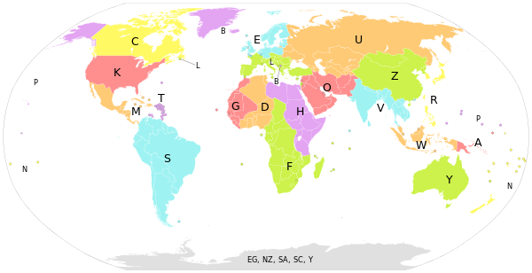
ICAO Airport Codes
UA.III.A.K2
Notes:
Discuss IACO airport codes.

Slide 9
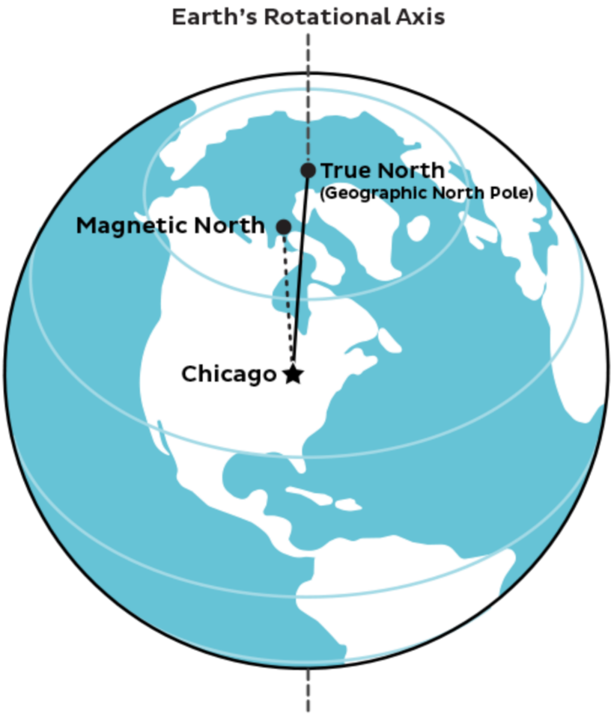
Aviation routine weather reports (METAR)
UA.III.A.K2
Notes:
Highlight the difference between true north and magnetic north.

Slide 10
Aviation routine weather reports (METAR)
METAR = Meteorological Aerodrome Report (current time)
Airman Knowledge Testing Supplement for Sport Pilot, Recreational Pilot, Remote Pilot, and Private Pilot
UA.III.A.K2
Notes:
Ref. Fig 12 in test supplement. Discuss basic purpose of METAR. The next slides will show how to decipher a METAR.

Slide 11
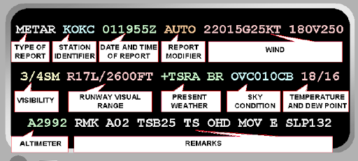
Aviation routine weather reports (METAR)
UA.III.A.K2
Notes:
METAR decode.

Slide 12
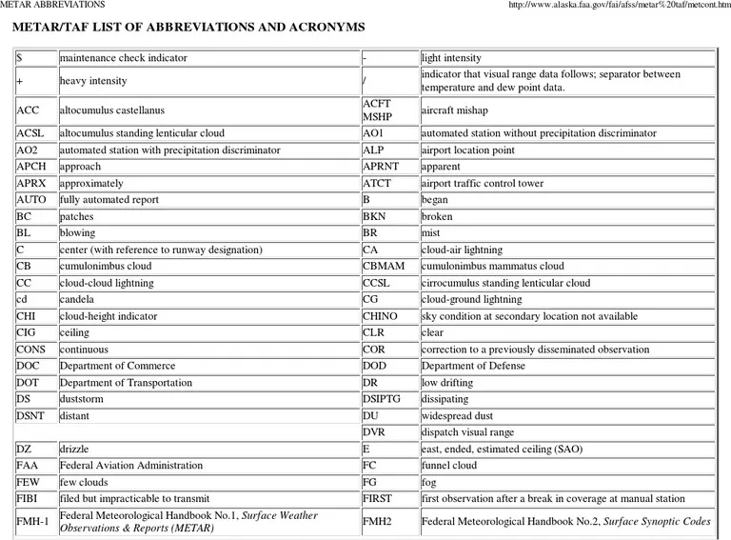
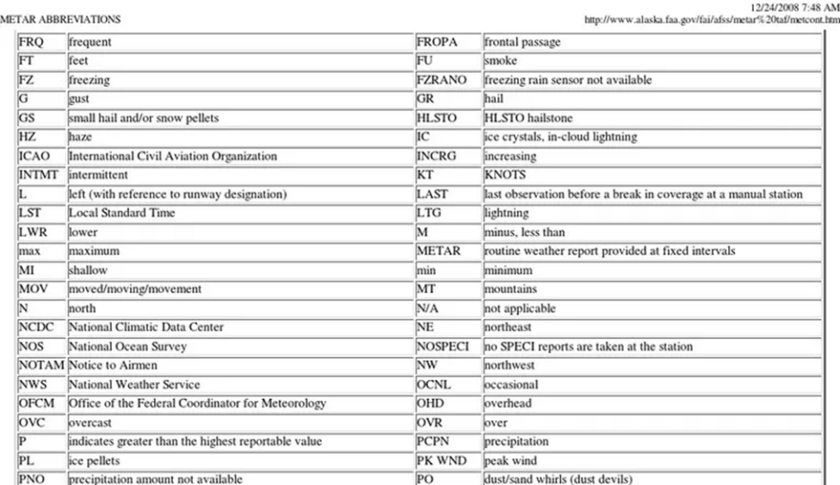
Aviation routine weather reports (METAR)
UA.III.A.K2
Notes:
METAR abbreviations and acronyms. Learners should have an understanding of the most common acronyms.

Slide 13
Aviation routine weather reports (METAR)
Type of Report: METAR
Station Identifier: Winkler County Airport, TX
Day/Time of the METAR: 12th day of the month at 1845Z
Wind Direction & Velocity: 110 degrees true 12 knots gusting to 18 knots
Prevailing Visibility: 15 statue miles
Sky Condition: Sky clear
Temperature/Dewpoint: 25°c/17°c
Altimeter Setting: 30.00 inches of mercury
UA.III.A.K2
Notes:
Animated decode of KINK METAR from Fig. 12

Slide 14
Aviation routine weather reports (METAR)
Prevailing Visibility: 1.5 statue miles
Wind Direction & Velocity: 320 degrees true at 5 knots
Day/Time of the METAR Issue: 12th day of the month at 1856Z
Station Identifier: Chicago Midway Airport, IL
Type of Report: Special METAR
Present Weather: Rain
Sky Condition: Overcast 700' AGL
Temperature/Dewpoint: 17°c/16°c
Altimeter Setting: 29.80 inches of mercury
Remarks: Rain began at 35 minutes past the hour
UA.III.A.K2
Notes:
Animated decode of KMDW SPECI METAR from Fig. 12

Slide 15
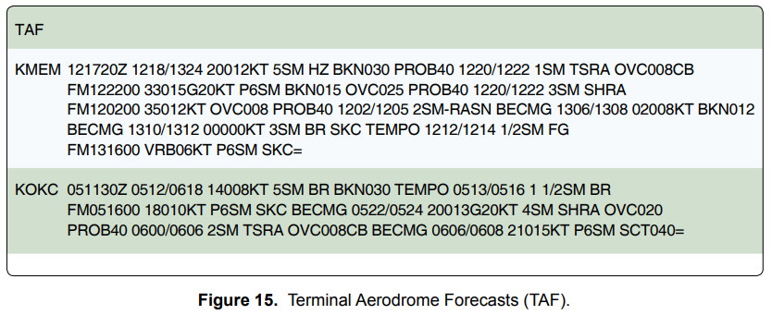
Terminal aerodrome forecasts (TAF)
TAF = Terminal Aerodrome Forecast (future, between 24 - 30 hours ahead)
Airman Knowledge Testing Supplement for Sport Pilot, Recreational Pilot, Remote Pilot, and Private Pilot
UA.III.A.K3
Notes:
Discus purpose of TAF . Use Fig. 15 from test supplement

Slide 16
Aviation routine weather reports (METAR)
UA.III.A.K2
Notes:
TAF abbreviations and acronyms. Learners should have an understanding of the most common acronyms.

Slide 17
Terminal aerodrome forecasts (TAF)
UA.III.A.K3
Notes:
Highlight the day/time TAF created and forecast periods. More info on decode shown on following slides.

Slide 18
TAF KOKC
UA.III.A.K3
Notes:
Highlight the day/time TAF created and forecast periods. More info on decode shown on following slides.

Slide 19
TAF KOKC
Station Identifier: Oklahoma City , OK
Issuance Day/Time: 5th day of the month at 1130Z
Validity Day(s)/Times: From the 5th day of the month at 1200Z until 6th day of the month at 1800Z
Wind Direction & Velocity: 140 degrees true 8 knots
Forecast Visibility: 5 statue miles
Significant Present, Forecast and Recent Weather: BR = Mist
Sky Condition: BKN = Broken 3000' AGL
UA.III.A.K3
Notes:
Animated decode of KOKC TAF (Fig. 15)

Slide 20
TAF KOKC
Significant Present, Forecast and Recent Weather: BR = Mist
Forecast Visibility: 1.5 statue miles
Validity Day(s)/Times: From the 5th day of the month at 1300Z until 5th day of the month at 1600Z
TEMPO: Temporary
Validity Day(s)/Times: From the 5th day of the month at 1600Z until the next forecast validity period
Forecast Wind Direction & Velocity: 180 degrees true 10 knots
Forecast Visibility: P = Greater Than 6 statue miles
Forecast Sky Condition: SKC = Sky Clear
UA.III.A.K3
Notes:
Animated decode of KOKC TAF (Fig. 15)

Slide 21
TAF KOKC
BECMG: Becoming
Validity Day(s)/Times: From the 5th day of the month at 2200Z until 5th day of the month at 2400Z
Forecast Wind Direction & Velocity: 200 degrees true 13 knots gusting 20 knots
Forecast Visibility: 4 statue miles
Significant Present, Forecast and Recent Weather: SH = Showers RA = Rain
Forecast Sky Condition: OVC = Overcast 2000' AGL
UA.III.A.K3
Notes:
Animated decode of KOKC TAF (Fig. 15)

Slide 22
TAF KOKC
Forecast Sky Condition: OVC = Overcast 800' AGL CB = Cumulonimbus
Significant Present, Forecast and Recent Weather: TS = Thunderstorms RA = Rain
Forecast Visibility: 2 statue miles
Validity Day(s)/Times: From the 6th day of the month at 0000Z until 6th day of the month at 0600Z
PROB40: PROB = Probability 40 = 40 percent
UA.III.A.K3
Notes:
Animated decode of KOKC TAF (Fig. 15)

Slide 23
TAF KOKC
BECMG: Becoming
Validity Day(s)/Times: From the 6th day of the month at 0600Z until 6th day of the month at 0800Z
Forecast Wind Direction & Velocity: 210 degrees true 15 knots
Forecast Visibility: P = Greater Than 6 statue miles
Forecast Sky Condition: SCT = Scattered 4000' AGL
= : End
UA.III.A.K3
Notes:
Animated decode of KOKC TAF (Fig. 15)

Slide 24
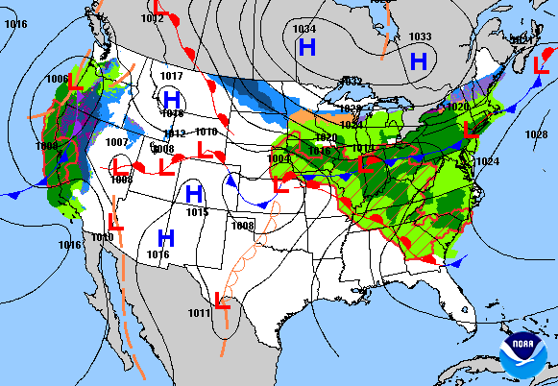
Weather charts
UA.III.A.K4
Notes:
Discuss weather charts.

Slide 25
Weather charts
UA.III.A.K4
Notes:
Discuss weather charts symbols

Slide 26
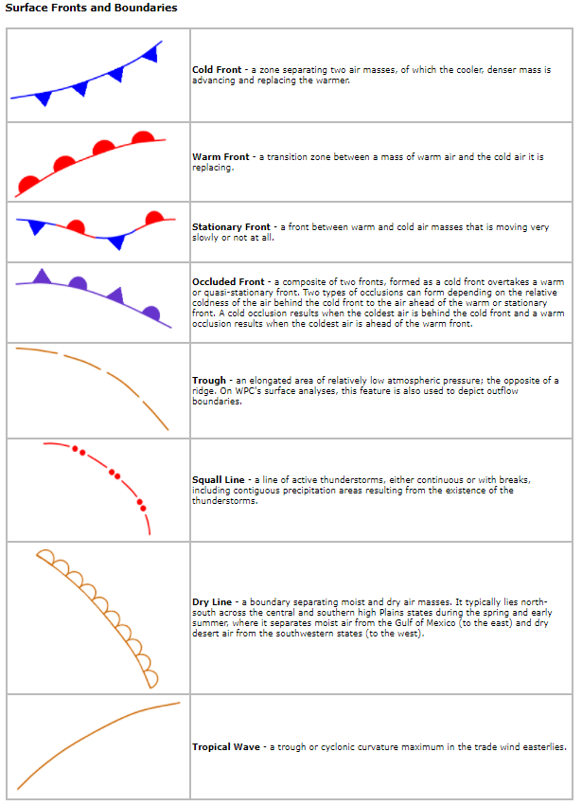
Weather charts
UA.III.A.K4
Notes:
Discuss weather charts symbols

Slide 27
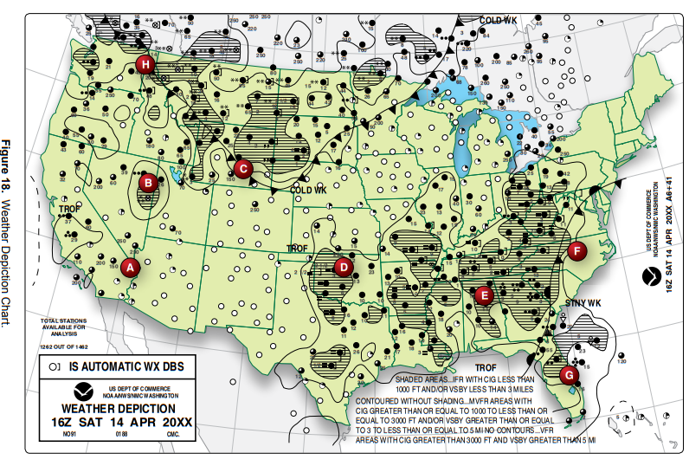
Weather charts
Airman Knowledge Testing Supplement for Sport Pilot, Recreational Pilot, Remote Pilot, and Private Pilot
UA.III.A.K4
Notes:
Discuss weather charts (Fig. 15)

Slide 28
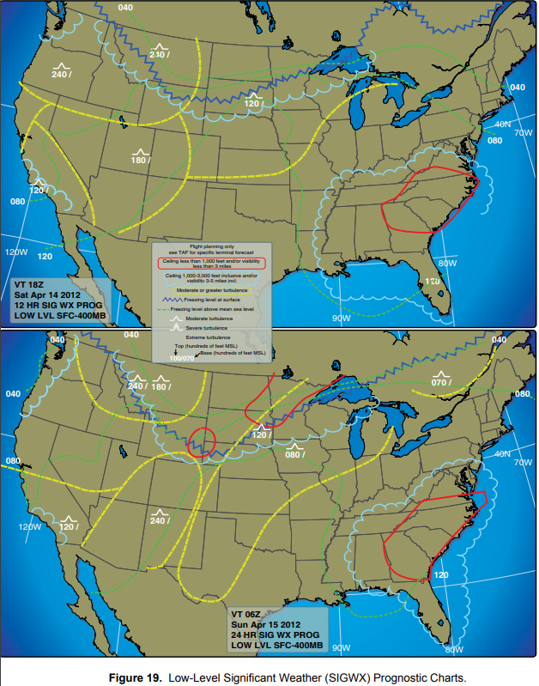
Weather charts
Airman Knowledge Testing Supplement for Sport Pilot, Recreational Pilot, Remote Pilot, and Private Pilot
UA.III.A.K4
Notes:
Discuss weather charts (Fig. 19). Highlight the need to select the right valid time (VT) to answer test question.

Slide 29
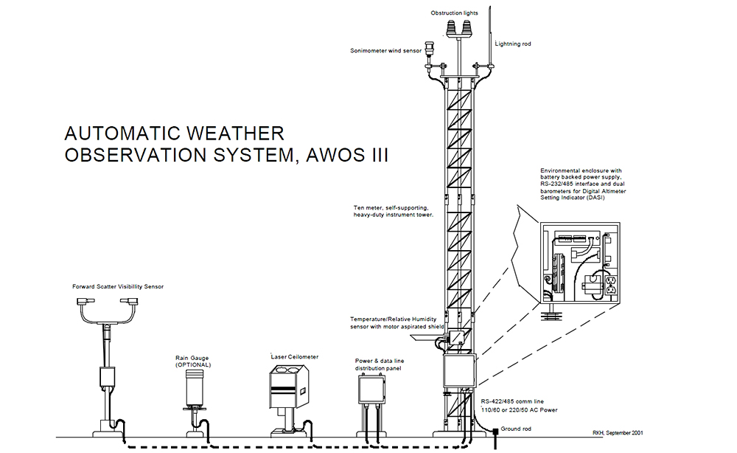
Automated surface observing systems (ASOS) and
automated weather observing systems (AWOS)
(AWOS)
UA.III.A.K5
Notes:
Briefly describe ASOS and AWOS

Slide 30
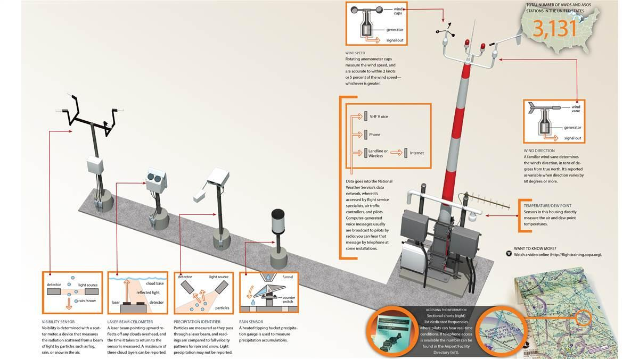
Automated surface observing systems (ASOS) and
automated weather observing systems (AWOS)
(ASOS)
(ASOS)
UA.III.A.K5

