Slide 1
Remote Pilot
UA.i: Starting the Course
Notes:
Educator: Welcome to the sUAS Remote Pilot Certification course. Below, you will find links to the presentation slide deck that corresponds with the REMOTE PILOT Small Unmanned Aircraft Systems Knowledge Test Study Guide. You are encouraged to modify the slides as necessary to suit your course and teaching approach.

Slide 2
Notes:
One of the requirements for this course is for the learner to successfully pass the Unmanned Aircraft General Knowledge Test and receive their FAA Remote Pilot Certification (shown here).

Slide 3
Topics
UA.i: Starting the Course
A: Course Navigation
B: Syllabus
C: FAA UAS Website
D: Remote Pilot - Airman Certification Standards
E: Create an FAA Tracking Number (FTN)
F: Create PSI Testing Account
G: Create FAA Drone Zone Account
Notes:
Course topics.

Slide 4
Course Navigation
UA.i.A
Notes:
If you are using an LMS for your course describe how to navigate the course.

Slide 5
Syllabus
UA.i.B
Notes:
Provide the learner with an overview of the syllabus and course expectations.

Slide 6
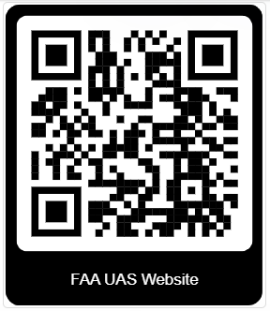
FAA UAS Website
https://www.faa.gov/uas
UA.i.C
Notes:
One of the best resources for both educators and learners is the FAA UAS website. Show learners content available to them at www.faa.gov/uas. Highlight the information available under the Certificated Remote Pilot including Commercial Operators section. Let the learner know that a step-by-step guide to getting their Remote Piote certificate is shown in the Become a Drone Pilot link.

Slide 7
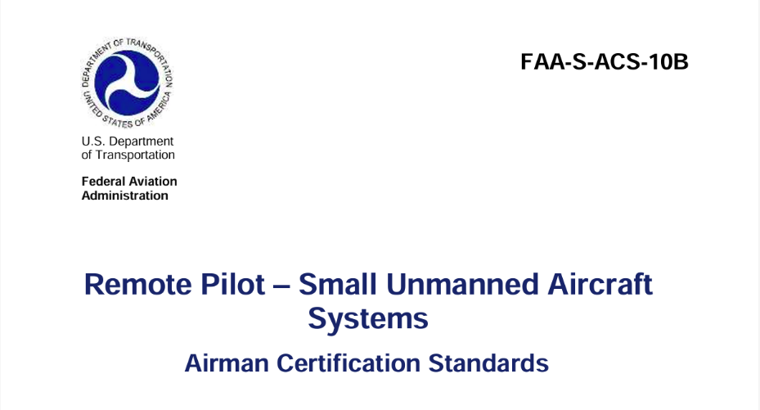
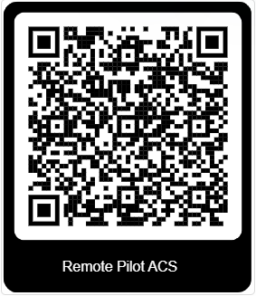
Airman Certification Standards (ACS)
https://www.faa.gov/training_testing/testing/acs/uas_acs.pdf
UA.i.D
Notes:
This course is based on the FAA Remote Pilot ACS. Show the learners how the ACS is organzized and information contained in the Appendices.

Slide 8
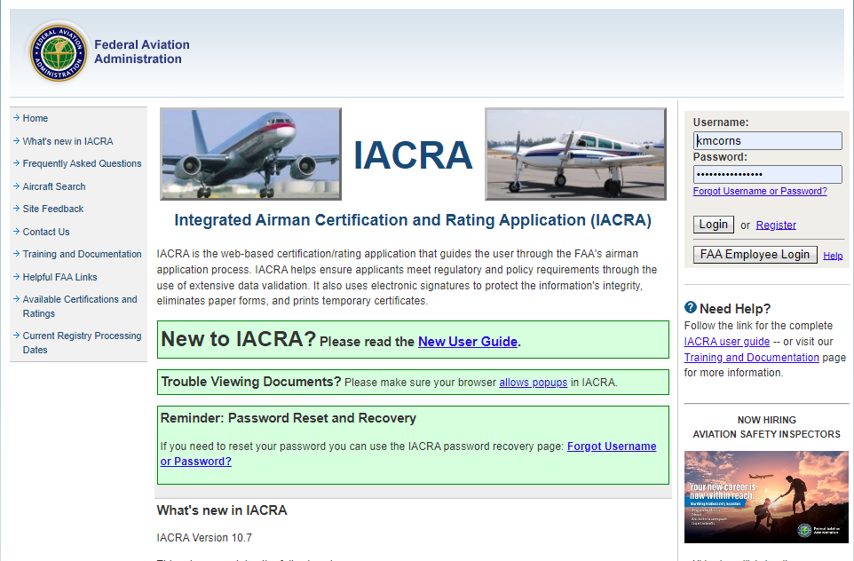
FAA Tracking Number (FTN)
https://iacra.faa.gov/IACRA/Default.aspx
UA.i.E
Notes:
IACRA is a web-based certification and rating application that assists users in navigating the FAA's airman application process. It ensures applicants comply with regulatory and policy requirements by performing thorough data validation. Learners will need to create an account and obtain an FAA Tracking Number (FTN), which is necessary to take the Unmanned Aircraft General Knowledge (UAG) test and to apply for their Remote Pilot certificate.
You can have learners create an account on their on or walk them through the process in class.

Slide 9
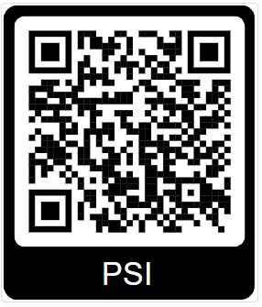
PSI
https://faa.psiexams.com/faa/login
UA.i.F
Notes:
PSI is the FAA approved third-party test provider. Learners will need to create an account in order to schedule and pay for the UAG test.

Slide 10
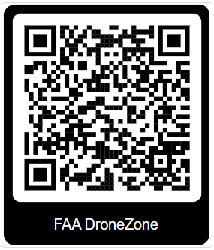
FAA DroneZone
https://faadronezone-access.faa.gov/#/
UA.i.G
Notes:
The Federal Aviation Administration’s DroneZone (FAADroneZone) is a solution specifically created to improve the customer experience and provide a single sign-on platform for the following services and any services that may be added in the future:
• Small Unmanned Aircraft System Registration System (sUASRS); • Small Unmanned Aircraft System (sUAS) Part 107 Waiver and/or Airspace Authorization (Part 107 Waiver Authorization) requests; • sUAS Part 107 Accident Reporting (Part 107 Accident Reporting); • FAA Recognized Identification Area (FRIA); • Community Based Organizations (CBO); • Certificate of Authorization DroneZone (CADZ); and • Notice of Identification (NOI).
The FAADroneZone requires account creation and authentication and provides stakeholders access to FAADroneZone services. Stakeholders include drone owners, drone operators, educational institutions, community-based organizations, and drone proponents. Additionally, the FAADroneZone provides a dashboard to authenticated users showing relevant information regarding submissions made to the FAA for regulated sUAS activities. Information provided may include a list of registered sUAS, status of waivers, authorizations, accident reports, operational guidance, or other services available on the platform. The FAADroneZone allows the FAA to group all of the sUAS back-end services used to manage the FAA’s engagement of sUAS within the National Airspace (NAS).

