Slide 1
UA.II Airspace & Op
A. Airspace Ops Req.

Slide 2
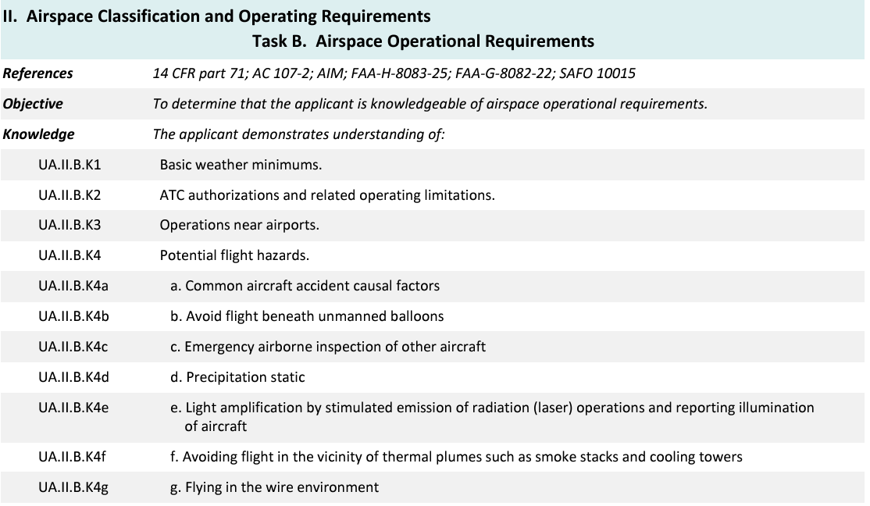
Topics

Slide 3
Topics

Slide 4
14 CFR §107—Small Unmanned Aircraft Systems
https://www.ecfr.gov/current/title-14/chapter-I/subchapter-F/part-107

Slide 5
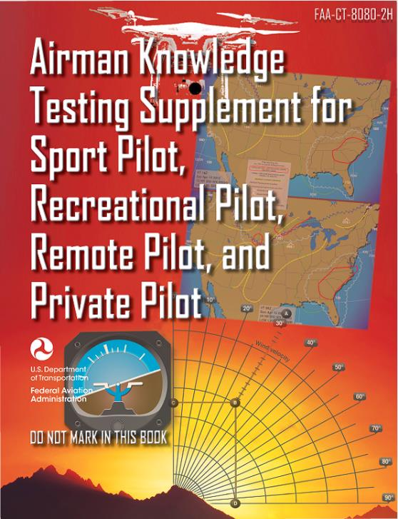
Remote Pilot Testing Supplement
https://www.faa.gov/sites/faa.gov/files/training_testing/testing/supplements/sport_rec_private_akts.pdf

Slide 6
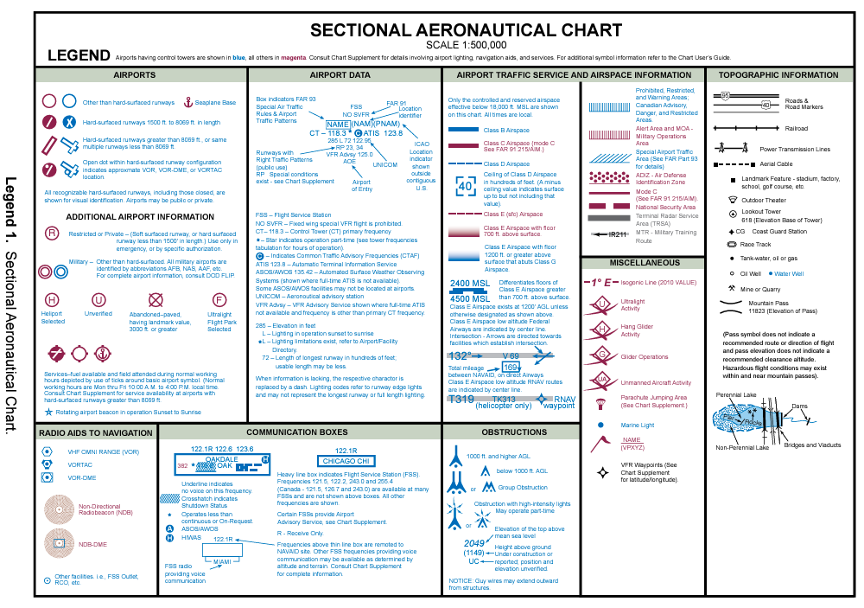

Slide 7
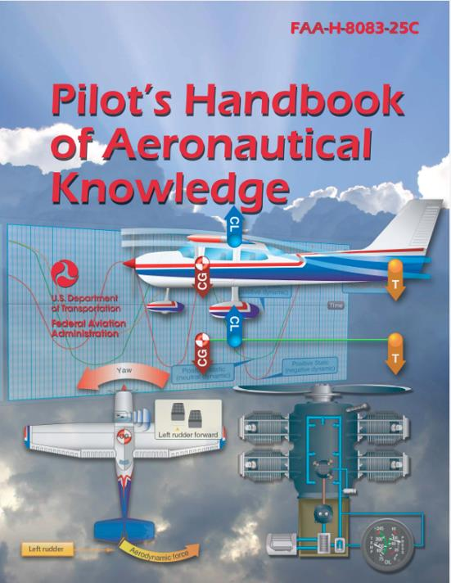
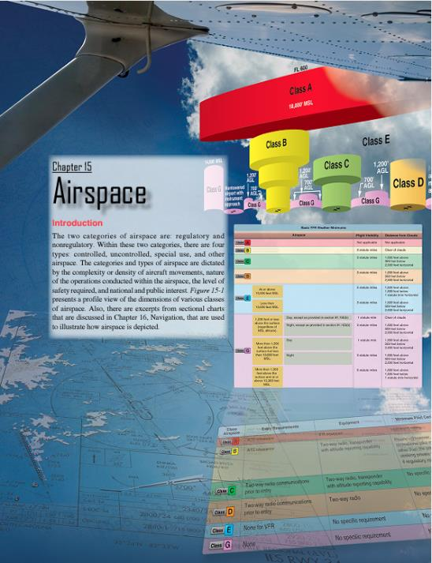
Additional Airspace Information
https://www.faa.gov/regulations_policies/handbooks_manuals/aviation/phak

Slide 8
Subpart B—Airspace Operational Requirements
§ 107.51 Operating limitations for small unmanned aircraft.
UA.II.B.K1

Slide 9
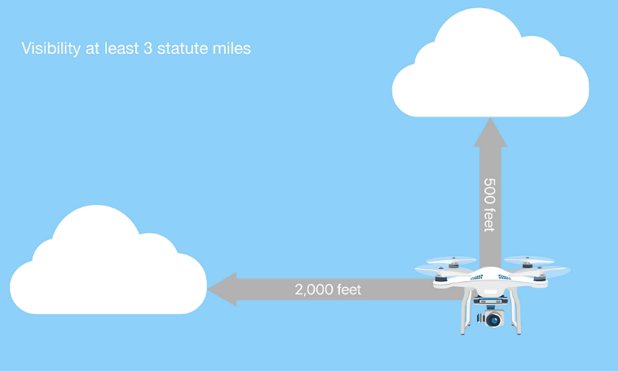
Subpart B—Airspace Operational Requirements
§ 107.51 Operating limitations for small unmanned aircraft.
UA.II.B.K1

Slide 10
Subpart B—Airspace Operational Requirements
ATC authorizations and related operating limitations AC 107-2A
5.10 Small unmanned aircraft may operate in controlled or uncontrolled airspace. Operations in Class B, Class C, or Class D airspace, or within the lateral boundaries of the surface area of Class E airspace designated for an airport, are not permitted unless that person has prior authorization from air traffic control (ATC) (§ 107.41). Information concerning the current authorization process is available at https://www.faa.gov/uas/. The remote PIC must understand airspace classifications and requirements. Failure to do so could be contrary to part 107 regulations and may potentially have an adverse effect on the safety of operations. Small UAS operating under part 107 may not be subject to part 91 requirements, because the equipage and communications requirements outlined in part 91 were designed to provide safety and efficiency in the National Airspace System (NAS). ATC authorizations may depend on operational parameters similar to those found in part 91. The FAA has the authority to approve or deny aircraft operations based on traffic density, controller workload, communication issues, or any other type of operation that could potentially impact the safe and expeditious flow of air traffic in that airspace.
UA.II.B.K2

Slide 11
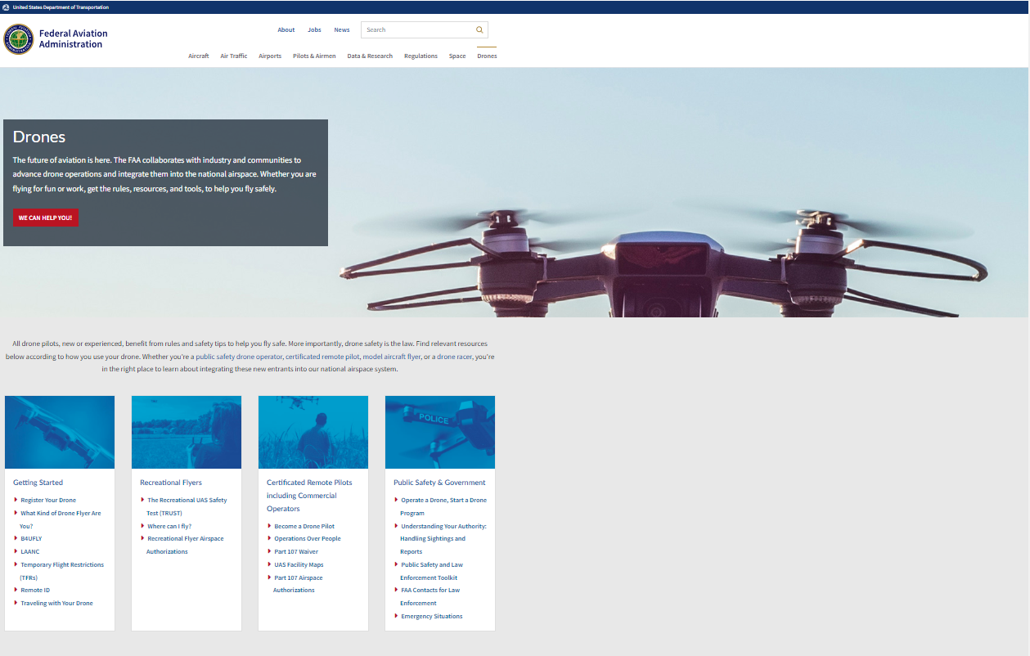
Subpart B—Airspace Operational Requirements
https://www.faa.gov/uas
UA.II.B.K2
Notes:
Go to www.faa.gov/uas
Click on UAS Facility Maps
Explain maps
Click on LAANC link and explain
Go to aloft and login
Demo LAANC

Slide 12
Subpart B—Airspace Operational Requirements
Operations near airports – Types
There are two types of airports—towered and non-towered. These types can be further subdivided to:
Civil Airports—airports that are open to the general public.
Military/Federal Government airports—airports operated by the military, National Aeronautics and Space Administration (NASA), or other agencies of the Federal Government.
Private Airports—airports designated for private or restricted use only, not open to the general public.
UA.II.B.K3

Slide 13
Subpart B—Operating Rules
§ 107.43 Operation in the vicinity of airports.
UA.I.B.K17

Slide 14
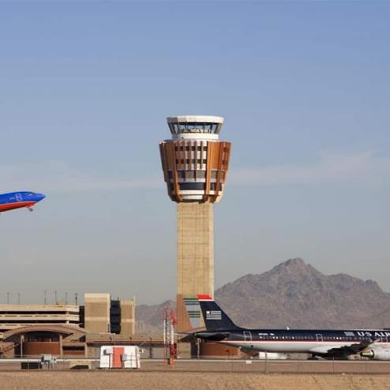
Subpart B—Airspace Operational Requirements
Operations near airports – Towered Airports
A towered airport has an operating control tower. Air traffic control (ATC) is responsible for providing the safe, orderly, and expeditious flow of air traffic at airports where the type of operations and/or volume of traffic requires such a service.
UA.II.B.K3

Slide 16
UA.II.B.K3
https://skyvector.com/

Slide 17
UA.II.B.K3
https://skyvector.com/

Slide 18
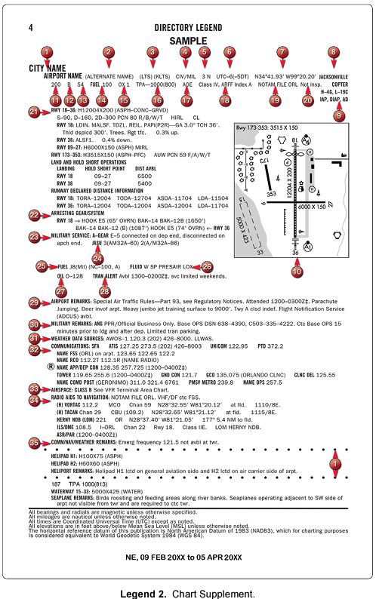
UA.II.B.K3

Slide 19
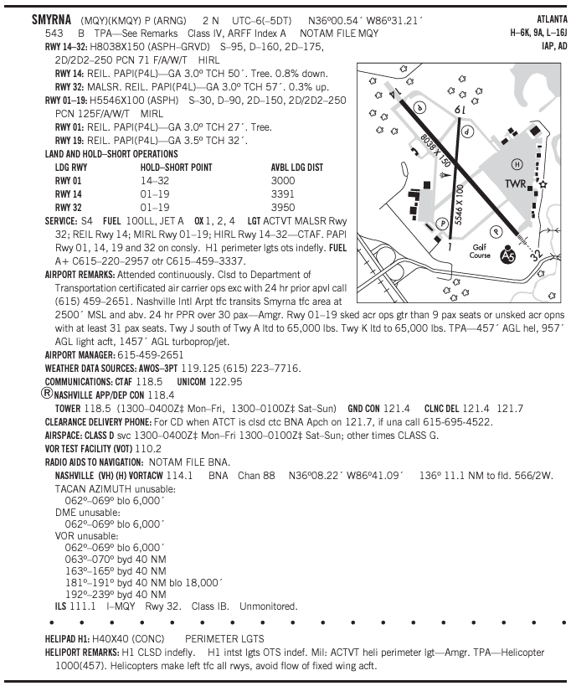
UA.II.B.K3

Slide 20
Subpart B—Airspace Operational Requirements
Operations near airports – Non-Towered Airports
A non-towered airport does not have an operating control tower. Two-way radio communications are not required, although it is a good operating practice for pilots to monitor other aircraft on the specified frequency for the benefit of other traffic in the area. The key to monitoring traffic at an airport without an operating control tower is selection of the correct common frequency. The acronym CTAF, which stands for Common Traffic Advisory Frequency, is synonymous with this program. A CTAF is a frequency designated for the purpose of carrying out airport advisory practices while operating to or from an airport without an operating control tower. The CTAF may be a Universal Integrated Community (UNICOM), MULTICOM, FSS, or tower frequency and is identified in appropriate aeronautical publications. UNICOM is a nongovernment air/ground radio communication station that may provide airport information at public use airports where there is no tower or FSS.
UA.II.B.K3

Slide 22
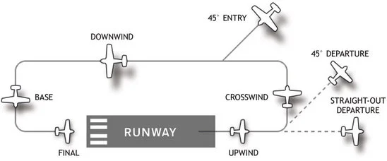
Subpart B—Airspace Operational Requirements
Operations near airports – Non-Towered Airports
Non-towered airport traffic patterns are always entered at pattern altitude. How you enter the pattern depends upon the direction of arrival. The preferred method for entering from the downwind side of the pattern is to approach the pattern on a course 45 degrees to the downwind leg and join the pattern at midfield.
UA.II.B.K3

Slide 23
UA.II.B.K3

Slide 24
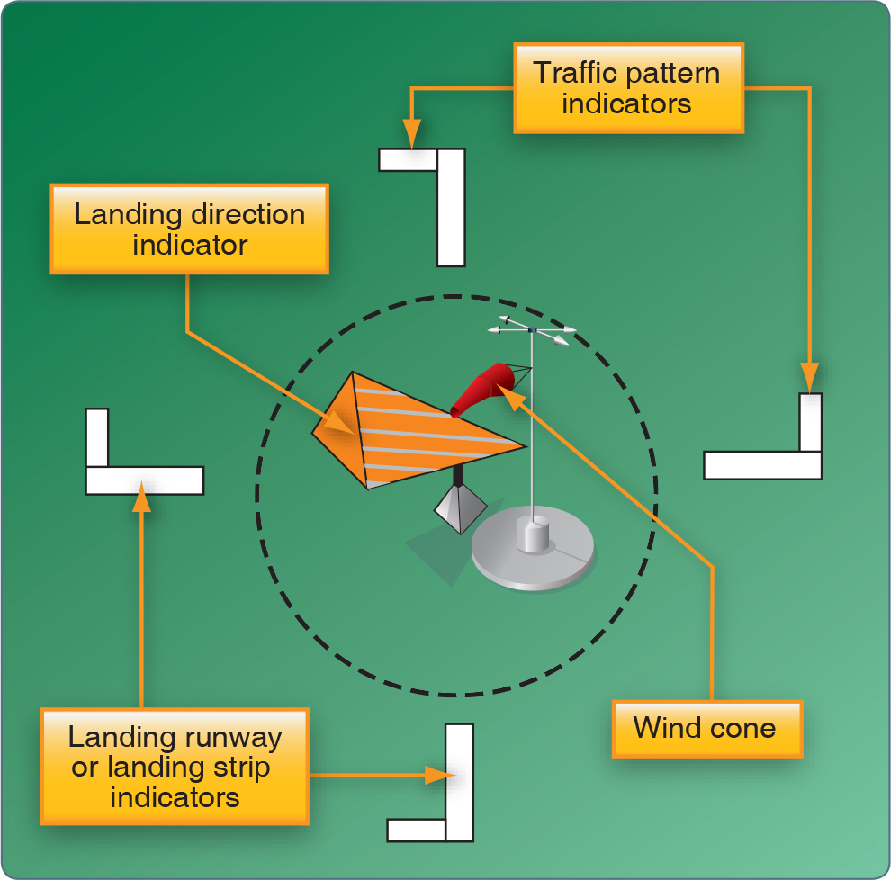
UA.II.B.K3

Slide 25
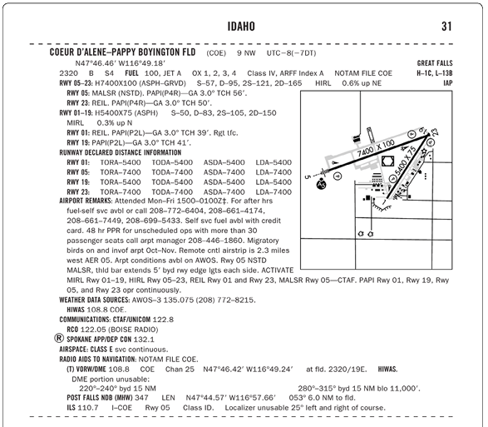
UA.II.B.K3

Slide 26
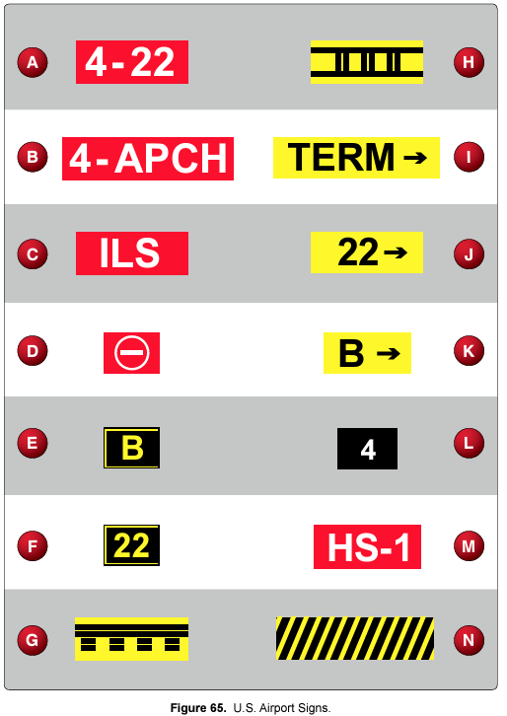
UA.II.B.K3

Slide 27
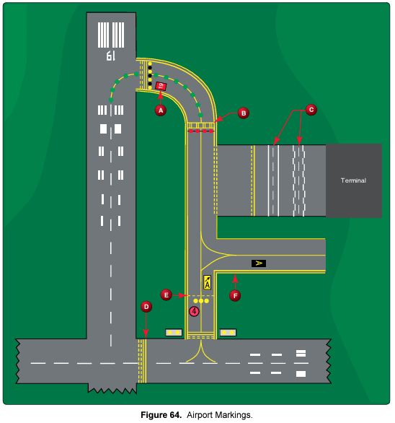
UA.II.B.K3

Slide 28
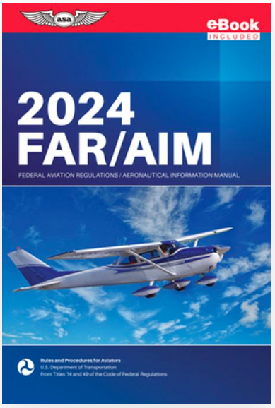
Notes:
Next section on Hazards comes out of the AIM

Slide 29
Subpart B—Airspace Operational Requirements
Potential Flight Hazards - General
Many structures exist that could significantly affect the safety of your flight when operating below 500 feet above ground level (AGL), and particularly below 200 feet AGL. While 14 CFR Part 91.119 allows flight below 500 feet AGL when over sparsely populated areas or open water, such operations involve increased safety risks. At and below 200 feet AGL there are numerous power lines, antenna towers, etc., that are not marked and lighted and/or charted as obstructions and, therefore, may not be seen in time to avoid a collision. Notices to Air Missions NOTAMs are issued on those lighted structures experiencing temporary light outages. However, some time may pass before the FAA is notified of these outages, and the NOTAMs issued, thus pilot vigilance is imperative. Additionally, new obstructions may not be on current charts because the information was not received prior to the FAA publishing the chart.
AIM 7-6-4
UA.II.B.K4

Slide 30
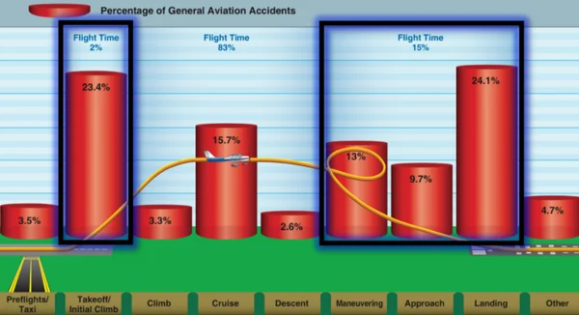
Subpart B—Airspace Operational Requirements
Potential Flight Hazards – Common aircraft accident causal factors
The 10 most frequent cause factors for general aviation accidents that involve the pilot‐in‐command are:
Inadequate preflight preparation and/or planning.
Failure to obtain and/or maintain flying speed.
Failure to maintain direction control.
Improper level off.
Failure to see and avoid objects or obstructions.
Mismanagement of fuel.
Improper inflight decisions or planning.
Misjudgment of distance and speed.
Selection of unsuitable terrain.
Improper operation of flight controls.
AIM 7-6-1
UA.II.B.K4a

Slide 31
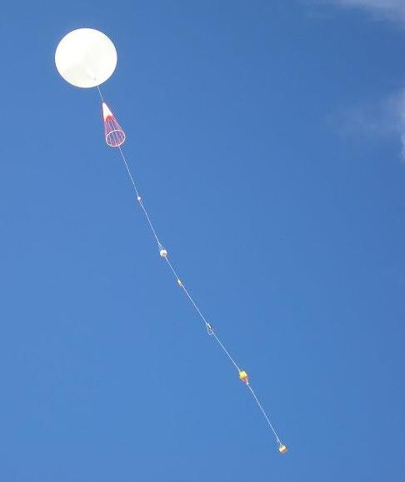
Subpart B—Airspace Operational Requirements
Potential Flight Hazards – Avoid flight beneath balloons
The majority of unmanned free balloons currently being operated have, extending below them, either a suspension device to which the payload or instrument package is attached, or a trailing wire antenna, or both. In many instances these balloon subsystems may be invisible to the pilot until the aircraft is close to the balloon, thereby creating a potentially dangerous situation. Therefore, good judgment on the part of the pilot dictates that aircraft should remain well clear of all unmanned free balloons and flight below them should be avoided at all times.
AIM 7-6-1
UA.II.B.K4b

Slide 32
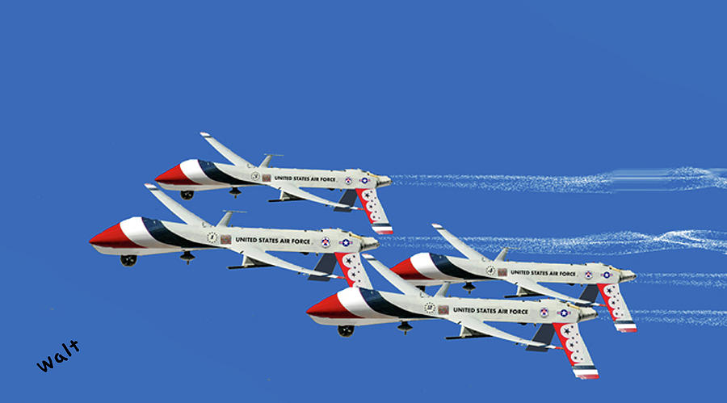
Subpart B—Airspace Operational Requirements
Potential Flight Hazards – Emergency airborne inspection aircraft
AIM 7-6-11
UA.II.B.K4c
Notes:
Note: While emergency airborne inspection of other aircraft is discussed in the AIM, 14CFR §107 does not specifically address this issue. It is suggested, that RPIC's do not attempt to conduct inspection of manned aircraft during flight.

Slide 33
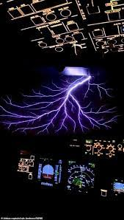
Subpart B—Airspace Operational Requirements
Potential Flight Hazards – Precipitation static
Precipitation static is caused by aircraft in flight coming in contact with uncharged particles. These particles can be rain, snow, fog, sleet, hail, volcanic ash, dust; any solid or liquid particles. When the aircraft strikes these neutral particles the positive element of the particle is reflected away from the aircraft and the negative particle adheres to the skin of the aircraft. In a very short period of time a substantial negative charge will develop on the skin of the aircraft. If the aircraft is not equipped with static dischargers, or has an ineffective static discharger system, when a sufficient negative voltage level is reached, the aircraft may go into “CORONA.” That is, it will discharge the static electricity from the extremities of the aircraft, such as the wing tips, horizontal stabilizer, vertical stabilizer, antenna, propeller tips, etc. This discharge of static electricity is what you will hear in your headphones and is what we call P-static.
AIM 7-6-12
UA.II.B.K4d
Notes:
Note: While emergency airborne inspection of other aircraft is discussed in the AIM, 14CFR §107 does not specifically address this issue. It is suggested, that RPIC's do not attempt to conduct inspection of manned aircraft during flight.

Slide 34
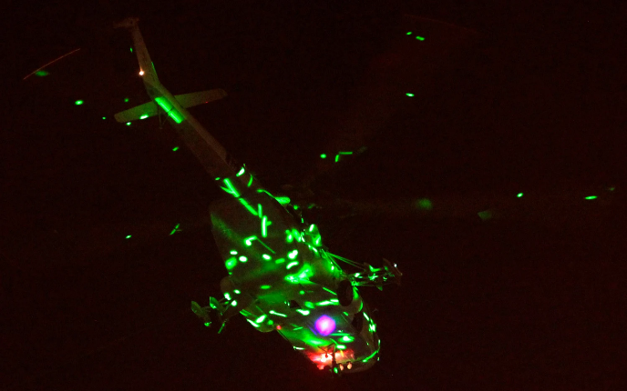
Subpart B—Airspace Operational Requirements
Potential Flight Hazards - Lasers
Lasers have many applications. Of concern to users of the National Airspace System are those laser events that may affect pilots, e.g., outdoor laser light shows or demonstrations for entertainment and advertisements at special events and theme parks. Generally, the beams from these events appear as bright blue-green in color; however, they may be red, yellow, or white. However, some laser systems produce light which is invisible to the human eye.
AIM 7-6-4
UA.II.B.K4e

Slide 35
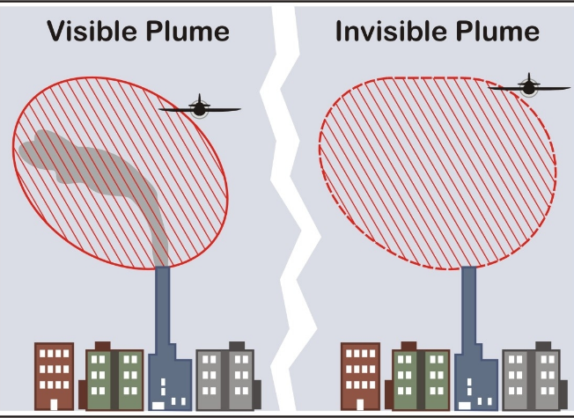
Subpart B—Airspace Operational Requirements
Potential Flight Hazards – Thermal Plumes
Exhaust plumes are defined as visible or invisible emissions from power plants, industrial production facilities, or other industrial systems that release large amounts of vertically directed unstable gases (effluent). High temperature exhaust plumes can cause significant air disturbances such as turbulence and vertical shear. Other identified potential hazards include, but are not necessarily limited to: reduced visibility, oxygen depletion, engine particulate contamination, exposure to gaseous oxides, and/or icing. Results of encountering a plume may include airframe damage, aircraft upset, and/or engine damage/failure. These hazards are most critical during low altitude flight in calm and cold air, especially in and around approach and departure corridors or airport traffic areas.
AIM 7-6-4
UA.II.B.K4f

Slide 36
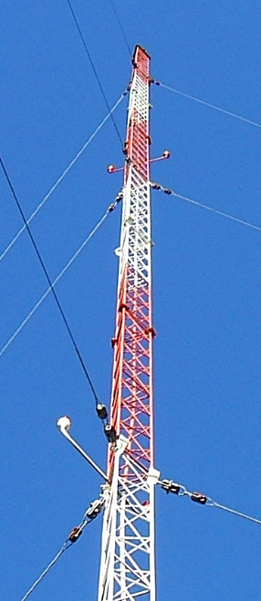
Subpart B—Airspace Operational Requirements
Potential Flight Hazards – Wire environment
Antenna Towers Extreme caution should be exercised when flying less than 2,000 feet AGL because of numerous skeletal structures, such as radio and television antenna towers, that exceed 1,000 feet AGL with some extending higher than 2,000 feet AGL. Most skeletal structures are supported by guy wires which are very difficult to see in good weather and can be invisible at dusk or during periods of reduced visibility. These wires can extend about 1,500 feet horizontally from a structure; therefore, all skeletal structures should be avoided horizontally by at least 2,000 feet.
Additionally, new towers may not be on your current chart because the information was not received prior to the printing of the chart.
Study Guide
UA.II.B.K4g

Slide 37
Subpart B—Airspace Operational Requirements
The NOTAM system, including how to obtain an established NOTAM
Notices to Airmen, or NOTAMs, are time-critical aeronautical information either temporary in nature or not sufficiently known in advance to permit publication on aeronautical charts or in other operational publications. The information receives immediate dissemination via the National Notice to Airmen (NOTAM) System. NOTAMs contain current notices to airmen that are considered essential to the safety of flight, as well as supplemental data affecting other operational publications. There are many different reasons that NOTAMs are issued. Following are some of those reasons:
Hazards, such as air shows, parachute jumps, kite flying, and rocket launches
Flights by important people such as heads of state
Closed runways
Inoperable radio navigational aids
Military exercises with resulting airspace restrictions
Inoperable lights on tall obstructions
Temporary erection of obstacles near airfields
Passage of flocks of birds through airspace (a NOTAM in this category is known as a BIRDTAM)
Notifications of runway/taxiway/apron status with respect to snow, ice, and standing water (a SNOWTAM)
Notification of an operationally significant change in volcanic ash or other dust contamination (an ASHTAM)
Software code risk announcements with associated patches to reduce specific vulnerabilities
PHAK Ch.1
UA.II.B.K5

Slide 38
Subpart B—Airspace Operational Requirements
1800wxbrief.com
Call 1800wxbrief
Talk to FSS briefer
FNS NOTAM Search (www.notams.aim.faa.gov)
Defense Internet NOTAM Service (https://www.notams.faa.gov)
PHAK Ch.1
UA.II.B.K5

Slide 39
Subpart B—Airspace Operational Requirements
Operator equipment for night flight
UA.II.B.K6
Notes:
There is no operator equipment for night operations. The only requirement is for the sUAS to have an anticollision light that is visible for 3sm.

Slide 40
Subpart B—Airspace Operational Requirements
Ground structures and ground structure lighting
Any temporary or permanent structure, including all appurtenances, that exceeds any obstruction standard contained in 14 CFR Part 77 or an overall height of 200 feet (60.96m) above ground level (AGL) should be marked and/or lighted. However, an FAA aeronautical study may reveal that the absence of marking and/or lighting will not impair aviation safety. Conversely, the object may present such an extraordinary hazard potential that higher standards may be recommended for increased conspicuity to ensure aviation safety. Recommendations for marking and/or lighting structures can vary, depending on terrain features, weather patterns, geographic location, number of structures, and overall design layout. The FAA may also recommend marking and/or lighting a structure that does not exceed 200 feet (60.96 m) AGL or 14 CFR Part 77 standards because of its particular location.
AC 70/7460-1M
UA.II.B.K7

Slide 41
Subpart B—Airspace Operational Requirements
Ground structures and ground structure lighting
Many structures exist that could significantly affect the safety of your flight when operating below 500 feet above ground level (AGL), and particularly below 200 feet AGL. While 14 CFR Part 91.119 allows flight below 500 feet AGL when over sparsely populated areas or open water, such operations involve increased safety risks. At and below 200 feet AGL there are numerous power lines, antenna towers, etc., that are not marked and lighted and/or charted as obstructions and, therefore, may not be seen in time to avoid a collision. Notices to Air Missions NOTAMs are issued on those lighted structures experiencing temporary light outages. However, some time may pass before the FAA is notified of these outages, and the NOTAMs issued, thus pilot vigilance is imperative. Additionally, new obstructions may not be on current charts because the information was not received prior to the FAA publishing the chart.
AIM 7-6-4
UA.II.B.K8

Slide 43
Subpart B—Airspace Operational Requirements
Manned aircraft lighting
In order to see other aircraft more clearly, regulations require that all aircraft operating during the night hours have special lights and equipment. The requirements for operating at night are found in Title 14 of the Code of Federal Regulations (14 CFR) part 91. In addition to aircraft lighting, the regulations also provide a definition of night flight in accordance with 14 CFR part 91, currency requirements, fuel reserves, and necessary electrical systems.
Position lights enable a pilot to locate another aircraft, as well as help determine its direction of flight. The approved aircraft lights for night operations are a green light on the right cabin side or wingtip, a red light on the left cabin side or wingtip, and a white position light on the tail. In addition, f lashing aviation red or white anticollision lights are required for night flights. These flashing lights can be in a number of locations, but are most commonly found on the top and bottom of the cabin.
Figure 13-7 shows examples of aircraft lighting. By interpreting the position lights on other aircraft, the pilot in aircraft 3 can determine whether the aircraft is flying in the opposite direction or is on a collision course. If a red position light is seen to the right of a green light, such as shown by aircraft 1, it is flying toward aircraft 3. A pilot should watch this aircraft closely and be ready to change course. Aircraft 2, on the other hand, is flying away from aircraft 3, as indicated by the white position light.
CFR-2010 Ch. 13
UA.II.B.K9

Slide 44
UA.II.B.K9

Slide 45
Subpart B—Airspace Operational Requirements
sUAS lighting requirements
5.7.1 Civil Twilight Operations.
When small UAS operations occur during civil twilight, the small unmanned aircraft must be equipped with anti-collision lighting visible for at least 3 statute miles (sm). However, the remote PIC may reduce the visible distance of the lighting to less than 3 sm during flight if he or she has determined that it would be in the interest of safety to do so.
5.7.2 Operations at Night.
Small UAS operations at night may occur only under the two risk mitigation measures listed in § 107.29. First, the remote PIC must have completed either an initial knowledge test or recurrent training that have been updated to include night operations. Second, the small unmanned aircraft must have lighted anti-collision lighting that is visible for at least 3 sm. The remote pilot may rely upon manufacturer statements indicating the anti-collision lighting is visible for 3 sm. However, the remote pilot ultimately remains responsible for verifying that anti-collision lighting is operational, visible for 3 sm, and has a flash rate sufficient to avoid a collision at the operating location.
AC 107-2A
UA.II.B.K10

