Slide 1
UA.III Weather
A. Sources of Weather

Slide 2
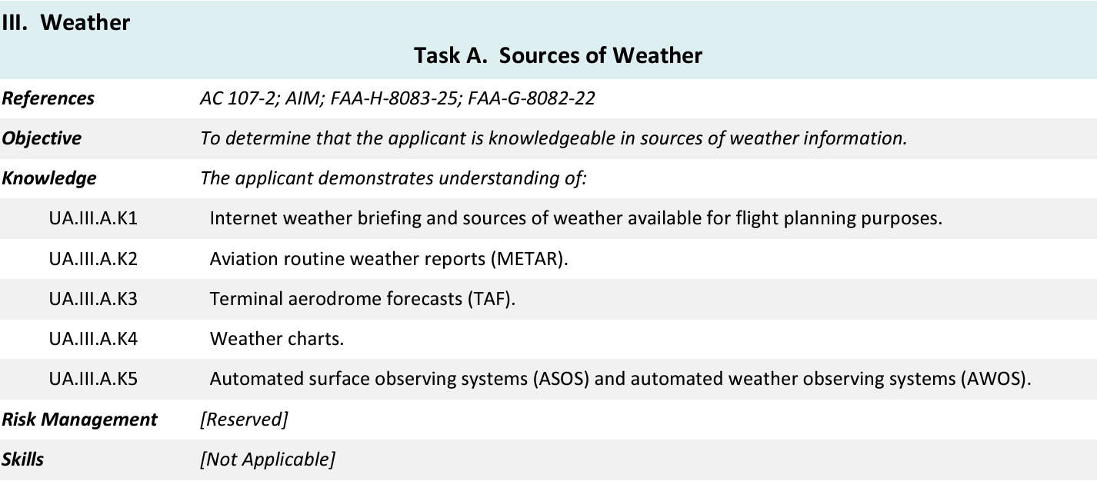
Topics

Slide 3
14 CFR §107—Small Unmanned Aircraft Systems
https://www.ecfr.gov/current/title-14/chapter-I/subchapter-F/part-107

Slide 4
Subpart B—Operating Rules
§ 107.41 Operation in certain airspace.
UA.I.B.K16

Slide 5
Airspace
Controlled | Uncontrolled
B | G
C
D
E*
* When associated with an airport

Slide 6
UA.II.A.K1

Slide 7
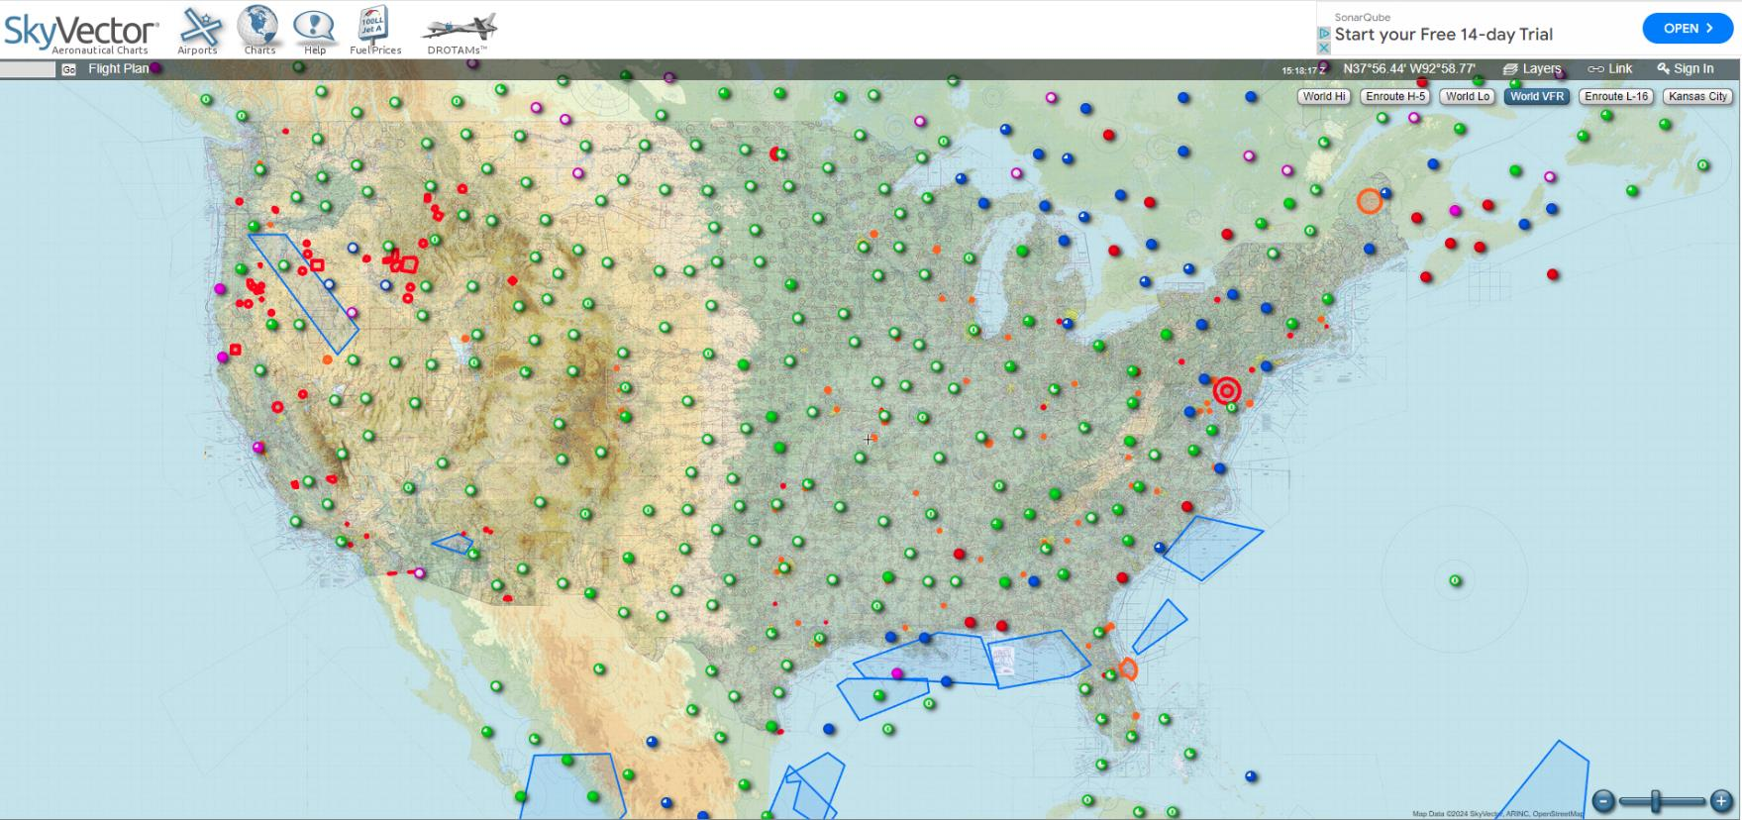
Aeronautical Chart Source
https://skyvector.com/
UA.II.A.K1

Slide 8
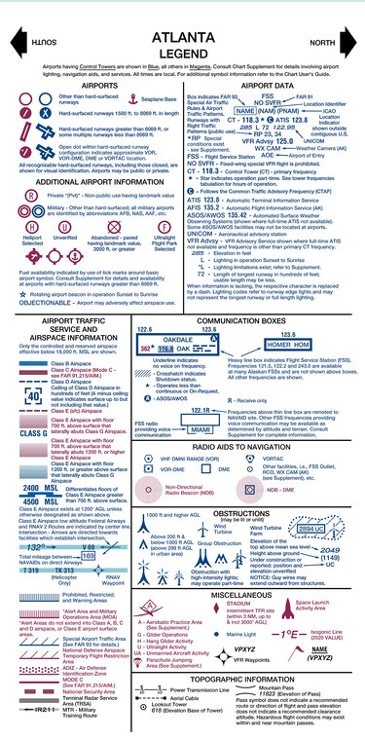
UA.II.A.K1

Slide 9
Remote Pilot Testing Supplement
https://www.faa.gov/sites/faa.gov/files/training_testing/testing/supplements/sport_rec_private_akts.pdf

Slide 10
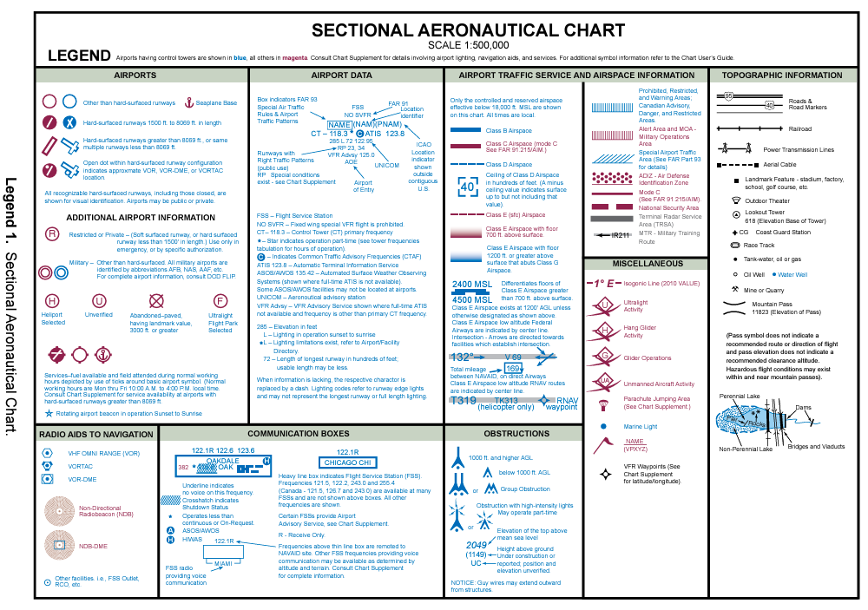

Slide 11
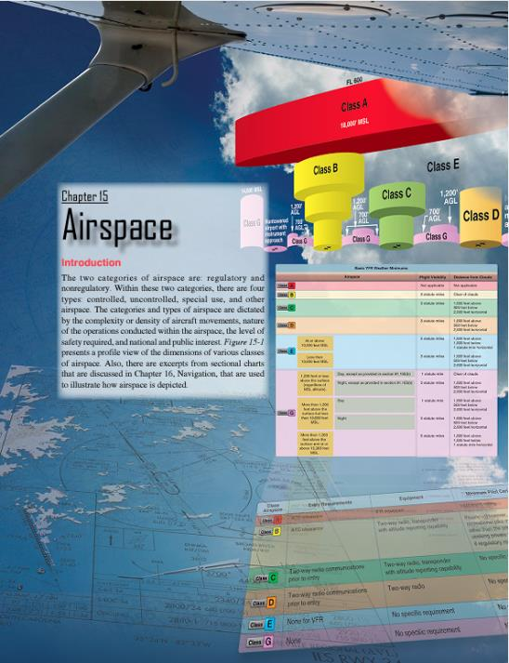
Additional Airspace Information
https://www.faa.gov/regulations_policies/handbooks_manuals/aviation/phak

Slide 12
Subpart A—Airspace Classification
Class B controlled airspace (PHAK Ch. 15)
Class B airspace is generally airspace from the surface to 10,000 feet MSL surrounding the nation’s busiest airports in terms of airport operations or passenger enplanements. The configuration of each Class B airspace area is individually tailored, consists of a surface area and two or more layers (some Class B airspace areas resemble upside-down wedding cakes), and is designed to contain all published instrument procedures once an aircraft enters the airspace. ATC clearance is required for all aircraft to operate in the area, and all aircraft that are so cleared receive separation services within the airspace.
UA.II.A.K1a

Slide 13
UA.II.A.K1a

Slide 14
Notes:
https://www.youtube.com/watch?v=rQ3BAE5GJWw

Slide 15
UA.II.A.K1a
https://skyvector.com/

Slide 16
Subpart A—Airspace Classification
Class C controlled airspace (PHAK Ch. 15)
Class C airspace is generally airspace from the surface to 4,000 feet above the airport elevation (charted in MSL) surrounding those airports that have an operational control tower, are serviced by a radar approach control, and have a certain number of IFR operations or passenger enplanements. Although the configuration of each Class C area is individually tailored, the airspace usually consists of a surface area with a five NM radius, an outer circle with a ten NM radius that extends from 1,200 feet to 4,000 feet above the airport elevation. Each aircraft must establish two-way radio communications with the ATC facility providing air traffic services prior to entering the airspace and thereafter must maintain those communications while within the airspace.
UA.II.A.K1b

Slide 17
UA.II.A.K1b

Slide 18
Notes:
https://www.youtube.com/watch?v=IpH-xWGyWfE

Slide 19
UA.II.A.K1a
https://skyvector.com/

Slide 20
Subpart A—Airspace Classification
Class D controlled airspace (PHAK Ch. 15)
Class D airspace is generally airspace from the surface to 2,500 feet above the airport elevation (charted in MSL) surrounding those airports that have an operational control tower. The configuration of each Class D airspace area is individually tailored and, when instrument procedures are published, the airspace is normally designed to contain the procedures. Arrival extensions for instrument approach procedures (IAPs) may be Class D or Class E airspace. Unless otherwise authorized, each aircraft must establish two-way radio communications with the ATC facility providing air traffic services prior to entering the airspace and thereafter maintain those communications while in the airspace.
UA.II.A.K1c

Slide 21
UA.II.A.K1d

Slide 22
Notes:
How to Identify Class D Airspace Tutorial 0:42 https://www.youtube.com/watch?v=QlBPNAUseNE

Slide 23
UA.II.A.K1a
https://skyvector.com/
Notes:
KNMM

Slide 24
Subpart A—Airspace Classification
Class E controlled airspace (PHAK Ch. 15)
Class D airspace is generally airspace from the surface to 2,500 feet above the airport elevation (charted in MSL) surrounding those airports that have an operational control tower. The configuration of each Class D airspace area is individually tailored and, when instrument procedures are published, the airspace is normally designed to contain the procedures. Arrival extensions for instrument approach procedures (IAPs) may be Class D or Class E airspace. Unless otherwise authorized, each aircraft must establish two-way radio communications with the ATC facility providing air traffic services prior to entering the airspace and thereafter maintain those communications while in the airspace.
UA.II.A.K1d

Slide 25
UA.II.A.K1d

Slide 27
UA.II.A.K1d
https://skyvector.com/
Notes:
Class E airspace designated for an airport SFC to 17,999

Slide 28
Subpart B—Operating Rules
§ 107.41 Operation in certain airspace.
UA.I.B.K16

Slide 29
UA.II.A.K1d
https://skyvector.com/
Notes:
Class E airspace extension SFC to bottom of Class B in this case. Can fly in this Class E without ATC permission.

Slide 30
UA.II.A.K1d
https://skyvector.com/
Notes:
Can fly in this Class E without ATC permission. Class E starts at 700’ AGL

Slide 31
UA.II.A.K1d
https://skyvector.com/
Notes:
Can fly in this Class E without ATC permission. Class E starts at 1200” AGL

Slide 32
Subpart A—Airspace Classification
Class G uncontrolled airspace (PHAK Ch. 15)
Uncontrolled airspace or Class G airspace is the portion of the airspace that has not been designated as Class A, B, C, D, or E. It is therefore designated uncontrolled airspace. Class G airspace extends from the surface to the base of the overlying Class E airspace. Although ATC has no authority or responsibility to control air traffic, pilots should remember there are visual flight rules (VFR) minimums that apply to Class G airspace.
UA.II.A.K1e

Slide 33
UA.II.A.K1e

Slide 34
Notes:
How to Identify Class G Airspace Tutorial 0:55 https://www.youtube.com/watch?v=i5GH2mcmh7U

Slide 35
UA.II.A.K1d
https://skyvector.com/
Notes:
Class G airspace. Can fly in this Class E without ATC permission. Class E starts at 1200” AGL.

Slide 36
Subpart B—Operating Rules
§ 107.45 Operation in prohibited or restricted areas.
UA.I.B.K18

Slide 37
Subpart A—Airspace Classification
Special Use Airspace (PHAK Ch. 15)
Special use airspace or special area of operation (SAO) is the designation for airspace in which certain activities must be confined, or where limitations may be imposed on aircraft operations that are not part of those activities. Certain special use airspace areas can create limitations on the mixed use of airspace. The special use airspace depicted on instrument charts includes the area name or number, effective altitude, time and weather conditions of operation, the controlling agency, and the chart panel location. On National Aeronautical Charting Group (NACG) en route charts, this information is available on one of the end panels. Special use airspace usually consists of:
• Prohibited areas
• Restricted areas
• Warning areas
• Military operation areas (MOAs)
• Alert areas
• Controlled firing areas (CFAs)
UA.II.A.K2

Slide 38
Subpart A—Airspace Classification
Special Use Airspace - Prohibited Area (PHAK Ch. 15)
Prohibited areas contain airspace of defined dimensions within which the flight of aircraft is prohibited. Such areas are established for security or other reasons associated with the national welfare. These areas are published in the Federal Register and are depicted on aeronautical charts. The area is charted as a “P” followed by a number (e.g., P-40). Examples of prohibited areas include Camp David and the National Mall in Washington, D.C., where the White House and the Congressional buildings are located.
UA.II.A.K2

Slide 39
UA.II.A.K2
https://skyvector.com/
Notes:
Camp David P-40

Slide 40
Subpart A—Airspace Classification
Special Use Airspace – Restricted Areas (PHAK Ch. 15)
Restricted areas are areas where operations are hazardous to nonparticipating aircraft and contain airspace within which the flight of aircraft, while not wholly prohibited, is subject to restrictions. Activities within these areas must be confined because of their nature, or limitations may be imposed upon aircraft operations that are not a part of those activities, or both. Restricted areas denote the existence of unusual, often invisible, hazards to aircraft (e.g., artillery firing, aerial gunnery, or guided missiles). IFR flights may be authorized to transit the airspace and are routed accordingly. Penetration of restricted areas without authorization from the using or controlling agency may be extremely hazardous to the aircraft and its occupants.
UA.II.A.K2

Slide 41
UA.II.A.K2
https://skyvector.com/
Notes:
Yuma Restricted Areas

Slide 42
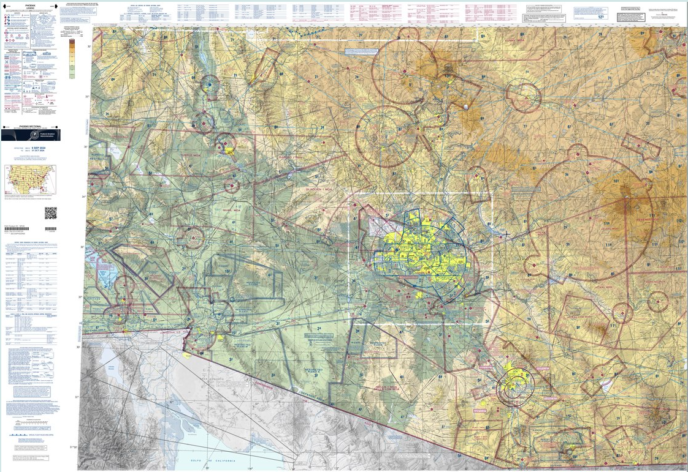
UA.II.A.K2
https://skyvector.com/
Notes:
Phoenix Sectional

Slide 43
Subpart A—Airspace Classification
Special Use Airspace – Warning Areas (PHAK Ch. 15)
Warning areas are similar in nature to restricted areas; however, the United States government does not have sole jurisdiction over the airspace. A warning area is airspace of defined dimensions, extending from 3 NM outward from the coast of the United States, containing activity that may be hazardous to nonparticipating aircraft. The purpose of such areas is to warn nonparticipating pilots of the potential danger. A warning area may be located over domestic or international waters or both.
UA.II.A.K2

Slide 44
UA.II.A.K2
https://skyvector.com/
Notes:
Phoenix Sectional

Slide 45
Subpart A—Airspace Classification
Special Use Airspace – Military Operating Areas (MOAs)(PHAK Ch. 15)
MOAs consist of airspace with defined vertical and lateral limits established for the purpose of separating certain military training activities from IFR traffic. Whenever an MOA is being used, nonparticipating IFR traffic may be cleared through an MOA if IFR separation can be provided by ATC. Otherwise, ATC reroutes or restricts nonparticipating IFR traffic. MOAs are depicted on sectional, VFR terminal area, and en route low altitude charts and are not numbered (e.g., “Camden Ridge MOA”). [Figure 15-5] However, the MOA is also further defined on the back of the sectional charts with times of operation, altitudes affected, and the controlling agency.
UA.II.A.K2

Slide 46
UA.II.A.K2
https://skyvector.com/
Notes:
Phoenix Sectional

Slide 47
Subpart A—Airspace Classification
Special Use Airspace – Alert Areas (PHAK Ch. 15)
Alert areas are depicted on aeronautical charts with an “A” followed by a number (e.g., A-211) to inform nonparticipating pilots of areas that may contain a high volume of pilot training or an unusual type of aerial activity. Pilots should exercise caution in alert areas. All activity within an alert area shall be conducted in accordance with regulations, without waiver, and pilots of participating aircraft, as well as pilots transiting the area, shall be equally responsible for collision avoidance.
UA.II.A.K2

Slide 48
UA.II.A.K2
https://skyvector.com/
Notes:
Phoenix Sectional

Slide 49
Subpart A—Airspace Classification
Special Use Airspace – Controlled Firing Area (PHAK Ch. 15)
CFAs contain activities that, if not conducted in a controlled environment, could be hazardous to nonparticipating aircraft. The difference between CFAs and other special use airspace is that activities must be suspended when a spotter aircraft, radar, or ground lookout position indicates an aircraft might be approaching the area. There is no need to chart CFAs since they do not cause a nonparticipating aircraft to change its flight path.
UA.II.A.K2

Slide 50
Subpart A—Airspace Classification
Special Use Airspace – Military Training Route (MTRs) (PHAK Ch. 15)
MTRs are routes used by military aircraft to maintain proficiency in tactical flying. These routes are usually established below 10,000 feet MSL for operations at speeds in excess of 250 knots. Some route segments may be defined at higher altitudes for purposes of route continuity. Routes are identified as IFR (IR), and VFR (VR), followed by a number. MTRs with no segment above 1,500 feet AGL are identified by four number characters (e.g., IR1206, VR1207). MTRs that include one or more segments above 1,500 feet AGL are identified by three number characters (e.g., IR206, VR207). IFR low altitude en route charts depict all IR routes and all VR routes that accommodate operations above 1,500 feet AGL. IR routes are conducted in accordance with IFR regardless of weather conditions. VFR sectional charts depict military training activities, such as IR, VR, MOA, restricted area, warning area, and alert area information.
UA.II.A.K3

Slide 51
UA.II.A.K2
https://skyvector.com/

Slide 52
Subpart A—Airspace Classification
Special Use Airspace – Temporary Flight Restrictions (TFRs)
A flight data center (FDC) Notice to Airmen (NOTAM) is issued to designate a TFR. The NOTAM begins with the phrase “FLIGHT RESTRICTIONS” followed by the location of the temporary restriction, effective time period, area defined in statute miles, and altitudes affected. The NOTAM also contains the FAA coordination facility and telephone number, the reason for the restriction, and any other information deemed appropriate. The pilot should check the NOTAMs as part of flight planning.
UA.II.A.K3

Slide 53
Subpart A—Airspace Classification
Special Use Airspace – Temporary Flight Restrictions (TFRs)
Some of the purposes for establishing a TFR are:
• Protect persons and property in the air or on the surface from an existing or imminent hazard.
• Provide a safe environment for the operation of disaster relief aircraft.
• Prevent an unsafe congestion of sightseeing aircraft above an incident or event, that may generate a high degree of public interest.
• Protect declared national disasters for humanitarian reasons in the State of Hawaii.
• Protect the President, Vice President, or other public figures.
• Provide a safe environment for space agency operations.
UA.II.A.K3

Slide 54
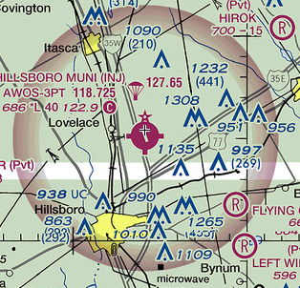
Subpart A—Airspace Classification
Special Use Airspace – Parachute Jump Aircraft Ops (PHAK Ch. 15)
Parachute jump aircraft operations are published in the Chart Supplement U.S. (formerly Airport/Facility Directory). Sites that are used frequently are depicted on sectional charts.
UA.II.A.K3

Slide 55
Subpart A—Airspace Classification
Special Use Airspace – Published VFR Routes (PHAK Ch. 15)
Published VFR routes are for transitioning around, under, or through some complex airspace. Terms such as VFR flyway, VFR corridor, Class B airspace VFR transition route, and terminal area VFR route have been applied to such routes. These routes are generally found on VFR terminal area planning charts.
UA.II.A.K3

Slide 56
UA.II.A.K2
https://skyvector.com/

Slide 57
Subpart A—Airspace Classification
Special Use Airspace – National Security Areas (NSAs) (PHAK Ch. 15)
NSAs consist of airspace of defined vertical and lateral dimensions established at locations where there is a requirement for increased security and safety of ground facilities. Flight in NSAs may be temporarily prohibited by regulation under the provisions of Title 14 of the Code of Federal Regulations (14 CFR) part 99, and prohibitions are disseminated via NOTAM. Pilots are requested to voluntarily avoid flying through these depicted areas.
UA.II.A.K3

Slide 58
UA.II.A.K2
https://skyvector.com/

Slide 59
Subpart A—Airspace Classification
Special Use Airspace – Air Traffic Control (ATC) and the NAS
The primary purpose of the ATC system is to prevent a collision between aircraft operating in the system and to organize and expedite the flow of traffic. In addition to its primary function, the ATC system has the capability to provide (with certain limitations) additional services. The ability to provide additional services is limited by many factors, such as the volume of traffic, frequency congestion, quality of radar, controller workload, higher priority duties, and the pure physical inability to scan and detect those situations that fall in this category. It is recognized that these services cannot be provided in cases in which the provision of services is precluded by the above factors.
UA.II.A.K4

