Slide 1
AERO 2710
UA.I Regulations
F. RID

Slide 2
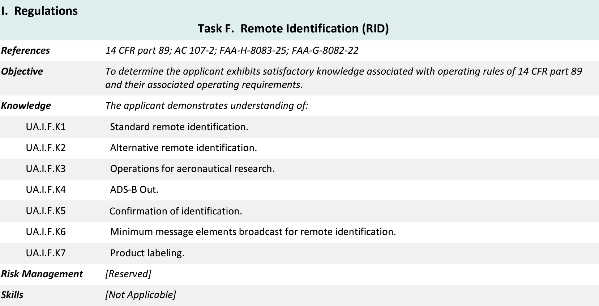
Topics

Slide 3
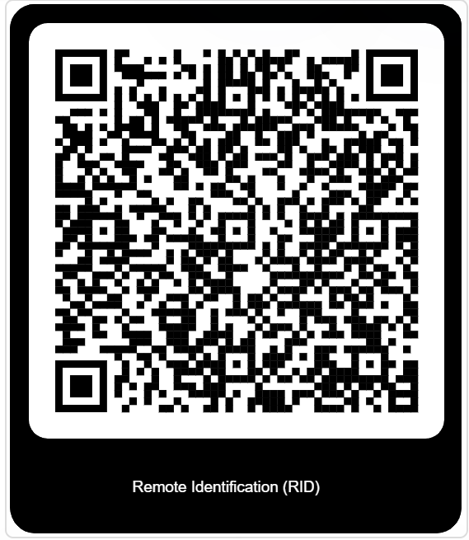
14 CFR §107—Small Unmanned Aircraft Systems
https://www.ecfr.gov/current/title-14/chapter-I/subchapter-F/part-89

Slide 4
Subpart B—Operating Rules
§ 89.110 Operation of standard remote identification unmanned aircraft.
UA.I.F.K1

Slide 5
Subpart B—Operating Rules
§ 89.110 Operation of standard remote identification unmanned aircraft.
UA.I.F.K1

Slide 6
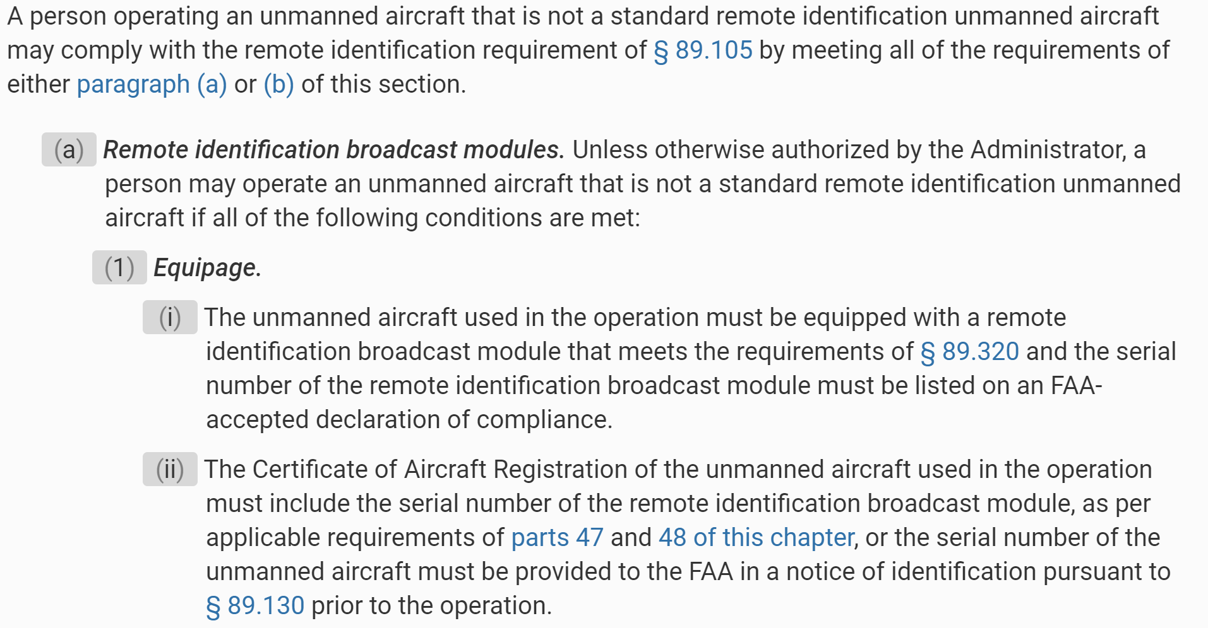
Subpart B—Operating Rules
§ 89.115 Alternative remote identification.
UA.I.F.K2

Slide 7
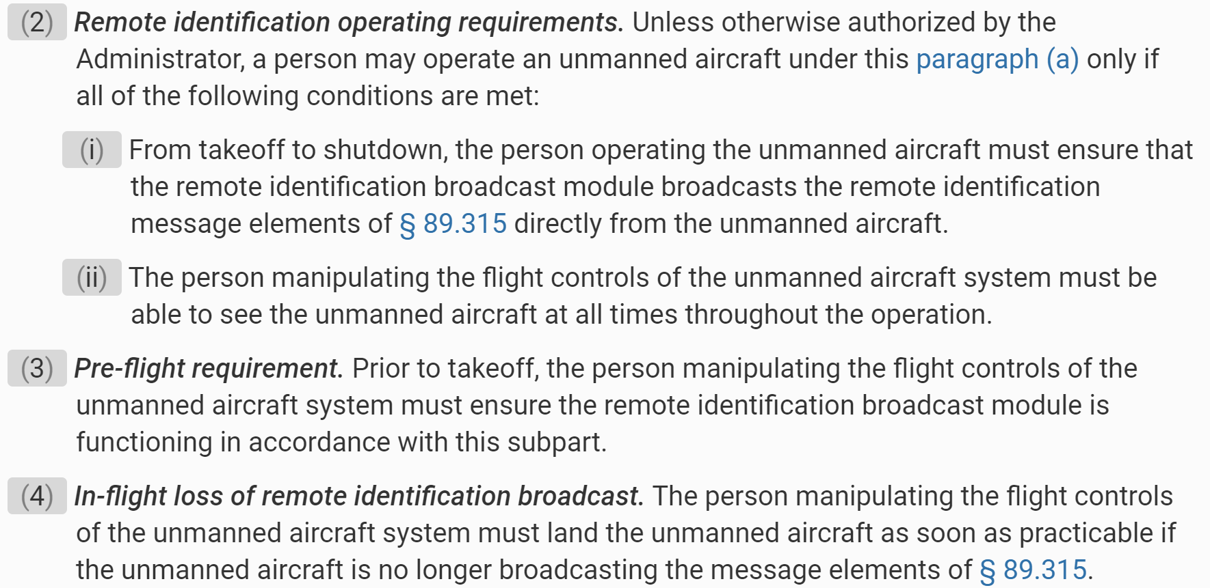
Subpart B—Operating Rules
§ 89.115 Alternative remote identification.
UA.I.F.K2

Slide 8
Subpart B—Operating Rules
§ 89.115 Alternative remote identification.
UA.I.F.K2

Slide 10
Subpart B—Operating Rules
§ 89.120 Operations for aeronautical research or to show compliance with regulations.
UA.I.F.K3

Slide 11
Subpart B—Operating Rules
§ 89.125 Automatic Dependent Surveillance-Broadcast (ADS-B) Out prohibition.
UA.I.F.K4

Slide 12
Subpart B—Operating Rules
§ 89.130 Confirmation of identification.
UA.I.F.K5

Slide 13
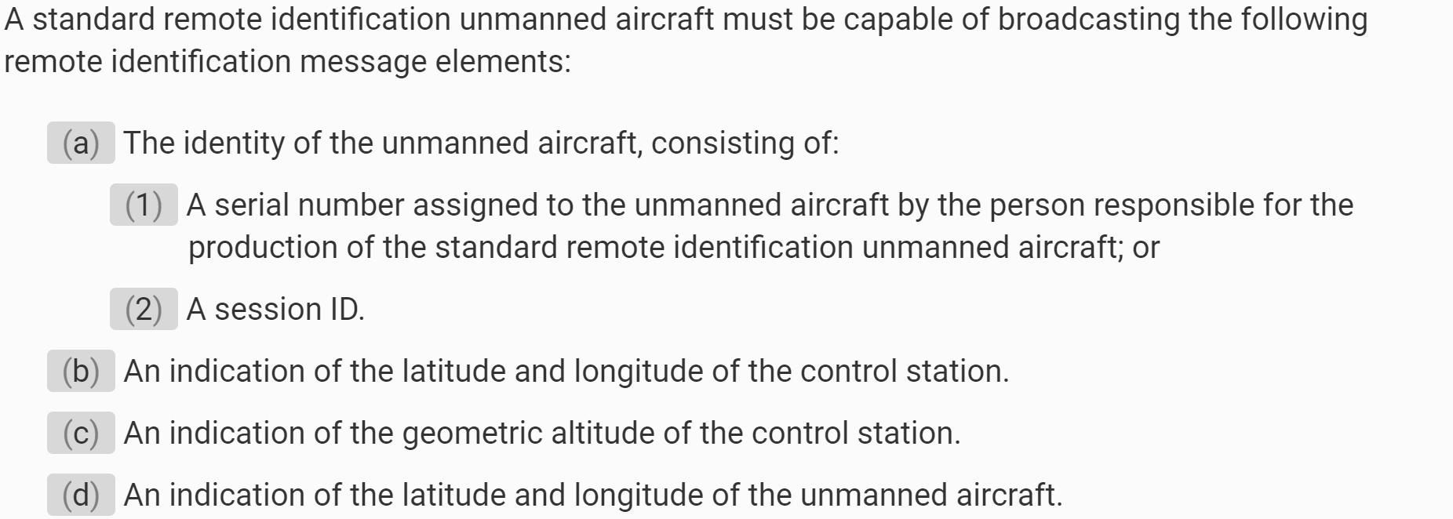
Subpart B—Operating Rules
§ 89.305 Minimum message elements broadcast by standard remote identification unmanned aircraft.
UA.I.F.K6

Slide 14
Subpart B—Operating Rules
§ 89.305 Minimum message elements broadcast by standard remote identification unmanned aircraft.
UA.I.F.K6

Slide 15
Subpart B—Operating Rules
§ 89.525 Labeling.
UA.I.F.K6

