Slide 1
AERO 2710
UA.I Regulations
D. Waivers

Slide 2
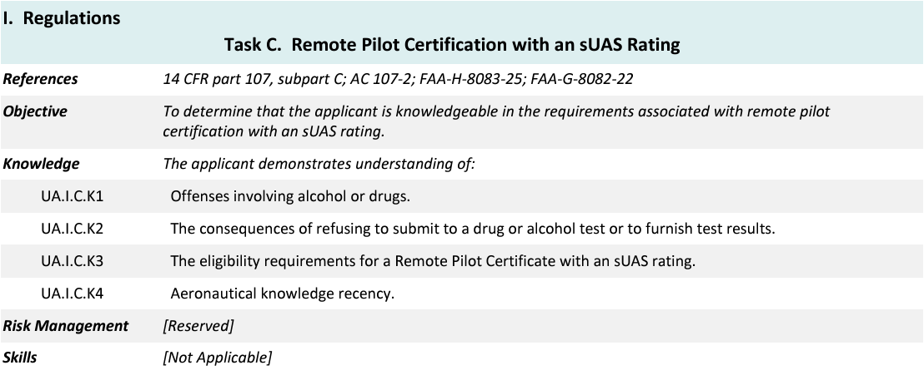
Topics

Slide 3
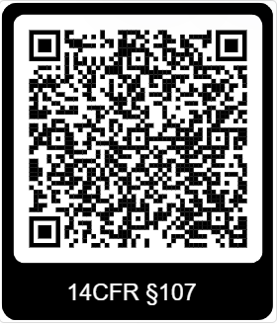
14 CFR §107—Small Unmanned Aircraft Systems
https://www.ecfr.gov/current/title-14/chapter-I/subchapter-F/part-107

Slide 4
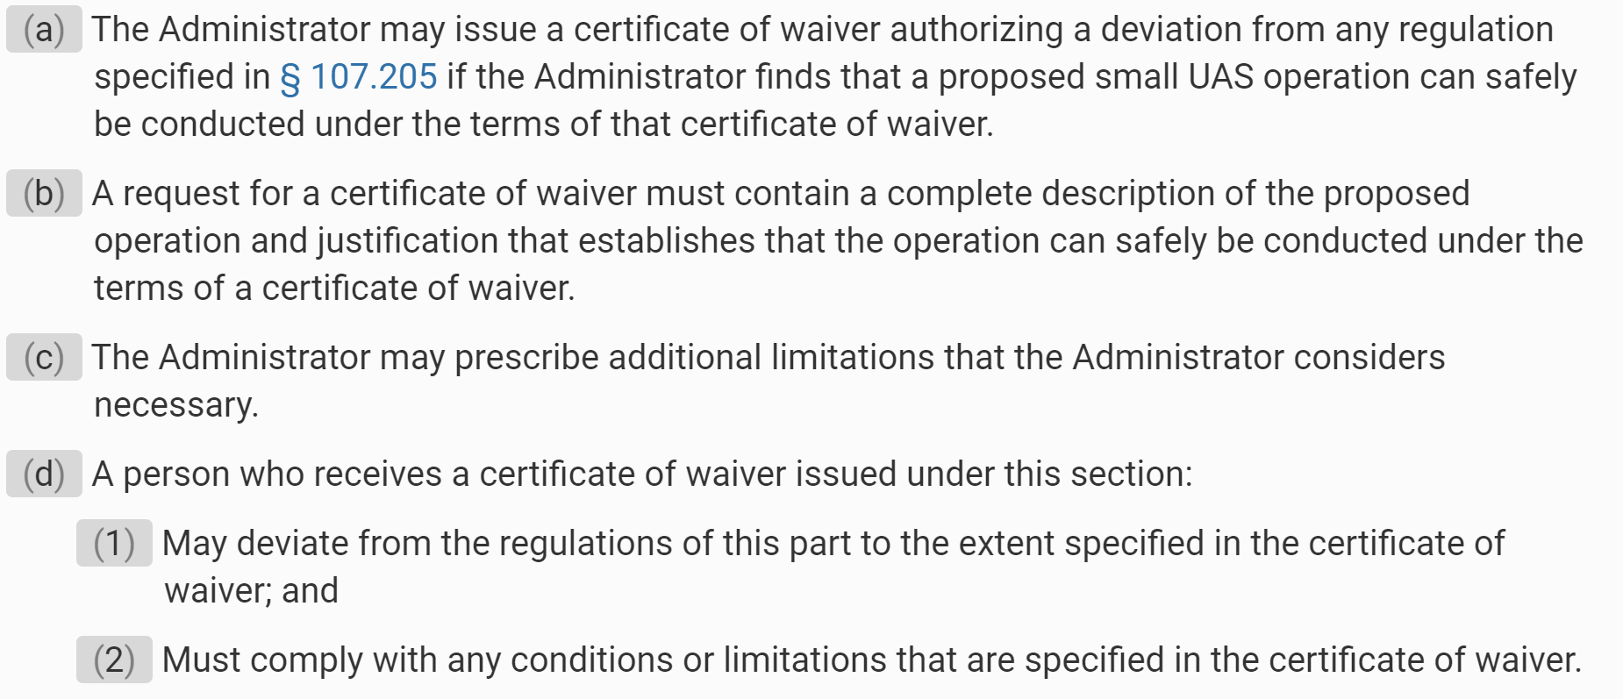
Subpart D—Waivers
§ 107.200 Waiver policy and requirements.
.
UA.I.D.K1
Notes:
Submit waivers through FAAdronezone.gov. Open your DroneZone account and show learners the waiver section.

Slide 5
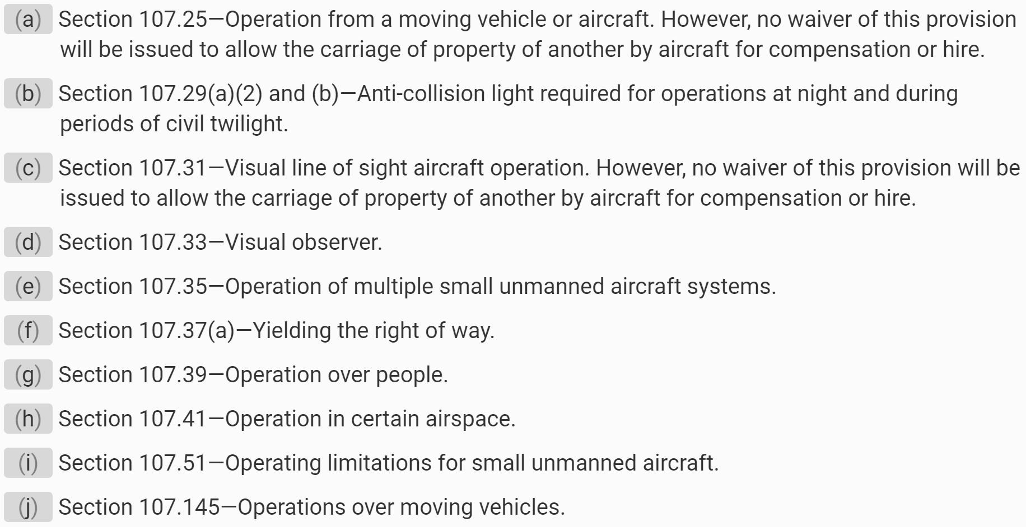
Subpart D—Waivers
§ 107.205 List of regulations subject to waiver.
.
UA.I.D.K1

