Slide 1
UA.I Regulations
C. Certification

Slide 2
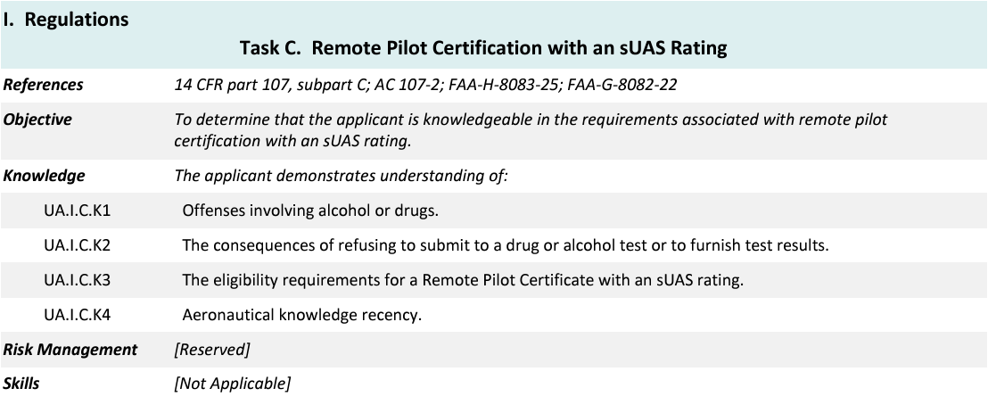
Topics

Slide 3
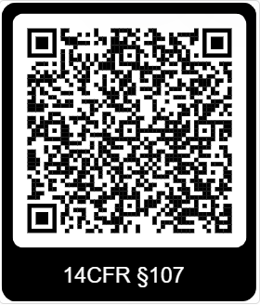
14 CFR §107—Small Unmanned Aircraft Systems
https://www.ecfr.gov/current/title-14/chapter-I/subchapter-F/part-107

Slide 4
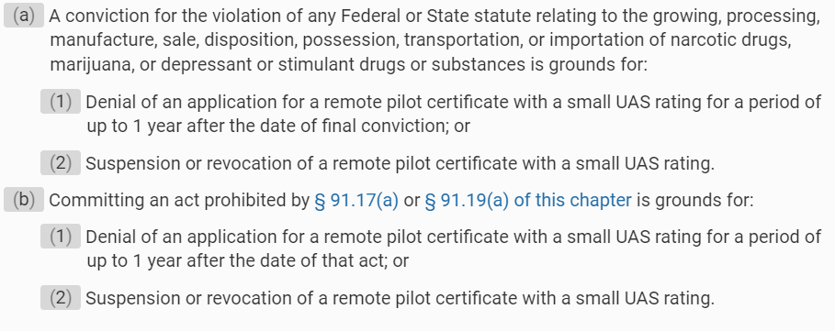
Subpart C—Remote Pilot Certification
§ 107.57 Offenses involving alcohol or drugs.
UA.I.C.K1

Slide 5
Subpart C—Remote Pilot Certification
§ 107.59 Refusal to submit to an alcohol test or to furnish test results.
UA.I.C.K2

Slide 6
Subpart C—Remote Pilot Certification
§ 107.61 Eligibility.
UA.I.C.K3

Slide 7
Subpart C—Remote Pilot Certification
§ 107.61 Eligibility.
UA.I.C.K3

Slide 8
Subpart C—Remote Pilot Certification
§ 107.64 Temporary certificate.
UA.I.C.K3
Notes:
After submitting your application to IACRA, the applicant will be vetted by the TSA. After vetting, the FAA will issue a temporary certificate. Once the temporary certificate has been issued, then the applicant is legal to conduct Part 107 operations. The temporary certificate is available in IACRA.

Slide 9
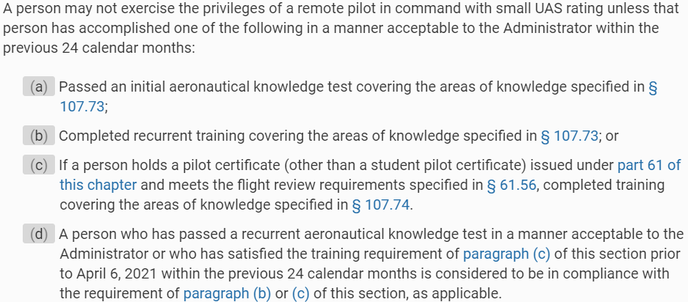
Subpart C—Remote Pilot Certification
§ 107.65 Aeronautical knowledge recency.
UA.I.C.K4
Notes:
Highlight the difference between 24 calendar months and 2 years. Also highlight that the 24 calendar months starts from the date of the test not the issue date on the Remote Pilot certificate. Recurrent training is online and free. The test is remediated to 100%.

Slide 10
Subpart C—Remote Pilot Certification
§ 107.71 Retesting after failure.
UA.I.C.*

Slide 11
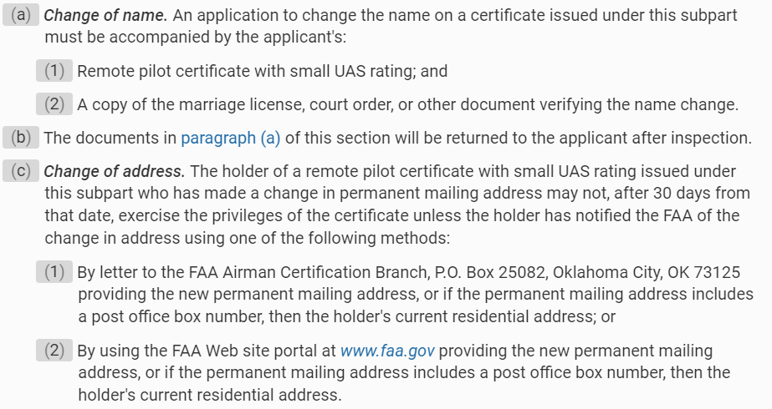
Subpart C—Remote Pilot Certification
§ 107.77 Change of name or address.
UA.I.C.*

Slide 12
Subpart C—Remote Pilot Certification
§ 107.79 Voluntary surrender of certificate.
UA.I.C.*

