Slide 1
AERO 2710
UA.I Regulations
B. Operating Rules

Slide 2
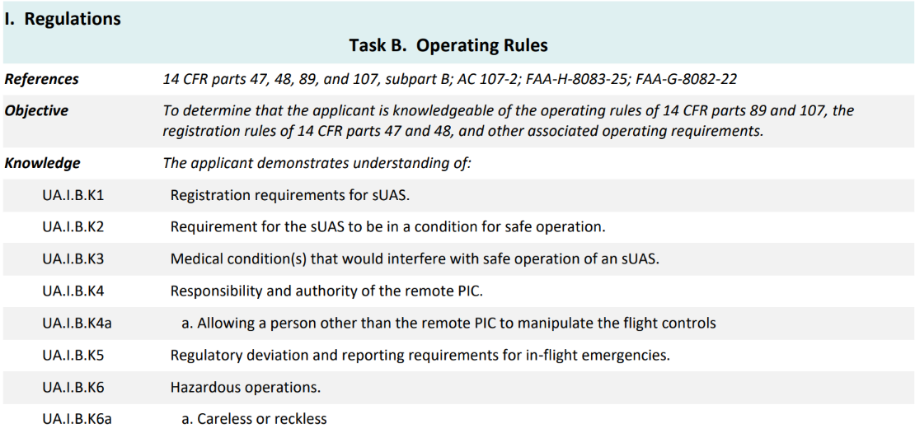
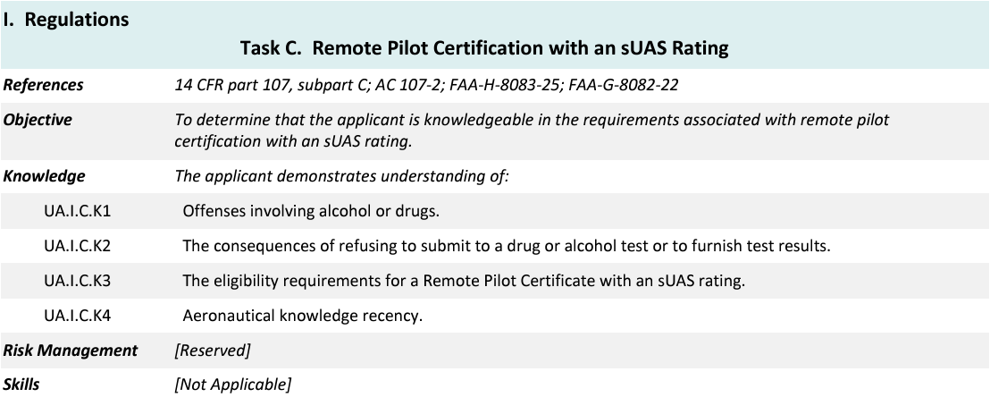
Topics

Slide 3
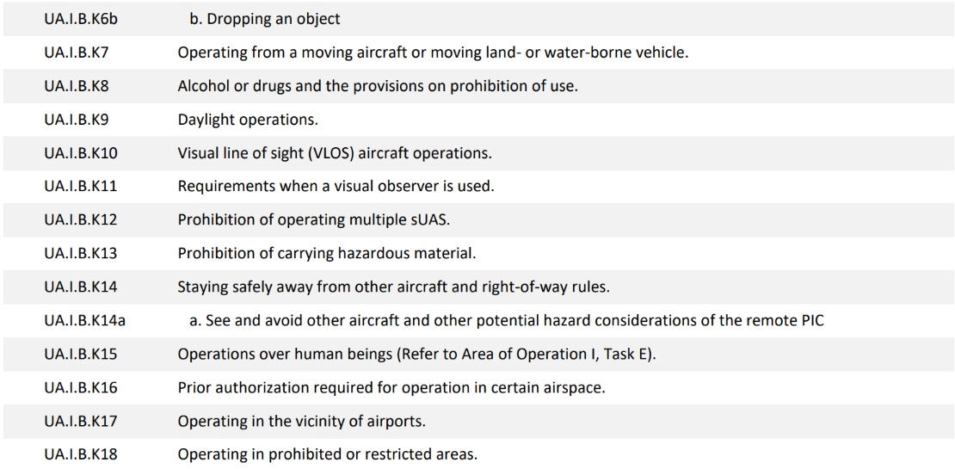
Topics

Slide 4
Topics

Slide 5
14 CFR §107—Small Unmanned Aircraft Systems
https://www.ecfr.gov/current/title-14/chapter-I/subchapter-F/part-107

Slide 6
Subpart B—Operating Rules
§ 107.13 Registration.
§ 91.203 Civil aircraft: Certifications required.
UA.I.B.K1
Notes:
All sUAS regardless of weight, need to be registered. Learners can register through the FAAdronezone. Registration costs $5 and is good for 3 years.

Slide 7
Subpart B—Operating Rules
§ 107.15 Condition for safe operation.
UA.I.B.K2

Slide 8
Subpart B—Operating Rules
§ 107.17 Medical condition.
UA.I.B.K3

Slide 9
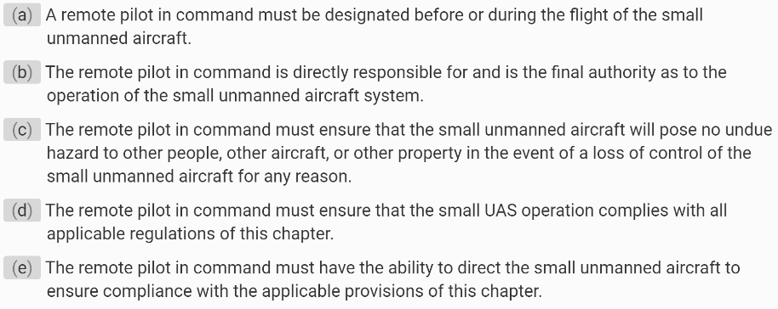
Subpart B—Operating Rules
§ 107.19 Remote pilot in command.
UA.I.B.K4

Slide 10
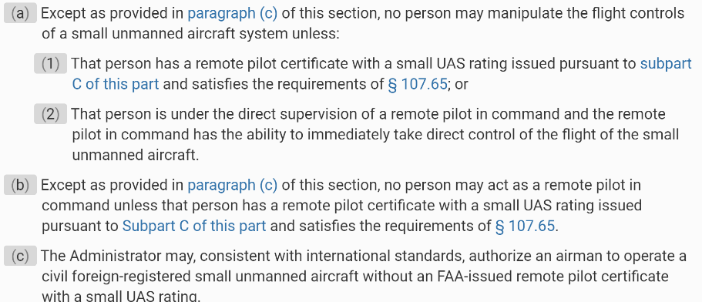
Subpart B—Operating Rules
§ 107.12 Requirement for a remote pilot certificate with a small UAS rating.
UA.I.B.K4a

Slide 11
Subpart B—Operating Rules
§ 107.21 In-flight emergency.
UA.I.B.K5
Notes:
The RPIC does not need to file a report unless requested by the FAA. It is recommended to file a voluntary report through the Aviation Safety Reporting System at https://asrs.arc.nasa.gov/uassafety.html.

Slide 12
Subpart B—Operating Rules
§ 107.23 Hazardous operation.
UA.I.B.K6

Slide 13
Subpart B—Operating Rules
§ 107.25 Operation from a moving vehicle or aircraft.
UA.I.B.K7

Slide 14
Subpart B—Operating Rules
§ 107.27 Alcohol or drugs.
§ 91.17 Alcohol or drugs.
UA.I.B.K8

Slide 15
Subpart B—Operating Rules
§ 107.27 Alcohol or drugs.
§ 91.19 Carriage of narcotic drugs, marihuana, and depressant or stimulant drugs or substances.
UA.I.B.K8

Slide 16
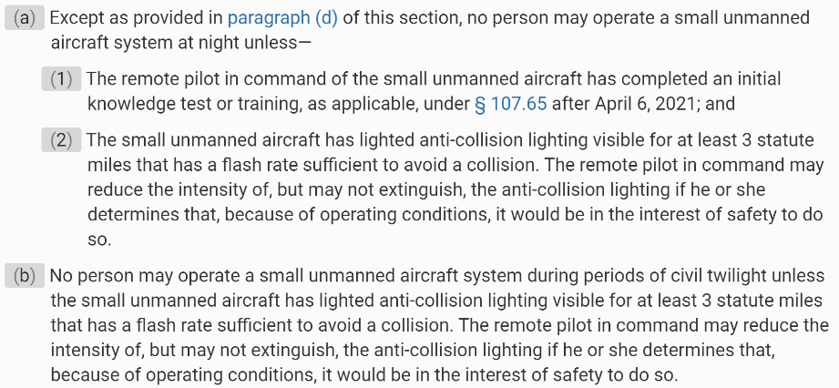
Subpart B—Operating Rules
§ 107.29 Operation at night.
UA.I.B.K9
Notes:
When the learners successfully pass the UAG and are issued their certificate, they will automatically be given a Part 107.29 waiver to fly at night.

Slide 17
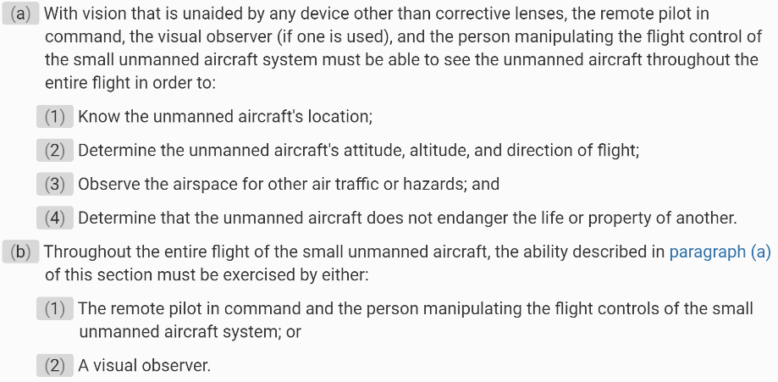
Subpart B—Operating Rules
§ 107.31 Visual line of sight aircraft operation.
UA.I.B.K10

Slide 18
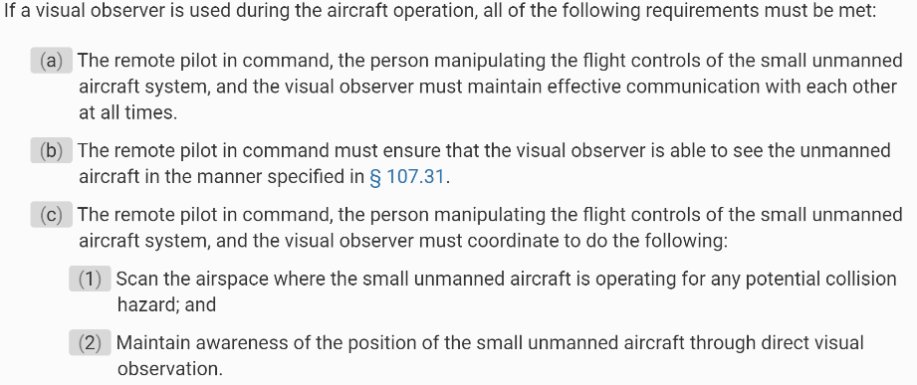
Subpart B—Operating Rules
§ 107.33 Visual observer.
UA.I.B.K11

Slide 19
Subpart B—Operating Rules
§ 107.35 Operation of multiple small unmanned aircraft.
UA.I.B.K12

Slide 20
Subpart B—Operating Rules
§ 107.36 Carriage of hazardous material.
§ 171.8 Definitions and abbreviations.
UA.I.B.K13

Slide 21
Subpart B—Operating Rules
§ 107.37 Operation near aircraft; right-of-way rules.
UA.I.B.K14

Slide 22
Subpart B—Operating Rules
§ 107.39 Operation over human beings.
UA.I.B.K15
Notes:
Note: You cannot fly over people unless you have a Category 1, 2 or 3 approved sUAS.

Slide 23
Subpart B—Operating Rules
§ 107.41 Operation in certain airspace.
UA.I.B.K16
Notes:
Highlight that there are 5 types of Class E airports. Only Class E Surface Areas (E2): Starts at ground level around airports without control towers and is controlled airspace. All other Class E airspace is considered as uncontrolled and do not require ATC approval to conduct operations. We’ll cover more in depth in the next chapter.

Slide 24
Subpart B—Operating Rules
§ 107.43 Operation in the vicinity of airports.
UA.I.B.K17

Slide 25
Subpart B—Operating Rules
§ 107.45 Operation in prohibited or restricted areas.
UA.I.B.K18

Slide 26
Subpart B—Operating Rules
§ 107.47 Flight restrictions in the proximity of certain areas designated by notice to airmen.
UA.I.B.K19

Slide 27
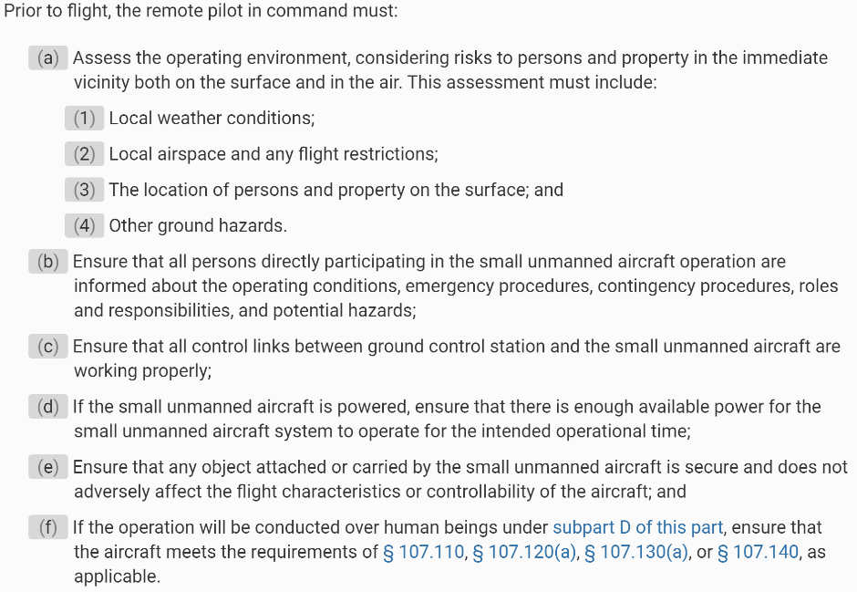
Subpart B—Operating Rules
§ 107.49 Preflight familiarization, inspection, and actions for aircraft operation.
UA.I.B.K20
Notes:
Preflight is the only inspection required by the FAA.

Slide 28
Subpart B—Operating Rules
§ 107.49 Preflight familiarization, inspection, and actions for aircraft operation.
UA.I.B.K20
Notes:
Preflight is the only inspection required by the FAA.

Slide 29
Subpart B—Operating Rules
§ 107.51 Operating limitations for small unmanned aircraft.
UA.I.B.K21
Notes:
Highlight that maximum groundspeed is given in knots and mph. On the UAG, the answer may be given in either.

Slide 30
Subpart B—Operating Rules
§ 107.51 Operating limitations for small unmanned aircraft.
UA.I.B.K21

Slide 31
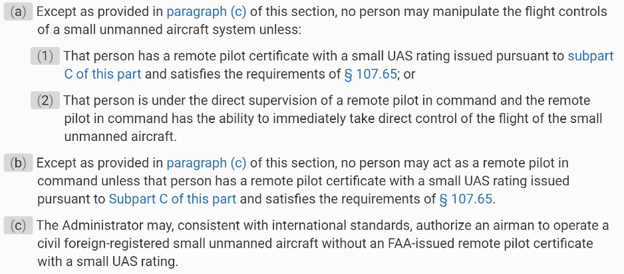
Subpart B—Operating Rules
§ 107.12 Requirement for a remote pilot certificate with a small UAS rating.
UA.I.B.K22

Slide 32
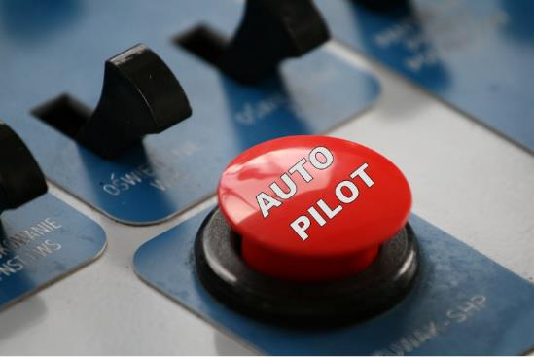
Subpart B—Operating Rules
UA.I.B.K23 Automated Operations
UA.I.B.K23
Notes:
An automated operation is generally considered an operation in which the remote pilot inputs a flight plan into the CS, which sends the flight plan to the autopilot on board the small unmanned aircraft. During automated flight, flight control inputs are made by components on board the aircraft, not from a CS. If the remote PIC loses the control link to the small unmanned aircraft, the aircraft would continue to fly the programmed mission/return home to land. During automated flight, the remote PIC must have the ability to change routing/altitude or command the aircraft to land immediately. The ability to direct the small unmanned aircraft may be through manual manipulation of the flight controls or through commands using automation.

Slide 33
Subpart B—Operating Rules
§ 107.29 Operation at night.
UA.I.B.K24

Slide 34
Subpart B—Operating Rules
§ 107.29 Operation at night.
UA.I.B.K24

Slide 35
Subpart B—Operating Rules
§ 107.29 Operation at night.
UA.I.B.K25

Slide 36
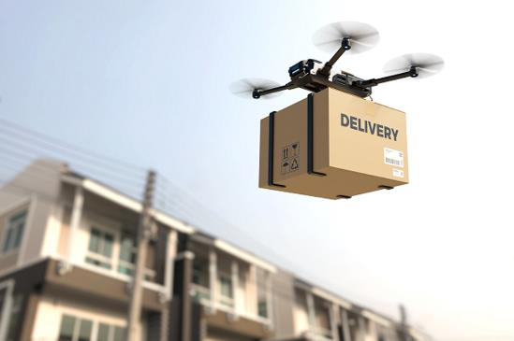
Subpart B—Operating Rules
UA.I.B.K26 Transportation of property
UA.I.B.K26
Notes:
Part 107 permits transportation of property by small unmanned aircraft for compensation or hire. These operations must be conducted within a confined area and in compliance with the operating restrictions of part 107. When transporting property, the transport must occur wholly within the bounds of a single State.

Slide 37
Subpart B—Operating Rules
§ 107.52 ATC transponder equipment prohibition.
UA.I.B.K27

Slide 38
Subpart B—Operating Rules
§ 107.53 Automatic Dependent Surveillance-Broadcast (ADS-B) Out prohibition.
UA.I.B.K27

