Slide 1
UA.I Regulations
A. General
Notes:
UA.I Regulations A. General

Slide 2
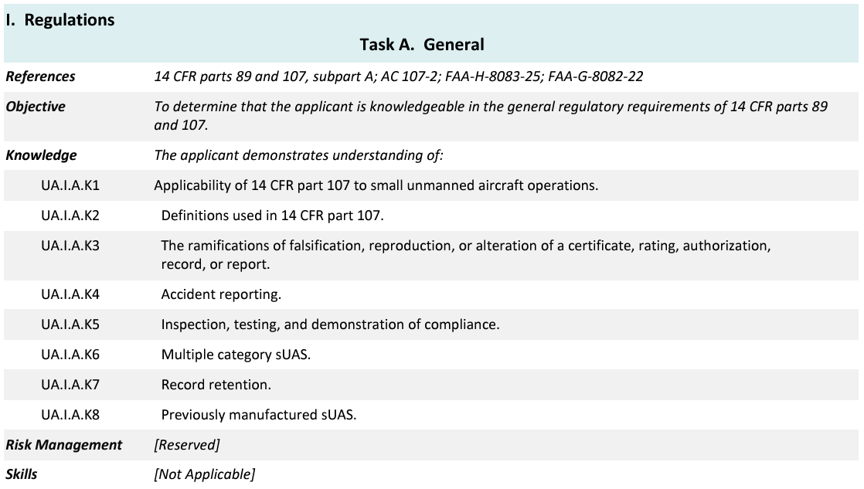
Topics

Slide 3
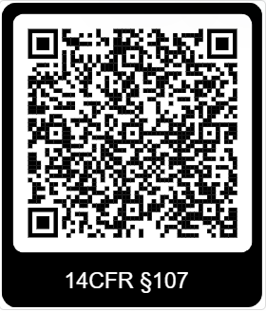
14 CFR §107—Small Unmanned Aircraft Systems
https://www.ecfr.gov/current/title-14/chapter-I/subchapter-F/part-107
Notes:
Link to 14 CFR Part 107

Slide 4
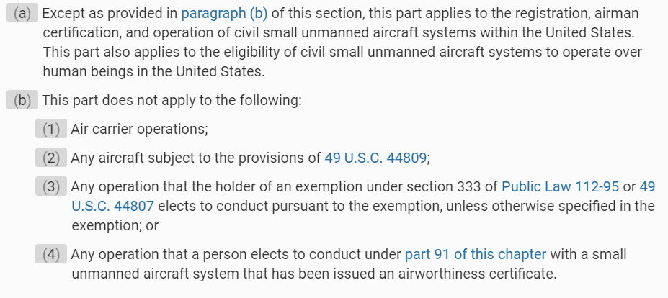
Subpart A—General
§ 107.1 Applicability
UA.I.A.K1

Slide 5
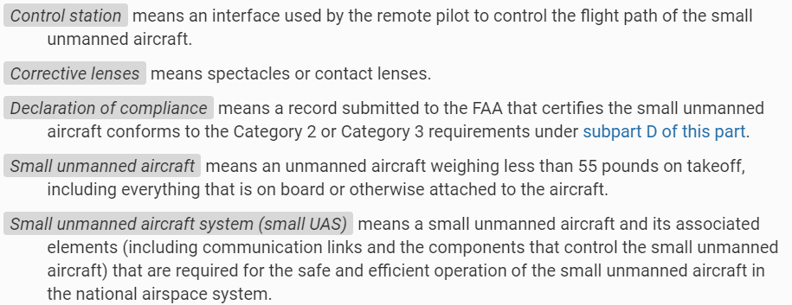
Subpart A—General
§ 107.3 Definitions.
UA.I.A.K2
Notes:
Highlight that small UAS are defined as less than 55 lbs. For hobby aircraft the weight is 55 lbs or less. Notice the difference in language.

Slide 6
Subpart A—General
§ 107.3 Definitions.
UA.I.A.K2

Slide 7
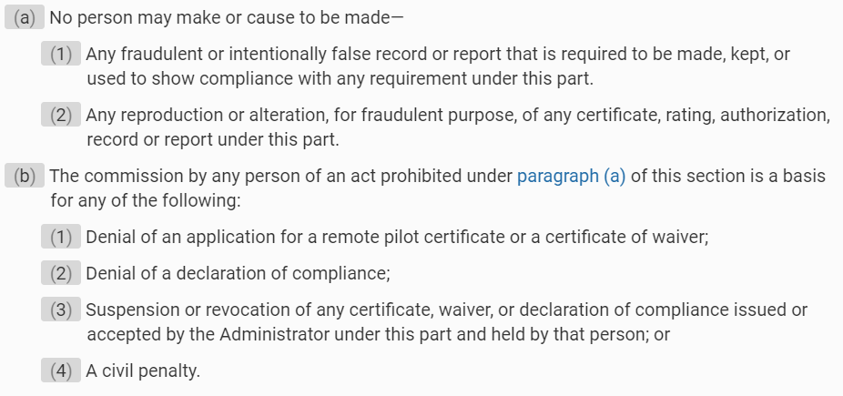
Subpart A—General
§ 107.5 Falsification, reproduction, or alteration.
UA.I.A.K3

Slide 8
Subpart A—General
§ 107.9 Safety event reporting.
UA.I.A.K4
Notes:
The FAA does not care about the value of a sUAS if crashed. But if it does more than $500 of fair market value damage, then it must be reported through the www.faadronezone.gov.
Serious injury basic definition if the injured person is admitted to the hospital. Then it must be report.

Slide 9
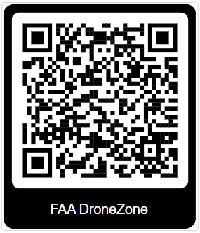
FAA DroneZone
https://faadronezone-access.faa.gov/#/
Notes:
Fill out safety report and submit through FAAdronezone.

Slide 10
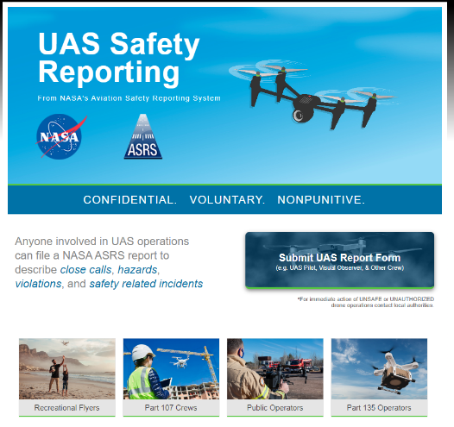
UAS Safety Reporting
https://asrs.arc.nasa.gov/uassafety.html
Notes:
Not required but highly recommended: The information you provide is kept CONFIDENTIAL
Anyone involved in Unmanned Aircraft Systems (UAS) / Drone operations can file a NASA ASRS report to describe close calls, hazards, violations, and safety related incidents.

Slide 11
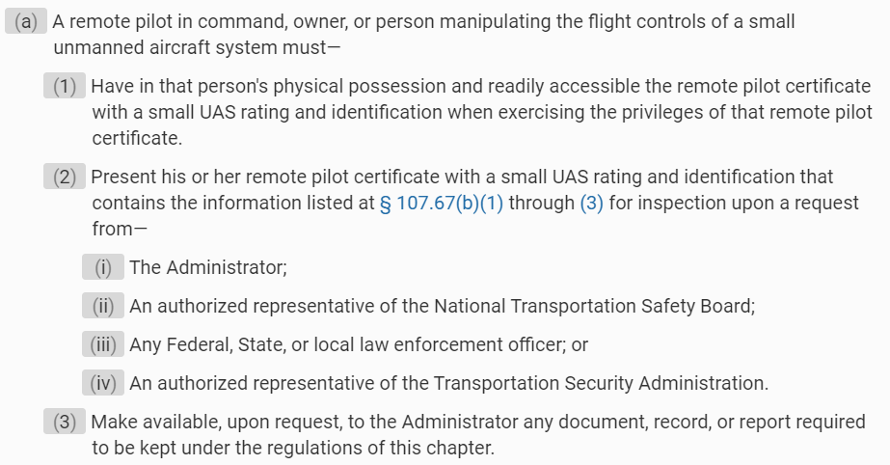
Subpart A—General
§ 107.7 Inspection, testing, and demonstration of compliance.
UA.I.K5
Notes:
Highlight the Administrator is an anyone in the FAA designated to oversea UAS operations.

Slide 12
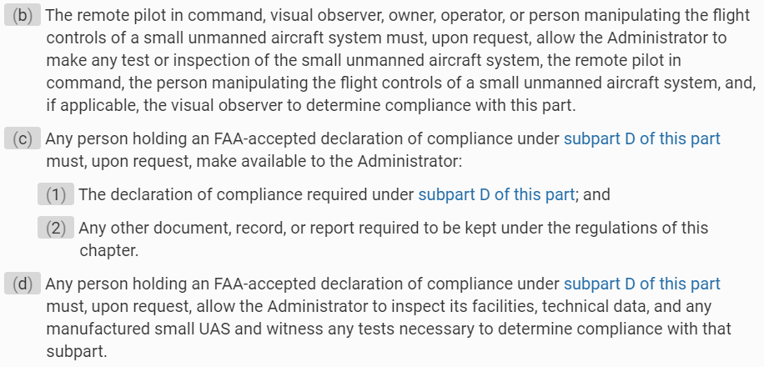
Subpart A—General
§ 107.7 Inspection, testing, and demonstration of compliance.
UA.I.A.K5

Slide 13
Subpart A—General
§ 107.35 Operation of multiple small unmanned aircraft.
UA.I.A.K6
Notes:
You can only operate one sUAS at a time. But can submit a waiver if you need to operate more than one at a time..

Slide 14
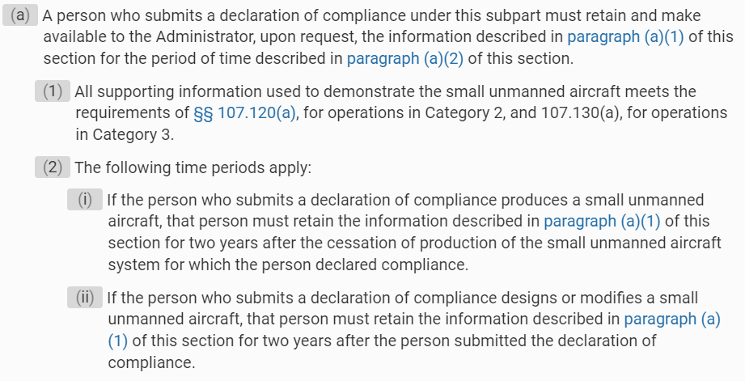
Subpart A—General
§ 107.165 Record retention.
UA.I.K7
Notes:
Only records required to maintain are for sUAS that are Category 2 or Category 3 certified.

Slide 15
Subpart A—General
§ 107.165 Record retention.
UA.I.A.K7

Slide 16
Subpart A—General
§ 89 Previously manufactured sUAS.
UA.I.A.K8
Notes:
After September 16, 2023, most small unmanned aircraft that are registered or required to be registered must comply with remote identification requirements. Which means they must be built with standard Remote ID. Those sUAS manufactured before this date will require a remote ID module to be legal to conduct Part 107 operations.

